Slide 1
European Union Regional Seminar on Decentralisation and Local Governance Nairobi 11 November 2011
Session 1.2: Setting the Stage/
Looking Back
Regional Decentralisation Trends, Challenges and Strategies
Paul Smoke
New York University

Slide 2
Outline
I. Trends and Evidence
II. Diversity: Objectives, Forms, Context, Starting Points, Trajectories
III. Designing Integrated Decentralisation and Local Government Reform
IV. Common Realities and Challenges
V. The Need for Strategic Implementation
VI. Summary: What Needs Attention

Slide 3
I. Trends and Evidence
Decentralisation increasingly common from the 1980s
Motivated by dissatisfaction with impact of centralised development, global pressures, aid trends, etc.
Intersects with domestic political agendas
Empirical literature on effects mixed and inconclusive
“Macro”(mostly quantitative) focuses on analysis of broad trends (cross-/intra-national); findings typically offer limited help little with crafting specific policies
“Micro” (leans qualitative but not all) can provide rich depth on specific cases; broader relevance unclear
Empirical challenges: methodological, data, variable measurement, interpretation
Key empirical lesson: attaining benefits depends on context and how designed/implemented

Slide 4
Decentralisation in Anglophone and Lusophone Africa
Systematic comparative work limited and contexts differ, but some “trends” can be noted:
Most countries adopted a formal decentralisation framework involving some autonomous powers, subnational elections, and revenue sharing (varying conditionality), but more limited revenue power
Many instances (to different degrees) of incomplete adherence to or implementation of frameworks (limiting local autonomy and accountability)
General increase in local services range/quantity, although uneven; less known on quality; revenue lags
Governance gains but uneven: political obstacles and new behaviours cannot be developed quickly
Capacity development, but uneven and unbalanced

Slide 5
Selected Recent Developments
Increasing attention to use of a more developmental and contextualized approach as opposed to a normative framework driven “sink or swim approach”
Increasing attention to political economy analysis and development partner adherence to Paris principles
Expanding focus on performance/incentives (and data collection, management and analysis; important but critics worry that focus on outcomes neglects systems and processes needed for sustainable performance
Some reframing of decentralisation as broader than passive assumption of former central functions (e.g. LGs developing a vision for local economic development)
In some countries there have been various elements of both formal and informal recentralisation

Slide 6
II. Diversity: Objectives, Forms, Context, Starting Points, Trajectories
Decentralization is a complex, diverse public sector reform that is adopted for different reasons (e.g. immediate crisis versus orderly public sector reform)
Reform (appropriate and actual) depends on:
Priority objectives (governance, development, service delivery, stability, equity, etc.); and
The context of a country (e.g. federal/unitary, whether post-conflict, current number of government levels, socio-economic characteristics, role of natural resources, capacity, etc.)
Various forms: deconcentration, devolution, delegation; quite often mixed systems may change over time
Uneven starting points: improve existing LGs, transform deconcentrated to devolved, create new LGS
Bottom Line: Diversity should raise caution about “best practice” reform; a country can learn/adapt from but rarely directly replicate what another has done

Slide 7
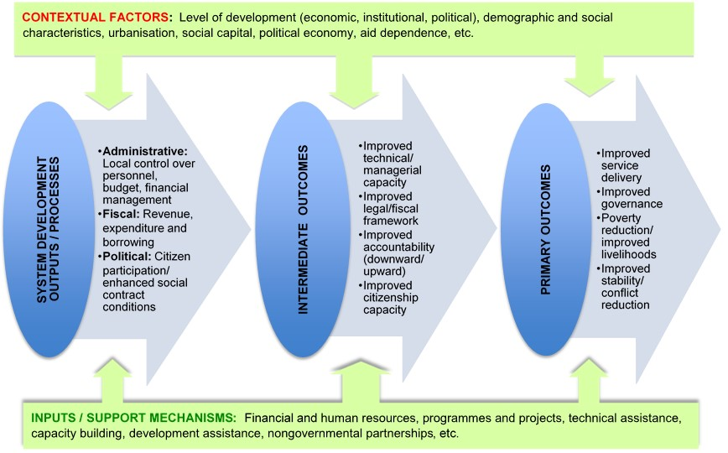
The Landscape of Decentralisation

Slide 8
III. Designing Integrated Decentralisation
National Framework of Integrated Reforms
Constitutional/legal/administrative
Fiscal Dimensions
Clear assignment of service functions/ revenues
Appropriate/sufficiently stable vertical share
Appropriately structured shared taxes/transfers
Fiscal responsibility/borrowing framework
Political Dimensions
Elections/other accountability mechanisms
Transparency in processes and decisions
Sufficient autonomy to allow response to citizens
Administrative/Managerial Dimensions
Institutional role/relationships appropriately defined
Planning/budgeting/PFM and civil service systems/processes (some degree of local control)
Framework to partner with private sector/NGOs

Slide 9
IV. Common Realities and Challenges
Being driven by crisis or political change shapes approach and pace of decentralisation
Reform often technocratic/uniform/fragmented (elite-driven/non-inclusive processes)
Demand side reform (civil society) often pro forma or separate from LG reform
Coordination of key actors (and DPs) weak
Neglect of private/informal sector role
A proper integrated approach is challenging and faces political economy/capacity obstacles
Substantial behavioural changes are needed at all levels (central, local, individual)
Insufficient attention to careful reform implementation (has been emphasis on design)

Slide 10
V. Need for an Strategic Implementation: Tactical Entry Points/Sequencing
Build on positive aspects of the system where success is more likely (where feasible)
Use a clearly defined starting point consistent with the capacity and/or performance of subnational governments (may be asymmetric)
Aspects of reform (administrative, fiscal, political) should be integrated (even if initially at a basic level depending on context)
Link technical reforms to specific functions that are going to be undertaken, such as service delivery or revenue generation
Further assumption of desired responsibilities/ behaviours should build progressively and according to clear criteria on earlier steps

Slide 11
Crafting Political Agreements and Institutional Arrangements
Work with willing partners (governmental and nongovernmental) in early stages rather than force initial changes where resistance is likely
Starting points and steps for reform may be partially negotiated with LGs and other actors, placing some responsibility on them for what they agree to undertake
Establish a coordinating mechanism to manage the implementation process; global experience suggests that an effective mechanism must have broad credibility (be as neutral as possible), be at a high level in the bureaucracy, and have authority to negotiate and enforce compliance with reforms as needed

Slide 12
Creating Robust Incentives
Provide strong positive/negative incentives for local governments/other actors to achieve desired and agreed goals
A coordinating body should oversee implementation to ensure that all parties—central, local, external—meet responsibilities as per the legal framework and agreements
Adopt innovative mechanisms that may help to facilitate successful implementation:
Enforceable accountability mechanisms, such as central contracts with local governments
Financial incentives for adoption of reforms and improvements in performance, such as compliance or performance based grants
Tournament based approaches that bring recognition (may be financial but need not be)

Slide 13
Building the Right Capacity Appropriately
Build capacity in a way that is well linked to the reform strategy and more demand driven
Target capacity building to more immediate functions/ tasks rather than provide only broad, generic classroom-based training
Providing as needed periodic, on-site follow-up, troubleshooting and technical assistance
Act on the need for dual track capacity building: both technical (training local governments to meet their responsibilities) and governance (training/facilitating citizens, elected officials and subnational staff to work more productively with each other)

Slide 14
VI. Summary: What Needs Attention
Balancing technical & political needs more carefully
Rebalancing central control & local autonomy, generally more towards the latter
Paying more attention to developing civic capacity in a way that is better linked to local government
Strategically implementing the often extensive/ complex reforms (starting point, asymmetry if appropriate, sequencing, incentives, etc.)
Building capacity targeted to proximate needs (and more demand driven) with appropriate follow up
Getting feedback, learning from experience and adjusting policy as needed—the latter seems to have been particularly difficult or involves over-reaction.

