Slide 1
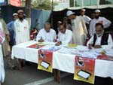
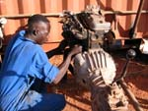


Summary – Day 2
ECDPM

Slide 2
4 main messages

Slide 3
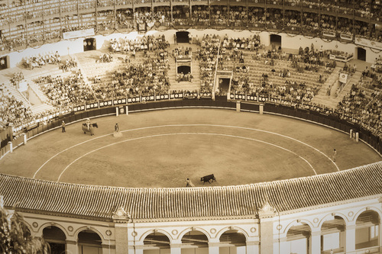
Message 1 : Make sure you’re well equipped to enter the decentralisation arena

Slide 4
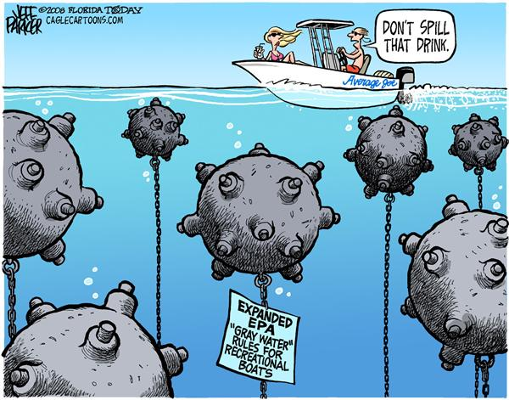
How to navigate the minefield?
Notes:
Neo: In the dialogue between donors and governments there is a tendency for government officials to be polite. They won’t critique DPs, they’ll talk in the same language. But they won’t implement any/most of the DP demands. Donors are also mostly working for visibility.

Slide 5
We need some sort of PEA and access to various forms of knowledge
MENU OF OPTIONS: Intuitive analysis, PEA exercises, conflict analysis
DIFFERENT SOURCES OF LOCAL KNOWLEDGE (e.g. huge potential CSOs)
STRATEGIC ALLIANCES WITH LG ASSOCIATIONS AND KNOWLEDGE INSTITUTIONS

Slide 6
We need the right INCENTIVES to apply knowledge
Space and time to engage with the actors
Support from sectoral and political units within the EU delegation
A clear mandate from the institution to engage in these “messy” political and institutional change processes
Courage (as there will be no quick outcomes)

Slide 7

PEAs confront us with our own realities

Slide 8

HQ does not always speak with a single or coherent voice
Notes:
There is also still a reluctance, especially from HQ to work in a more political manner. Some EUDs feel that now they do have the information but they can’t act on it.

Slide 9
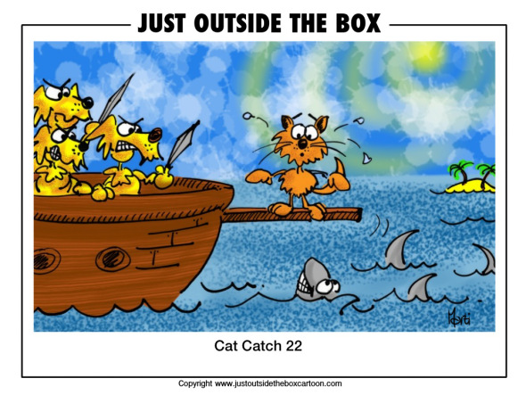
We embark on a perilous journey…

Slide 10
Message 2:
Work with the existing policies, systems and capacities… however weak they are…

Slide 11

Message 3: Autonomy and Accountability are hard nuts to crack but they are key to unleash local level potential

Slide 12

The balance between central gov control and local gov autonomy will and should constantly shift

Slide 13
Main GoK Players:
Office of President
Prime Minister
Parliament
Ministry of
Finance
Ministry of State
for Planning and
National
Development
(OPM)
Provincial/District
Administration/
Development
Committees
Parliamentary
Constituencies
Sectoral Ministries
(>25)
Ministry of Local
Government
(ODPM)
Community
Development
Trust Fund (CDTF)
Provincial
and District
Development
Plans (PDP/DDP)
Constituency
Development Fund
(CDF) and Plans
PDP/DDP
Sectoral Plans and
Programs
Local Authority
Service Delivery
Action Plans
(LASDAP)
CDTF and
Various CBO Plans

Slide 14
NEED FOR A PRO-ACTIVE ROLE
OF LOCAL AUTHORITIES

Slide 15
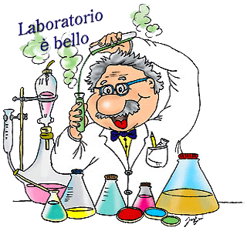
Laboratory approach to promoting autonomy and accountability

Slide 16

Look for the (small) cracks that can create an opening
Notes:
VISUAL: looking for a small crack, that can (not always of course) create an opening for something to happen. And in promising environments it might even lead to bigger impacts.

Slide 17
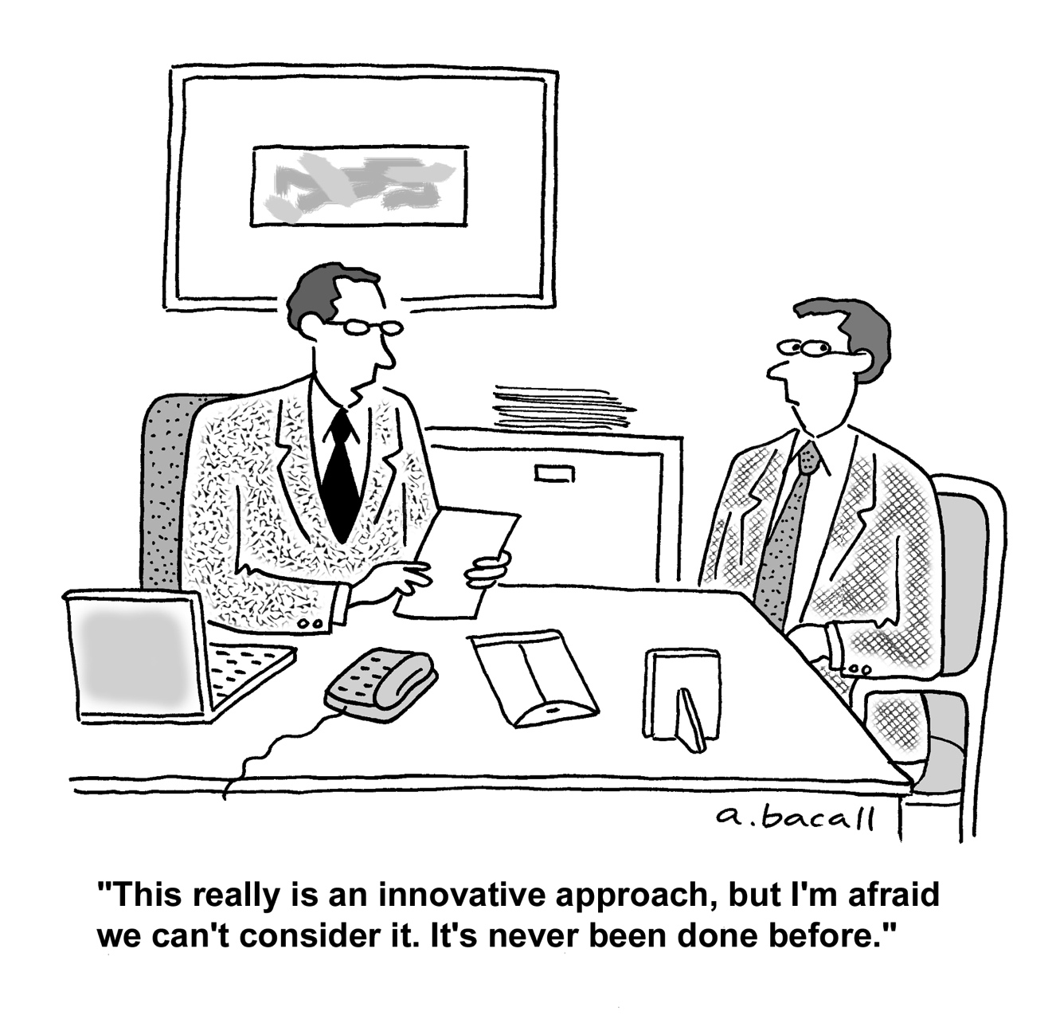
INNOVATION IS KEY TO UNLOCK POTENTIAL

Slide 18

Let the development genie out of the bottle

Slide 19
Message 4:
Rethink the donor framework for engaging strategically with LAs
Notes:
VISUAL: looking for a small crack, that can (not always of course) create an opening for something to happen. And in promising environments it might even lead to bigger impacts.

Slide 20

The ‘fil rouge’ of the seminar
RED THREAD:
How to support endogenous dynamics and liberate the potential of local authorities as partners and actors in EU support to decentralisaiton strategies?
Part 3:
Windows of opportunities and strategic use of aid modalities
Part 1:
Setting the scene: decentralisation dynamics in the region
Part 2:
Part 4:
Looking forward: What next for EU support to decentralisation in the region
Political economy of decentralisation
Autonomy and accountability

