Slide 1
Session 4.1. Choosing suitable aid modalities in support to LDD: time to revalue “smart projects” insights from practice: The ACORDS Program (Madagascar) Jorge Rodríguez Bilbao DEVCO UNIT B2 “Civil Society and Local Authorities" EUROPEAN COMMISSION - DG DEVCO REGIONAL SEMINAR on Decentralisation & Local Governance In Anglophone and Lusophone Africa (Nairobi, Kenya, 11-14 November 2013)

Slide 2
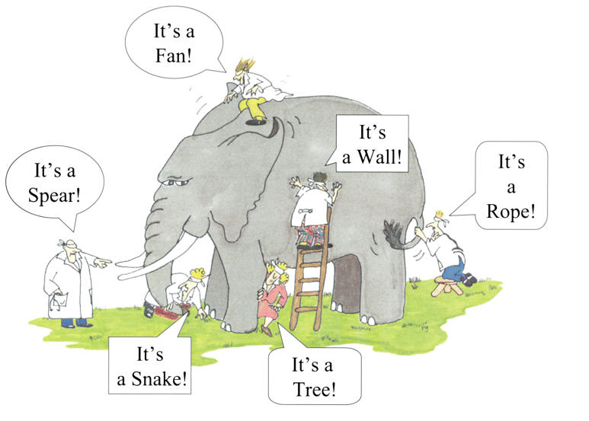
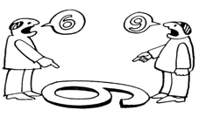
Context
Decentralization as a "virtual" process
COUNTRY
DONORS
Good policy (on paper ) but not implemented
Lack of clear vision and understanding of practical implications
Decentralization is not high on the social/national debate
Sector Ministries neglect LA
Big influence in the national policy
No common vision
Too much focus on the Local dimension
Comunity driven approaches/sector support policies neglecting LA as contracting authority

Slide 3
ACORDS DESIGN (2004)
STARTING POINT
Take into account in an effective and practical way the transfer of responsibility for social services provision (health, education, public markets, and secondary roads) from Line Ministries to LG as defined by law in the decentralization process framework.
HOW????
HOW????
Put the money into the LG budget from the onset
(Kind of BS at local level!!)
CHALLENGE
CHALLENGE
Translate direct funding into service delivery with LG as project owners
This entails the need for LG to learn doing a very complex job that they had never done before : to plan and manage the complexities of converting a budget into service delivery whilst building delivery infrastructures, and engaging with specialists in their respective services to be delivered.
Notes:
If the devolution of authority to the municipalities with their elected mayors was to be successful, they would have to learn to do a very complex job that they had never done before. : plan and manage the myriad complexities of converting a budget into service delivering whilst building an infrastructure of delivery and engaging the specialist in their respective services to be delivered.
As for the project, the municipality was in the driver’s seat: getting the job done was now their job. But as novices, they faced a steep learning curve. The role of the Implementation Unit was precisely to assist the municipalities up this learning curve.
help the municipal project managers to deal with them and learn from the experience
Requiere the establishment of a project facilitating unit (Not PIU!)
Fundinf flows at sub-national level done outside the budget

Slide 4
ACORDS Design
Three Basic Principles
1
The municipality as:
the “main dialogue partner” and “public contracting authority” in the areas of competence transferred by law;
3
"DNA” & GPS of the Program
Interactions between program and policy making process in both directions
Flexibility of the approach and tools, in order to adapt (and interact) with the “moving” decentralisation process
Use, although it can be difficult in weak system and institutional environment, country systems to the extent feasible and to increasingly do so as systems and capacities are built and enhanced
2
Search for linkages with the decentralisation policy in connection with sectoral policies

Slide 5
Implementation: Walker, there is no path, the path is made when walking
Forget about elaborating a “detailed road map”!
Live with failures is an integral part of implementation process
Design needs to be permanently updated/fine-tuned from lessons during implementation!
It is a question of dealing with problems as they arise, feeling your way, muddling through….
Each step of reform is built from lessons learnt from the previous one
Notes:
5

Slide 6
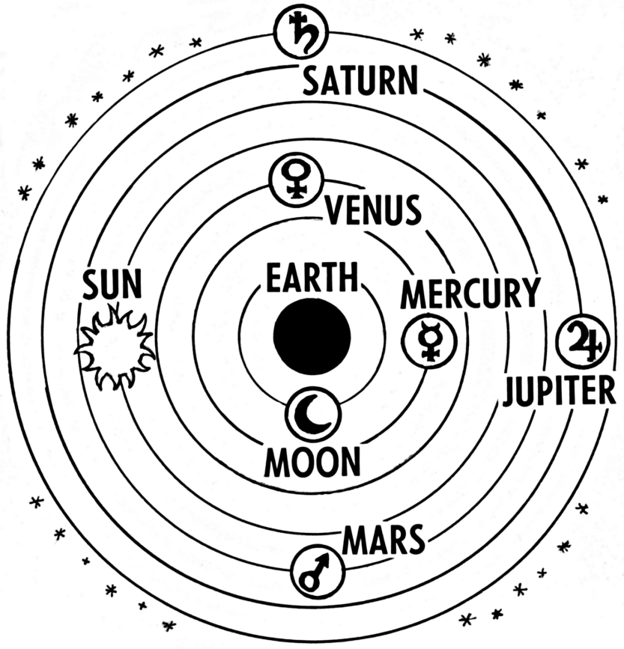
This approach entailed a Copernican Revolution!!!!!:
The main elements
CB approach: capacities will be the result of the action and not a precondition for receiving funds);
Ensure direct funding of LG budget;
From PIU towards “Facilitation Unit”: A drastic change in the role of the PIU which evolve towards advising and facilitating the ‘learning by doing’ process

Slide 7
Learning by doing
LG are in the driving seat
They will face a steep learning curve in order to translate the financial support into service delivery

Slide 8
Decentralization is moving!
“2D” POLICY ON PAPER
Head of District
Branch offices of the
Relevant Ministries
Technical services
Control « Ex-post »of municipal accounts
Institutional backup of municipalities
Coordination between municipalities and the Ministries technical services
Planning
Provide adivice and technical support to the municipalities
Provide staff (medical, teachers..)
Ensure quality of service
Municipality
(executive and
Council)
Planning, implementing and managing public services
Technical studies and Works
Service Providers &
Contracting firms
Population
Has to be involved at every stage to ensure accountability

Slide 9
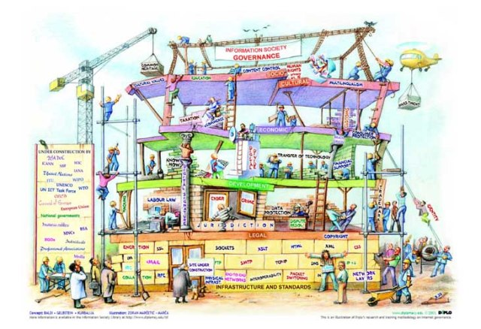
THE CHALLENGE OF CONVERTING MONEY INTO SERVICE DELIVERY BECAME…….
THE CHALLENGE OF ACOMPANYING A STATE BUILDING PROCESS FROM BELOW

Slide 10
LG: The foundations of this building process..
Service delivery: entry door
………………
Local Governments
Citizens
Equity of service delivery
Decentralization
Work on the
interaction
Fill in the
Boxes
Public Service delivery
Quality
Equity
Quality of
Service delivery
Territorial Administration
Civil Servant of line ministries at local level

Slide 11
New elements of this approach Copernican Revolution!!!!!:
Financial transfer to LA (BS): entry door to test and institutionalise:
procedures for planning, budgeting and implementation of local public sector expenditures and
The structures and procedures through which the state supports and supervises LA
Capacity Building approach:
On the job training
Empower role of LA as autonomous actors and a distinct sphere of governance
Include all relevant actors within the local sector arena
ABILITY TO PROMOTE CHANGE IN GOVERNMENT ATTITUDES, provide means for experimentation in new forms of local governance
Notes:
11

Slide 12
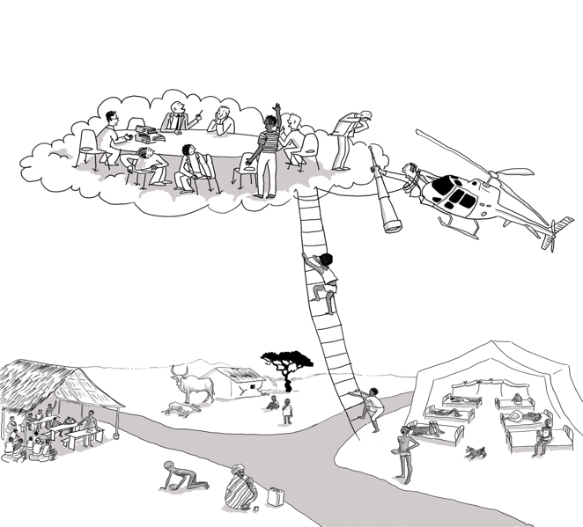
Need to have a “external catalyst” to accompany reform process in a weak political and institutional environment
Key operational device: constantly asses, learn, reflect, revise, and adapt to the issues and challenges that emerge
FUNCTIONS
Accompany different categories of actors up the learning curve through tailor-made and on-the-job training
Provide Local evidence/perspective to inform Policy Dialogue
Inspire/fine-tune policy formulation processes

Slide 13
…..ACORDS became a decentralization Lab in Madagascar

Slide 14
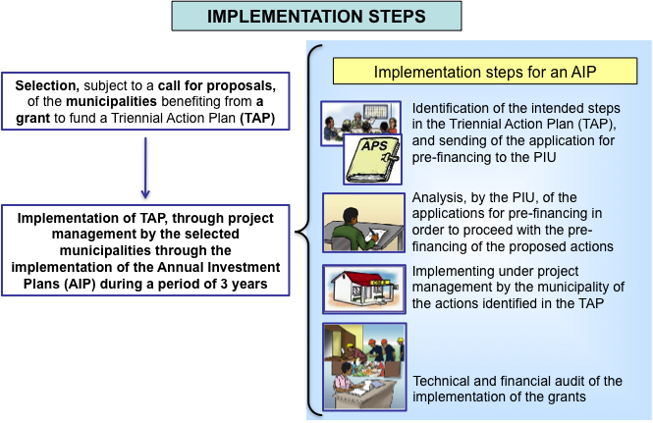
TOOLS PROVIDED AT MADAGASCAR (1)
Rules of the game to translate money into service delivery
Tailored operational guidelines for decentralized planning, programming, budgeting and implementation of local development projects and public service delivery;
These include LA as contracting authorities as well as the structures and procedures through which the State supports and supervises LA
Specific guidelines on Procurement systems tailored to the specificities of LG in rural areas;
Notes:
Finance didn’ follow fonctions
No Human ressources policy at SN level
Grants
Requiere the establishment of a project facilitating unit (Not PIU!)
Funding flows at sub-national level done outside the budget

Slide 15
The "how" matters!!! (1)
Endogenous and bottom-up elaboration of tools & methods !: Not by external consultants
Tailor-made design of tools involving in an interactive manner all stakeholders at local and national level;
Continuous testing & fine-tuning from practice (5 years!);
Guidance using as much as possible national procedures, systems and institutions –even if they are weak, ambiguous and unclear: Ambiguity : Windows of opportunity for creative interpretation….

Slide 16
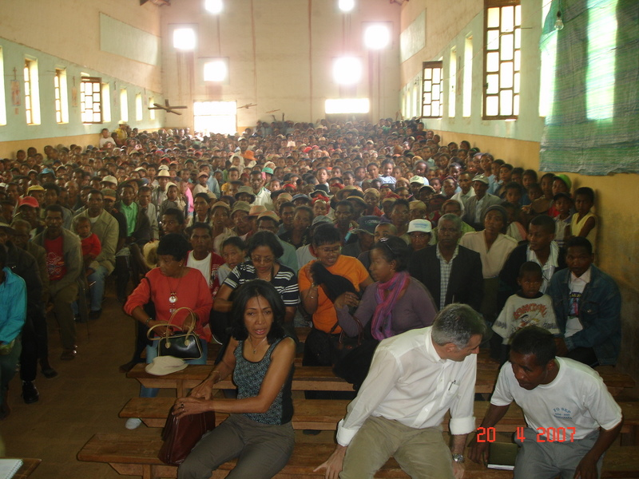
The "how" matters!!! (2)
Communicate, communicate, communicate!!!!!
Using radio (malagasy) for transparency of budget allocation and use, to promote debates at local level, and explain basic concepts about decentralization through fiction stories using comedians (regular radio programs)
Holding public debates on the results of annual audits, involving the local governments executive, Districts and citizens
Using « movies » to feed PD at national level with local evidence;
Organising public debates with LG/sector ministries around topics showed in movies
Concrete (and tested ! ) ideas shape/fine- tune specific features of decentralization policies!!
Some of them institutionalized!!

Slide 17
THE “HOW” MATTERS!!! (3)
Imagination, creativity, pragmatism and flexibility
Practical question: How to organise a tender in a context characterised by? :
Isolation
No construction firms/service providers available;
illiterate councillors and majors
Use your imagination!!!: Any procurement rule <10000 € will respect EDF procedures!!

Slide 18
Last message: Not shorcuts, not models!!
Attitudinal change can be achieved if given time
It takes vision and willingness to experiment. It takes courage to learn from mistakes and courage to implement necessary and/or controversial changes as implementation moves ahead
Trade-off between exploration and experimentation on one hand and consolidation and predictability on the other.
The transition from an experimental mode to an institutional is a complex issue
What did work once does not necessarily work today
.
We need "artist" with special talents...rather than "technicians"
Notes:
18

Slide 19
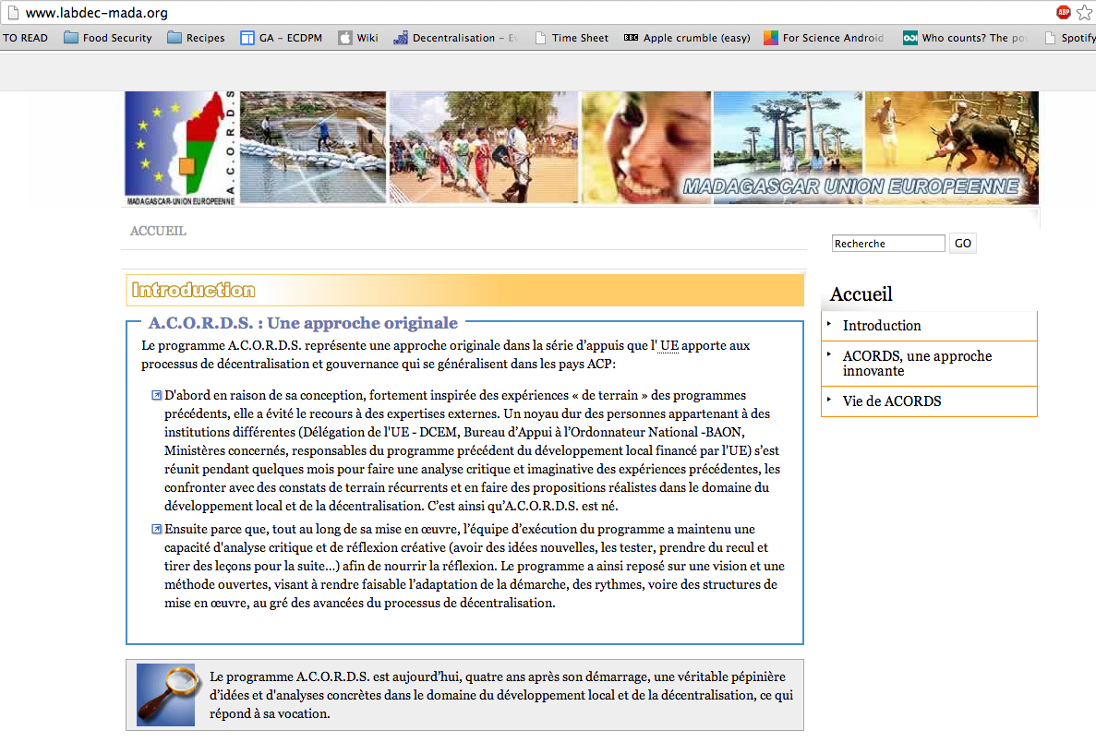

Slide 20
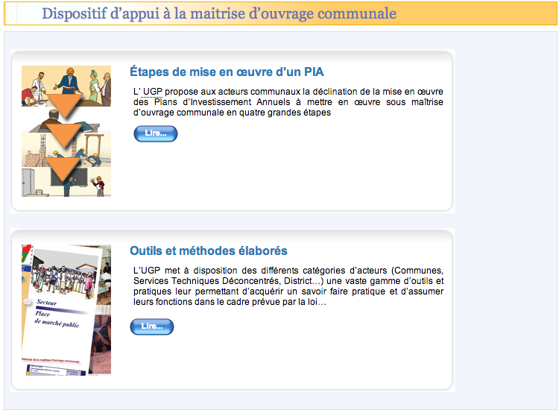

Slide 21
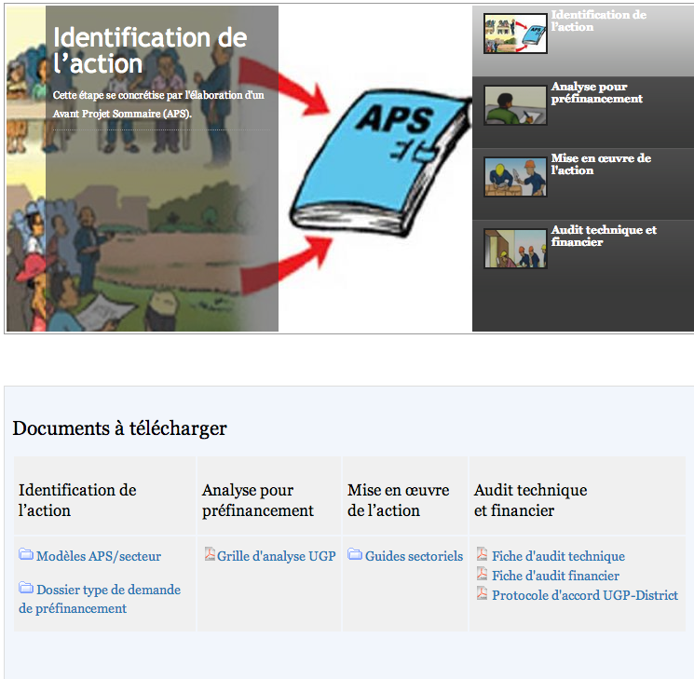

Slide 22
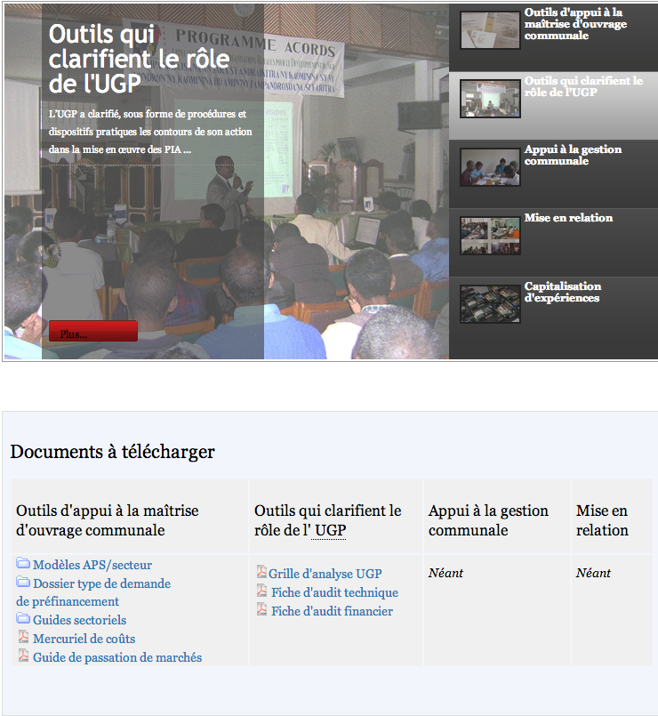

Slide 23
Thank you!!

