Slide 1




DRAFT GUIDANCE on
Using “project approaches” to support local development and decentralisation
Presentation at EU regional seminar on
Decentralisation and local governance
(Kenya, 11-14 November 2013)
By J. Bossuyt (ECDPM)

Slide 2
Why this guidance?
1) Stimulate a debate on relevant support strategies and use of (a mix) of suitable aid modalities –beyond the dominant orthodoxy in favour of BS
2) Revalue the use of well-designed and implemented “project approaches” in particular country contexts to empower local authorities, building decentralisation “from below” and scale-up innovative approaches

Slide 3
Objectives
1) To review the policy debate on the respective merits and limitations of programme-based approaches and project approaches
2) To identify the “DNA” of smart and successful project interventions;
3) To provide operational guidance to EC staff on how to design and implement smart projects (possibly as part of a wider portfolio approach) that provide space for experimentation from the bottom-up and allow for an effective scaling up of these field experiences to the national level.

Slide 4
Reviewing the policy debate
Strong preference for programme-based approaches
Wide recognition of the limitations of stand-alone projects
Tendency to see the choice of aid modalities as a neutral thing
HOWEVER:
Decentralisation is a highly political process
Decentralisation does not lead automatically to empowerment of local authorities

Slide 5
PUTTING POLITICS AND STRATEGY FIRST
CHOICE OF RELEVANT (MIX OF) AID MODALITIES SHOULD DEPEND ON:
1) What are the decentralisation realities on the ground in political economy terms?
2) What does the EU essentially seeks to achieve with its support in a given country context?

Slide 6

DNA of a project approach
1: A CLEAR VISION
2: COHERENT DESIGN CHOICES
3: FLEXIBLE AND PROCESS-ORIENTED IMPLEMENTATION

Slide 7
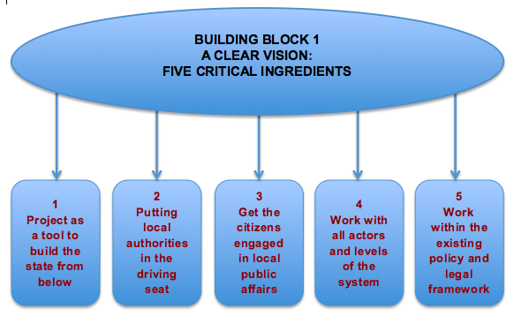

Slide 8
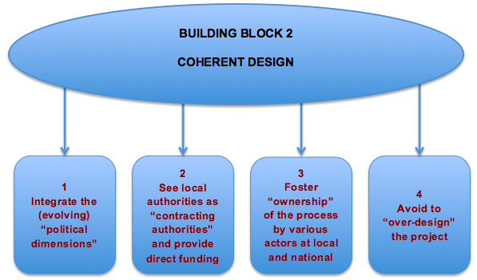

Slide 9
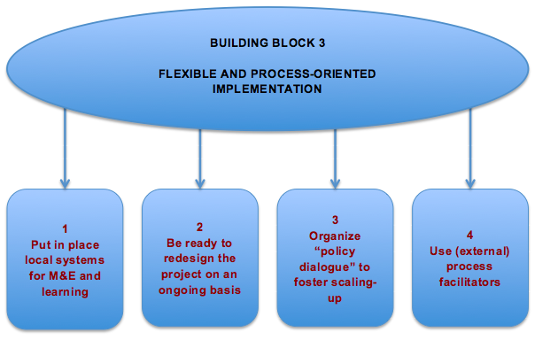

Slide 10
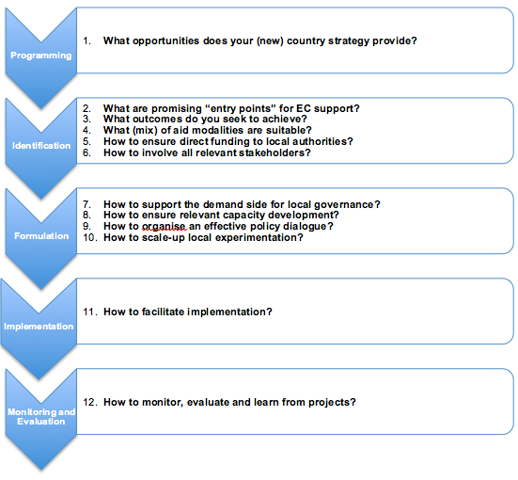

Slide 11
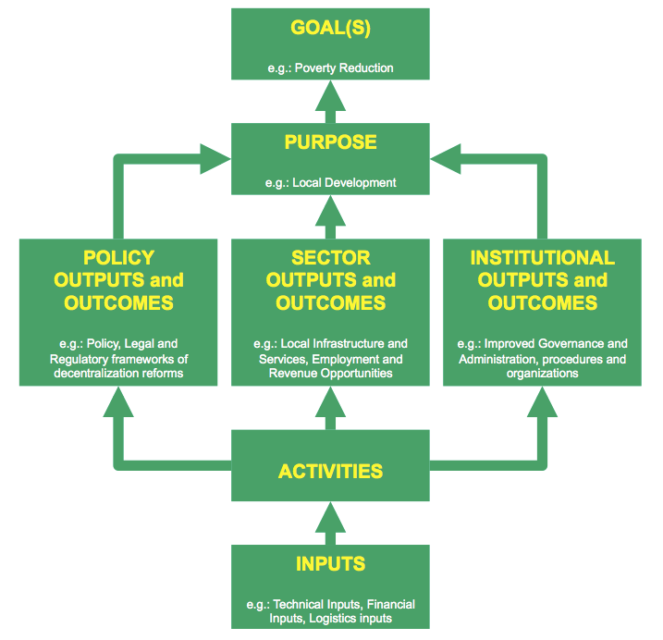

Slide 12
