Slide 1
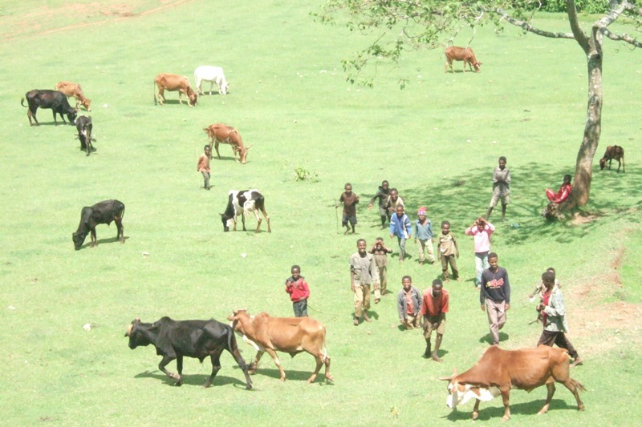
EU+ Ethiopia
Nutrition: An Overview
Nigel Nicholson EC Nutrition Advisory Service
Addis Ababa 30 June 2014

Slide 2
Presentation
Concepts and definitions
Levels of undernutrition
Consequences - reasons to invest in nutrition
Causes
Programming implications
  nutrition-specific interventions
  nutrition-sensitive interventions
Mainstreaming nutrition into key sectors

Slide 3
Concepts and definitions
Malnutrition
Under-nutrition Over-nutrition
(overweight / obesity)
Energy
Protein
Vitamin
Minerals
Notes:
CLICK FOR NUTRIENTS
Missing: water, fibre

Slide 4
Concepts and definitions
Key Terms
Intra uterine growth restriction → Small for Gestational Age (SGA)
→ Low Birthweight (LBW)
Stunting: short stature
low height-for-age (retard de croissance)
Wasting: thin
low weight-for-height (émaciation)
Underweight: poor growth - ?thin ?short
low weight –for-age (insuffisance pondérale)
Micronutrient deficiencies
(iodine, iron, vitamin A, zinc deficiencies, etc…)
Notes:
Micronutrient deficiencies relate to mineral and vitamin deficiencies

Slide 5
Concepts and definitions
Diagnosis
Anthropometric measures: weight, height, age
→ weight-for-height, height-for-age, weight-for-age
Also: Birthweight
Mid Upper Arm Circumference (MUAC)
Skinfold thickness etc
Biochemical measures:
  Low haemoglobin in blood→ Iron/folic acid deficiency - anaemia
  Low serum retinol→ vitamin A deficiency
Clinical signs:
  Bilateral oedema→ kwashiorkor
  Goitre → iodine deficiency
  Bleeding gums → vitamin C deficiency
  Curved leg bones (rickets) → Vitamin D deficiency

Slide 6
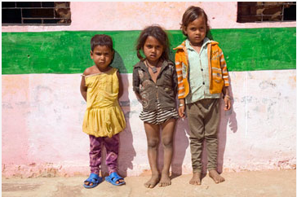
What can you say about the nutritional status of these children?
Courtesy of DFID
Notes:
Each of these children is 3 years old. Roshani on the left is 16cm shorter than Sonam on the right and the chances of Roshani being this short naturally is less than 3 in 100.
The point is that nutrition and assessing the extent of undernutrition is not very obvious. We need to look for it to see it often (

Slide 7
Concepts and definitions
Wasting
Stunting
Source: Addressing Undernutrition in External Assistance, Reference Document n°13
Notes:
Other terms you might come across:
acute/chronic
GAM, SAM
Marasmus / kwashiorkor
CLICK
In fact, these categories overlap – wasting and stunting often co-exist in the same child; and micronutrient deficiencies would almost certainly be found in all malnourished individuals – whether they are under nourished or overnourished

Slide 8
Levels of Undernutrition
Small for Gestational Age: 32 million infants born every year representing 27% of all births in LMICs (Lancet, 2013)
Low birth weight: 19 million infants born LBW every year representing 16% of all births in LMICs* 20% in Ethiopia (2011)
Wasting: 52 million children under-five years (8%)* 10% in Ethiopia (2011)
Stunting: 165 million children U5 (26%)* 44% in Ethiopia (2011)
Overweight: 43 million U5 (7%)*
*Source: WHO/UNICEF/WORLD BANK 2012, data from 2011
Notes:
Wasting represents about 1,600,000 children (2012) and stunting 6,130,000 children (2012)
Stunting in Ethiopia higher than the E & S Africa average. Considerable regional disparities in Ethiopia: rising to over 52% in Amhara, 44% IN SNNPR and 41% in Oromia (DHS 2011). Almost half the children in the poorest quintile are stunted. 67% of the adult population in Ethiopia suffered from stunting as a child (Cost of Hunger Study)

Slide 9
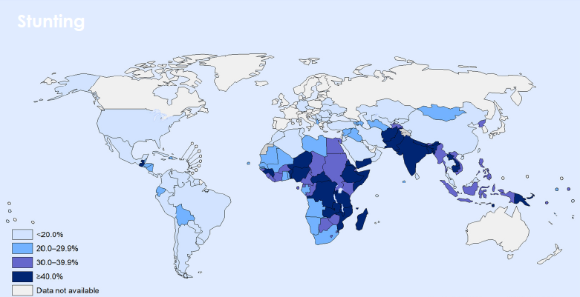
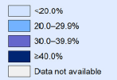
Stunting amongst children under five years of age
Levels of Undernutrition
> 90% of stunted children live in Asia and Africa
Source: WHO/UNICEF/WORLD BANK 2012, data from 2011

Slide 10
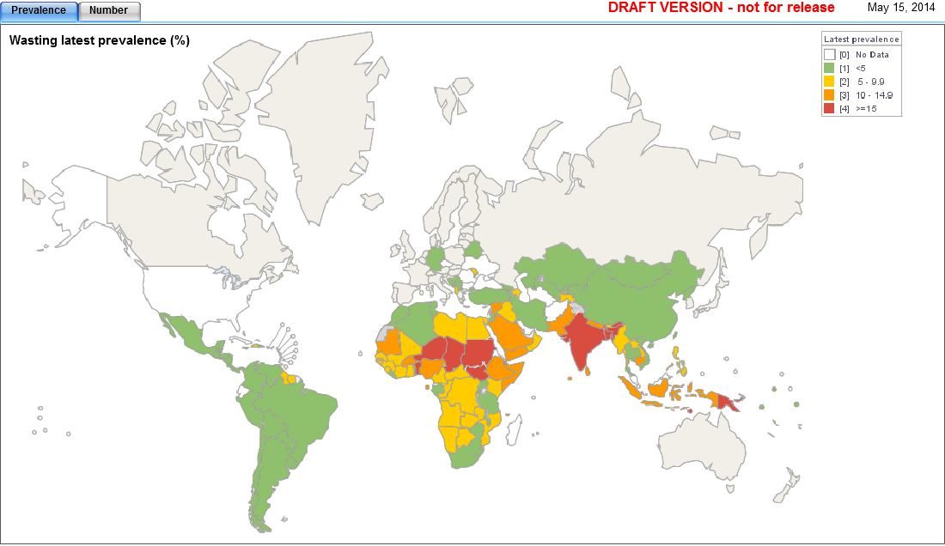
Wasting amongst children under five years of age
Levels of Undernutrition
Source: DRAFT DATA (pre-release) - WHO 2014
Notes:
69% wasted children are found in Asia
55% of all wasted children in the world live in only 9 countries: India, Bangladesh, Niger, Sudan, S Sudan, Chad, Djibouti, Timor L’Este, Papua New Guinea

Slide 11
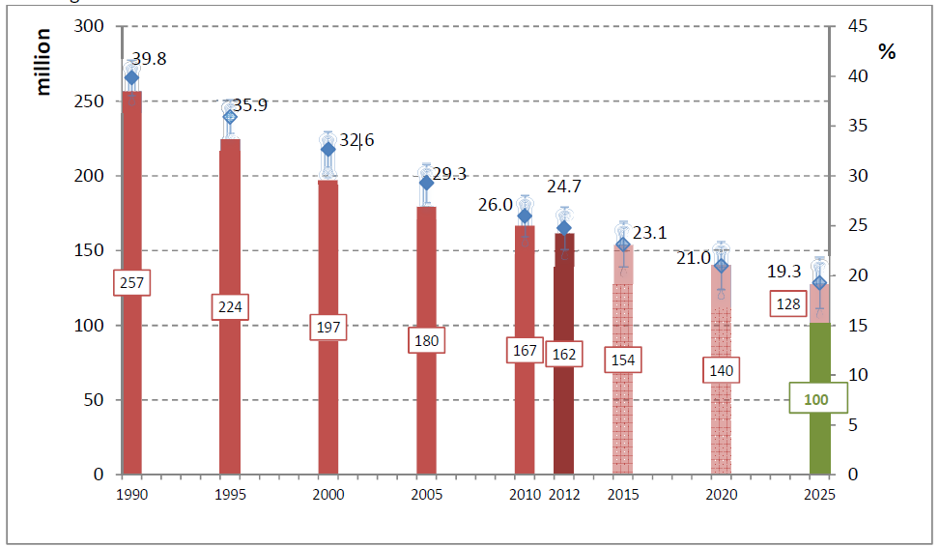
Global Stunting trends
Levels of Undernutrition
Source: WHO, 2012 data
Notes:
Important regional disparities within this overall trend – number of stunted in Africa are INCREASING, even though prevalence is decreasing slightly…. By 2025, nearly half the world’s stunted children will be in Africa

Slide 12
Consequences
Death
3 million deaths U5 children per year
i.e. 45% of child deaths (Lancet 2013)
23% of maternal mortality (Lancet 2008)
Ill-health
Responsible for 35% of the disease burden amongst children under the age of five (Lancet 2008)
Increases adult risk of chronic disease (diabetes and heart disease)
Lower Educational Attainment
Impairs cognitive development
Increases the risk of poor school performance
The effects of stunting are irreversible after the age of two years:
Crucial window of opportunity to address undernutrition from conception to 24 months (1000 days)
Notes:
Sources: Lancet Series on Child and Maternal Nutrition, 2008 and 2013
World Health now considers poor nutrition to be the single most important threat to global health
In Ethiopia 51% of child mortality associated with undernutrition (NNP)
CLICK ILL HEALTH
CLICK EDUCATION

Slide 13
Consequences
On future generations
Undernourished girls are more likely to become short women who are more likely to give birth to small babies.
Undernutrition gets perpetuated across generations
On the the economy
Undernutrition → lasting mental and physical deficits → reduction of individuals’ and societies’ productivity → loss of upto 8% of GDP (Lancet 2013)
Annual costs associated with child undernutrition are estimated Ethiopian Birr 55.5 billion, which is equivalent to 16.5% of GDP
→ Contributes to perpetuating poverty,
of people and nations
Notes:
Sources: Lancet Series on Child and Maternal Nutrition, 2013
CLICK ECONOMY
CLICK POVERTY

Slide 14
Consequences
Eliminating undernutrition in young children has multiple benefits
Boosts gross national product by 11% in Asia and Africa
Improves school attainment by at least one year
Increases wages by 5-50%
Reduces poverty as well-nourished children are 30% more likely to escape poverty as adults
Empower women to be 10% more likely to run their own businesses
The Copenhagen Consensus 2012 Expert Panel of renowned economists:
Agreed that fighting malnutrition should be the top priority for policy-makers and philanthropists
Found that every $1 invested in reducing undernutrition results in $30 return on investment in terms of better health, schooling and productivity
Notes:
Sources: Lancet Series on Child and Maternal Nutrition, 2013
CLICK ECONOMY
CLICK POVERTY

Slide 15
Why nutrition?
Because when..
Children receive proper nutrition and develop strong bodies & minds
Girls & women are well-nourished and have healthy newborn babies
Children receive proper nutrition and develop strong bodies & minds
The world is a safer, more resilient & stronger place
Adolescents learn better & achieve higher grades
in school
Communities & nations are productive & stable
Families & communities emerge out of poverty
Young adults are better able
to obtain
work & earn more

Slide 16
Causes
Notes:
Implications: actions at different levels and through several sectors, including agriculture

Slide 17
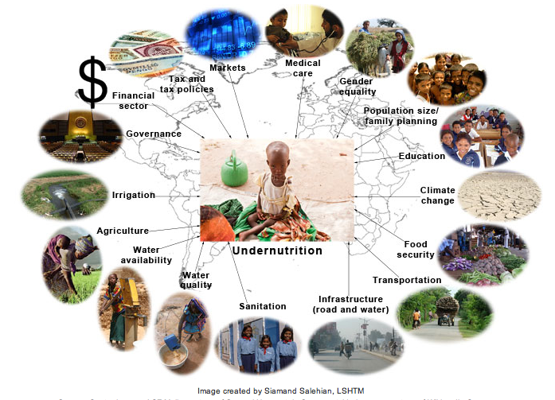
Causes
Notes:
This shows the wide range of potential actors that need to become involved in efforts to reduce undernutrition

Slide 18
Programming Implications
Nutrition-Specific Actions
  Mostly targeted at immediate causes
  Heath sector interventions mainly (breastfeeding promotion, treatment of severe acute malnutrition, addressing micronutrient deficiencies)
  With a 90% coverage, 10 evidence-based interventions could reduce stunting by about 20% (Source: Lancet 2013)
Nutrition-Sensitive Actions
  Targeted at underlying and basic causes
  Under the responsibility of sectors such as social protection, health, water /sanitation, agriculture, education
  Need to increase the impact of these sectors on nutrition
  ‘nutrition-sensitive development’
Notes:
CLICK NUTR-SENS
CLICK Nutr-Sens Devt

Slide 19
Nutrition-specific actions
Nutrition-sensitive actions
Notes:
CLICK
If we want to make significant progress in reducing stunting, we NEED to work through nutrition-sensitive actions
without efforts to address the underlying and basic causes of undernutrition, the global problem will not be resolved.

Slide 20

Mainstreaming Nutrition into Key Sectors
Framework for action
Governance
Health – Nutrition links
Watsan – Nutrition links
Education – Nutrition links
Social Protection – Nutrition links
Agriculture – Nutrition links
Implications for programming
Notes:
Bring to everyone’s attention the Reference Document for this exercise

Slide 21
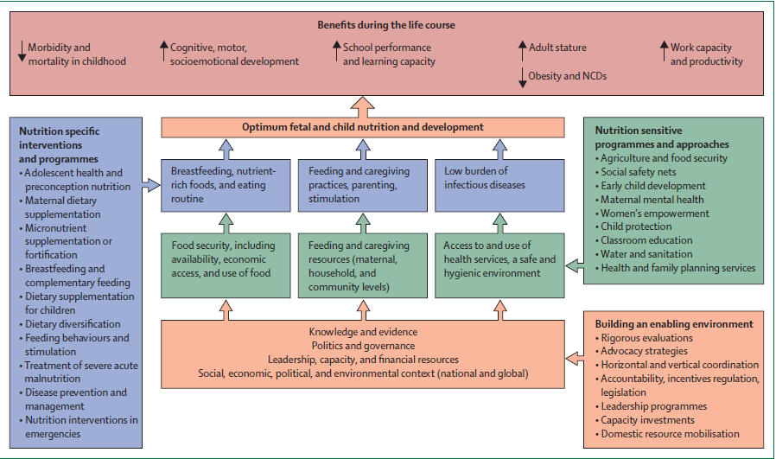
Framework for action to achieve optimum fœtal and child nutrition and development
Source: Lancet, 2013

Slide 22
Multi-sectoral nature of nutrition
HEALTH
SOCIAL PROTECTION
ENVIRONMENT & NAT. RESOURCES
The causes of undernutrition are multi-sectoral and multi-layered.
Therefore
Undernutrition will only be tackled effectively if all relevant sectors take responsibility to address the causes that they can influence.
HUMAN RIGHTS
GENDER
EDUCATION
FOOD SECURITY
WASH
GOVERNANCE
AGRICULTURE

Slide 23
Example of a comprehensive nutrition strategy/policy
Reduction in child and maternal undernutrition
Social protection policies are designed so as to have greater impact on nutrition
Overall health sector policy includes a well-resourced nutrition action plan
Water and sanitation policy prioritises measures to prevent undernutrition
Gender
and
Equity
Education policy contributes to the prevention of undernutrition
Comprehensive strategic policy environment for nutrition
Food security and agriculture policies aligned behind nutrition objectives
Notes:
A conducive national Policy environment eg PRSP

Slide 24
Health → nutrition links
Scale up the 10 nutrition-specific/evidence-based actions
  Optimum maternal nutrition during pregnancy
  Infant and young child feeding
  Micronutrient supplementation in children at risk
  Management of acute malnutrition
Support nutrition-sensitive actions under health
  vaccination campaigns
  malaria prevention
  maternal health
Support overall health system
  Primary health care
  Health information systems
  Advocacy and policy development
  Capacity development
Notes:
Breastfeeding is nearly universal in Ethiopia (98% of children 0-5 years ever breastfed), but inadequate complementary feeding 6-8 months are thought to be a key determinant of malnutrition in Ethiopia (UNICEF)

Slide 25
Watsan → nutrition links
Some of the most significant nutritional gains are through investing in sanitation and hygiene promotion to prevent diarrhoea and other enteric diseases
Entry points include:
Water/sanitation/hygiene policies and programmes
Health care and hygiene promotion
Infrastructure (water and sanitation treatment)
Reducing inequalities in access to water
Regulations to ensure water quality and efficiency
Reducing load on women (time demands, physical burden of collecting water; protection risks; ability to care for children

Slide 26
Education → nutrition links
Survey results demonstrate a much lower prevalence of undernutrition amongst children whose mothers attended school compared with those with no schooling (2.5 x lower in Burundi; 4 x lower in Niger)
Entry points include:
Curriculum – introducing nutrition and growth, family planning, pregnancy and infant feeding and hygiene promotion
Teacher training on enhanced curricula
Enrolment – improving attention especially for girls
School management – incorporating health and nutrition services in school calendar
Community-based approaches – to promote nutrition practices
Evidence that school feeding has limited impact on nutrition
Notes:
In Ethiopia literacy rates are as low as 40% and 10% amongst female headed households

Slide 27
Social protection → nutrition links
Evidence that social transfers targetting poor and vulnerable individuals/households can play a significant role in reducing under-nutrition when they reduce household deficits in consumption, protect them from shocks and boost their productive capacity.
Entry points include:
Prioritising maternal and child benefits
Prioritising areas or populations worst affected by undernutrition
Adapting the design of social transfers such as exempting PLW from labour requirements
Establishing links with other services (such as health/education)
Adapting the nature of the social transfer (e.g. food supplements as well as cash)
Taking into account the cost of diet and the household’s purchasing power when setting the transfer
Notes:
Not so much the case yet with the PSNP in Ethiopia

Slide 28
Agriculture → nutrition links
Agriculture can improve nutrition through six pathways:
Empower women as income-earners, decision-makers and primary child-care providers
Improve the diet (quantity and quality) by increasing household consumption
Reduce income poverty (sale of production, employment as agricultural labour)
Increase availability of food through higher levels of food production, improved post-harvest technology and decreased food prices
Sustainable management of natural resources in support of improved livelihoods and resilience to climate change
Generate higher national revenue leading to macro-economic growth which can then be invested to improve basic social services

Slide 29
Insufficient measure and understanding of agriculture contribution to nutrition
Agriculture tends to focus on cereal production and availability
Food security tends to focus on:
  Food energy
  Household level
Ignores 2 elements of the food security definition: “all people” (i.e. individual level) and “nutritious food” (i.e. diet quality/micronutrients)
→ Lack of explicit nutrition objectives within food security programmes
→ Absence of nutrition-specific indicators and monitoring of nutrition outcomes
Weak evidence of what works according to context

Slide 30
Implications for programme design all sectors
Situation analysis should take account of basic, underlying and direct causes of undernutrition
Objectives must go beyond mentioning nutrition and should have a stated aim to improve nutrition of groups worst affected by undernutrition
Results/Outcomes should be specifically targeted to improve the nutritional status of women or adolescent girls or children
Activities should as far as possible be based on interventions proven to achieve better nutrition of the target group (or be linked to ongoing operational research)
Monitoring & Evaluation should include relevant indicators especially stunting and wasting of children under five years of age
Learning should be based as much as possible on evidence from the field

Slide 31
Types of indicators
Input indicators: measure the financial, administrative and regulatory resources provided
Process indicators: assess the means or methods to achieve the desired results
Output indicators: measure the immediate and concrete consequences of the measures taken and resources used
Outcome indicators: measure the results in terms of target group benefits
Impact indicators: measure the long-term consequences of the outcomes

Slide 32
Nutrition Impact Indicators
Prevalence of stunting in children aged <5 years
Prevalence of underweight in children <5 years
Prevalence of wasting in children aged <5 years
Prevalence of severe acute malnutrition (including oedema) in children <5 years
Prevalence of low MUAC (6-59 months)
Low birth weight (LBW) rate
Prevalence of low body mass index (BMI) in women
Prevalence of overweight amongst women
Prevalence of iodine deficiency disorders (IODD)
Prevalence of children (2-5 yrs) with vitamin A deficiency
Prevalence of PLW with vitamin A deficiency
Prevalence of anaemia in pregnant women
Maternal mortality ratio (per 100,000 live births)
Infant mortality rate
Under five mortality rate

Slide 33
The 2012 WHA Targets
40% reduction of the number of U5 who are stunted
30% reduction of low birthweight
No increase in childhood overweight
Reducing and maintaining wasting to less than 5%
50% reduction of anaemia in women of reproductive age
Increase exclusive breastfeeding in the first 6 months,
up to at least 50%
Ethiopia committed to reduce prevalence of stunting to 20% by 2020 (N4G Event London June 2013)
Notes:
The World Health Assembly is the governing body of WHO – made of all member states.
Last year, they approved 6 new global targets for nutrition, to be achieved by 2025.
The EC’s commitments in nutrition are wholly in line with, and support of, these targets.

Slide 34
Notes:
If 45% represents 6,130,000 in 2012 then it will represent about 7,800,000 in 2020. If the prevalence of stunting is to be reduced to 20% then this would represent 3,545,454 children U5 in 2020

Slide 35
Participatory Session
Group Work
Review of Indicators in the National Nutrition Programme (NNP) of Ethiopia 2013-205

Slide 36
Participatory Session
Review the indicators identified against each NNP Strategic Objective
Assess the relevance of each indicator against each SO
Suggest changes and/or additions to the indicators
Identify any nutrition indicators missing (including those that could link to regional or global targets)
Identify how the information for each indicator could be collected (through new or existing surveys and information systems)
Identify what mechanism and capacity would be necessary to generate and monitor these indicators

Slide 37
Concluding Remarks
  Even if nutrition-specific interventions assume 90% coverage, they can only contribute to an approximate 20% reduction in stunting
  Key therefore that nutrition-sensitive interventions are undertaken in conjunction with nutrition-specific interventions to address basic and underlying causes
  There is a real lack of evidence to support different nutrition-sensitive interventions in different contexts: need to develop operational research and M&E structures which can capture this evidence
  Common experience of the EU+ Joint Action on Nutrition really important to generate this learning

Slide 38
Additional slides for reference only

Slide 39
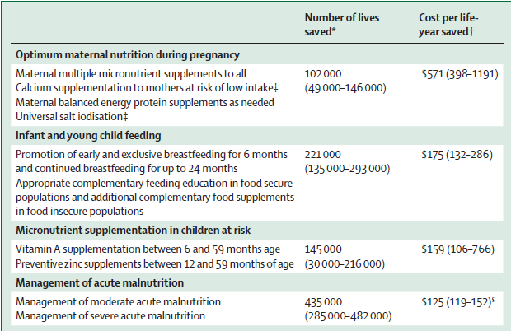
Nutrition-specific actions

Slide 40
Entry points to improve nutrition through agriculture
Approaches and tools
Inclusion of nutrition objectives and indicators in projects, programmes and policies (e.g. food intake/diet quality indicators, anthropometry, household purchasing power in addition to production and availability indicators)
Inclusion of a nutrition perspective in tools such as ‘value chain analysis’ modelling, etc…
Controlling for negative impacts on nutrition (e.g. increase in water borne diseases, increase in women workload leading to poorer child care)
Targets
Prioritising areas or groups worst affected by undernutrition (poor households, etc…)
Women empowerment: stengthening their economic power while protecting their abilty to care for children

Slide 41
Examples
Pathway One: empowering women:
Farmer associations (inclusive of women)
Improving women’s access to land, education, extension services, technology, inputs, market and information
Credit facilities for women
Micro-enterprise (including food processing and preservation)
Animal husbandry
Ensuring provision of appropriate child-care

Slide 42
Examples
Pathway Two: increasing household consumption:
Kitchen gardens especially legumes (rich in energy, protein and iron)
homestead production of animals (subject to context)
Fish farming (subject to context)
Dairy production
Inter-cropping (complementary cereal-legume production)
Utilisation of biofortified crops (micro-nutrient or protein-rich foods)
Promotion of indigenous foods (forest products, wild fruits, insects, herbs)

Slide 43
Examples
Pathway Three: reducing income poverty:
Introduction of cash crops as supplements rather than substitutes for food crops
off-farm employment (to reduce dependency on agriculture)
Improve market access for smallholders (including improved infrastructure)
Improved market information
Strengthen value-added agro-enterprises that integrate smallholders into food supply chains

Slide 44
Examples
Pathway Four: increasing availability of food
Subsidised farm inputs to poor/vulnerable households
Control pests and diseases including aflatoxins
Inter-cropping
Improved food storage facilities
Food conservation and preservation

Slide 45
Examples
Pathway Five: management of natural resources
Risk mitigation and management of climatic shocks and natural hazards
Soil, water and bio-diversity conservation
Agro-forestry
Conservation agriculture practices
Bio-control of pests
Production of perennial plants including trees and bushes (structural and soil-improving functions)
Legumes (nitrogen fixation)

Slide 46
Examples
Pathway Six: macro-economic growth
Soil, water and bio-diversity conservation
Agro-forestry
Conservation agriculture practices
Bio-control of pests
Production of perennial plants including trees and bushes (structural and soil-improving functions)
Legumes (nitrogen fixation)

Slide 47
Outline
The Millennium Development Goals
The World Health Assembly Targets
The SUN Movement
The Nutrition for Growth Compact

Slide 48
Nutrition for Growth
A Nutrition for Growth Compact
  to ensure that at least 500 million pregnant women and children under two are reached with effective nutrition interventions.
  to reduce the number of children under five stunted by at least 20 million.
  to save the lives of at least 1.7 million children under 5 by preventing stunting, increasing breastfeeding, and increasing treatment of severe acute malnutrition.
At the London conference in June 2013: Ethiopia reaffirmed its commitment to: (i) reduce stunting to 20% and underweight to 15% by 2020; (ii) allocate an additional US$15 million per year to nutrition to 2020; and (iii) build on multi-sectoral collaboration
Notes:
In June 2013, the governments of the UK and Brazil, together with CIFF (the Children's Investment fund Foundation) co-hosted a high-level meeting: Nutrition for Growth: Beating Hunger through Business and Science.
The Compact was endorsed by 94 stakeholders, including 19 donors and development agencies.
>>> new commitments of up to GBP £2.7 billion (USD $4.15 billion) to tackle undernutrition up to 2020.
Commissioner Piebalgs announced that the EU would spend €3.5 billion between 2014-2020 on improving nutrition.
The June event also resulted in a commitment to Launch an annual Global Nutrition Report from 2014. How this will work, in terms of data required, organisation, and production, is under discussion currently, and the EC is very closely involved with regard to supporting countries to produce reliable and relevant data.

