Slide 1
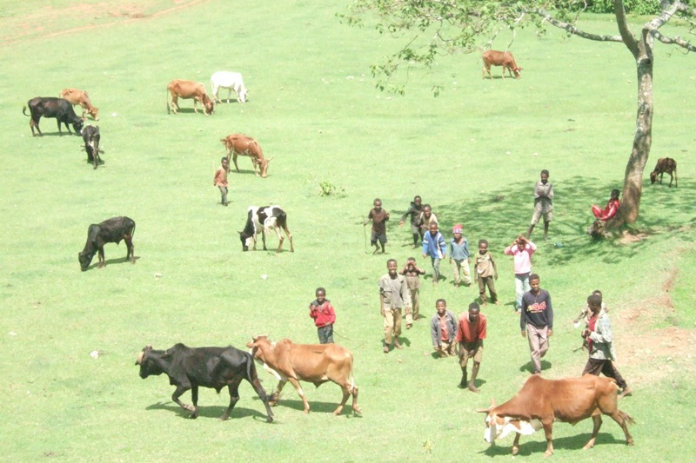
EU+ Ethiopia
An Overview of Nutrition and the International Context
Nigel Nicholson, EC Nutrition Advisory Service
Addis Ababa 30 June 2014

Slide 2
Presentation
Concepts and definitions
Levels of undernutrition
Consequences - reasons to invest in nutrition
Causes
Programming implications
  nutrition-specific interventions
  nutrition-sensitive interventions
International Context

Slide 3
Concepts and definitions
Malnutrition
Under-nutrition Over-nutrition
(overweight / obesity)
Energy
Protein
Vitamin
Minerals
Notes:
CLICK FOR NUTRIENTS
Missing: water, fibre

Slide 4
Concepts and definitions
Key Terms
Intra uterine growth restriction → Small for Gestational Age (SGA)
→ Low Birthweight (LBW)
Stunting: short stature
low height-for-age (retard de croissance)
Wasting: thin
low weight-for-height (émaciation)
Underweight: poor growth - ?thin ?short
low weight –for-age (insuffisance pondérale)
Micronutrient deficiencies
(iodine, iron, vitamin A, zinc deficiencies, etc…)
Notes:
Micronutrient deficiencies relate to mineral and vitamin deficiencies

Slide 5
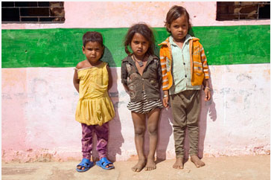
What can you say about the nutritional status of these children?
Courtesy of DFID
Notes:
Each of these children is 3 years old. Roshani on the left is 16cm shorter than Sonam on the right and the chances of Roshani being this short naturally is less than 3 in 100.
The point is that nutrition and assessing the extent of undernutrition is not very obvious. We need to look for it to see it often (

Slide 6
Concepts and definitions
Wasting
Stunting
Source: Addressing Undernutrition in External Assistance, Reference Document n°13
Notes:
Other terms you might come across:
acute/chronic
GAM, SAM
Marasmus / kwashiorkor
CLICK
In fact, these categories overlap – wasting and stunting often co-exist in the same child; and micronutrient deficiencies would almost certainly be found in all malnourished individuals – whether they are under nourished or overnourished

Slide 7
Levels of Undernutrition
Small for Gestational Age: 32 million infants born every year representing 27% of all births in LMICs (Lancet, 2013)
Low birth weight: 19 million infants born LBW every year representing 16% of all births in LMICs* 20% in Ethiopia (2011)
Wasting: 52 million children under-five years (8%)* 10% in Ethiopia (2011)
Stunting: 165 million children U5 (26%)* 44% in Ethiopia (2011)
Overweight: 43 million U5 (7%)*
*Source: WHO/UNICEF/WORLD BANK 2012, data from 2011
Notes:
Wasting represents about 1,600,000 children (2012) and stunting 6,130,000 children (2012)
Stunting in Ethiopia higher than the E & S Africa average. Considerable regional disparities in Ethiopia: rising to over 52% in Amhara, 44% IN SNNPR and 41% in Oromia (DHS 2011). Almost half the children in the poorest quintile are stunted. 67% of the adult population in Ethiopia suffered from stunting as a child (Cost of Hunger Study)

Slide 8
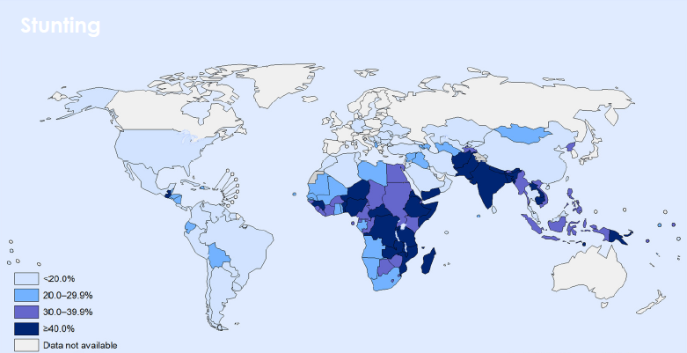
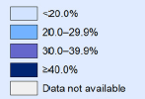
Stunting amongst children under five years of age
Levels of Undernutrition
> 90% of stunted children live in Asia and Africa
Source: WHO/UNICEF/WORLD BANK 2012, data from 2011

Slide 9
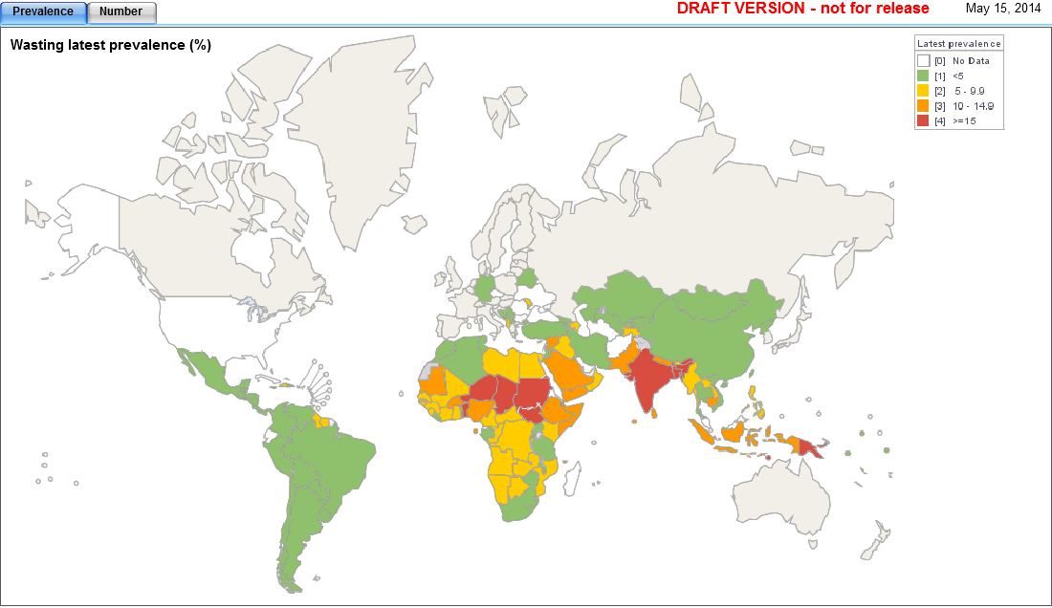
Wasting amongst children under five years of age
Levels of Undernutrition
Source: DRAFT DATA (pre-release) - WHO 2014
Notes:
69% wasted children are found in Asia
55% of all wasted children in the world live in only 9 countries: India, Bangladesh, Niger, Sudan, S Sudan, Chad, Djibouti, Timor L’Este, Papua New Guinea

Slide 10
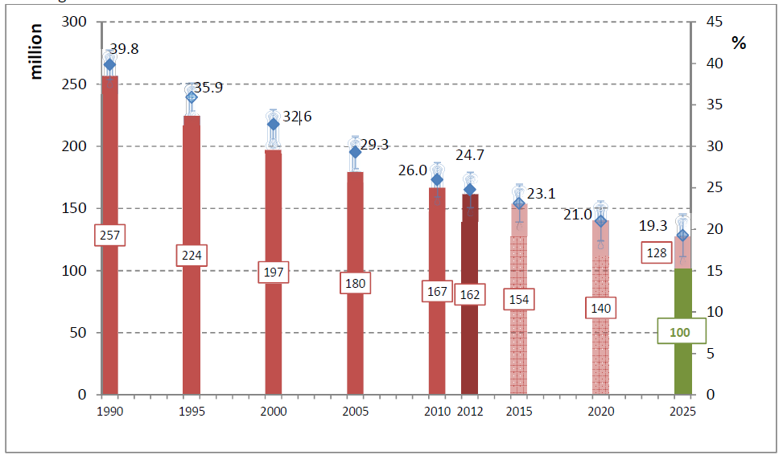
Global Stunting trends
Levels of Undernutrition
Source: WHO, 2012 data
Notes:
Important regional disparities within this overall trend – number of stunted in Africa are INCREASING, even though prevalence is decreasing slightly…. By 2025, nearly half the world’s stunted children will be in Africa

Slide 11
Consequences
Death
3 million deaths U5 children per year
i.e. 45% of child deaths (Lancet 2013)
23% of maternal mortality (Lancet 2008)
Ill-health
Responsible for 35% of the disease burden amongst children under the age of five (Lancet 2008)
Increases adult risk of chronic disease (diabetes and heart disease)
Lower Educational Attainment
Impairs cognitive development
Increases the risk of poor school performance
The effects of stunting are irreversible after the age of two years:
Crucial window of opportunity to address undernutrition from conception to 24 months (1000 days)
Notes:
Sources: Lancet Series on Child and Maternal Nutrition, 2008 and 2013
World Health now considers poor nutrition to be the single most important threat to global health
In Ethiopia 51% of child mortality associated with undernutrition (NNP)
CLICK ILL HEALTH
CLICK EDUCATION

Slide 12
Consequences
On future generations
Undernourished girls are more likely to become short women who are more likely to give birth to small babies.
Undernutrition gets perpetuated across generations
On the the economy
Undernutrition → lasting mental and physical deficits → reduction of individuals’ and societies’ productivity → loss of upto 8% of GDP (Lancet 2013)
Annual costs associated with child undernutrition are estimated Ethiopian Birr 55.5 billion, which is equivalent to 16.5% of GDP
→ Contributes to perpetuating poverty,
of people and nations
Notes:
Sources: Lancet Series on Child and Maternal Nutrition, 2013
CLICK ECONOMY
CLICK POVERTY

Slide 13
Consequences
Eliminating undernutrition in young children has multiple benefits
Boosts gross national product by 11% in Asia and Africa
Improves school attainment by at least one year
Increases wages by 5-50%
Reduces poverty as well-nourished children are 30% more likely to escape poverty as adults
Empower women to be 10% more likely to run their own businesses
The Copenhagen Consensus 2012 Expert Panel of renowned economists:
Agreed that fighting malnutrition should be the top priority for policy-makers and philanthropists
Found that every $1 invested in reducing undernutrition results in $30 return on investment in terms of better health, schooling and productivity
Notes:
Sources: Lancet Series on Child and Maternal Nutrition, 2013
CLICK ECONOMY
CLICK POVERTY

Slide 14
Causes
Notes:
Implications: actions at different levels and through several sectors, including agriculture

Slide 15
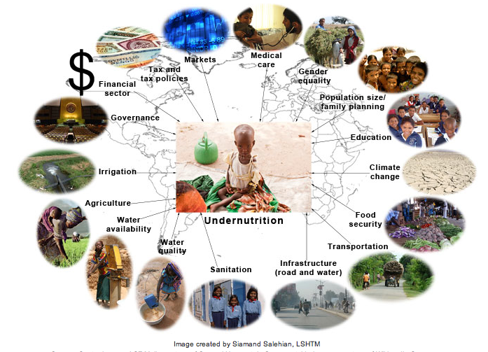
Causes
Notes:
This shows the wide range of potential actors that need to become involved in efforts to reduce undernutrition

Slide 16
Programming Implications
Nutrition-Specific Actions
  Mostly targeted at immediate causes
  Heath sector interventions mainly (breastfeeding promotion, treatment of severe acute malnutrition, addressing micronutrient deficiencies)
  With a 90% coverage, 10 evidence-based interventions could reduce stunting by about 20% (Source: Lancet 2013)
Nutrition-Sensitive Actions
  Targeted at underlying and basic causes
  Under the responsibility of sectors such as social protection, health, water /sanitation, agriculture, education
  Need to increase the impact of these sectors on nutrition
  ‘nutrition-sensitive development’
Notes:
In Ethiopia there are significant opportunities to integrate nutrition into the flagship programmes such as the PSNP, HABP (Household Asset Building Programme) and the AGP
CLICK NUTR-SENS
CLICK Nutr-Sens Devt

Slide 17
Nutrition-specific actions
Nutrition-sensitive actions
Notes:
CLICK
If we want to make significant progress in reducing stunting, we NEED to work through nutrition-sensitive actions
without efforts to address the underlying and basic causes of undernutrition, the global problem will not be resolved.

Slide 18
International Context of Nutrition
The Millennium Development Goals
The World Health Assembly Targets
The SUN Movement
The Nutrition for Growth Compact
The European Union

Slide 19
The MDGs
8 global goals established in 2008
  Nutrition is directly included in Goal 1 (Eradicate extreme poverty and hunger)
  Nutrition is required to achieve Goal 4 (Reduce child mortality) and Goal 5 (Improve maternal health)
20 measurable targets
  Target 1c: Halve, between 1990 and 2015, the proportion of people who suffer from hunger
Mixed progress in achieving them by 2015
Notes:
Also, undernutrition affects progress towards 3 other goals (2, 3 and 6)
For background information:
Goal 1: Eradicate extreme poverty and hunger
Goal 2: Achieve universal primary education
Goal 3: Promote gender equality and empower women
Goal 4: Reduce child mortality
Goal 5: Improve maternal health
Goal 6: Combat HIV/AIDS, malaria and other diseases
Goal 7: Ensure environmental
Goal 8: Develop a global partnership for development

Slide 20
The 2012 WHA Targets for 2025
40% reduction of the number of U5 who are stunted
30% reduction of low birth-weight
No increase in childhood overweight
Reducing and maintaining wasting to less than 5%
50% reduction of anaemia in women of reproductive age
Increase exclusive breastfeeding in the first 6 months
(up to at least 50%)
Notes:
The World Health Assembly is the governing body of WHO – made of all member states.
Last year, they approved 6 new global targets for nutrition, to be achieved by 2025.
The EC’s commitments in nutrition are wholly in line with, and support of, these targets.

Slide 22
The Scaling Up Nutrition (SUN) Movement
SUN is a global movement which unites governments, civil society, international organisations and businesses to end under-nutrition.
SUN promotes and supports the four processes of: (i) bringing people into shared space for action; (ii) ensuring a coherent policy and legal framework; (iii) aligning programmes around common goals; and (iv) financial tracking and resource mobilisation
National nutrition goals have been or are being established by countries to address immediate and underlying causes of undernutrition. These national goals will be in line with the WHA global targets of 2012.
(NB: EC tool to help determine national stunting targets)
Notes:
Note: governments = national governments as well as donors.
SUN is not a global pot of new money – it is trying to work with all relevant stakeholders to ensure that efforts are complementary (‘aligned’), and working towards the same purpose (as outlined by national nutrition plans) – and helping to catalyse new action and investments.
SUN’s central philosophy is to follow the leadership of countries that have committed to tackling undernutrition.

Slide 23
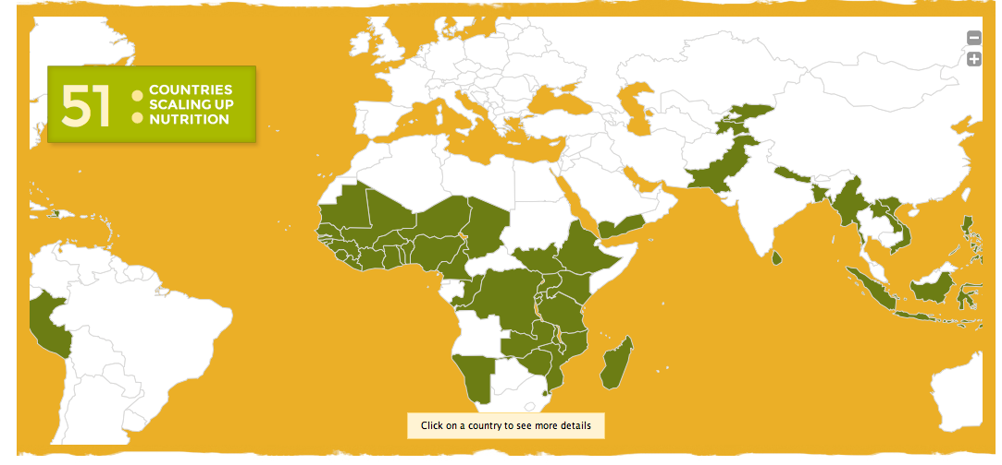
SUN website June 2014

Slide 24



Global Networks
of stakeholders shift resources &
align actions to support country efforts.
Govt focal point
With overall support and coordination provided by the
SUN Secretariat
and
SUN Lead Group
Donor convenor
Multi-stakeholder platform
Country Network
Civil Society Network
United Nations
Network
Donor Network
Business
Network
Notes:
The EC is actively engaged in, and supporting the SUN movement through:-
Commissioner Piebalg’s membership of the SUN Lead Group
Participating in the Donor Network
And providing financial support the SUN Secretariat.
In Ethiopia, the State Minister of Health is the SUN Focal Point ….. The State Minister of Health chairs the National Nutrition Coordinating Body (NNCB) in Ethiopia
Other coordination mechanisms include: (i) health, population and nutrition group; and a sub-group of this: the nutrition development partners which works closely with the National Nutrition Technical Committee consisting of technical advisors in the various ministries
CLICK – in-country structres

Slide 25
SUN
Donor Convenors
BANGLADESH World Bank; USAID
BENIN World Bank; UNICEF
BURKINA FASO ECHO; UNICEF
DRC World Bank; UNIC
ETHIOPIA DFID; UNICEF
GHANA USAID
GUATEMALA IADB; WFP
GUINEA (Republic of) UNICEF
HAITI UNICEF
KENYA EU
KRYGYZ REPUBLIC World Bank; UNICEF
LAO PDR EU
MADAGASCAR UNICEF
MALAWI Ireland; USAID
MALI Canada
MOZAMBIQUE DANIDA; UNICEF
MYANMAR DFID
NAMIBIA UNICEF
NEPAL World Bank
NIGER EU
NIGERIA DFID; UNICEF
PAKISTAN DFID; World Bank
PERU World Bank
RWANDA USAID
SIERRA LEONE Ireland & USAID
TAJIKISTAN USAID; UNICEF
TANZANIA Ireland; USAID
UGANDA USAID
YEMEN EU
ZAMBIA DFID; UNICEF
ZIMBABWE Switzerland
Source: SUN website, June 2014
Notes:
The EC also support SUN at country level – by being convenor or co-convenor in 5 SUN countries.
Only 29 of the 51 countries have donor convenors at present – this is a real challenge to country-level progress….
Principles of donor participation
Strengthening country ownership and leadership
Focusing on results
Adopting a multi-sectoral approach
Focusing on effectiveness
Fostering collaboration and inclusion
Promoting accountability
There will be an evaluation of SUN in 2015 to determine how effective it has been in galvanising national and international efforts towards successful reduction in undernutrition. In the meantime, there is a lot of work going on to build a strong M+E system that will allow us to be able to answer that question reliably. And the EC is deeply involved in trying to build stronger accountability in nutrition – alongside other donors, and more recently in the context of the Nutrition for Growth event.

Slide 26
Nutrition for Growth
A Nutrition for Growth Compact
  to ensure that at least 500 million pregnant women and children under two are reached with effective nutrition interventions.
  to reduce the number of children under five stunted by at least 20 million.
  to save the lives of at least 1.7 million children under 5 by preventing stunting, increasing breastfeeding, and increasing treatment of severe acute malnutrition.
At the London conference in June 2013: Ethiopia reaffirmed its commitment to: (i) reduce stunting to 20% and underweight to 15% by 2020; (ii) allocate an additional US$15 million per year to nutrition to 2020; and (iii) build on multi-sectoral collaboration
Notes:
In June 2013, the governments of the UK and Brazil, together with CIFF (the Children's Investment fund Foundation) co-hosted a high-level meeting: Nutrition for Growth: Beating Hunger through Business and Science.
The Compact was endorsed by 94 stakeholders, including 19 donors and development agencies.
>>> new commitments of up to GBP £2.7 billion (USD $4.15 billion) to tackle undernutrition up to 2020.
Commissioner Piebalgs announced that the EU would spend €3.5 billion between 2014-2020 on improving nutrition.
The June event also resulted in a commitment to Launch an annual Global Nutrition Report from 2014. How this will work, in terms of data required, organisation, and production, is under discussion currently, and the EC is very closely involved with regard to supporting countries to produce reliable and relevant data.

Slide 27

Objectives
review progress made since the 1992 ICN, including country-level achievements in scaling up nutrition through direct nutrition interventions and nutrition-enhancing policies and programmes;
review relevant policies and institutions on agriculture, fisheries, health, trade, consumption and social protection to improve nutrition;
strengthen institutional policy coherence and coordination to improve nutrition, and mobilize resources needed to improve nutrition;
strengthen international, including inter-governmental cooperation, to enhance nutrition everywhere, especially in developing countries.
Notes:
International Conference in Nutrition – the first was in 1992; this is the 2nd. Big news.
19-21 Nov, in Rome (FAO)
Global Nutrition Report will be announced there (in November)

Slide 28
Nutrition at Core of EU Policy
Agenda for Change
Communications on the EU’s Food Security and Humanitarian Food Assistance Policies (equal emphasis on the four pillars of food security)
Communication on the EU Approach to Resilience: Learning from the Food Security Crises (linking nutrition and resilience)
Communication on Nutrition: Enhancing Maternal and Child Nutrition in External Assistance (both the development and humanitarian perspective)

Slide 29
EC Communication on Nutrition
Two objectives:
Reduce stunting in children under five by 7 million (10% of the WHA goal) by 2025
Reduce the number of children under five who are wasted
Three strategic priorities:
Stronger mobilisation and political commitment for nutrition at the country and international level
Nutrition interventions to be scaled up at the country level
Applied research, information systems and technical expertise to build capacities for the implementation of the Communication
€3.5 billion pledged by the Commissioner in June 2013 to achieve the targets of the Communication

Slide 30
Draft Nutrition Action Plan
Building upon the strategic objectives of the Communication and incorporating an accountability framework
Scaling-up nutrition sensitive actions with particular reference to:
  Agriculture and food security;
  Health
  Socal protection and social transfers;
  Water,sanitation and hygiene; and
  Education
Better knowledge for Nutrition
Clearer geographical scope
Strong collaboration with governments and development partners
Accountability
National Evaluation Platforms for Nutrition to be launched
Notes:
Under Agriculture and food security:
Increase purchasing power of women
Increase access to nutritional foods for women, adolescent girls and children
Improving diets of women, adolescent girls and children

Slide 31
Strategies of Member States
United Kingdom (DFID): Neglected Crisis of Undernutrion
SO1 Mobilising and coordinating the international response
SO2 Reaching 12m children through programmes in partner countries
SO3 Investing in multiple sectors to deliver improved nutrition
SO4 Building evidence and demonstrating results
France: Nutrition in Developing Countries
SO1 Support countries to identify, prevent and treat malnutrition in women of reproductive age and children under two
SO2 Contribute to the mobilisation of international actors against malnutrition
Notes:
France: under SO1 emphasis on capacity building, information systems, interventions to prevent and treat malnutrition and operational research to generate evidence. Under SO2 strengthen nutrition governance and debate on emerging issues affecting malnutrition

Slide 32
National Evaluation Platforms for Nutrition
NEPN will be a country-driven process to ensure ownership and sustainability and achieve a more holistic approach
Linking three types of information
  Information about levels of undernutrition (stunting, wasting, low-birth weight, anaemia);
  Information about levels of investment aimed at reducing undernutrition; and
  Information about programme implementation
Expected outputs
  Consistent monitoring of a set of interventions
  Standardisation of indicators to measure these interventions
  Harmonisation of data collection and quality checking
Key attribute of the NEPN approach is that it can assess progress in addressing undernutrition as linked to specific programmes

Slide 34
Key Questions
Are there conflicting policies or strategies on nutrition between EU Member States?
What are the challenges in Ethiopia to achieving both the national targets and the global goals on nutrition?
What are the opportunities in Ethiopia that you would identify to achieve thses?
What support do Member States require to identify and consider programming from a nutrition perspective?

Slide 35
Concluding Remarks
Significance of taking into account nutrition into all programme interventions in Ethiopia
Importance of placing emphasis on nutrition-sensitive interventions as well as nutrition-specific interventions
Critical that an evidence base is generated in Ethiopia to promote better understanding on what interventions impact on undernutrition where
Significant opportunities for the EU+ Group to work collectively and strategically towards reducing undernutrition in line with both Ethiopian and global targets
Important to ensure that systems are in place in Ethiopia to monitor progress towards these goals

