Slide 1
PEFA FRAMEWORK FOR ASSESSING PUBLIC FINANCIAL MANAGEMENT
Module 1:
The PEFA Program &
the Mechanics of the Framework

Slide 2
Content
1 Overview of the PEFA Program
2 The Mechanics of the Framework

Slide 3
Content: 1 Overview of PEFA Program
Overview of the PEFA Program
Global Roll-out of the Framework
Upgrade 2016 & Quality Assurance
Support to users

Slide 4
Content
Overview of the PEFA Program
Global Roll-out of the Framework
Phase IV – 2012-17
Support to users

Slide 5
What is the PEFA Program?
Public Expenditure & Financial Accountability
Objective:
Results orientation in development of PFM systems
Harmonization of PFM analytical work
‘Strengthened Approach’ to support PFM Reforms
Established:
Established in 2001 by seven agencies
Contributing to development effectiveness: builds on the “Addis Ababa Action Agenda” (Third International Conference on Financing for Development)

Slide 6
The PEFA Partners

Slide 7
‘Strengthened Approach’: implications
Focus on improvement in country PFM systems:
Emphasizing country leadership & ownership for results
Common information pool, few duplicative diagnostics
Joint donor work in country, reducing transaction costs & creating consistency in analysis

Slide 8
Purpose of the PEFA Framework
The Framework provides:
a high level overview of all aspects of a country’s PFM systems performance (including revenue, expenditure, procurement, financial assets/ liabilities): are tools in place to help deliver the 3 main budgetary outcomes? (aggregate fiscal discipline; strategic resource allocation; efficient service delivery)
It does not provide an assessment of :
underlying causes for good or poor performance i.e. the capacity factors (other tools are available)
government fiscal & financial policies
Notes:
THE PURPOSE OF THIS PRESENTATION is to give you an insight into the content of the PFM Performance Measurement Framework, what it can measure, what it covers, how it measures PFM performance and how the results are presented in a report. On this basis you should be able to go on to the practical case study exercises in the next session, where you will apply the Framework
***************
The Framework measures performance by looking at the outputs from the PFM systems, but not the reasons behind performance such as institutional, organizational and human resource aspects of capacity. [It can be considered as an annual medical with your GP. It will point to weaknesses, some of which are easy to identify the cause of and remedies to, whereas other will need to be investigated by specialist who can then propose detailed measures]
The Framework does not assess the government’s fiscal and expenditure policies, but only the performance of the systems which the government needs in order to implement such policies.
It is intended to be widely applicable across countries with different levels of economic development. No reference to poverty reduction and poverty reducing expenditures because such concepts specifically related to HIPC countries and may not be used in many middle (and high) income countries (ref. testing of indicators in the UK and Norway).

Slide 9
What can countries use PEFA for?
Inform PFM reform formulation, priorities
Monitor results of reform efforts
Harmonize information needs for external agencies around a common assessment tool
Compare to and learn from peers
& can use for ‘self-assessment’

Slide 10
Budget Support and PEFA
PEFA allows assessment of status of PFM in a country, can support reform dialogue, & facilitates monitoring of progress over medium term
Budget support instrument requires establishing benchmarks for demonstrating progress in PFM systems & progress from year to year to trigger disbursements
One object of budget support instrument is to foster dialogue on improving PFM and in so doing enhance the chances of increasing rate of development

Slide 11
Relevance of PEFA in BS assessment
BS Eligibility criteria | PEFA relevance
Stable macro-economic framework | Description & aggregate statistics on macroeconomic & fiscal circumstances & results, debt sustainability
Sound public financial management | Overall assessment of strengths & weaknesses, quantified ratings across all major aspects of PFM performance, analysis of reform progress, successive assessments for monitoring. ‘Preferred tool to assess quality of PFM’ (BS Guidelines, p.37) – but not only consideration. Useful platform for dialogue & monitoring.
Transparency and oversight of the budget | Quantified ratings on public access to budget documents & budget information, financial reporting & audit
National/sector policies and reforms | Performance information for service delivery, national & sector strategies linked to budget
Risk management | Identify high-level risks in gov’nce & perfor’nce

Slide 12
Content
Overview of the PEFA Program
Global Roll-out of the Framework
Upgrade 2016 & Quality Assurance
Support to users

Slide 13
Adoption of the PEFA Framework
Very good progress – globally
500+ assessments, covering 140+ countries
Since 2010, mostly Repeat & Sub-National assessments
High country coverage in many regions
Africa and Caribbean 90% of countries
Latin America, Eastern Europe, Asia Pacific 50-80%
Used in many ‘middle income’ countries
Upper MICS: e.g. Brazil, Turkey, Belarus, South Africa
Lower MICS: e.g. India, Kazakhstan, Ukraine, Morocco

Slide 14
Global Roll-out of the Framework

Slide 15
Mounting an assessment
Country focus and decision:
Application of the Framework is entirely decentralized to country level (if, when, how to use)
Financed by ‘Lead Agency’, often using consultants
Inclusiveness:
All stakeholders can be involved and any agency can, in principle, undertake any role in implementation; it does not ‘belong’ to any organization
Supported by a neutral body: PEFA Secretariat – ‘guardian of the methodology’

Slide 16
Stakeholder Involvement
Government leadership/self-assessment
Active government participation in assessment is key to (later) use in reform policy dialogue, but caution….
Increasing frequency of self-assessment with expert assistance & external validation – but still a minority, as full self-assessment demanding on govt capacity
Development Agencies
25 development banks & donor agencies involved (leading, financing or in reference group)
EU & World Bank have led 63% of all assessments
Increased frequency of partner inclusiveness

Slide 17
Content
Overview of the PEFA Program
Global Roll-out of the Framework
Upgrade 2016 & Quality Assurance
Support to users

Slide 18
Upgrade 2016
Comprehensive upgrade of the Framework
Guidance to users:
10 Steps for planning, implementing and using PEFA
Reporting performance changes in PEFA 2016
Aligning 2015 with PEGFA 2016
Concept note template
Excel calculation spreadsheets for indicators
Strengthened Quality Assurance via “PEFA CHECK”
Respond to increasing need for & use of PEFA at Sub- National level through guidance & support capacity

Slide 19
Content
Overview of the PEFA Program
Global Roll-out of the Framework
Upgrade 2016 & Quality Assurance
Support to users

Slide 20
The PEFA Secretariat
Neutral body:
Supports / advises any user of Framework – free of charge
Does not undertake or finance assessments, nor represent any particular interest
Exercises ‘Quality Assurance’ role, via “PEFA Check”
Provides ‘Guidance’ targeted at different users (in multiple languages): ‘Handbook’; aids for assessors; database of assessments; training materials – see website www.pefa.org: also
Notes:
The Secretariat’s clients include: Development agency staff, Partner government officials, private sector consultants, training institutes, researchers

Slide 21
IN SUMMARY….
PEFA initiative is a partnership, built on principles of ‘Strengthened Approach’ to supporting PFM Reform
Framework determines if a country has systems to deliver 3 main budgetary outcomes
Framework globally adopted: 500+ assessments in 144 countries
Upgraded Framework released in February 2016

Slide 22
Content
1 Overview of the PEFA Program
2 The Mechanics of the Framework

Slide 23
Content: 2 Framework Mechanics
The PEFA Framework
The high-level Indicator Set
Scoring Methodology
The PFM Performance Report
Guidance materials

Slide 24
Content
The PEFA Framework
The high-level Indicator Set
Scoring Methodology
The PFM Performance Report

Slide 25
The PEFA Framework
PFM Performance Measurement Framework
Better known as ‘the PEFA Framework’ [Blue Book]
The ‘flagship’ product of the PEFA Program
Launched in June 2005; revised 2011: Upgrade 2016
Designed to measure performance of national PFM systems
Application to countries at different stages of development

Slide 26
Components of the Framework
A standard set of 31 high level indicators to assess performance against 7 ‘pillars’ of a country’s PFM system
A concise, integrated performance report developed to provide a narrative which analyses the implications of the indicator ratings for the three budgetary outcomes – goes beyond the scores

Slide 27
Focus of the Framework
Focused on central government operations, but links to other parts of public sector (SNGs, PEs) to the extent these have implications for CG
Applicable to SNGs, but specific guidelines
Not for public business / state-owned enterprises, as different governance standards
Sector level PFM assessment – not directly applicable
Notes:
In many countries provincial governments play a key role – either as autonomous government in their own right with revenue raising mandates or as implementing agencies on behalf of the central government – understanding how sub national government relates to the central government is required before embarking on the PFM performance report as parts of the indicator set relate to these relationships – where sub national government are major implementing agencies on behalf of central government would expect scoring of indicators to look at performance at the sub national level of government (treat the same way as Line Ministries).
In some countries the PEFA indicator set has been adapted to measure sun national government performance – PEFA Secretariat is reviewing the results of this work with a view to issuing guidance in the near future (which may include some revisions to the indicators to reflect the circumstances of sub national governments). In some countries, India and Pakistan, the indicator set has been used exclusively for measuring performance at the state level (in these countries state government are more or less autonomous and therefore a stand alone PEFA PMR makes sense).

Slide 28
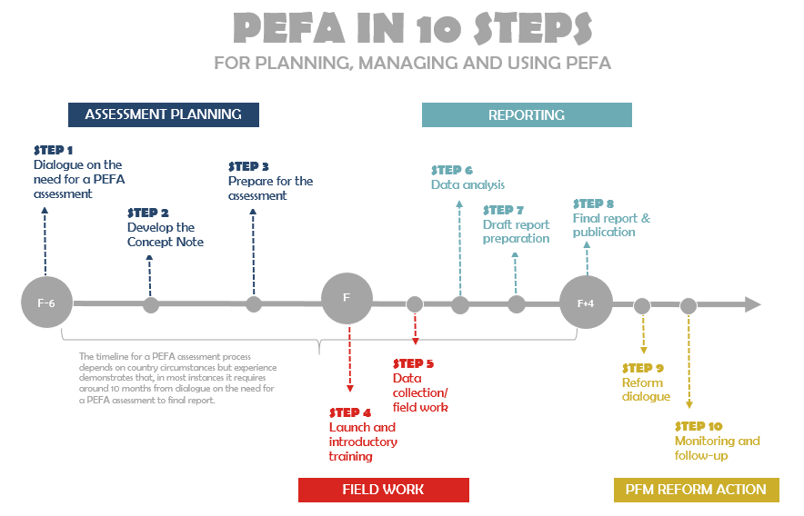

Slide 29
Content
The PEFA Framework
The high-level Indicator Set
Scoring Methodology
The PFM Performance Report

Slide 30
Standard set of high-level indicators: 7 pillars
I Budget reliability (1 – 3)
II Transparency of Public Finances (4 – 9)
III Management of Assets & Liabilities (10 – 13)
IV Policy-based fiscal strategy & budgeting (14 – 18)
V Predictability & Control in Budget Execution (19 – 26)
VI Accounting & Reporting (27 – 29)
VII External Scrutiny & Audit (30 – 31)

Slide 31
Overview
IV. Policy-based fiscal
strategy & budgeting
(PI:14-18)
II. Transparency of
public finances
(PI:4-9)
III. Management of
Assets & Liabilities
(PI:10-13)
VII.
External
scrutiny
and audit
(PI:30-31)
V.
Predictability
and control
in budget
execution
(PI:19-26)
I.
Budget
reliability
(PI:1-3)
VI.
Accounting, Recording
and Reporting
(PI:27-29)

Slide 32
What is different from 2011?
Indicators are re-organized & re-numbered under seven pillars (six ‘critical dimensions’ of 2011 + one)
Four new PIs: 11-PIM; 12-PAM; 14-MFF; 15-FS
Removal of 3 donor PIs;
3 revenue PIs reduced to 2, BUT scope extended
Every 2011 indicator links to at least one indicator in ‘Upgrade’ (except donor indicators)
Many new dimensions (was 76, now 94!)
(Scoring & report – see below!)

Slide 33
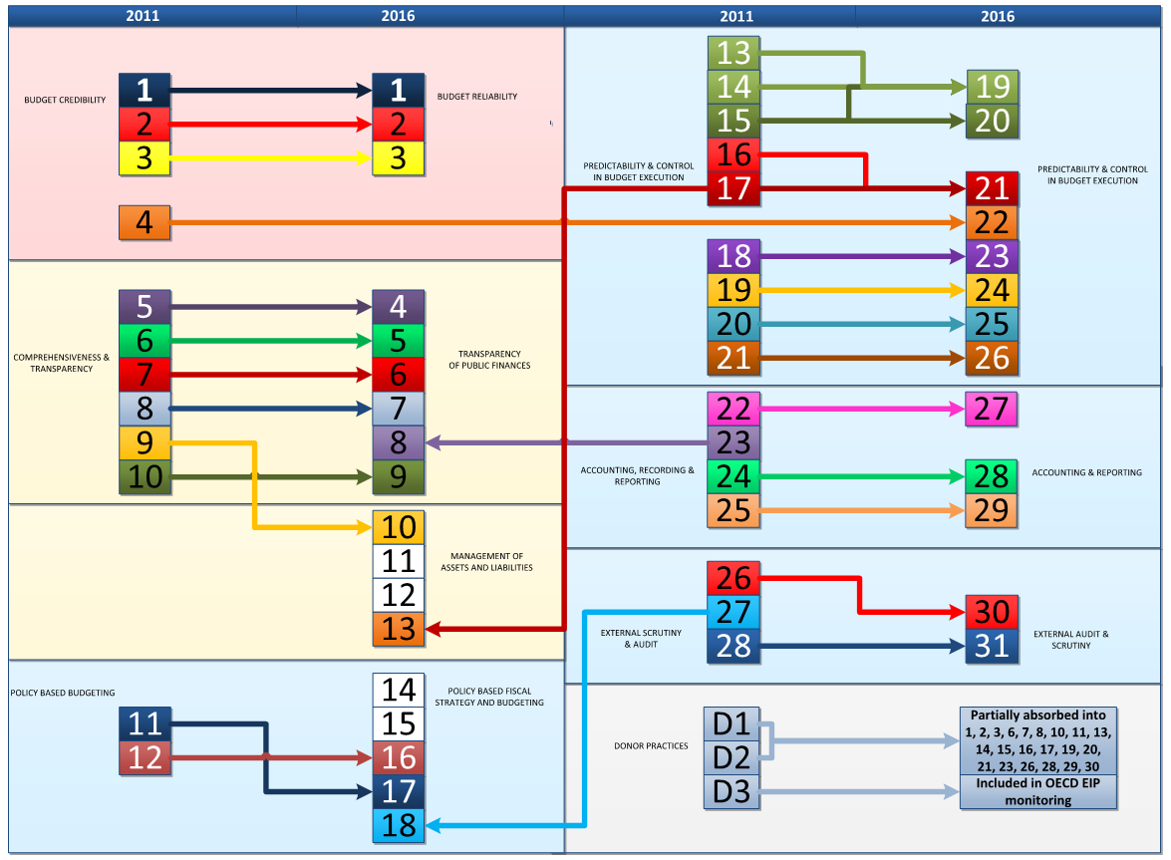
Links between 2011 & upgraded indicators

Slide 34
Interconnection of PIs – EG: Coverage of Internal Control
Often inadequately covered, despite importance for:
countries; to increase efficiency of expenditure & improve service delivery
donors; to help manage risk of misuse of funds & to achieve development objectives
Dedicated indicator PI-20 focuses on unique aspects of internal control not captured in other indicators, ie:
25.1. Segregation of duties
25.2. Effectiveness of expenditure commitment controls
25.3. Compliance with payment rules and procedures
Other indicators capture aspects of Internal control (but no ‘double jeopardy’!), & report section 4.2 & Annex 2

Slide 35
Content
The PEFA Framework
The high-level Indicator Set
Scoring Methodology
The PFM Performance Report

Slide 36
Calibration & scoring
Calibrated on 4 Point Cardinal Scale (A, B, C, D)
Evidence-based – use ‘Guidance’ issued by Secretariat
Do not score above ‘D’ if evidence is insufficient
Use of ‘D*’, only at dimension level
‘A’ reflects internationally accepted ‘good practice’
Determine score by starting from criteria for ‘C’ (= ‘basic’), then work upwards if evidence allows
Notes:
The scoring system is based on a four point ordinal scale (A, B, C, D).
Performance is measured against a calibration based on ‘internationally accepted good practice’ representing a score ‘A’. This is not necessarily the same as international ‘best practice’.
Sophisticated reforms such as performance based budgeting are not incorporated in the Framework, since the salient features of such reforms often lack international consensus. So ‘A’ ratings do not mean New Zealand standard of system.
Performance is not measured against the local legislation, because this legislation may not always represent internationally accepted good practice. E.g. PI-11(iii) on approval of the budget before the start of the fiscal year.
A numerical scale has deliberately been avoided in order to discourage simplistic numerical aggregation, which may serve only the purpose of cross-country comparison. Such cross-country comparison was not the purpose of developing the PEFA framework and therefore not the basis for its design.
Look at an indicator example in the blue booklet e.g. PI-19 pages 38-39. Note the 4 parts for each indicator: general description; definition of dimensions; calibration table with specific requirements for each score; scoring aggregation method.
It is useful to start scoring by considering the description of the D rating and whether the PFM system meets the requirements of a C rating. If so, would it also meet the criteria for a B rating etc. In this way, none of the requirements will be overlooked.
Do not score if evidence is insufficient. A ‘no score’ indicates a serious gap in information which the government should normally possess. This information gap should be a focus for improvement before the next assessment takes place. Do not score ‘D’ if there is no information available
Use of Arrow: (i) a performance change from last assessment , not reflected in the score (ii) a recent change in systems which is certain to have brought an improvement for which hard evidence is not yet available due to the time lag of obtaining such data – the use of arrows will increase as more repeat assessments come forward.

Slide 37
Calibration & scoring
Most indicators have 2, 3 or 4 dimensions (total: 94)
Each dimension must be rated separately
Aggregate dimension scores for indicator; two methods Weakest Link (M1) or AVerage (M2), SPECIFIED for each indicator*
Intermediate scores (B+, C+) for multi-dimensional indicators, where dimensions score differently
*For example: for PI with 3 dims rated A; B; C
If WL (e.g. PI-20): then score = C+
but if AV (e.g PI-25): then score = B (from table)
Notes:
The scoring system is base don a four point ordinal scale (A, B, C, D).
Performance is measured against a calibration based on ‘internationally accepted good practice’ representing a score ‘A’. This is not necessarily the same as international ‘best practice’.
Sophisticated reforms such as performance based budgeting are not incorporated in the Framework, since the salient features of such reforms often lack international consensus. So ‘A’ ratings do not mean New Zealand standard of system.
‘D’ represents poor/unsatisfactory performance. ‘C’ a rudimentary but crudely functioning system.
Performance is not measured against the local legislation, because this legislation may not always represent internationally accepted good practice. E.g. PI-11(iii) on approval of the budget before the start of the fiscal year.
A numerical scale has deliberately been avoided in order to discourage simplistic numerical aggregation, which may serve only the purpose of cross-country comparison. Such cross-country comparison was not the purpose of developing the PEFA framework and therefore not the basis for its design.
Look at an indicator example in the blue booklet e.g. PI-19 pages 38-39. Note the 4 parts for each indicator: general description; definition of dimensions; calibration table with specific requirements for each score; scoring aggregation method.
It is useful to start scoring by considering the description of the D rating and whether the PFM system meets the requirements of a C rating. If so, would it also meet the criteria for a B rating etc. In this way, none of the requirements will be overlooked.
Do not score if evidence is insufficient. A ‘no score’ indicates a serious gap in information which the government should normally possess. This information gap should be a focus for improvement before the next assessment takes place. Do not score ‘D’ if there is no information available
Use of Arrow: (i) a performance change from last assessment , not reflected in the score (ii) a recent change in systems which is certain to have brought an improvement for which hard evidence is not yet available due to the time lag of obtaining such data – the use of arrows will increase as more repeat assessments come forward.

Slide 38
Content
The PEFA Framework
The high-level Indicator Set
Scoring Methodology
The PFM Performance Report

Slide 39
The PFM Performance Report
Executive summary
Introduction
Country background information
Assessment of PFM systems
Conclusions from analysis of PFM system
Government PFM Reform Process
Annexes

Slide 40
Transitional arrangements - 4.4: Performance changes since previous assessment
For comparisons with previous assessments using PEFA 2005 or 2011, supplementary ‘Annex 4’ required to show what scores WOULD HAVE BEEN using earlier PEFA on current data (recalibrating previous assessment using PEFA 2016 NOT recommended)
Main performance changes between assessments, based on Annex 4, should be outlined in executive summary & discussed in more detail in section 4.4

Slide 41
Transitional arrangements – ‘Testing version’ 2015 to PEFA 2016
PEFA 2016: 31 PIs, 94 dims: testing 30 PIs & 90 dims. New PI-22, refinements to 14 PIs (simplifications; new dims; revisions; recalibrations; removal of negative references; alignment with GFS 2014). Hence:
50% of dims largely unchanged – no reassessment
25% of dims can be reassessed using same data
25% of dims require additional data to assess or reassess dimension (& indicator) scores
If report not finalized - countries may revise draft to use PEFA 2016
If report finalized – could be revised & re-issued as PEFA 2016, or addendum included with updated PI summary & explanation of requirements met

Slide 42
IN SUMMARY…..
A PEFA assessment provides a qualitative review of the 7 ‘pillars’ of a country’s PFM system using 31 indicators, based on ‘generally accepted good practice’
Each indicator is rated using an ordinal scale of A to D according to specific criteria, using defined evidence
Results are contextualized to evaluate the ability of the system to deliver fiscal discipline, allocate resources strategically and deliver services efficiently

Slide 43
Thank you for your attention: Questions?

