Slide 1
PEFA FRAMEWORK FOR ASSESSING PUBLIC FINANCIAL MANAGEMENT
Module 3:
The Assessment Process

Slide 2
Content
PEFA in 10 steps
Stakeholders
Scope of assessment: Concept Note/TOR
Resource requirements & mobilization
Quality Assurance: PEFA CHECK
Disclosure of final reports

Slide 3
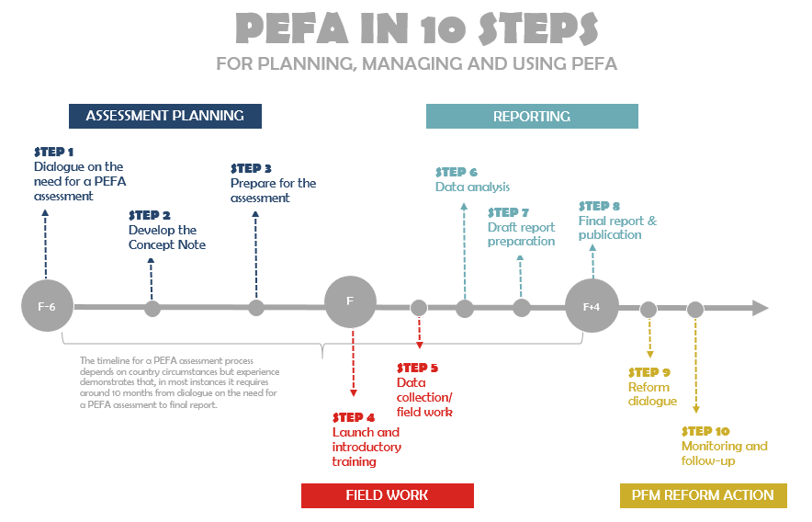

Slide 4
10 steps for planning, implementing & using PEFA
A–Assessment Planning | Dialogue on need for PEFA assessment Develop Concept Note/ToR Prepare for assessment & identify what is needed to achieve objectives
B–Fieldwork | Launch introductory training Data collection/fieldwork
C–Reporting | Data analysis Draft assessment report preparation
D–PFM Reform Action | Final report & publication Reform dialogue Monitoring & follow-up

Slide 5
Checklist for assessment CN/ToR*
Background & context
Purpose of the assessment
Involvement of stakeholders in assessment
Methodology for undertaking assessment
Reporting
Consultation & follow up
Implementation schedule & deliverables
Team composition & Inputs
* N.B. Guidance from Secretariat, on website

Slide 6
Stakeholders
Government: Determined by interest & capacity (& expectations: comparisons with neighbours?)
Self-assessment (with external Int Agency validation)
Joint assessment (joint team)
Collaboration with IA-led assessment
International Agency: collaboration often partial unless PFM or budget support group operating effectively, but…
Other Stakeholders
Supreme Audit Institution
Legislature
Civil Society & Private Sector Organizations

Slide 7
Roles & responsibilities
In every case, Government has to:
Participate in Oversight Team
Provide ‘Assessment Manager’
Provide information / assist with data collection
Participate in workshops
Review & comment on draft reports
Other Stakeholders
Development partners (whether contributing or not)
Parliament
SAI
Civil Society (?)

Slide 8
Oversight Team
Govt, Donors & other stakeholders should create Oversight Team, to:
ensure needs & issues of all parties addressed
lead to a consensus regarding findings
Appoint Assessment Manager, who will:
Ensure Concept Note/TOR reviewed & approved
Ensure resources are mobilized
Liase with & support Assessment Team ‘on the ground’
Adhere to QA arrangements
Disclose final report (& potential use of report)
Notes:
The PEFA approach should be based on coordination among donors and with the government counterparts. Donor coordination should be an essential element in the process (Good practice coordination: Guyana).
When a PEFA assessment is taken into consideration, purpose, content and process (including quality assurance) between Government focal points partners and lead development partners should be discussed and explained. This includes a discussion with representatives of the MOF and key line ministries as well. To the extent possible, members of Parliament (and/or the political leadership) and representatives of the Supreme Audit Institution should participate in the discussions. When these discussions are carried out, the PEFA framework (and PEFA assessments of other countries) should be distributed and referred to.
Existing PFM diagnostics should be referred to during the PEFA exercise.
The PFM report should identify the share of public expenditures that is made by central government and the latter should help with the information.
Elaboration of concept notes and TOR should be a collaborative efforts.
Resources required to undertake a PEFA based PFM assessment should not be under-estimated. Resources needed for a PEFA assessment should include personnel for assessment preparation, management and implementation as well as resources from Government, donor agencies and from the PEFA Secretariat.
The identification of stakeholders (mainly Government, donors including lead donor, consultants, other stakeholders and the PEFA Secretariat) and how they have to be involved in the assessment have to be clearly emphasized in the TOR.
Individual steps or stages in implementing the assessment should be known as well as outputs to be produced in connection with each stage of the assessment and the timetable for these. The number and duration of field missions as well as the timing and purpose of any workshops prior to, during and after the field work should also be known.
The monitoring of progress has to be carried out by the lead donor mainly. It consists for the lead donor to interact on a regular basis with the team of assessors to make sure that activities are carried out timely (deadlines are met) and in conformity with the TOR. In order for the process to be facilitated the assessment has to be implemented in a reasonable period of time.
Quality review mechanisms need as well to involve all interested donors and the partner government. Best practices call for PEFA reviews to be wide review process involving main interested donors, the Government and at different stages of the process the PEFA Secretariat (for the methodological aspects).
Once finalised, the report should be made public and made available to anyone that requests the information. That is what a “shared information pool” is about. If possible include in the TOR.
The Government should be open to discussions on the possibility of incorporating the PEFA indicators in their own M & E system and the donors should promote such discussions. Donor agencies may devise standard methods of risk assessment based on PEFA indicator ratings.
Last update Feb, 16 2010

Slide 9
Agreeing definitions
Why define?
Many comments on drafts caused by different perceptions of what is assessed – need clarity on: Scope; Transparency; Sharing of findings & results; Consistency across PIs & over time
Identify coverage per dimension (in Guidance)
Which definitions?
Central government (GFS?); AGAs; P Enterprises
Expenditure Arrears
Sub-National governments vs. Deconcentrated
Extra-budgetary activity
Notes:
It is important to understand and agree definitions and use them consistently.
Per IMF-GFS, Budgetary Central Govt is what is contained in the main annual budget document.
Government activities are also carried out by bodies legally separated from the government (AGAs) and by budgetary agencies from their own revenues. Both categories are EBAs. But where is the line between AGAs and government business enterprises ? Do you include Quasi-fiscal operations undertaken by government business enterprises ? Or Tax expenditures ?
SN governments have locally elected councils and are legally separate from CG. Deconcentrated admin bodies are local offices of CG MDAs, not legally separate from CG.
Per GFS 1986 (cash basis), expenditure includes net (policy) lending. The GFS 2001 (accrual basis) counts all lending as financing.
Arrears are government liabilities for unpaid salaries, unpaid interest and purchases of goods and services (recurrent + capital) which are past their due dates of payment (commonly taken as >30 days old). Calculation of arrears depends on (1) an accrual basis of accounting, to capture liabilities, and (2) age analysis of liabilities. Both are rare in practice. (example Mali: arrears defined very restrictively by a PRGF agreement between government and IMF; arrears defined in a much broader by the UEMOA which the government had signed up to. Score entirely depended on which definition was chosen).
Budget Execution – be sure to understand how government reports budget execution and whether this would give rise to anomalies. Some governments include commitments (not accrued expenditure) in reported expenditure – should this be adjusted for and if so how will the adjustment be made. Other governments allow line agencies to transfer unspent funds at the year end into “carry over” accounts and count this as executed expenditure – again how should this be catered for – what adjustments might be needed to get a real picture of budget execution ?

Slide 10
Sources of information
Ministry of Finance : Budget directorate, Revenue Agency(s), Internal Audit, Accountant General’s Office;
Parliament : Public Accounts Committee, Clerk, Budget & Finance Committee
Supreme Audit Institution
Line ministries, AGAs & Local governments
Courts
Private sector : Tax lawyers, accountants, C of Commerce
NGOs &Associations (Interest Groups)
See PEFA ‘Handbook’, for coverage of each indicator

Slide 11
Resources
No standard answer - each country different! Depends on: scope; extent of recent related work; size of country & Govt; Govt participation; ease of access to information; language
Personnel
For assessment preparation, management & implementation: Govt, donor agencies, consultants
Financial
Donor budgets; External inputs, consultants, Workshops

Slide 12
Who contributes what?
Government will decide on personnel it can contribute
Each Int Agency to decide personnel resources/budgets it can make available
External resources may be provided by one agency or shared among several
Maintain flexibility
Allocate substantial resources for follow-up work
Resource backup if output is unsatisfactory & needs further work/additional expertise

Slide 13
Composition & Management of AT
Multi-skilled team: covering full range of indicators: Planning & Budgeting, Accounting & Auditing, Procurement & Tax administration (‘part-time’ specialists?)
PEFA-experienced team member (Leader?): International & local consultants: assessment process needs coordination of activity & methodological consistency
Costs & resource use:
Average $250,000
Average 150 professional labor days (90-275): elapsed time +/- 10 months
Volume linked to size of country
Notes:
Early experience shows steep learning curve for new PEFA assessors; both for consultants and donor agency team leaders who undertook more than one assessment.
Specialist team members can often be mobilized locally thus minimizing travel time and logistics costs e.g. the World Bank has procurement specialists in many country offices and a tax specialist may be drawn from one of the major accounting/audit firms (ref. Mauritius).
Monitoring of applications during 2005-2006 shows the strong impact on report quality by having a team leader (or at least an important member) with previous PEFA experience.

Slide 14
Typical time allocation for AT
 |  | AT | days
Off Site | Assessment planning | 3 or 4 | 5
Field Mission | Introductory training Data collection – interviews | All | 15
Off Site | Data analysis Preparation of Draft report | All | 10
(Country) | Reviewers comments | - | Month?
2nd Field Mission | Additional data collection & analysis ‘Presentation’ workshop | All | 10
Off Site | Revised draft report | TL? | 10
Off Site | Review by PEFA Secretariat & others | - | 10
Off Site | Incorporation of comments & production of final document, including PEFA Check | TL | 5

Slide 15
Requirements for a credible report
Adherence to PEFA methodology
Data/Information must be adequate & correct
Quality of Section 4
4.1 ‘Conclusions of analysis of PFM systems’
4.2 Effectiveness of Internal Control framework
4.3 PFM strengths & weaknesses (& implications for achieving budgetary outcomes)
Structure, logic & language: key messages
Timeliness & availability

Slide 16
Is a report credible?
A good report: accurately reflects operation of PFM system in the country; meets Framework objectives & satisfies intended use
A poor report
Done to, rather than with, Govt
Lack of agreement on country situation
Fails to capture strengths & weaknesses in PFM system
Not sufficiently specific to track progress

Slide 17
PEFA CHECK
Enhanced Quality Assurance for PEFA Assessments
PEFA CHECK seeks to:
Increase trust of users in quality of reports
Enforce good practices: creates incentive to comply in preparation & implementation of an assessment, based on 6 criteria = “Process quality endorsement”

Slide 18
PEFA CHECK: criteria
1 Concept Note (CN or ToR) follows peer review process, involving at least 4 PFM institutions (Govt & PEFA Secretariat, plus 2 others: e.g. international agencies, PFM related NGOs, civil society) before fieldwork: final version shared with all reviewers
2 Complete draft report submitted to all reviewers
3 Revised draft report & separate matrix with reviewers comments & AT responses submitted to all reviewers: PEFA Secretariat evaluates if comments addressed
4 Assessment management & QA arrangements described in report including clear reference to follow-up review

Slide 19
Assessment management & QA
1 PEFA assessment management organization
Oversight Team*: Assessment Manager*: Ass’nt Team*
2 Review of CN/ToR
Date of review: Invited reviewers*: Reviewers who commented*: Date(s) of final CN/ToR
3 Review of assessment report
Date(s) of reviewed draft report(s): Invited reviewers*: esp. PEFA Secretariat & date(s) of its review(s): Reviewers who provided comments*
*name & organization for each, or as group e.g. ‘Oversight Team’

Slide 20
Report disclosure
A ‘common information pool’ means general access to final reports – many potential users
Public access, usually by posting on a website if allowed by Government
When informed, PEFA Secretariat will include on website

Slide 21
IN SUMMARY….
PEFA is a collaborative exercise: requires careful planning & extensive consultation with Govt, donors, civil society (& PEFA Secretariat!): ensure CN/ToR captures all relevant issues & that QA is built into process from start
Successful outcome more likely if there are workshops: to start the process (to prepare for interviews & the provision of evidence); & at end to review the draft Report
Publication is expression of transparency by Govt, & should assist policy dialogue among stakeholders (which will also consider factors beyond PEFA to develop realistic expectations for the sequence & pace of reforms

Slide 22
Thank you for your attention: Questions?

