Slide 1
PEFA FRAMEWORK FOR ASSESSING PUBLIC FINANCIAL MANAGEMENT
Module 7:
Sub-National Governments;
Sector-level analysis;
Other PFM Diagnostic tools

Slide 2
Content
Sub-national Governments
Sector-level analysis
Other PFM diagnostic tools

Slide 3
Content
Sub-national Governments
Sector-level analysis
Other PFM diagnostic tools

Slide 4
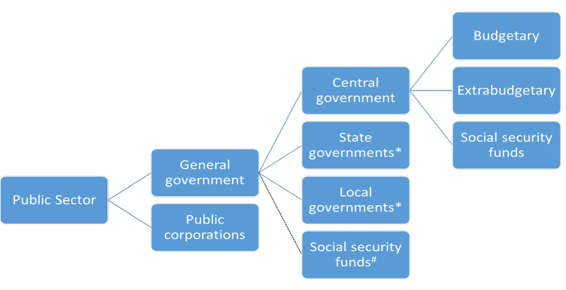
Structure of the Public Sector
Source: excerpt from IMF (2014), Government Finance Statistics Manual 2014

Slide 5
Sub-National PEFA Assessments
Increasing trend: now 1/3 of all assessments are ‘SNGs’ – State, province, region, canton, district, city…
Reasons for undertaking vary, need may be from:
  SNG (e.g. public service delivery, borrowing power)
  CG (e.g. political dialogue, oversight, reform)
  donors (e.g. fiduciary risk, loans etc.)
Approaches differ:
  single entity,
  sample of entities at same level
  sample of entities at different levels

Slide 6
Definition of SN Gov’t, ex GFSM 2014
SNG ... has authority to levy taxes ... within its area of jurisdiction (but not beyond). It must also be entitled to spend or allocate some, or all, of taxes or other revenue that it receives according to its own policies, within general rules of law of the country, although some of transfers it receives from central government may be tied to certain specified purposes. It should also be able to appoint its own officers, independently of external administrative control.

Slide 7
Problems using PEFA at SNG level
SNG so heterogeneous: how to compare?
Scope of indicators (e.g. revenue; transfers from national govt; fiscal risks; also PIs 5 & 9)
Difficulties in distinguishing national & SN performance features (‘boundaries’)
Indicator HLG-1 not included
Local assessors/consultants with no prior PEFA experience
Integration with National Assessment

Slide 8
Structural Models
Almost every country has unique structure, determined by historical & political circumstances
Variations may relate to:
  Federal vs Unitary states
  Symmetrical vs Asymmetrical federalism
  Federal units covering all vs part of a country
  Francophone vs Anglophone decentralization
Notes:
Federation – a union comprising a number of partially self-governing states (or regions or provinces or cantons) united by a central/federal government. These states typically have their own constitutions which can be amended without recourse to the federation.
Semi-autonomous states may cover all or only part of a country
Symmetrical federalism – all entities have same status versus Asymmetrical
Examples of Asymmetrical federalism – England, Scotland, Wales and Northern Ireland within the UK.
Mainland (Tanganyika) and Zanzibar within Tanzania
Part of country not covered by federal units - DC is not a state within the USA federation
Anglophone decentralisation – elected local governments mainly accountable to the local electorate
Francophone decentralisation – provincial government units governed by officials appointed by central government, mainly accountable to central government – “central government at the local level”

Slide 9
Sub-National Assessments
Political & Admin Decentralization: accountability; oversight
Fiscal decentralization: Service obligations / Expenditure assignments (Central: typically, defense; SNG: typically, primary services, e.g. health) but some services split between levels of govt: also, parallel structures
Financing
Revenue assignments (often not called ‘tax’ even if it is)
Shared revenue – collected by central or SN govt
Grants from higher level government
Borrowing

Slide 10
Purpose of the Assessment
Inform PFM reform & track progress
Central government
Single (or multiple) sub-national government(s) Region, Province, State, Municipality, District etc
Satisfy fiduciary requirements (FRA)
Limited or no decentralization – Central government
Sub-national government receives significant transfers from the center & has significant responsibility for service delivery – Central government plus one or two levels of SN government
Notes:
What are PEFA assessments at the SN level used for (their purpose) and how does that link to the typical central (or national) government assessment?

Slide 11
Adaptation of PEFA Framework
Two types of SN Assessments
One SN entity - Primary Purpose: inform entity’s reform formulation & track progress: unrelated to national assessment: Resource inputs high
Sample of entities - Primary Purpose: inform national reform formulation & donor fiduciary needs: related to national assessment: Resource inputs are lower for each entity, but high in total
For use at SN level:
Extra indicator “Higher-Level Government 1” (HLG-1)
Annex to Assessment Report (providing ‘Profile’)

Slide 12
Additional Indicator HLG-1
Additional indicator required: HLG-1, 3 dims:
HLG-1.1 Outturn of transfers from HLG
HLG-1.2 Earmarked grants outturn
HLG1.3 Timeliness of transfers from HLG
Audit & legislature PIs need careful consideration to distinguish national/local oversight, & terminology aligned with local institutions

Slide 13
Include profile of SN as Annex in report
SN government structure (with Table showing: Corporate body? Own political leadership? Approves own budget? No. of jurisdictions; Ave pop; % of public expenditure; % of public revenues; % funded by transfers
Main functional responsibilities of SN government
SN budgetary systems
SN fiscal systems (with Table providing overview of SNG finances)
SN institutional (political & administrative) structures

Slide 14
Content
Sub-national Governments
Sector-level analysis
Other PFM diagnostic tools

Slide 15
PEFA at the Sector level
Donor may require comfort before committing funds to specific sector such as health; agriculture
“Adaptation” of PEFA indicators
Applicability?
  Some indicators clearly ‘national’
  Others not sufficiently sensitive
Indicator set designed to provide overview of system, so if not all used, result only partial
Examples: Egypt x 3; Mozambique

Slide 16
Using PEFA to assess a sector
Issues/queries to be addressed:
Do donor funds reach the sector from Treasury?
Are planning & budgeting processes:
  Robust, & ensure funds will reach priorities?
  Allowing appropriate political engagement
  Well-organised & timely?
Does composition of expenditure outturn match approved budget?
Is adequate budgetary information available, in a timely fashion?
Is in-year spending flexibility allowed?
Are transfers to SN levels & between sector institutions transparent?
What controls exist to ensure budgetary changes are appropriately authorised, recorded & reported

Slide 17
A ‘sectoral’ application
PI* | Description | Measure | S1 | S2 | S3 | S4
1 | Variance: Budget expenditures vs. actual expend over 3 years | Variance from Budget (%) | C | D | Poor | A
22 | Timeliness & regularity of accounts reconciliation | Regularity of bank recs & clearance of advances & suspense | B | B | Did not rate | Did not rate
23 | Availability of info on resources received by service delivery units | Info on resources actually received by service delivery units | B | B | B | B
24 | Quality & timeliness of in-year budget reports for sector | Scope & coverage of reports; timeliness & quality of data | C | C | B | B

Slide 18
A sector suggestion
PEFA | Sector-specific indicator
PI-1 & 2 | SI-1. Sector exp out-turn: SI-2 Composition of sector exp vs. original app’d budget
PI-4 | SI-3. Stock & monitoring of expenditure payment arrears payment arrears in sector
PI-7 | SI-4. Extent of unreported government operations in sector
PI-8 | SI-5. Transparency of inter-governmental fiscal relations within sector
PI-11 | SI-6. Orderliness & participation in annual budget process within sector
PI-12 | SI-7. Multi-year perspective in sector expenditure policy & budgeting
NEW | SI-8. Sector-specific revenue from service fees
PI-16 | SI-9. Predictability in availability of funds for commitment of expenditures
PI-18 | SI-10. Effectiveness of sector payroll controls
PI-19 Split | SI-11. Competition & value for money in procurement; SI-12. Controls in proc’ment SI-13. Controls of procured goods
PI-20 | SI-14. Effectiveness of internal controls for non- salary expenditure
PI-21 | SI-15. Effectiveness of internal audit within sector
PI-23 | SI-16. Availability of information on resources received by service delivery units
PI-24 | SI-17. Quality & timeliness of in-year sector budget reports
PI-26 | SI-18. Scope, nature & follow-up of external audit
PI-27 | SI-19. Legislative scrutiny of annual budget law by sector committees
PI-28 | SI-20. Legislative scrutiny of external audit reports relating to sector

Slide 19
Content
Sub-national Governments
Sector-level analysis
Other PFM diagnostic tools

Slide 20
Other PFM diagnostic tools, including ‘Drill downs’
Range of diagnostic tools
PEFA linkages with other tools
‘Drill-downs’

Slide 21
Other PFM tools

Slide 22
SIGMA – Principles of Public Admin
 | Qualitative indicators (56) | Quantitative indicators (102)
Strategic framework of PAR* | 3 | 10
Policy development & co-ordination | 12 | 13
Public service and HRM* | 11 | 16
Accountability | 4 | 17
Service delivery | 3 | 13
Public financial management | 23 | 33
Around ½ are similar to PEFA dimensions

Slide 23
Public Expenditure Reviews (PER)
To strengthen budgetary analysis & processes in country concerned, so as to achieve a better focus on growth & poverty reduction
To assess a country’s public expenditure program, to meet accountability requirements & provide government with external view of budget

Slide 24
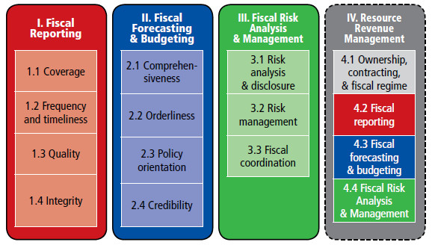
Fiscal Transparency Evaluation - IMF

Slide 25







TADAT – Tax Administration Diagnostic Assessment Tool
TADAT is supported by international development partners & institutions, including EC, Germany, IMF, Japan, Netherlands, Norway, Switzerland, UK & WB
http://www.tadat.org/
Piloted in several countries from late 2013 – now in use

Slide 26
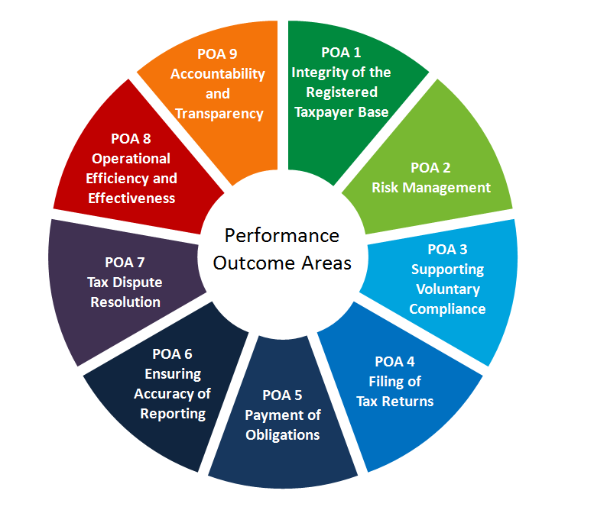
TADAT
The tax administration is transparent in the conduct of its activities and accountable to the government and the community.
All businesses, individuals, and other entities that are required to register are included in a taxpayer registration database. Information held in the database is complete and accurate.
Tax administration operations are efficient and effective in performing key functions and achieving expected outcomes.
The tax administration’s management of compliance risks results in higher levels of voluntary compliance and community confidence in the tax administration.
The tax dispute resolution process is independent, accessible to taxpayers, and effective in resolving disputed matters in a timely manner.
Taxpayers have the necessary information and support to voluntarily comply at a reasonable cost to themselves.
Taxpayers report complete and accurate information in their tax returns.
Taxpayers file returns on time.
Taxpayers pay their taxes in full on time.

Slide 27
INTEGRATED ASSESSMENT MODEL FOR TAX ADMINISTRATION (IAMTAX)
The model recently developed by WB is made available to tax administrations: assesses & monitors performance of tax administration over time
The measurement framework of IAMTAX can be used both as a benchmarking tool and a monitoring and diagnostic tool
http://www.iamtax.org/IAMTAX/

Slide 28
Measuring Procurement Performance
OECD/DAC & World Bank Joint Procurement Roundtable developed detailed procurement benchmarking & measurement tools: WHY? To:
provide international standards & stop imposing individual donor standards
facilitate integration of CPAR with strengthened approach to PFM
OECD/DAC Procurement Indicators: 4 Pillars, 12 Indicators, 55 sub-Indicators
Legislative & Regulatory Framework
Institutional Framework & Management Capacity
Procurement Operations & Market Practices
Integrity of Public Procurement System

Slide 29
Public Investment Management Assessment (PIMA)

Slide 30
Debt Management Performance
Assessment Tool (DeMPA)
Modeled on PEFA: 16 indicators, 34 dimensions,
Governance & Strategy Development
Coordination with Macroeconomic Policies
Borrowing & Related Financing Activities
Cash Flow Forecasting & Cash Balance Management
Operational Risk Management
Debt Records and Reporting

Slide 31

Purposes of these tools
 | PEFA | ECFIN/ OA | PER | PETS | MAPS | DeMPA | TADAT
Identification of PFM strengths & weaknesses | X | X | X | X |  | X
Focused on part of the Budget Cycle |  |  | X | X | X | X | X
Integrated Focus | X | X
In-depth analysis of capacity factors |  |  | X |  | X |  | X
Recommendations for reform |  | X | X | X
Assess fiduciary risk to public/external funds |  | X
Track progress over time | X |  |  |  | X | X | X

Slide 32
In Summary….
Significant use of PEFA in SNGs in last few years, but vital to describe context when assessing a SNG entity
PEFA can be applied at the sector level, BUT….
Many other tools still in place
Specific diagnostic tools – relatives of PEFA – for tax administration (IAMTAX; TADAT), for debt management (DEMPA) & for public procurement systems (OECD DAC)

Slide 33
Thank you for your attention:
Questions?

