Slide 1

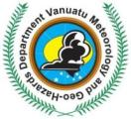
Disaster Risk Management and Climate Change Adaptation in Vanuatu
Given by: Honourable Minister of Lands, Ralph Regenvanu Date: 07 July 2014
ACP/EU Presentation
Vanuatu Ministry of Lands and Natural Resources
Vanuatu Ministry of Climate Change and Natural Disasters

Slide 2
Overview
Vanuatu: a multi-disasters prone country
Vanuatu Risk Profile
Risk Assessment and Evaluation
Risk Information Management
Warning Dissemination Strategy
An example of National Risk Management: Urban Risk Planning

Slide 3
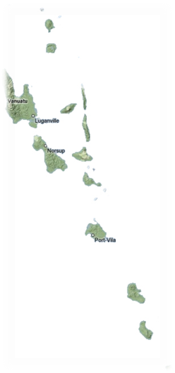
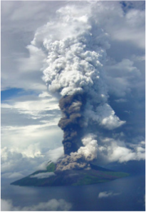
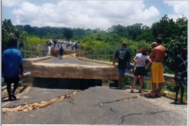
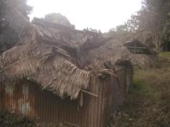
Vanuatu: a multi-disasters prone country
Vanuatu is a group of 84 islands (most of them are inhabited) within 12,189 sq km land area
Around 250,000 people (2009 census)
Located on the tropical cyclone belt (average of 4 tropical cyclones per year)
Close to a warm pool (ENSO for 3 to 7 years)
Temperature already changed by 0.2 degree Celsius (PACCSP, 2012)
Temperature for Vanuatu is projected to rise between 0.4 to 1 degree Celsius and sea level rise between 3 to 17cm by 2030 (PACCSP, 2012, High level scenario)
Belongs to the “Pacific Ring of Fire”
  Currently 6 active volcanoes with an average of one volcanic crisis per year
  Average of 300 earthquakes recorded per month, one earthquake of M 7.0 every year
  Average of one significant tsunami (wave >1m) every 10 years

Slide 4
Vanuatu Risk Profile
The UN (2010) reported an increase in the frequency and intensity of natural disasters, particularly storms and floods, in SIDS. The EMDAT Disaster Database also shows a clear increase in the number of natural disasters occurring in the SIDS between 1970 and 2010.
Over 110 disasters affected the Pacific regions, respectively, between 2000 and 2011 (UNISDR 2013). The World Risk Index presented in the 2012 World Risk Report (UNU 2012) identifies global disaster risk hotspots where high exposure to natural hazards and climate change coincides with very vulnerable societies.
Among the 15 countries with the highest risk worldwide, eight are island states, with Vanuatu and Tonga in the top two positions.

Slide 5
Vanuatu Risk Profile
Vanuatu is expected to incur, on average, 48 million USD per year in losses due to earthquakes and tropical cyclones
Replacement value of all the assets in Vanuatu is 3.3 billion USD, of which about 86.5% represents buildings and 12.5% represents infrastructure
In the next 50 years, Vanuatu has :
  50% chance of experiencing a loss exceeding 330 million USD and casualties larger than 725 people
  10% chance of experiencing a loss exceeding 540 million USD and casualties larger than 2,150 people
A tropical cyclone loss exceeding 312 million USD, which is equivalent to about 43% of Vanuatu’s GDP, is to be expected, on average, once every 100 years (Source PCRAFI)

Slide 6
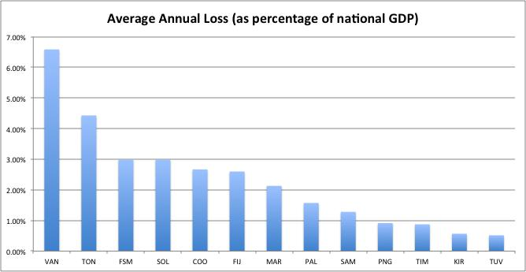
Vanuatu Risk Profile
Almost 7 percent of GDP lost every year because of natural disasters (on average)
(Source PCRAFI)

Slide 7
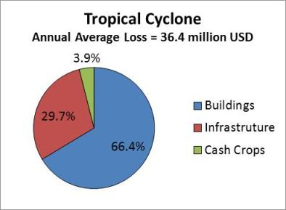
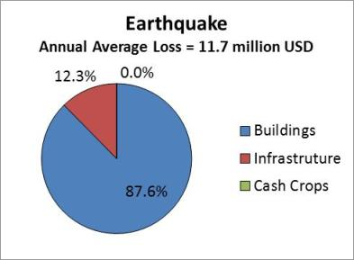
Vanuatu Risk Profile
(Source PCRAFI)

Slide 8
Risk Assessment and Evaluation
Institutional Arrangement in Vanuatu regarding disaster risk management
In 2006, Vanuatu created a 10 year National Action Plan (NAP) under the National Disaster Risk Reduction and Disaster Management Action Plan and Implementation Strategies (2006-2016). In particular:
  Strategy 1: Strengthen national policy, legislative, organizational and decision making arrangements for coordinated and effective DRR&DRM
  Strategy 2: Mainstream DRM&DM into national macroeconomic policy and fiscal management and national budgetary processes

Slide 9
Risk Assessment and Evaluation
In 2007, National Adaptation Program of Action (NAPA) was formulated setting the adaptation priorities for Vanuatu
In 2010, Vanuatu has improved its hazard monitoring and warning services and has taken the lead within the region in creating a National Hazards Observatory housing the newly established Vanuatu Meteorological and Geo-hazards Department (VGMD) as well as the National Disaster Management Office (NDMO)

Slide 10
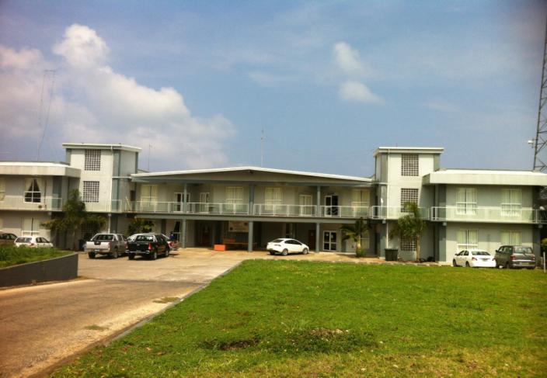
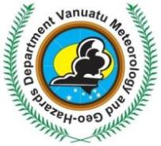
Risk Assessment and Evaluation

Slide 11
Risk Assessment and Evaluation
In 2012, the Department also houses the newly formed National Advisory Board on Climate Change and Disaster Risk Reduction Project Management Unit (NAB/PMU). The NAB/PMU reports to both VMGD and NDMO
In 2013, the creation of the Ministry of Climate Change and Natural Disasters finalize the objectives of the NAP by enforcing the needs of a common authority for Climate Change Adaptation and Disaster Risk Reduction

Slide 12
Risk Assessment and Evaluation
VMGD
NDMO
OBSERVATION
IT & ENGINEERNG
WEATHER FORECASTING
Tropical Cyclones
Flooding
Severe Weather
ADVISORY COORDINATION
RESPONSE
RECOVERY
24 Hrs Operations
GEOHAZARDS
Tsunamis
Volcanic Eruptions
Earthquakes
CLIMATE
Drought
ENSO Alert System
CLIMATE CHANGE
Climate Change Impacts
Vanuatu Multi-hazards and Emergency Management

Slide 13
Risk Information Management
How risk information is managed
by the Vanuatu Government
The risk information is driven by a ”Two way information and communication strategy” based on the real-time Monitoring of multi hazards in one way and near real-time Dissemination of information to the communities in the way back
This strategy is sealed by the VMGD Communications, Engagement and Partnership Strategy for 2012-2017

Slide 14
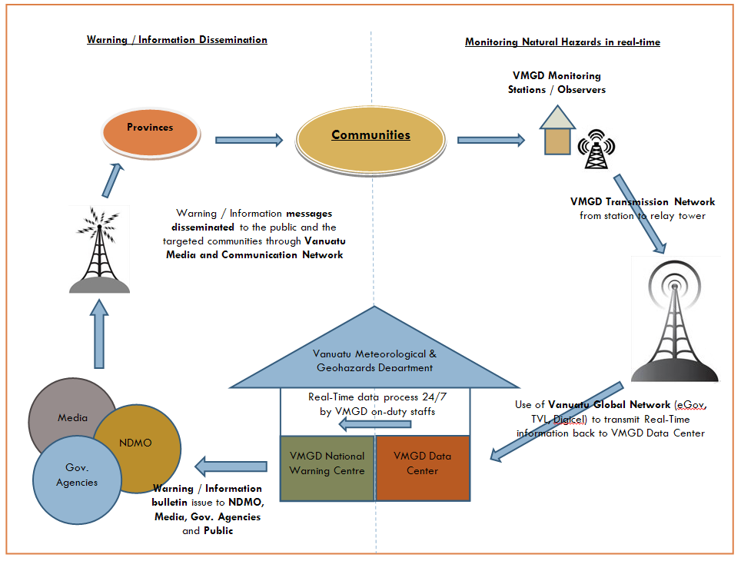
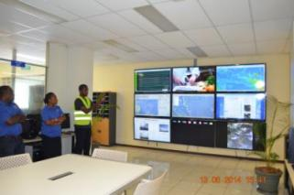

Slide 15
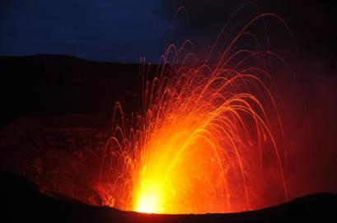
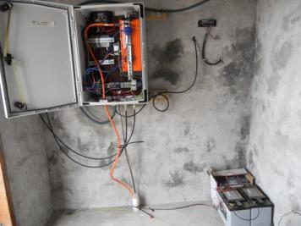
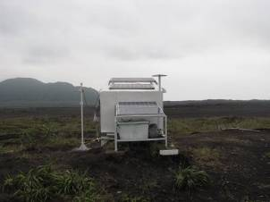
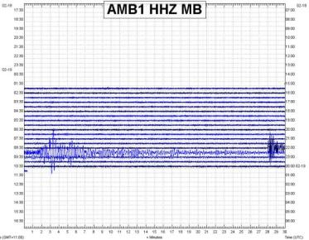
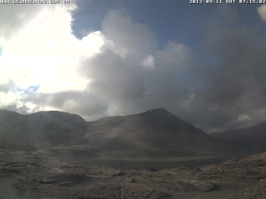
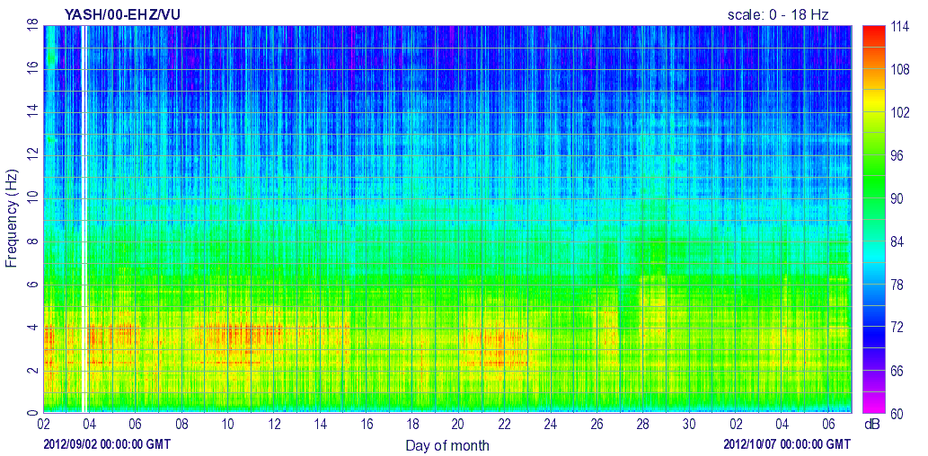
Improvement of the Vanuatu capacity for multi-hazards monitoring: IRCCNH Project (ACP/EU funds)
Volcanic Activity monitored by local stations connected to the National Warning Centre 24/7

Slide 16
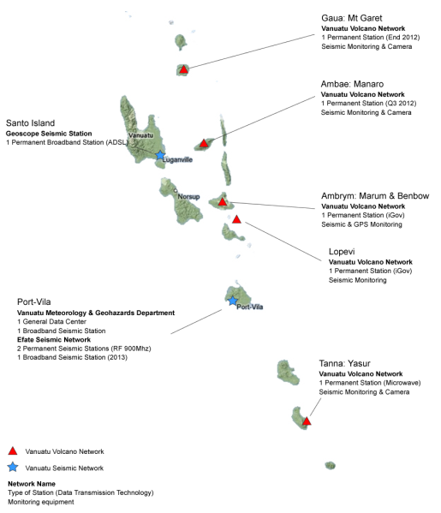
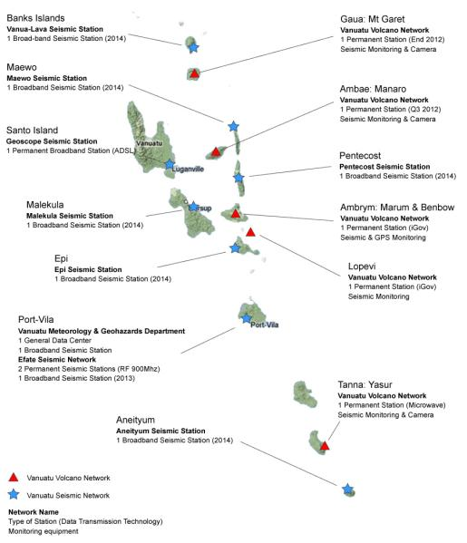
Improvement of the Vanuatu capacity for multi-hazards monitoring: IRCCNH Project (ACP/EU funds)
Going from 3 real-time multi-hazards monitoring stations to more than 15 at the end of 2015

Slide 17
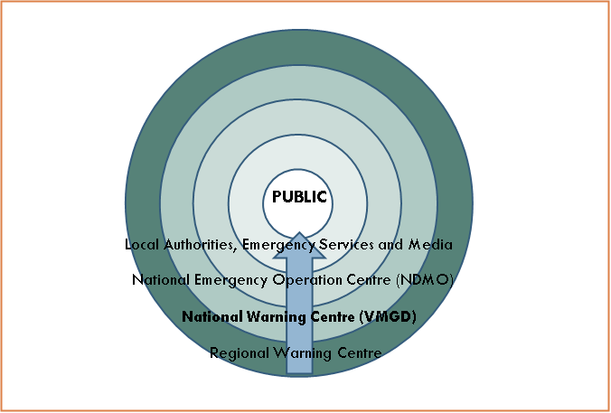
Risk Information Management

Slide 18
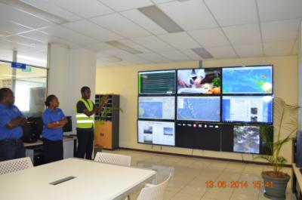
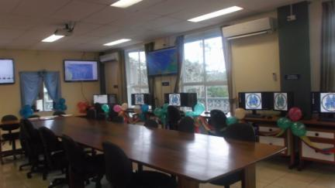
Warning Dissemination Strategy
“Reaching the Last Mile in case of Emergency”
With the National Warning Centre (VMGD) …
… and the National Disaster Operational Centre (NDMO).

Slide 19
Warning Dissemination Strategy
An information disseminate in real-time : A strategy in 3 parts
Local Alert System (e.g. sirens, bells, …)
Media Broadcast
(e.g. TV and Radio broadcast)
Messaging and Connected Broadcast System
(e.g. SMS, Facebook, Twitter, Website and others, …)
No matter the technology, the most important goal is to reach “the last mile”

Slide 20
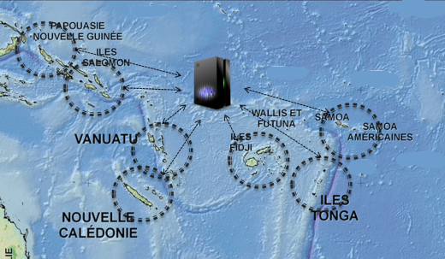
Disaster Management Regional Initiative

Slide 21
Disaster Risk Management Regionalization Strategy
Through different regional programs (ORSNET, MVN, …) South West Pacific Islands countries agreed to regionalize their Disaster Risk Management in order to:
Have a common set of multi-hazards monitoring equipment (sustainability)
Have a common ICT strategy :
  Free access to National communication system for Disaster Risk Management
  Use of a common network communication system
  Use of a common framework for Warning Dissemination System
Create a Regional Institutional Arrangement to sustain the idea of data and capacity sharing

Slide 22
Disaster Risk Management Regionalization Strategy
Regional Initiative : Vanuatu taking the lead
Oceania Regional Seismic NETwork (ORSNET): Regional initiative for Earthquake and Tsunami Risk Mitigation
Regional Telecom and Radiocommunications Regulations initiative for available and free communications in time of Disaster
Melanesian Volcanic Network (MVN): Regional initiative for Volcanic Risk Mitigation (Vanuatu, Solomon Islands and PNG)

Slide 23
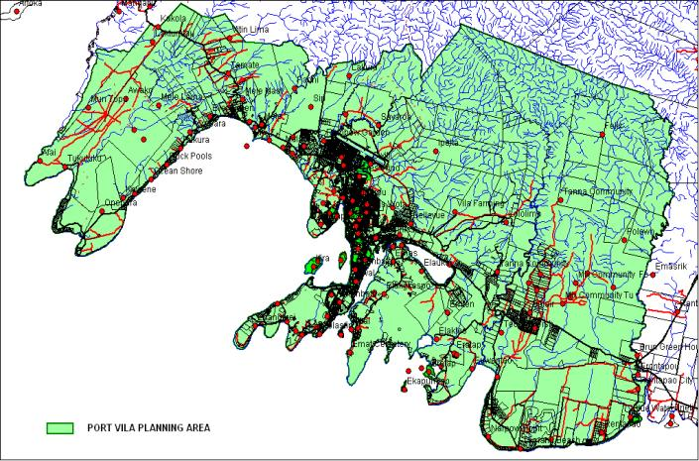
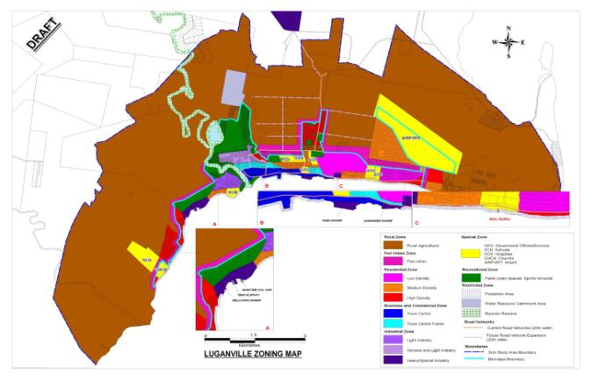
Urban Risk Planning
An example of Urban Development Program:
the Mainstreaming Disaster Risk Reduction Project (MDRR)

Slide 24
Urban Risk Planning
An example of Urban Development Program:
the Mainstreaming Disaster Risk Reduction Project (MDRR)
Stage 1: Urban Growth Trends, Risk Assessment and Analysis
  Urban Growth Trends report
  Urban Risk Assessment and Geo-data management report
  Multi-hazards and Risk Mapping
Stage 2: Urban Risk Management Strategy
  Final Development of Control and Zoning Plan for Port Vila and Luganville
  Draft Urban Area Natural Disaster Risk Management guidelines suitable for inclusion in various policies (e.g. National Subdivision Policy)
  Draft amendments to the 1982 Physical Planning Act (CAP c193)
  Preliminary Stakeholder Participation and Communications Implementation Action Plan targeting informal and peri-urban settlements
  Final Tsunami Evacuation Map

Slide 25
Challenges
Difficulty to reach the “last mile”
Managing the Urban and Rural growth development
Deficiencies with current national legislation and policies for rationalizing monitoring and reporting of all natural hazards (e.g. Met Act review, NDMO Act review)
Improvement of capacity for disaster risk reduction and disaster management at every levels (ministry, national, sectorial and provincial)
Strengthening of DRM/CCA governance system and institutional arrangement (e.g. NAB, Provincial Disaster Committee, …)

Slide 26
Priorities
Strengthening institutional arrangements and technical cooperation at the regional level
Strengthening Disaster Risk Financing
Strengthening of DRR and CCA Network : National to Provincial
Strengthening resilience on DRR/CCA for land use (agriculture, forestry and urban/sector planning)
Strengthening resilience on DRR/CCA for infrastructure and utilities (power, water and telecommunications, transport and met/geohazards)
Mainstreaming of Climate Change adaptation into policies and planning

Slide 27
Thank you.

