Slide 1


Progress and Strategic Directions in the Pacific
Brussels, 07 July 2014
Michael Bonte-Grapentin, Senior DRM specialist

Slide 2
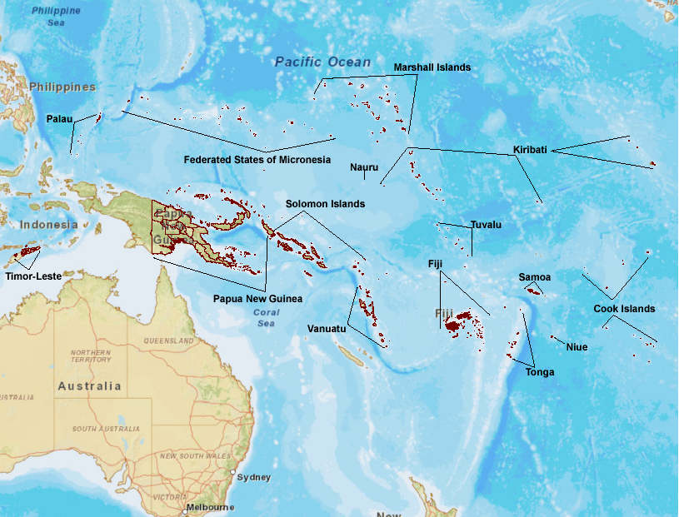
Geographic overview
Window 1+2 (USD10.1M) Regional: PCRAFI-3 ($1.4M)
Regional: Programmatic TA ($2M - pipeline)
Solomon Is: Community Resilience ($1.8M)
Timor Leste: Building Resilience Dili-Ainaro Road Corridor ($1M)
Tonga: Recovery Planning TC Ian ($0.1M)
Tonga: TC Ian Reconstruction and Resilience ($2M)
Vanuatu: Increasing Resilience ($3M)
Window 3 (USD1.1M) Regional: PDNA Training ($0.6)
Fiji: PDNA TC Evan ($0.1M)
Samoa: PDNA TC Evan ($0.15M) Solomon Is: PDNA Floods (0.15M)
Tonga: TA Housing Recovery ($0.1M)
Regional Hub
Window 1 – Regional /Sub-regional activities
Active TA/IL program
Window 2 – Country level activities
Active TA program
Window 3 – Post disaster, Capacity building & Recovery

Slide 3
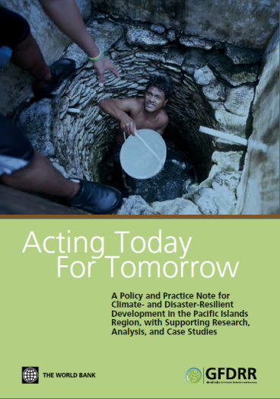
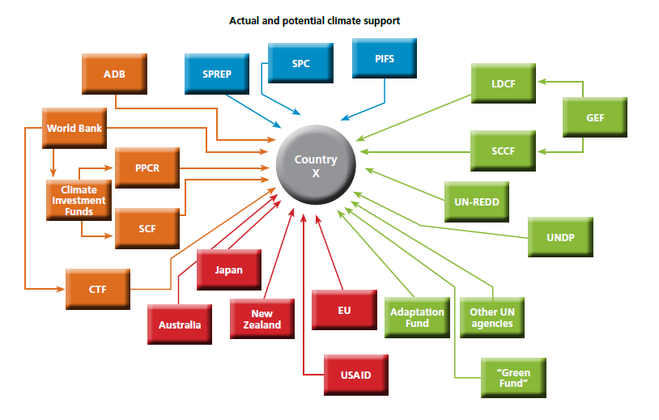
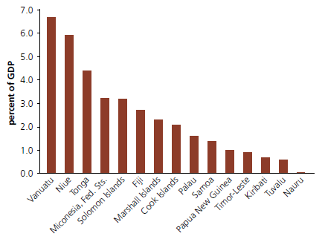
Strategic Context
Proliferation of funding → Proliferation of impact
Average Annual Loss
Can Pacific island countries afford shocks from climate and disaster risks? Impacts from disasters are amongst the highest globally (scaled by GDP)

Slide 4
Strategic Context (2)
What would it take to half the risk by 2030-2050?
Total Risk
Risk informed Economic Growth
Cost-efficient risk reduction and prevention
Cost-efficient financial protection for residual risk
Maximum bearable loss

Slide 5
Strategic Drivers for Results
PREP Pacific Resilience Program
Partnerships intern/extern
Program-matic TA
what?
How?
Risk Governance
Disaster Risk Finance and Resilient Reconstruction
Policy reforms, policy dialogue MoF,
institutional capacity (incl. fiduciary),
Sector investments: Infrastructure, etc.
Immediate response capacity
‘Building back better’
Resilient Investments
EWS, Flood/coastal protection, Community Driven Development
Risk information and tools

Slide 6
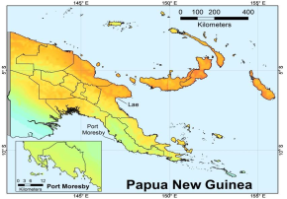
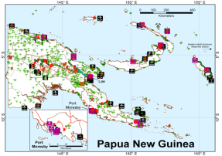
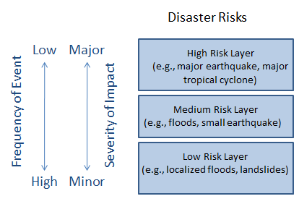
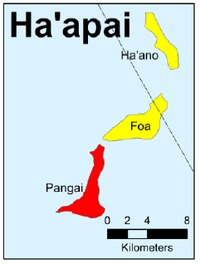
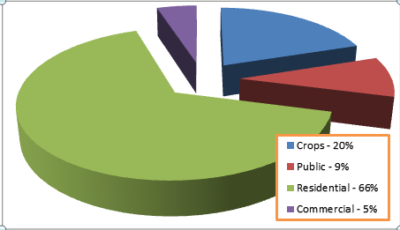
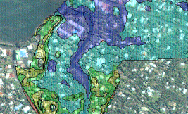
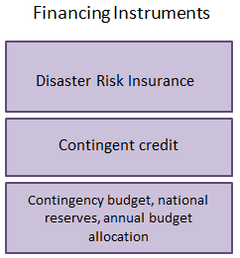
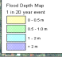





Where? – Understanding Risk
Hazard
Exposure/Vulnerability
Risk
Pacific Risk Information System
http://pacris.sopac.org
Disaster Risk Financing
Rapid Damage Estimation
Urban/Sector Planning

Slide 7
Pacific Resilience Portfolio (USD170M)

Slide 8
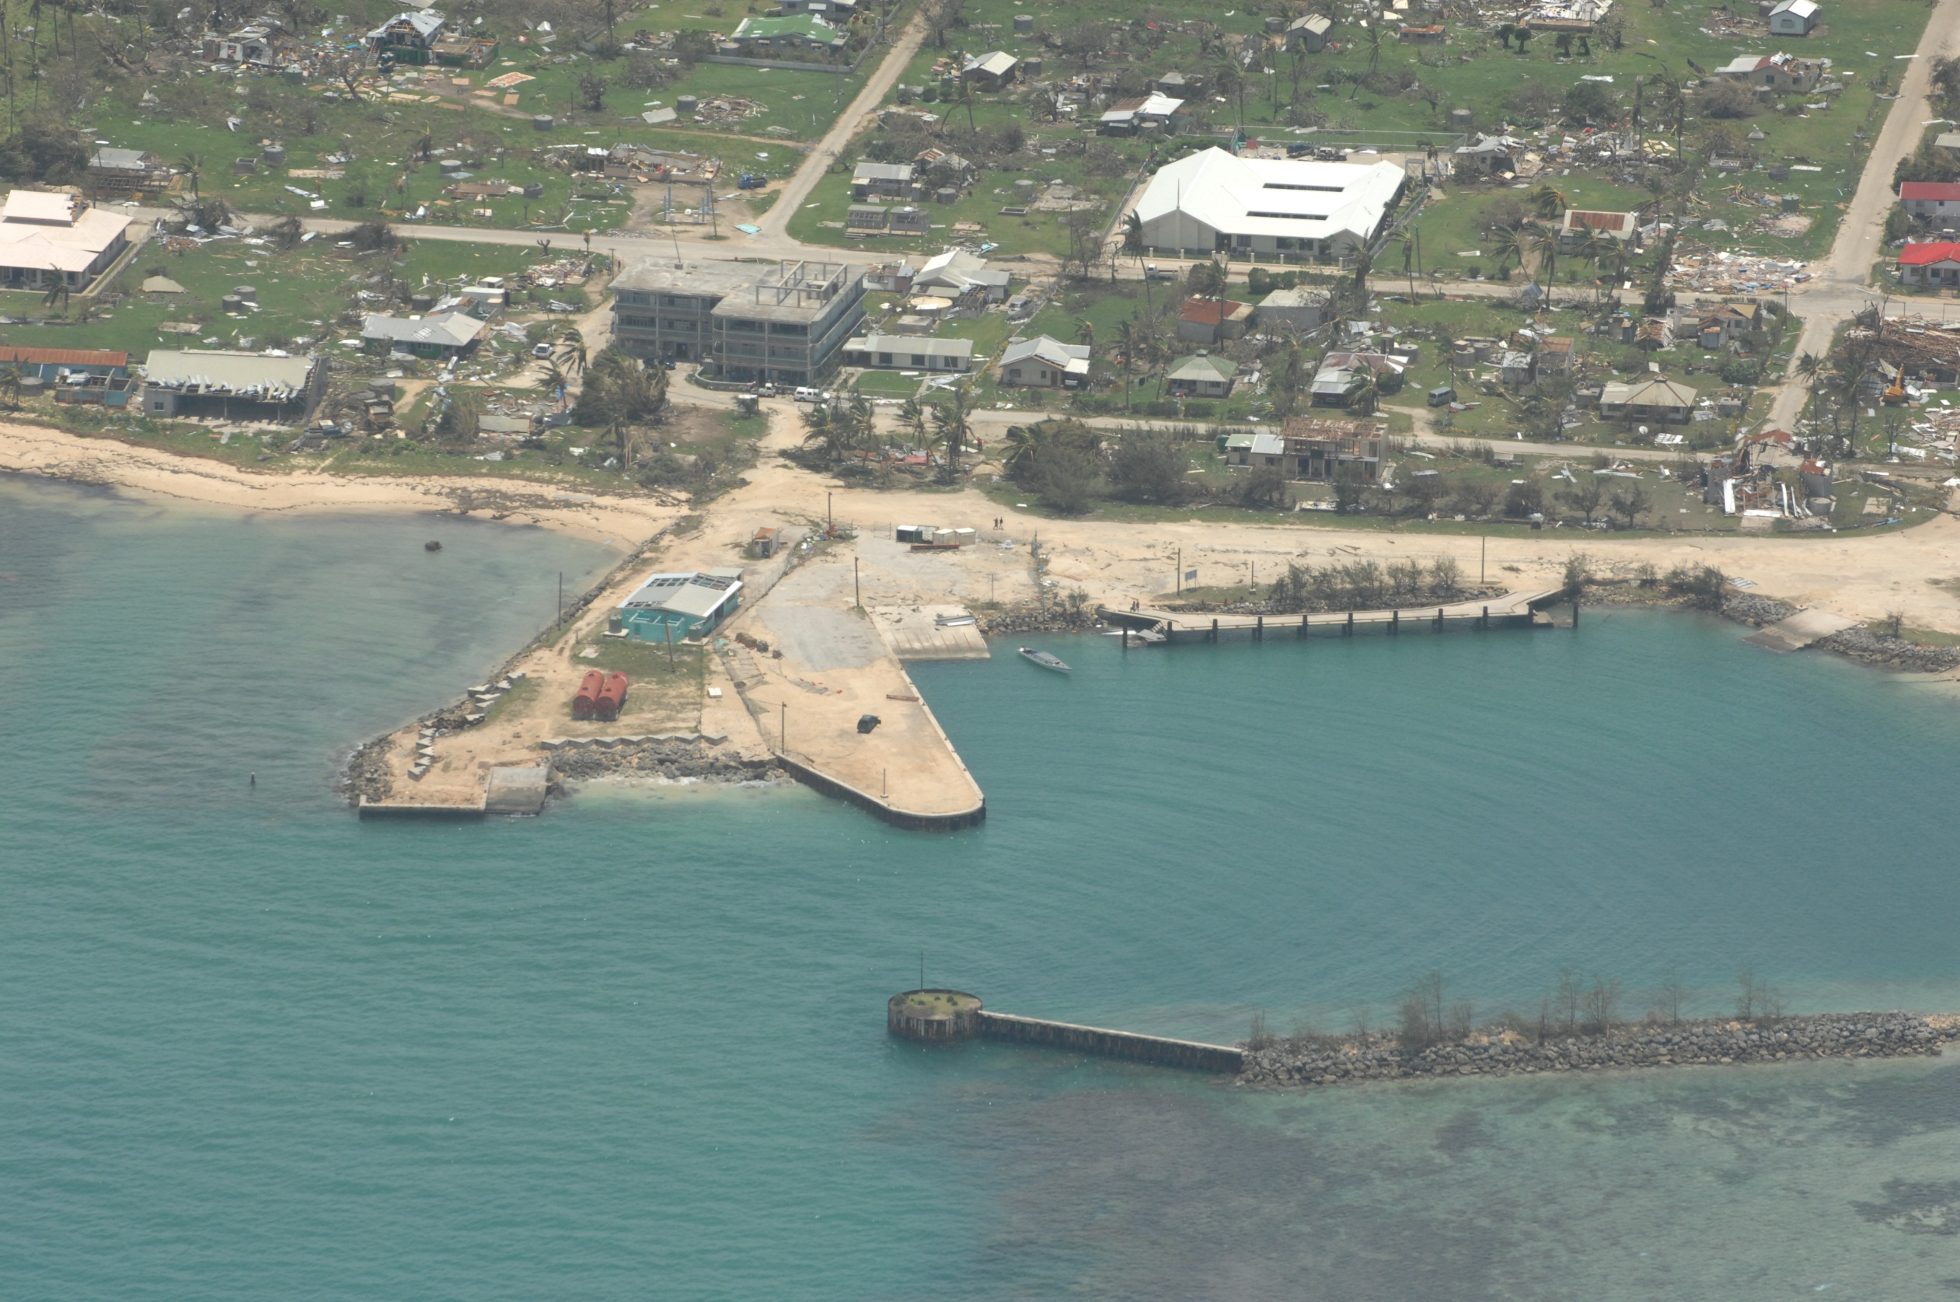
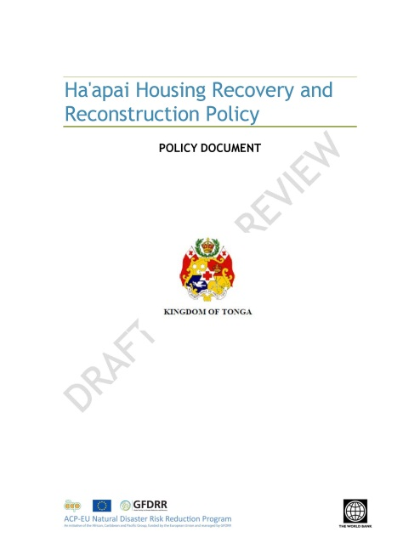
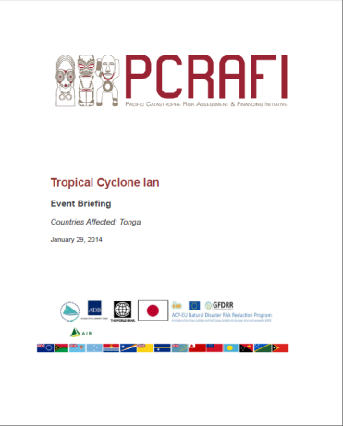
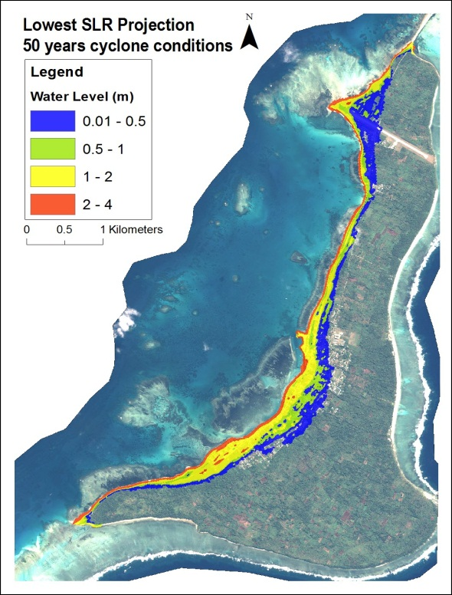
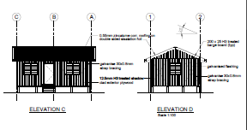
  Tonga: Following TC Ian Tonga received a PCRAFI payout of US$1.27M and developed the first housing recovery and reconstruction policy providing the basis for a US$14M reconstruction and climate resilience project. The reconstruction takes inundation hazard and cyclone-proof designs into account.
Notes:
Update on PCRAFI:
The Bank executed portion of this grant is proceeding as expected. A risk modeling consulting company has been hired to develop an approach that would allow rapid appraisal of damages caused by tropical cyclones based on modeled losses. The consulting company has prepared a work program to complete this task and a draft methodology for reporting modeled losses. An Event Report was prepared for Tropical Cyclone Evan on Samoa and Fiji and the Earthquake in Solomon Islands using this approach. Lessons learned from these events have be incorporated into a protocol for future events. A Recipient Executed project funded under this grant, to be implemented by SOPAC, has been delayed due to changes in the proposed staffing for the assignment. The negotiations with SOPAC were completed in early July. One issue is still pending on the payment of local taxes, which needs to be resolved before the grant agreement can be signed. This is expected before the end of August, 2013. SOPAC will assist in the development of a protocol for using the modeled risk estimates and upgrading the estimates as more information is known about actual losses from an event. SOPAC will also further develop the Pacific Catastrophe Risk Information system (PACRIS).

Slide 9
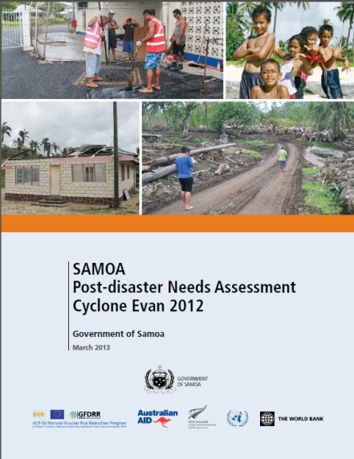
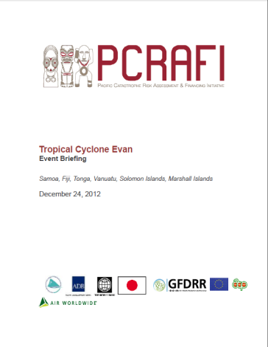
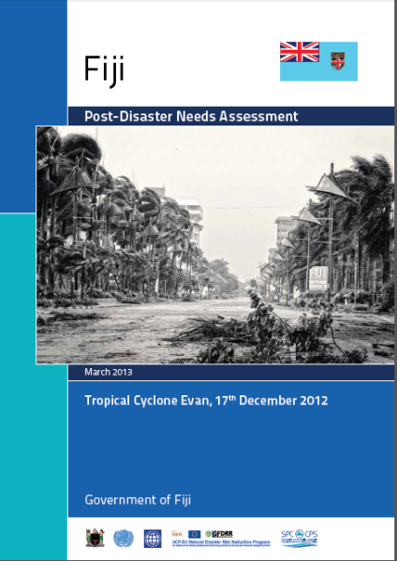
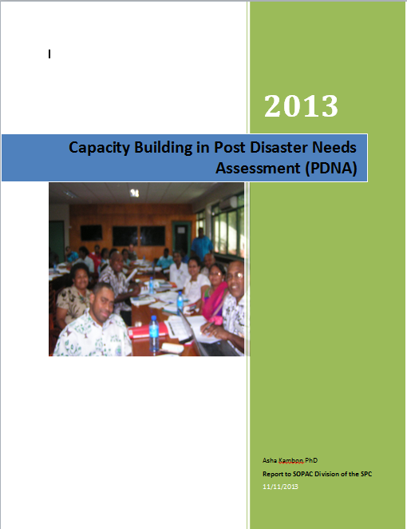
Success Stories (2)
  Samoa PDNA: mobilizing of US$20M of additional IDA for 3 emergency operations (economic recovery, road and agriculture rehabilitation)
  Fiji: PDNA new standard methodology to assess post disaster damages and losses
Notes:
Update on HoA Open Data
RCMRD: The Horn of Africa Open Data Mapping Project
Implementation status :
Component 1: Open Data platform - The platform has been developed and is currently live at http://horn.rcmrd.org. See attached report.
Component 2: East Africa RHOK event shall be held on the 5th & 6th October 2013. The focus of this event is Improving Disaster Resilience and climate adaptation in the Horn of africa using technology - with a thematic focus on droughts and floods. See attached shedule.
Constraints: Limited resources, the grant was only $290K. Supervison costs can not exceed $29K which is very small.
Coordination with EU delegation: Have been briefed and kept in the loop.
The project has been instrumental in complimenting the DRM work in Kenya. Several world Bank TTLs have used the open data instrument for their projects.
Update on PCRAFI:
The Bank executed portion of this grant is proceeding as expected. A risk modeling consulting company has been hired to develop an approach that would allow rapid appraisal of damages caused by tropical cyclones based on modeled losses. The consulting company has prepared a work program to complete this task and a draft methodology for reporting modeled losses. An Event Report was prepared for Tropical Cyclone Evan on Samoa and Fiji and the Earthquake in Solomon Islands using this approach. Lessons learned from these events have be incorporated into a protocol for future events. A Recipient Executed project funded under this grant, to be implemented by SOPAC, has been delayed due to changes in the proposed staffing for the assignment. The negotiations with SOPAC were completed in early July. One issue is still pending on the payment of local taxes, which needs to be resolved before the grant agreement can be signed. This is expected before the end of August, 2013. SOPAC will assist in the development of a protocol for using the modeled risk estimates and upgrading the estimates as more information is known about actual losses from an event. SOPAC will also further develop the Pacific Catastrophe Risk Information system (PACRIS).
Southern Africa: Technical Centre for Disaster Risk Reduction and Climate Change Adaptation for Southern Africa:
Implementation status :
3-4 June 2013: Project Launching workshop in Maputo, Mozambique with the 4 member countries (Malawi, Mozambique, Madagascar and Comoros) represented at the Ministerial level.
17 July 2013: Transfer of the 1st tranche by the bank to the implementing agency, UN-Habitat.
Activity 1. Draft baseline study of the existing offer and demand of DRR/CCA services in the sub-region, including mapping of stakeholders and on-going activities - - ToRs drafted, consultant identified, actual work to start from mid Oct. 2013 (2 months duration – data collection to be carried out during the 1st month).
Activity 2. Draft contents and tools of the DIMSUR flagship course on urban resilience -- Consultant recruited since mid Aug. 2013; first draft of the Urban Risk Reduction and Resilience Tools expected by Nov. 2013.
Activity 3. Legal and institutional aspects related to the establishment of the DIMSUR addressed -- Draft of the MoU binding the 4 countries to the DIMSUR and a proposed Charter (describing the governing and organisational structure), including UN-Habitat as a facilitator, already prepared by the legal consultant. These documents will be circulated to the 4 countries by end of Sep. 2013. A round-trip to meet with the 4 governments is planned in Oct. 2013.
Constraints: Language barrier - There is no common language to facilitate easy dialogue and discussions among the four member countries when it comes to agreeing on actions. Malawi speaks English, Mozambique speaks Portuguese, while Madagascar and Comoros speak French
Coordination with EU delegation : EU delegation has always been kept in the loop and fully involved on the high level process.

Slide 10
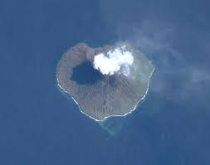
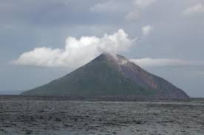
Success Stories (3)
South- South exchange Vanuatu/Solomon Islands
CRISP includes the establish of an early warning network for volcanic/seismic hazards under Component B
There are eight volcanoes in Solomon Islands, of which four have been recently active.
VMGD completed a country visit in September 2013 to assess the volcano-seismic monitoring needs of Solomon Islands.
Total costs have been estimated to be US$932k including:
(i) 9 stations and data center, including spare parts,
(ii) Capacity building and maintenance missions
Priority action plan currently being identified

Slide 11
Pacific Resilience Program (PREP):
Guiding principles
Combine financial protection with investments on resilience (and not standalone disaster risk financing project)
Promote a regional approach to reduce insurance costs, improve early warning and build common approaches on DRM
Leverage resources (national IDA, regional IDA, donor funding, climate funds..) to scale up resilience
A phased approach which will allow countries to join when they are ready

Slide 12
Pacific Resilience Program (PREP):
Results
Expected results:
  Improved early warning for the population at risk (speed and coverage) => Ultimately save lives
  Increased resilience of targeted investments => Ultimately reduce economic losses when a disaster happens
  Increased financial resilience and reduced cost of insurance premium (regional pool) => Improve relief activities and protect fiscal balance
Participating countries:
  At this stage: 7 countries in two phases:
  Federated States of Micronesia (FSM), Fiji, the Republic of Marshall Islands (RMI), Samoa, Solomon Islands, Tonga and Vanuatu

Slide 13
Pacific Resilience Program (PREP):
Program Description
At the country level:
Component 1: Increased Resilience
Component 2: Disaster Risk Financing and Insurance
At the regional level
Component 3: Regional Technical Assistance and Institutional Capacity Building
Component 4: Project Implementation Support and Program Management

Slide 14
PREP: Component 1- Increasing Resilience
Objective: increase the resilience of participating countries:
Early warning and preparedness => Strengthening forecasting of natural hazards, dissemination of warnings to the population, + emergency preparedness and response mechanisms.
Investments in resilience (focus on Public Buildings, e.g. retrofitting schools ) => Reducing the risks and prepare the country to access climate finance for resilient development.

Slide 15
PREP: Component 2 - Disaster Risk Financing
Objective: improve post disaster financial response capacity for emergency relief and early recovery
At national level => through national Reserves and contingent components for more frequent and less severe disasters (up to 1/20 year return period).
At regional level => Continue the PCRAFI Catastrophe Risk Insurance scheme to cover less frequent but more severe disasters (greater than 1 in 20 year return period) and better adapt to country financial framework and conditions.

Slide 16
PREP: Component 3 - Regional Technical Assistance and Institutional Capacity Building
Objective: provide to participating countries highly specialized technical assistance and better risk information
Activities: Technical support to countries:
    Early Warning & Preparedness
    Risk assessment & Mainstreaming of DRM into critical sector investments
    Disaster Risk Financing and Insurance
    Post disaster needs assessment and recovery planning

