Slide 1
Resilience in Practice
Ethiopia Case Study
10.07.2014
Willem Olthof – DEVCO
Sarah Svedin - ECHO
Notes:
Date

Slide 2
Outline
Context: chronic food insecurity and recurrent crises
2. The EU approach to resilience in Ethiopia
3. EU Resilience Clusters
4. Focus on the Wolayta Cluster
5. Some early lessons

Slide 3
1. Context
  Recurrent droughts
  Chronic food insecurity, with peaks (famines)
  High population growth and density
  Most people reside in rural areas and are dependent on agriculture
  Rapid economic growth for over a decade
  Rapid expansion of infrastructure and basic services

Slide 4
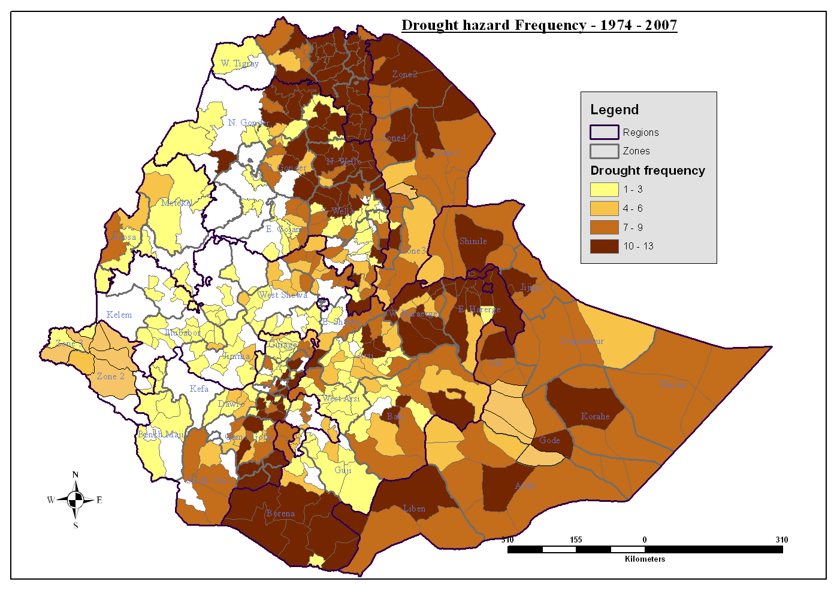

Slide 5
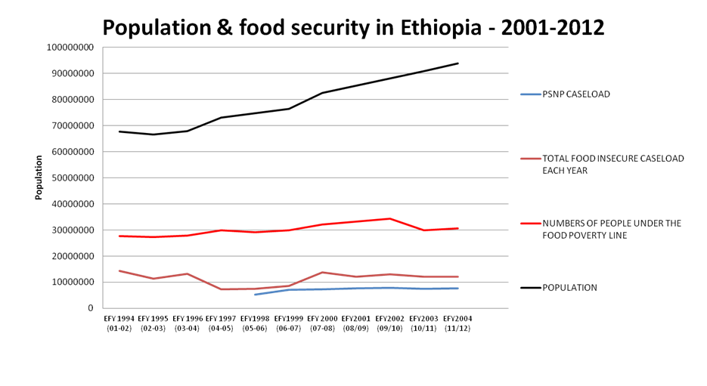

Slide 6
PSNP
Productive Safety Net Programme
Essence: food or cash for (public) work
Replaced (large part of) annual emergency appeal system (food aid):
  Ad hoc; not predictable
  Too late, too little
  Expensive
  Disruptive
  Saved lives, not livelihoods

Slide 7
PSNP (continued)
Since 2005; gradual expansion over food deficit areas
Covers on average 7.5 million people (2013: 6.9 million, 8 regions, 319 woreda's)
  Predictable – vulnerable people identified in advance; community-based with appeal mechanism
  Choice of cash and/or food; but cash first principle
  Most beneficiaries provide labour in return for cash/food; some are exempted
  More cost-effective than humanitarian assistance
  Overall: 'prevent people from falling lower'

Slide 8
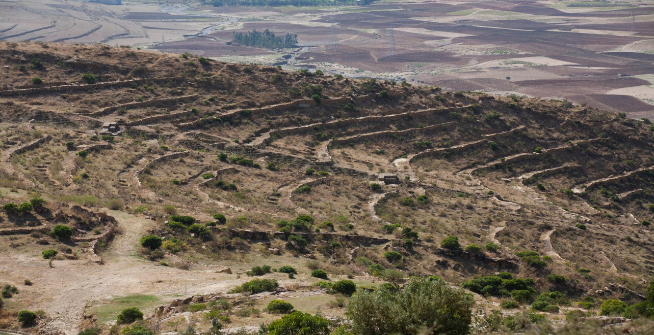
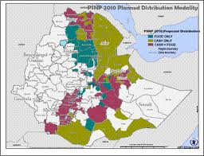
PSNP Ethiopia

Slide 9
2. The EU Approach to Resilience
Aligned to national priorities (IDDRSI framework; CPD)
EU support: combination of:
- resilience-enhancing systems: safety net, basic service delivery, local government capacities
and
- geographically targeted support to vulnerable population groups: 'EU Resilience Clusters'
Notes:
In the framework of the IGAD Drought and Disaster Resilience and Sustainability Initiative, Ethiopia has developed a national Country Programming Paper (CPP) on Resilience. The EU interventions on resilience are largely in line with the priorities identified in the CPP. As a result, resilience activities are predominantly related to 'drought resilience'.
Overall the EU support to building resilience in Ethiopia contains two complementary components:
Support those systems (often Government-owned and –led) that provide a basis for reacting to drought emergencies, e.g. the food security safety net (PSNP), basic social services (including health), veterinary services; and
Strengthening the resilience of communities, particularly of vulnerable population groups, by improving livelihoods (related to income, but also to sanitation and hygiene), and investing in the people themselves (e.g. education, nutrition). In Ethiopia, a specific approach is followed by focusing on a limited number of priority areas, called 'EU Resilience Clusters'
The former is mainly addressed by long-term development assistance, the latter by both humanitarian and development instruments.

Slide 10
Key characteristics
  Malnutrition/food insecurity as 'entry point'
  Focus on the most vulnerable population groups
  Division of Labour (DEVCO-ECHO) with a 'grey zone' of overlap
  Conscious attempt to create synergies
  Multi-level, multi-partner, multi-sector approach
  4 corner stones:
    Basic services
    On and Off-farm livelihoods
    Safety Net
    DRR/DRM

Slide 11
Articulation of support instruments
Source | 2012 |  | 2013 |  | 2014 |  | 2015 |  | 2016
 | 1 | 2 | 1 | 2 | 1 | 2 | 1 | 2 | 1 | 2
ECHO
IfS
10th EDF B
11th EDF
Notes:
After the big 2011 drought in the Horn of Africa, EU financial support has been mobilised from various sources. While humanitarian support has been provided throughout, it has gradually reduced in size. At the same time, development support has picked up. First through an allocation from the Instrument for Stability (€ 13.7 million) which supported livelihoods in (conflict-prone) pastoralist areas. Subsequently through an additional allocation of € 50 million from the EDF (B-envelope funding) which supports the Risk Financing Mechanism of the Productive Safety Net Programme (PSNP), as well as nutrition, livestock disease control, and livelihoods. This will be followed by further support to various aspects of resilience under the 11th EDF for which (at least) € 110 million has been earmarked.
Both the B-envelope and the 11th EDF will provide support to the 'Resilience Clusters'.

Slide 12
3. EU Resilience Clusters
Selection Criteria:
  Malnutrition rates
  Chronic vulnerability
  Drought-prone areas
  Partner presence (ECHO)
8 Clusters:
  6 joint DEVCO-ECHO
  1 ECHO; 1 DEVCO
Notes:
In practice:
The resilience programme in Ethiopia started after the 2011 drought in the Horn of Africa where both DEVCO and ECHO mobilised additional resources with the objective to approach things differently and better for the future. The idea of supporting resilience through a mixture of system-oriented interventions (nutrition, livestock health) and geographically targeted projects was formed, and the EU Resilience clusters approach was developed, in a first instance by ECHO.
An 'EU Resilience Cluster' is a geographical area, formed by a group of adjacent woredas (districts) where EU-funded resilience activities are implemented.
Clusters have been selected on the basis of their vulnerability to recurrent droughts, their levels of food insecurity/malnutrition, and the presence of experienced implementing partners.
They correspond to areas where:
- ECHO has been repeatedly responding in emergency mode;
- With historic needs over the last 20 to 30 years and presence of ECHO partners in the recent past;
- Areas with a homogeneity of livelihoods so that a common strategy can be developed for the entire area of the cluster
Using this methodology and keeping in mind the financial resources available, eight EU Resilience Clusters have been identified (see map next slide). In six clusters both DEVCO and ECHO are present, in one cluster only ECHO-financed activities take place, and in one cluster only DEVCO-financed interventions. Contracts are signed with consortia of NGOs, rather than with individual partners. All partners work towards the same objectives.

Slide 13
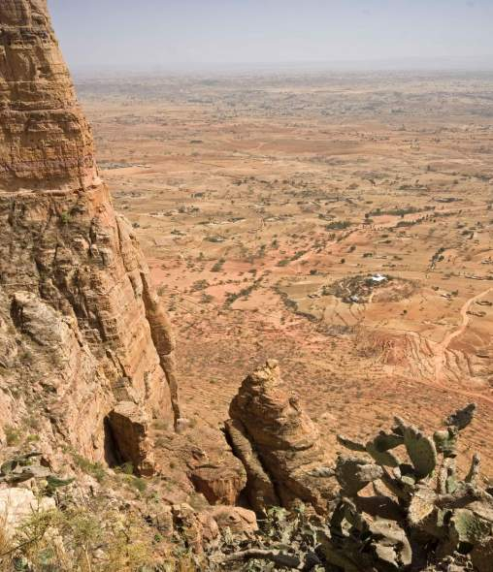
Eight 'EU Resilience Clusters'
8 areas identified (clusters of districts) / 34 districts in total
Covering > 2.5 M people with 74,000 people avg per district) ~ 12 M people in Ethiopia who are drought exposed
Homogeneity of livelihood features (common risk analysis)
Notes:
These 8 clusters are estimated to assist over 2M people, corresponding to approximately 10-15% of the people recurrently affected by natural disasters in the country (as you could see from Wim's previous graph, the EU clusters do thus not cover all urgent needs)
While ECHO started funding resilience-building projects in these clusters in 2012, since 2014 DEVCO is also funding projects in the clusters under the EC-SHARE initiative.
The financing tools (ECHO/HIP with in total so far approximately 40 MEUR having been channelled to resilience building for 2012,2013 and 2014, and DEVCO/SHARE with 50 MEUR from 2014 to 2017 out of which 30 MEUR are directly channelled to the clusters) are currently contributing to the overall programme. The selection of geographic clusters has been revised to operate the resilience building programme over the middle to long term (from SHARE into 11th EDF which will channel funds into resilience building as from 2017).

Slide 14
Notes:
The map shows the 8 clusters: Wag-Himra cluster in Amhara region, the Afar-cluster, the Siti-cluster, the Liben cluster, Bale cluster, Borena cluster, Wolayita cluster and South Omo cluster(where only DEVCO is present).
The details show:
Partners which are ECHO funded and what sectors of intervention they operate in (RED)
Partners which are DEVCO funded and what sectors of intervention they operate in (BLUE)

Slide 15
DEVCO-ECHO Cluster Financing Model
Notes:
Recently, end of June 2014, a one week long intensive workshop (and field mission) on the EU Resilience Cluster Approach was organised in Addis Abeba with the objective to take stock of progress made so far and outline challenges ahead. ECHO and DEVCO colleagues from HQ and field were present.
We will get back to the early lessons which could be drawn and the challenges faced at the end of this presentation, but here want to show a graphic representing the cluster financing model which shows how we envisage the evolution in time.
The idea is that after a couple of years of exclusively ECHO intervention in the clusters, slowly building the first step of resilience, DEVCO has now joined since the beginning of the year and is thus strengthening the clusters. A gradual phasing down of ECHO support and a gradual phasing up of DEVCO support is envisaged as the needs change from being emergency based to becoming of a more developmental nature. Optimally, DEVCO support will at one point constitute the main part of EU assistance to resilience building in Ethiopia, but keeping in mind that ECHO may have to intervene punctually in case of a crisis occurring within a cluster, thus needing again pure emergency assistance.
This graph is an illustration of the planned transitioning to an upgraded DEVCO support under the EDF 11 on the one side, and recentralising the role of ECHO around its humanitarian mandate on the other side, whilst ensuring a continuous involvement from both sides of the EU house as an essential part of the Linking Relief, Rehabilitation and Development resilience strategy.

Slide 16
4. The Wolayita EU Resilience Cluster
'Green hunger'
ECHO
- Consortium (CONCERN, IMC, PIN)
- 2012-2014: 4,6 MEUR, 385,000 beneficiaries
 | ECHO | DEVCO
Consortium lead | Concern | Vita
Period | 2012-14 | 2014-16
Amount | € 4.6 M | € 3 M
Beneficiaries | 385,000 | 72,000
Multi-sectoral with focus on | Nutrition, health, water, livelihoods | Livelihoods
Notes:
Example of an EU resilience cluster in practice:
The Wolayita Cluster is situated about 300 kilometres south of Addis Ababa and is known to be part of the 'green hunger zone' of Ethiopia. Although rainfall is usually adequate and the continuous presence of crops on the fields gives a green and lush image, poverty is deep and malnutrition is high (child malnutrition appears as much related to issues of health (malaria) and hygiene (water) as with feeding practices and food availability). It is an area with a high population density, resulting in very small landholdings which do not permit families to be sustainable off the land (0.2-0.5 hectare, when it is calculated that 1.5 hectare minimum are needed per HH). In this cluster, ECHO and DEVCO finance resilience building with inter-linked activities in different sectors (nutrition, health, livestock asset building, water supply, seed multiplication, disaster risk reduction etc.)
Practically, two consortia operate in the Wolayita cluster, one ECHO funded where Concern is the lead NGO, and one DEVCO funded where Vita is the lead NGO.
ECHO
Concern is implementing with two other NGOs, IMC and PIN, since 2012 under a common 36-months long strategy and common logical framework. Each Partner focuses on its respective strengths (for example: IMC does nutrition and health, PIN leads on water and sanitation activties, and Concern on food-security and disaster risk reduction). The activities of the different sectors are linked together to create synergies and eventually build resilience.
The project is implemented in 4 woredas (districts) and has between 2012 – 2014 reached out to an estimated 385,000 people (130,000 phase 1 + 255, 000 phase 2 = estimated around 385,000). 4.6 MEUR is channelled by ECHO to this cluster.
DEVCO
VITA leads the DEVCO funded consortium, where with IDE, Caritas, AMREF and the Ethiopian Catholic Church Social and Develoment Commission are also members. The project duration is of 36 months with a DEVCO budget of 3 MEUR which should reach up to and be continued by the 11th EDF in 2017. The overall objective is to enhance social and economic stability of households by supporting the recovery of livelihoods. Activities are related to enhancing income generating capacities (productivity of livestock; livelihood diversification, and productivity of smallholder farming) and to strengthening of the capacities of local government and community/traditional institutions, and in total approximately 72,000 people (pastoralists, agro-pastoralists and smallholder farmers) will be supported.

Slide 17
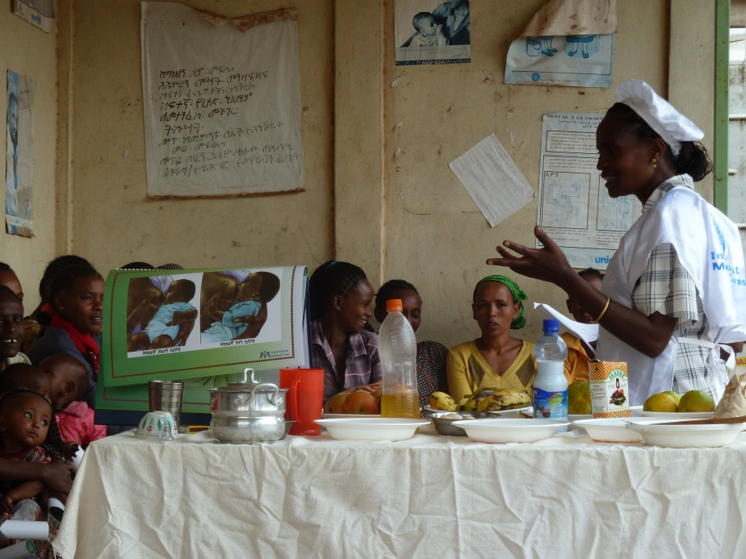
Wolayta Cluster activities
Nutrition: CMAM, IYCF
Health: system strengthening, provision of medicines and equipment
Food security: agricultural trainings, provision of seeds, veterinary support, distribution of small ruminants, soil-fertility and environmental management capacity building, small-scale irrigation schemes, enhancing income generating capacities
WASH: rehabilitation of water schemes, trainings in hygiene and sanitation
Disaster Risk Reduction: strengthen local authorities and communities in contingency planning, information reporting systems.
Pictures to come
Notes:
Activities are divided between ECHO/DEVCO to reflect the different mandates, but there is still 'overlapping areas' where both the ECHO and DEVCO funded partners carry out similar activities:
ECHO
Nutrition: support to Community based Management of Accute Malnutrition (CMAM), Community based Infant and Young Child Feeding promotion (cooking demonstration, behavioural change, training of HEWs)
Health: strengthening of systems, provision of medicines and supplies (malaria, communicable diseases)
Food security: agricultural trainings, provision of seeds, veterinary support, distribution of small ruminants (donkey carts, sheep & goats, oxen)
WASH: rehabilitation of water points, bore holes, strengthening/establishing water committees, construction of latrines, trainings in hygiene and sanitation
Disaster Risk Reduction: strengthen local authorities and communities in contingency planning, information reporting systems.
DEVCO
Food security & livelihood: small scale irrigation structures, productivity of smallholder farming (maize, sweet potato) also through livelihood diversification, livestock management training, rural infrastructures, natural resources, enhancing income generating, and strengthening the capacities of local government and community/traditional institutions, soil-fertility and environmental management capacity building.
Health: longer-term reversible family planning, empowerment of women, capacity building of local authorities.
One of the points discussed at length during the one week EU joint resilience workshop and field mission was the division of labour between ECHO/DEVCO according to the different mandates. We are currently drafting a guiding paper on this topic which will help our Partners but also us during the phase of assessing proposals. The paper outlines how the different activties within different sectors of intervention ought to be divided (according to nature, urgency, the aid modality, systems VS household level, periphery VS federal level, community participation VS institutional capacity building etc.)

Slide 18
Wolayta Cluster challenges
- Remain focused on comparative advantages, division of labour, respect of mandates
- Coordination within the cluster
- Coordination & cooperation with authorities
- Targeting of beneficiaries, malnutrition as entry-point
  Importance of off-farm/alternative livelihoods
Notes:
What are the challenges faced when using the resilience model of joint EU clusters in Ethiopia?
We have already mentioned the division of activities between what is ECHO/DEVCO funded → to truly apply an integrated approach can be challenging in itself, as the different mandates of ECHO/DEVCO need to be considered. Within the integrated approach, ECHO & DEVCO need to make sure their respective activties remain within their different humanitarian and development mandates. Whilst coordinating and aligning with national strategies, it is important for the alignment to respect mandates and focus on the most vulnerable people to recieve assistance.
It also requires continued efforts of coordination/ harmonisation within the cluster, between the two consortia in Wolayita, but also with other Actors in the area to avoid duplications.
Finally, coordination & cooperation with the local authorities is a challenge, as authorities may push for a certain type of activties rather than others (for example water schemes to an unproportionately large extent). Authorities may also wish for interventions to be implemented in different different geographical locations, and not neccessairly focused on the same areas (then defeating the purpose of resilience). In some areas, authorities may wish for the targetted beneficiaries to be automatically the same as those benefitting under the national PSNP saftey net programme, in other areas they may push for the opposite.
The challenge with regards to beneficiaries is that focus should always remain on the most vulnerable, and the entry-point for selection and for all activities should be mal-nutrition and food insecurity. Malnutrition and hotspot woredas guides the intervention. Most vulnerable should be targeted, and not automatically selected according to the wealth ranking of the local authorities.
For example in Wolayita, the opposite of what we want to achieve would be the case where the CONCERN-consortium operates in one location completely separate from where the VITA-consortium operates, that the sectors of intervention are not inter-linked at all and that no analysis is done with regards to the national programmes such as PSNP.
Finally, in Wolayita, the specific challenge of shifting towards alternative livelihoods needs to be tackled. With a high population density and not enough land per household to farm, off-farm activties become increasingly important as an alternative which would help reduce food insecurity.

Slide 19
5. Early Lessons
  Cluster approach is a promising concept
    Scope to enhance DoL and create synergies
    Allows continued focus on vulnerable areas
    Potential for effects
  Scope and Need for enhancement knowledge base
    To understand (drivers of) dynamics
    To assess impact and determine exit strategy
  Coordination is vital but challenging
    At various levels, with many partners, incl. local authorities
    Between DEVCO and ECHO
Notes:
Early lessons can already be drawn from the EU joint resilience building programme in Ethiopia:
- The cluster-approach and introduction of consortia of NGOs has proven to be positive and bringing a clear added value (stimulates synergies and the use of comparative advantages, facilitates communication and coordination amongst members and with the EU). But the coordination at cluster-level is challenging. Besides intra-consortium coordination, it requires coordination with other partners, including NGOs, UN agencies and local authorities. It is demanding.
There is a need to now conduct more detailed research to better understand the dynamics and to start assessing the impact of resilience building. With the help of the Joint Research Centre, finding modes to measuring the impact of resilience without having to wait for 20 years, is currently explored.
The coordination between ECHO and DEVCO is working very well which is much part to why this approach seems to have a future in Ethiopia.

Slide 20
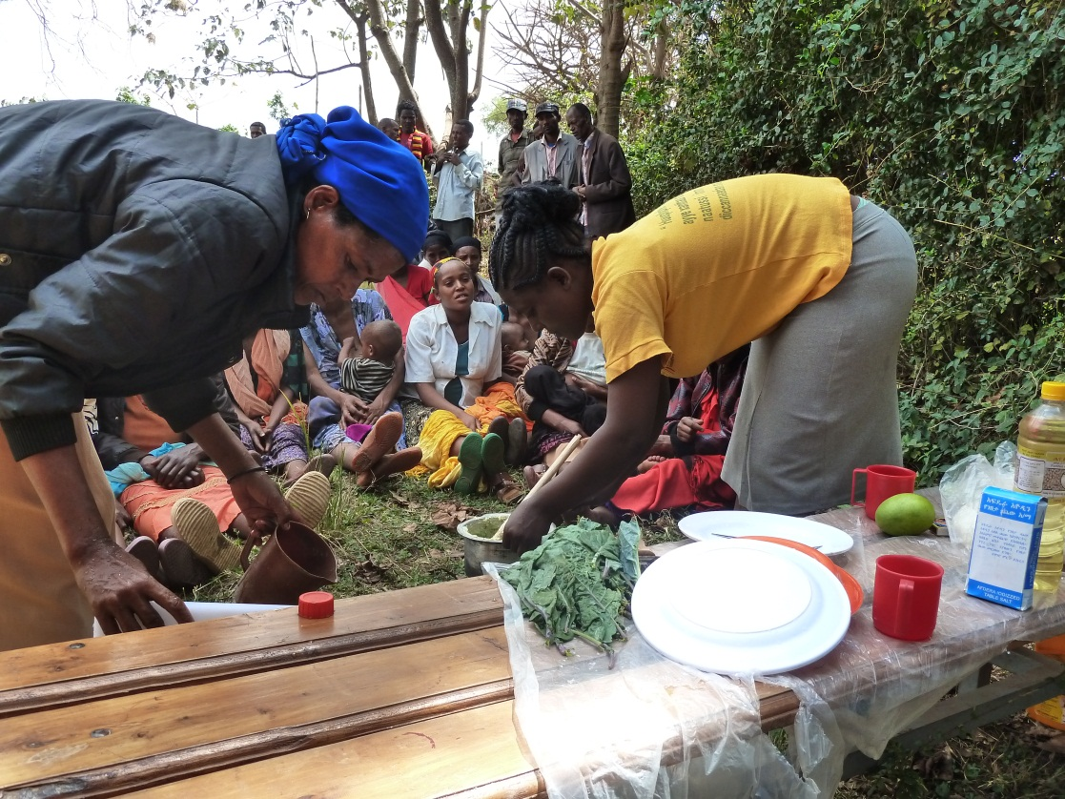
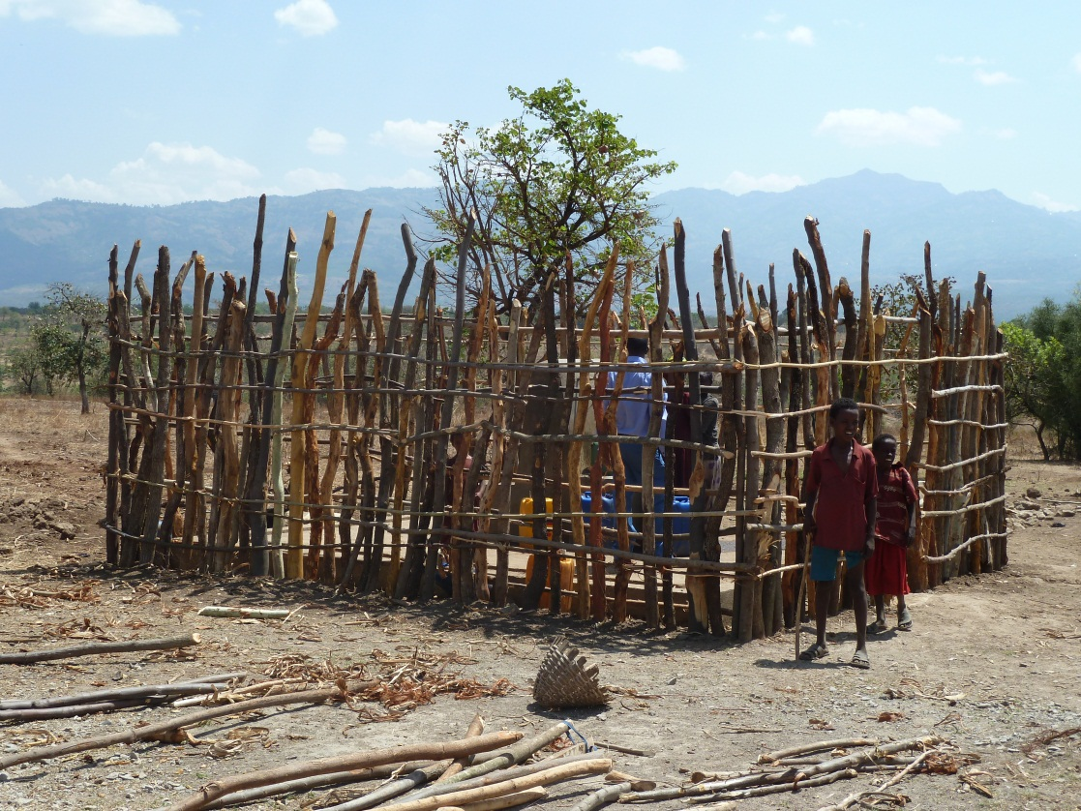
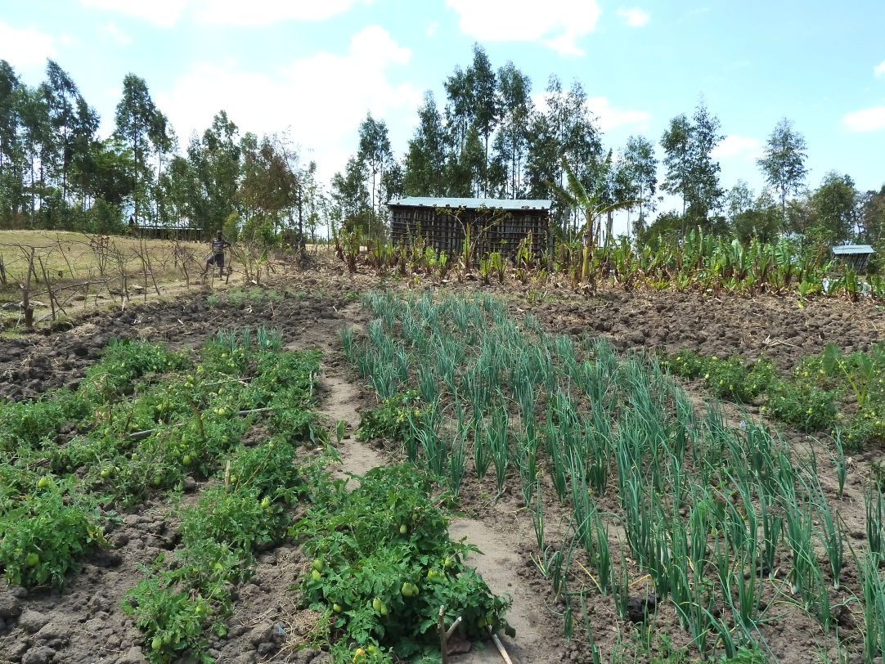
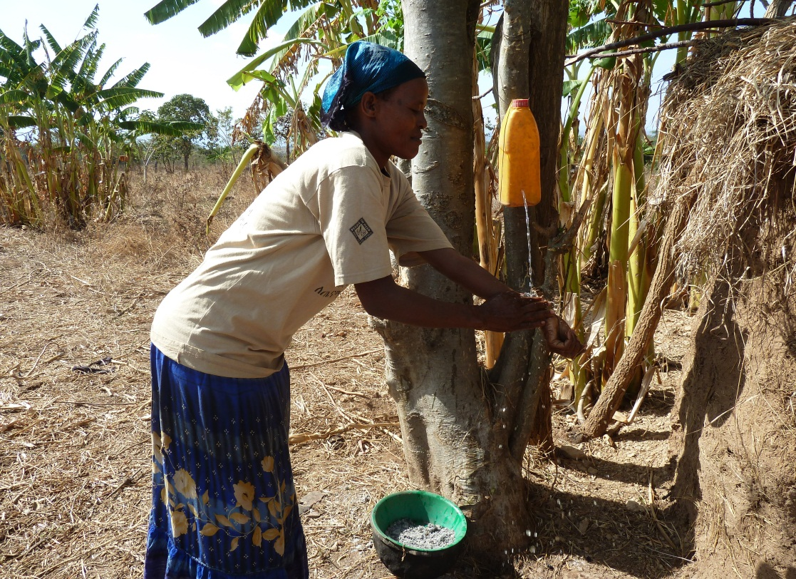

Slide 21
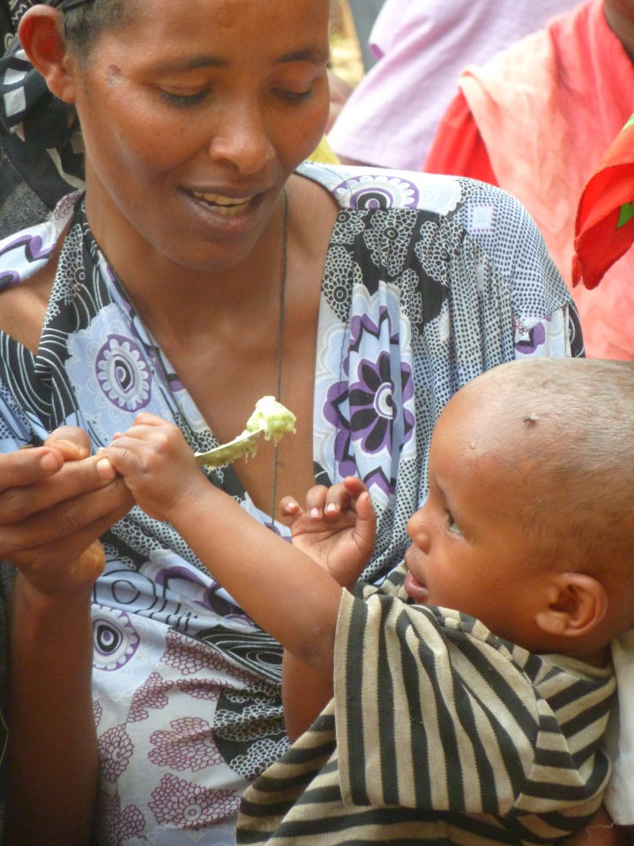
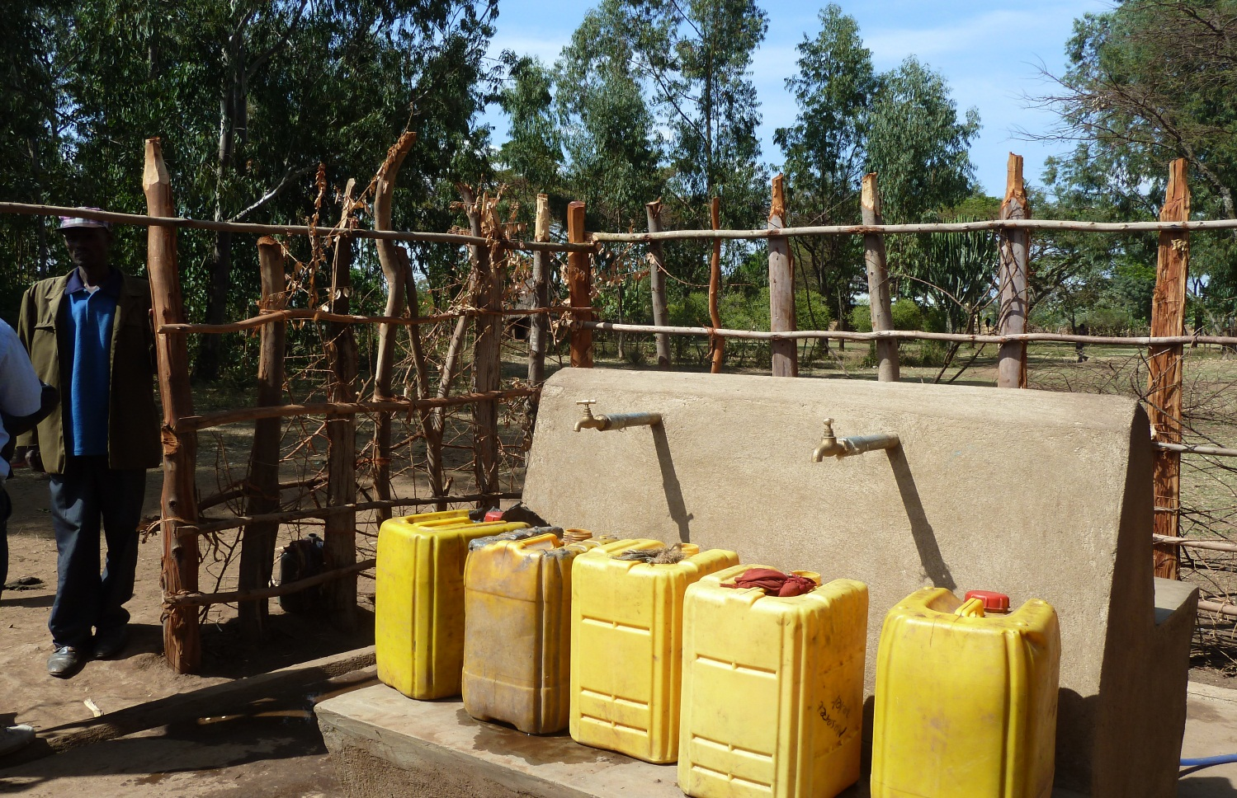
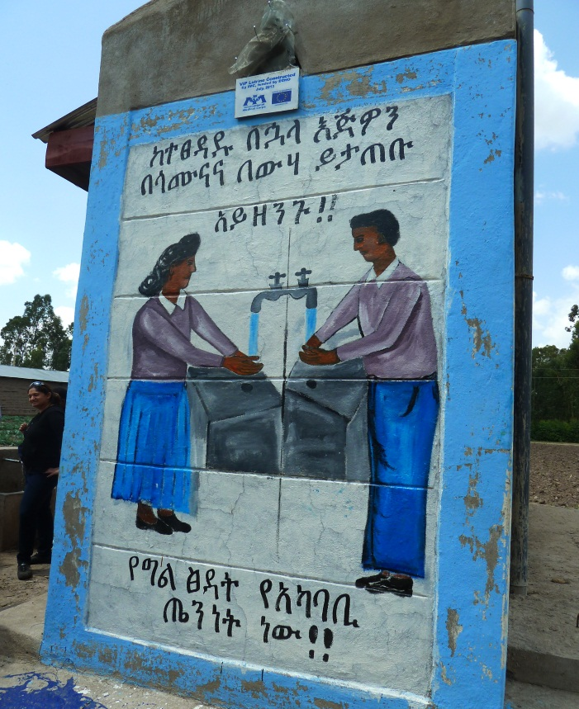
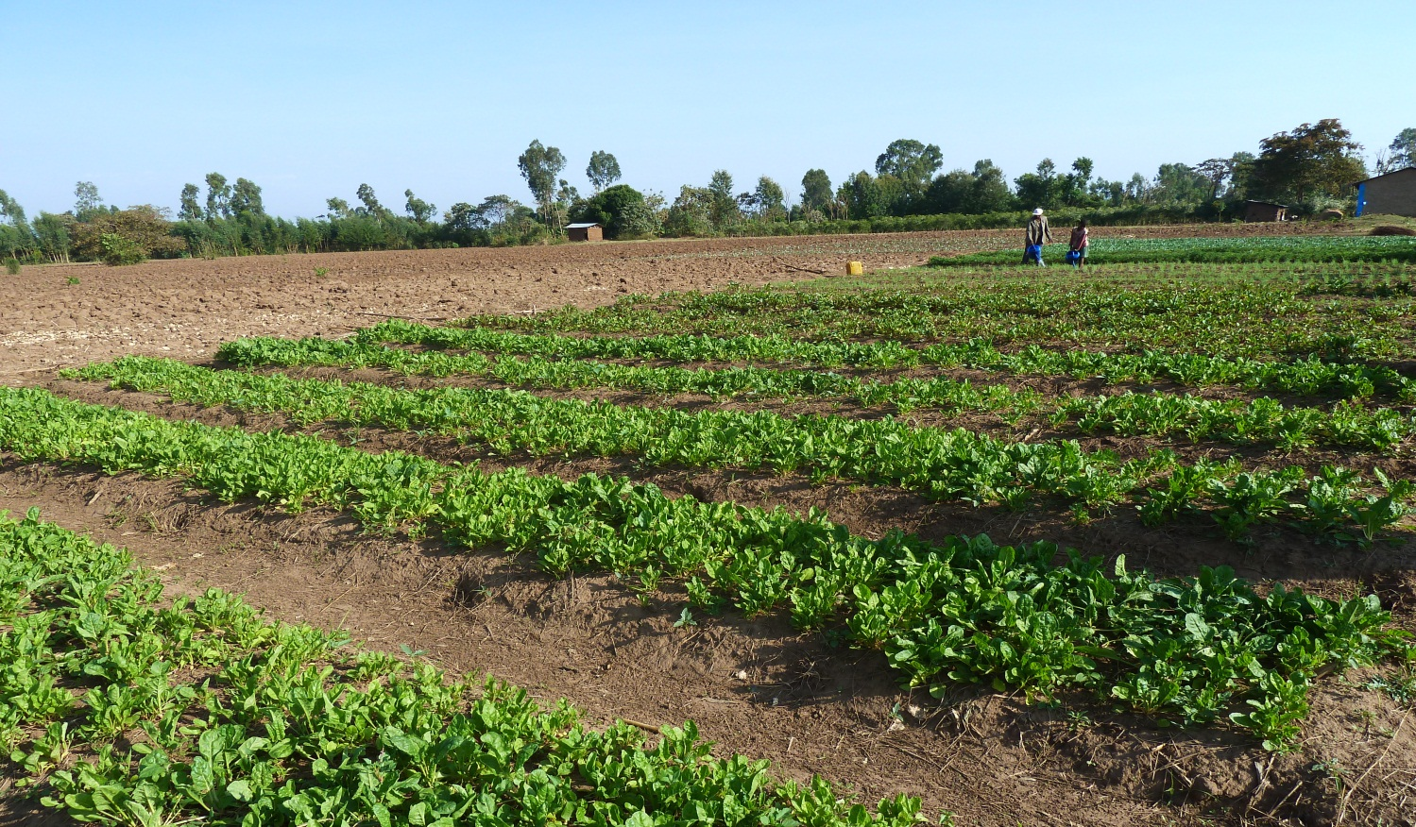

Slide 22
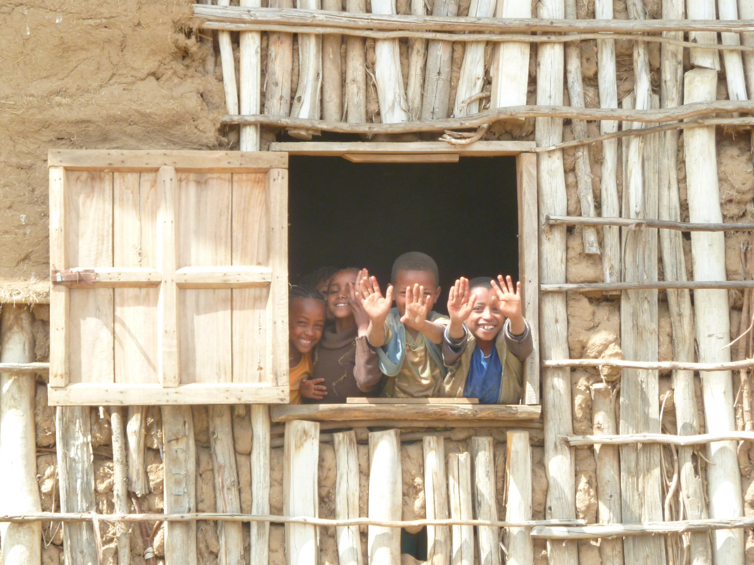
Thank you…
Thank you …

