Slide 1
Response to inadequate care of orphan and vulnerable children affected or infected by HIV/AIDS
ELOKE ONYEBUCHI PETRUS
20 APRIL 2014

Slide 2
INTRODUCTION
A child orphan is a child under 18 who has lost one
or both parents
Maternal orphan
Paternal orphan
A vulnerable child is one affected by HIV
through illness of a parent or principal caretaker

Slide 3
ORPHAN AND VULNERABLE CHILDREN IN NIGERIA
In 2003
•7 million orphans from all causes
•1.8 million children orphaned by AIDS(26 percent of all orphans)
•0.8 million children orphaned by AIDS during that year alone
In 2005
• 1.3 million children orphaned by AIDS
• 238,000 children living with HIV/AIDS
In 2010
• 8.2 million orphans from all causes
• 3.25 million children orphaned by AIDS
FHI/GHAIN, 2007

Slide 4
STAKEHOLDERS
Government Ministries (FHI/GHAIN, 2007; Alana, R., etal., 2008; UNAIDS, 2004)
National partners (Donor agencies)
Community/faith based organisations (FHI/GHAIN, 2007; Child fund/APAC, 2009,)

Slide 5
PLANNERS/EVALUATORS/IMPLEMENTERS
Children/adolescents (UNAIDS, 2004)
Government ministries (UNAIDS, 2004; FHI/GHAIN, 2007; Alana, R., etal., 2008; Alliance Zambia, 2009)
Non – governmental organisations (Alana, R., 2008)
Implementing agencies like support group of people leaving with HIV/AIDS (FHI/GHAIN, 2007)

Slide 6
RESPONSE/MANAGING THREAT
Intervention
Extended family care (Alana, R., etal., 2008; Desmond, etal., 2002; UNAIDS, 2004; Kendall 2008)
Community/faith based care (FHI/GHAIN,2007; Desmond, etal., 2002; Alana, R., etal., 2008; Child fund/APAC, 2009)
Institutional/foster care (Desmond, etal., 2002; UNAIDS, 2004, World Bank, 2004)
Activities
Medical care
Nutritional support
Education on voluntary counselling and testing on HIV/AIDS (VCT) (UNAIDS, 2004)
Psychosocial and counselling support (UNAIDS, 2004; Alana, R., etal., 2008)

Slide 7
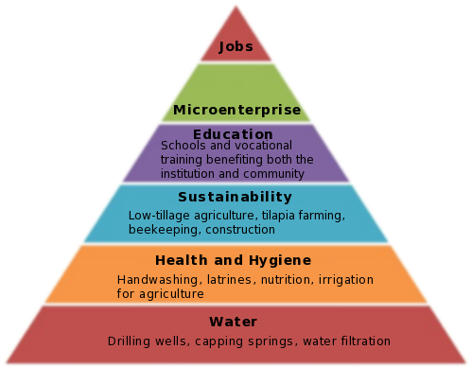
ORPHAN CARE MODEL 1
Source: Brad Davidson

Slide 8
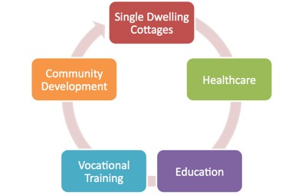
CHOSEN INITIATIVE

Slide 9
WHOSE AGENDA?
United Nations General Assembly (UNGASS) initiated government intervention to the problem (UNAIDS, 2004)
Previous intervention have been home and community base (FHI/GHAIN, 2007; UNAIDS, 2004, Desmond, etal., 2002)

Slide 10
Role of voluntary sectors
Close linkages with the government to ensure sustainability
Assistance in accessing government entitlement and grants
Funding
Placement of children in adoption and foster care
Collaborative advocacy and registration development
Alana, R., etal., 2008

Slide 11
GLOBAL AND LOCAL ISSUES
Partnership collaboration
Global media AIDS initiative (GMAI)
Community based orphan and vulnerable children (CUBS) project
Civil society organisation (Alliance Zambia, 2009)
Alliances and shared responsibilities
Civil society assumes an unorthodox role of enhancing intra – governmental collaboration by investing time and resources (Alliance Zambia, 2009).

Slide 12
Maximising impact
Cost effectiveness
Actual cost of care (Desmond, etal., 2002)
Minimal cost of care(Desmond, etal., 2002)
Drivers
Non governmental organisations
Voluntary sectors
Foreign development partners
(FHI/GHAIN, 2007)
Win – win situations

Slide 13
SUSTAINABILITY
Sustain(able)
“To hold up under, withstand; to maintain or prolong; to support; to keep from falling; to endure; to nourish, nurture, provide for.”
(Collins Dictionary and Thesaurus 1987)
Development
“Development is the process of improving the quality of human life.”
(World Health Organization 1992)

Slide 14
Conclusion
National Governments need to build from community based care (UNAIDS, 2004)
Private sector should be engaged for multisectorial management
More advocacy and resource mobilisation from the implementers to ensure sustainability

Slide 15
Reference
Alana Rosenberg, Kari Hartwig, Michael Merson, 2007. Government–NGO collaboration and sustainability of orphans and vulnerable children projects in southern Africa. Evaluation and Program Planning 31 (2008) 51–60
FHI/ GHAINS, 2007. The GHAIN Programme for Orphans and Vulnerable Children ACHIEVEMENTS AND LESSONS. [Online] Available at: http://www.fhi.org/NR/rdonlyres/edn3z2iveph4w42qaa3jgjfy2qtkvqllwzhymo7easitpymokfzhd2mclxtdal7sdawxmuvfkqn3al/GHAINOVCFinalReportHV.pdf
Child fund/APAC, 2009. District and community-based coordination structures for Orphans and Vulnerable Children. Enhancing Community-Based Care and Support for Children and Youth Living with HIV and AIDS — July 2004 to June 2010. [Online] Available at: http://www.childfund.org.au/static/2/C/580192f20c911ea4c962a4763ed58e92.pdf
UNAIDS, 2004. Reports on the Global AIDS epidemics. 4th Global report. http://www.unaids.org/bangkok2004/GAR2004_pdf/UNAIDSGlobalReport2004_en.pdf
Chris Desmond, Jeff Gow, Heidi Loening-Voysey, Theresa Wilson, Bridget Stirling, 2002. Approaches to caring, essential elements for a quality service and cost-effectiveness in South Africa. Evaluation and Program Planning, Volume 25, Issue 4, November 2002, Pages 447-458.
Alliance Zambia, 2009. Coordination for vulnerable children: Alliance Zambia’s efforts to strengthen government and community OVC systems. http://www.aidsalliance.org/includes/Publication/Zambia_OVC_briefing.pdf
Scheirer, M. A. (2005). Is sustainability possible? A review and commentary on empirical studies of program sustainability. American Journal of Evaluation, 26(3), 320–347.
Kalanidhi subbarao and Diane Coury – World Bank, 2004. Reaching out to African Orphans. A framework for action. [Online] Available at: http://siteresources.worldbank.org/INTHIVAIDS/Resources/375798-1103037153392/ReachingOuttoAfricasOrphans.pdf
Brad Davidson, 2009. orphan care model. community development. [Online] Available at: http://hisg.org/initiatives/Orphan-care/ideal-program/pt-4-orphan-care-and-community-development/

