Slide 1


Joint Programming
Part 1- A way to increase
aid effectiveness
Jost Kadel,
DEVCO/A2 Aid and Development Effectiveness and Financing
Alex Gerbrandij,
EEAS/VI.B.2 Development Cooperation Coordination Division
Brussels, 10 July 2014
Notes:
DEVCO- Bernard San Emeterio
1
1

Slide 2
Outline of presentation
History
Why now?
Scope
Principles
Benefits and Gains
What Joint Programming is about/not about

Slide 3
History of Joint Programming (1)
(A selection of policy decisions)
Council Resolutions on Harmonisation, Coordination, complementarity, etc. in: 1974, 1976, 1984, 1986, 1995, 2000.
Ad Hoc Working Party on Harmonisation Report, 2004: recommends a joint EU approach for programming aid.
EU Consensus on Development, 2005: sets out a common aim and principles for the EC’s and EU MS’s development work.
Joint Framework for Country Strategy Papers, 2006: sets out a path towards joint programming by the EC and EU MS, also including other donors where possible.
EU Code of Conduct on Complementarity and Division of Labour, 2007: proposes limiting country involvement to three active sectors per donor and five donors per sector.
Fast Track Initiative on Division of Labour, 2008: speed up the implementation of the Code of Conduct in about 30 countries.

Slide 4
History of Joint Programming (2)
Common EU Position for Busan, Council Conclusions 2011 with a specific annex on JP ("European Union strengthening Joint Multi-annual Programming"), also defining what JP is about
“Agenda for Change”, Council Conclusions 2012, with strong reference on division of labour and JP: ("This process would result in a single joint programming document which should indicate the sectoral division of labour and financial allocations per sector and donor. The EU and Member States should follow the document when devising their bilateral implementation plans. Participation should be open to non-EU donors committed to the process in a given country.")

Slide 5
Why Joint Programming now?
…apart from our accountability to live up to the recent political commitments in the context of the Agenda for Change, the Busan Outcome Document etc:
Lisbon Treaty: Calls for complementarity and coordination; mandate for the EU Delegations to coordinate EU development cooperation which gives the EU Delegations a stronger coordination role now!
New global realities: We feel that we need to act together to keep our European voice heard as new powerful players emerge on the scene
There is to a growing extent the conviction at political and implementation levels among EU MS that JP will lead to more efficiency, higher impact, visiblity and effectiveness; transparency and predictability
Investment of EU and MS in operational follow-up at HQ and field level is absolutely key; including better and continuous communication. This happens now, needs to be maintained.
This also helped that the conceptual approach is now well understood at various levels

Slide 6
Scope of Joint Programming
Joint analysis of partner country’s development strategy
  Joint response to that strategy
  Identification of sectors of intervention
  In-country division of labour: who is working in which sectors, based on comparative advantages
Indicative multi-annual financial allocation per sector and donor

Slide 7
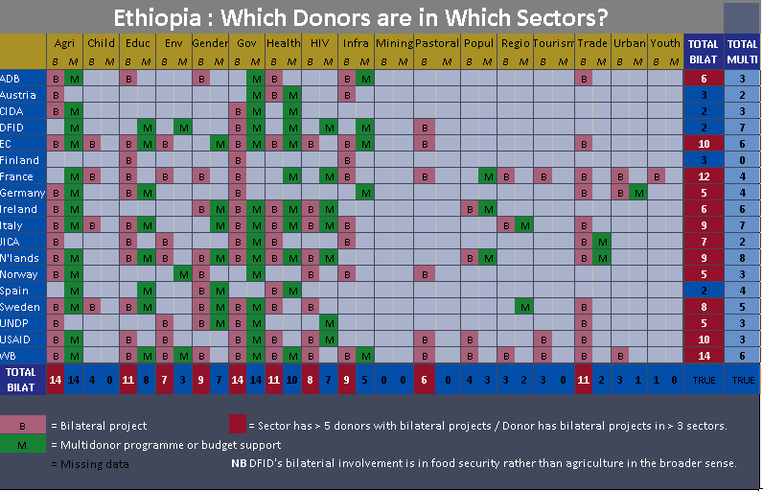

Slide 8
Principles of Joint Programming
Where possible, led by partner country government and based on their strategy
Is aligned to partner country's development strategies;
Synchronisation with partner country's election/planning cycle
Conducted primarily at partner country level in order to respond to specific needs and the situation on the ground
EU MS might like to keep their bilateral implementation plans, but they will be aligned to the joint response
Taking into account donor-wide strategies as far as they already exist to avoid parallel processes/duplication
Open to other committed donors, while the EU is driving force
Gradual approach, according to country specific situations

Slide 9
Benefits of Joint Programming
  Strong alignment with partner country's strategies
  Improved Complementarity among EU donors → less fragmentation → aid effectiveness
  Improved impact (and visibility?) through more coherent EU and MS interventions
  Potential for medium-term cost savings: JP allows the EU and the Member States to substitute their individual country strategies and to work more focused

Slide 10
References for Joint Programming (1)
The Busan commitments
  “We will, by 2013, make greater use of country-led co-ordination arrangements, including division of labour, as well as programme-based approaches, joint programming and delegated co-operation.“
  In practice: International Development Banks and non-European donors remain hesitant, as well as some Member States……

Slide 11
References for Joint Programming (2)
The EU programming instructions (DCI + EDF)
  “EU delegations in partner countries (…) will (…) submit to relevant Directors in the EEAS and DEVCO (…) where possible a draft joint programming document”
  “the multi-annual indicative programme, which represents the EU response, should (…) be synchronized with the country’s/region’s strategy cycle.”
  “The EU Delegation should collaborate on synchronization with MS present in the partner country, including with a view to joint programming”
  “In case of fragile or conflict affected states (…) in particular the EU, should actively strive towards Joint Programming”
  (For the ENI programming instructions references on JP are equivalent)

Slide 12
What joint programming is not…..! (1)
Brussels will decide what EU MS do
EU MS not present on the ground decide what we do
EU MS will have to use EU templates, procedures & timetables
EU MS will have to scrap their bilateral implementation plans
All projects will have to be implemented jointly and simultaneously

Slide 13
What joint programming is not…..! (2)
EU donors must support delegated cooperation or silent partnerships
  Donors might opt for delegated cooperation and/or silent partnership, but this is no pre-condition for JP
EU donors must support Sector Wide Approaches (SWAPs), Program Based Approaches (PBA), or for jointly administered trust funds
  Donors keep on choosing their most appropriate modalities, however, JP will facilitate the development of (SWAPs) and (PBAs) as EU JP improves donors’ complementarity, transparency and predictability
EU donors have to carry out joint monitoring and evaluation

Slide 14
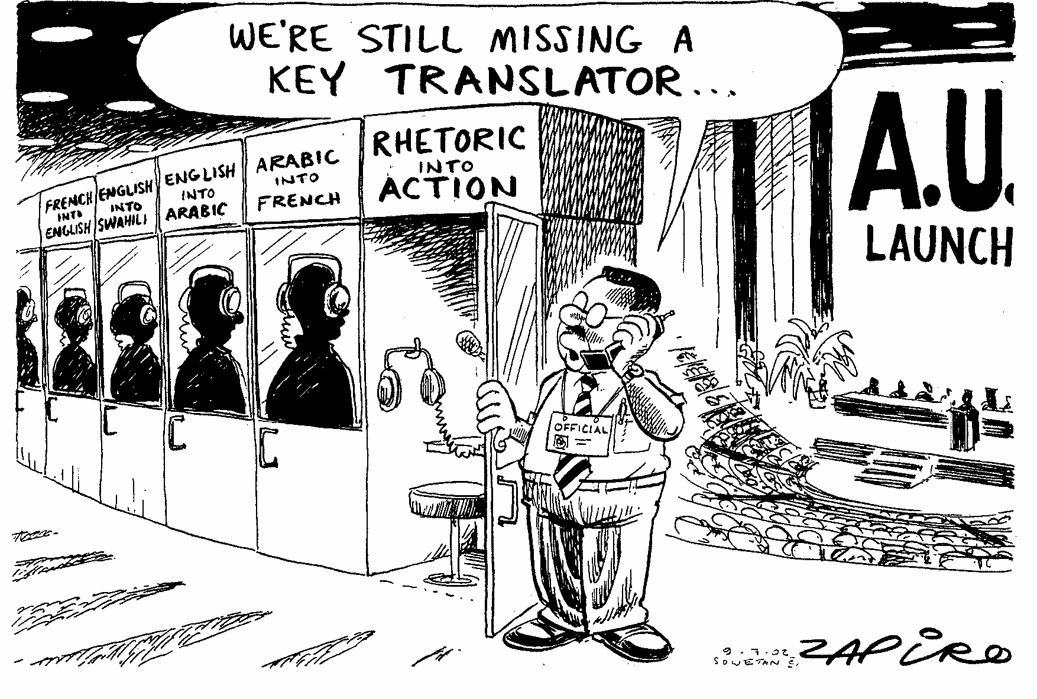
…in conclusion….

Slide 15
Thank you…!
http://capacity4dev.ec.europa.eu/joint-programming
Notes:
DEVCO- Bernard San Emeterio
15
15

