Slide 1


Joint Programming Training
Part 2: Guidance, Practice and Implementation
Jost Kadel,
DEVCO/A2 Aid and Development Effectiveness and Financing
Alex Gerbrandij,
EEAS/VI.B.2 Development Cooperation Coordination Division
Notes:
DEVCO- Bernard San Emeterio
1
1

Slide 2
1. EU programming

Slide 3
EEAS & Commission roles in EU programming (Council decision July 2010)
Management of cooperation programmes is under the responsibility of the Commission
The High Representative shall ensure overall political coordination of the external action, in particular through external assistance instruments (DCI, EDF etc)
Throughout the whole cycle of programming, planning and implementation, the High Representative and the EEAS shall work with the relevant members and services of the Commission
All proposals for decisions will be prepared by following the Commission’s procedures and will be submitted to the Commission for adoption

Slide 4
EEAS & Commission roles in EU programming (Council decision July 2010)
EEAS shall have responsibility for preparing the following decisions of the Commission regarding the strategic, multiannual steps within the programming cycle:
(1) country allocations;
(2) country and regional strategic papers;
(3) national and regional indicative programmes.
With regard to the European Development Fund and the Development Cooperation Instrument, any proposals, shall be prepared jointly by the relevant services in the EEAS and in the Commission under the responsibility of the Commissioner shall be submitted jointly with the High Representative for adoption by the Commission.

Slide 5
Guiding principles for EU programming
2014-2020
Ownership & alignment
Comprehensiveness, consistency and coherence
Sector concentration
Differentiation
Synchronisation and flexibility
Blending for growth
Coordination and Joint programming

Slide 6
Guiding principles for EU programming synchronisation
  In several countries synchronisation will take place
  Still remains challenge in others: ex. Uganda
Uganda | 2011 | 2012 | 2013 | 2014 | 2015 | 2016 | 2017
NDP
EU
BE |  |  |  |  |  | ?
DE |  |  |  |  |  | ?
DK |  |  |  |  |  | ? | ?
IR |  |  |  |  | ?
IT |  |  |  | ? | ?
NL
SE |  |  |  | ? | ?
UK

Slide 7
Key principle: synchronisation
Programming in principle for 2014-2020
Review synchronised with the country planning cycle (date specified in MIP) or two MIPs
Reviews allow for adapting MIP to changing country needs and priorities, JP & division of labour
Example of Bolivia:
 | 2014 | 2015 | 2016 | 2017 | 2018 | 2019 | 2020
€ 280m |  | € 120m |  |  | € 160m

Slide 8
EU Procedure for JP document (1)
For EU part in JP: apply same process /procedure in Brussels as for a bilateral/single proposal without JP
JP document in-country prepared under guidance of heads of missions; including required consultation (CSOs, etc.).
This is where support by consultants could come in.
Once agreed by EU HoMs JP doc sent to EEAS and DEVCO; follow in-house assessment procedure (CTM, etc.)
HoD will see that MS and other donors handle the JP doc through their own system (including role of their capitals)
Notes:
DEVCO- Bernard San Emeterio
8

Slide 9
EU Procedure for JP document (2)
Following endorsement by HQs finalise JP in-country with partner country, then initialled by HoMs and if possible partner country
Final document to be transmitted by HoMs to capitals
Adoption and formalisation according to individual donor procedures/requirements
Again: for the EU part, our own procedure apply: same as for single programming doc, but take account of Member States’ and other donor contributions
Consider signing ceremony (only after legal basis DCI or 11th EDF)
Notes:
DEVCO- Bernard San Emeterio
9

Slide 10
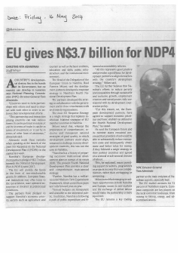
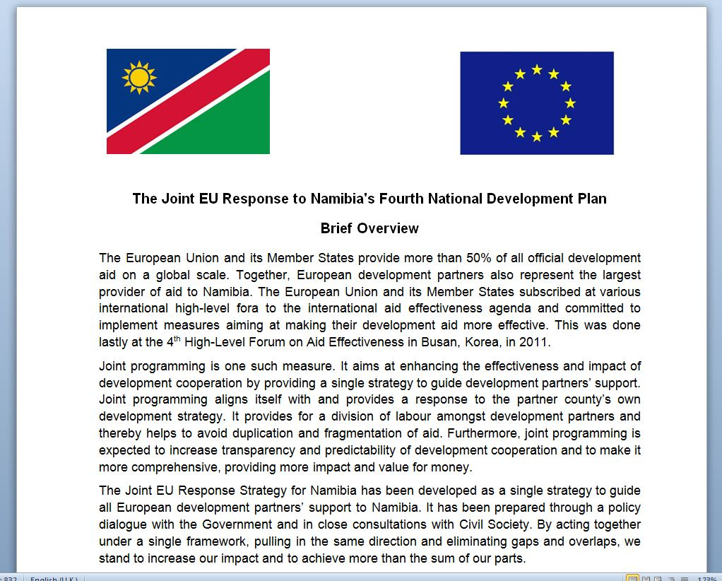

Visibility - Namibia EU Joint Response Strategy May 2014
  EU+MS contribute N$3.7 bn = € 250 million
  Public presentation – no initialling/signing
  Active government intervention
  Press coverage
Notes:
DEVCO- Bernard San Emeterio
10

Slide 11
3. Joint Programming implementation:
Where are we?

Slide 12
How to assess JP feasibility in-country: Heads of Missions reports
  Key principle: in-country led
  First Wave in 2012: 11 countries
  Added value of HoMs reports: enables shared position of EU and MS on the ground (ownership of process)
  HoMs reports exercise extended in 2013: to another 40+ countries
Notes:
DEVCO- Bernard San Emeterio
12

Slide 13
State of play: 55 countries (1)
Progress in 34 countries
Joint Programming documents (14):
  2012-2013: Ghana, Guatemala, Laos, Rwanda, South Sudan (1st phase)
  2014: Burma/Myanmar, Burundi, Chad, Cambodia, Mali (1st phase, short term), Namibia, Paraguay, Senegal, (South Sudan 2nd phase), Togo
Joint analysis/response (7):
  Bangladesh (2014), Bolivia, Comoros (end 2014), Cote d'Ivoire, Ethiopia, Liberia (end 2014), Kenya (end 2014)
First preparatory work started (13):
  Algeria, Georgia, Honduras, Malawi, Mauritania, Mozambique, Nepal, Niger, Nicaragua, Palestine, Tanzania, Uganda, Yemen

Slide 14
State of play: 55 countries (2)
21 other countries:
Countries that might start in 2015-17 (5):
  Benin, Burkina Faso, El Salvador, Sierra Leone, Philippines
Potential, but to be decided/worked out (13):
  Afghanistan, Armenia, Egypt, Haiti, Jordan, Libya, Moldova, Morocco, Pakistan, Somalia, Tunisia, Vietnam, Zimbabwe
Not at this stage, to be reviewed (3):
  Timor Leste, Ukraine, Zambia
Estimated share of Joint Programming in European Development Fund and Development Cooperation Instrument:
60-70% (of bilateral envelopes)

Slide 15
Windows for synchronisation/JP per year
2013/2014 | 2015 | 2016 | 2017 | 2018 | Date to be confirmed
Bangladesh | Comoros | Afghanistan | Bolivia phase 2 | Cambodia phase 2 | Algeria
Bolivia |  | Bangladesh phase 2 | Georgia | Honduras | Mali phase 2
Burma/Myanmar phase 1 |  | Benin | Ghana phase 2 | Kenya phase 2 | Moldova
Burundi |  | Burkina Faso | Guatemala phase 2 | Liberia phase 2 | oPt
Cambodia |  | Burma/ Myanmar phase 2 | Haiti phase 3 | Nicaragua | Timor Leste
Chad |  | Burundi phase 2 | Nepal | Paraguay phase 2
Côte d'Ivoire |  | Chad phase 2 | Philippines | Rwanda phase 2
Egypt |  | Côte d'Ivoire phase 2 | Senegal phase 2
Ethiopia |  | Egypt phase 2 | Sierra Leone
Ghana |  | El Salvador | South Sudan phase 3
Guatemala |  | Ethiopia phase 2 | Togo phase 2
Haiti phase 2 |  | Laos phase 2
Kenya |  | Malawi
Laos |  | Mauritania
Liberia |  | Morocco
Mali |  | Mozambique
Namibia |  | Niger phase 2
Paraguay |  | Pakistan
Rwanda |  | Tanzania
Senegal |  | Tunisia
South Sudan phase 2 |  | Uganda
Togo |  | Vietnam
Niger phase 1 |  | Yemen
 |  | Zimbabwe

Slide 16
Regional breakdown
Dark green = Joint programming agreed
Middle dark = Potential, but not agreed yet
Light green = No Joint Programming at this stage

Slide 17
Country type breakdown

Slide 18
Stakeholders
  In most JP countries all active MS join JP
  JP seen as more challenging in donor-crowded countries
  Other European donors Switzerland and Norway participate in a number of countries
  Partner countries generally supportive, but not pro-active: to be involved from the beginning as far as possible

Slide 19
From Joint Programming towards joint implementation
Council conclusions Nov. 2011:
  'Joint programming does therefore not encompass bilateral implementation plans. It allows the EU and the Member States to substitute their individual country strategies.'
However, joint implementation is logical next step:
  EDF Regulation:
    'and where appropriate joint results framework'
    'joint donor-wide missions and by the use of co-financing and delegated cooperation arrangements'
    'where appropriate, seek to undertake joint evaluations with EU Member States, other donors and development partners'
  Joint Programming strategically paves the ground for joint implementation, once division of labour has been decided
  EU+MS expressed an interest: Joint Programming workshops in Guatemala and Addis Ababa called for move towards joint implementation

Slide 20
Joint implementation: possible approaches
Division of labour within sectors:
  sector mapping; who does what (best), donor roles (lead, active); managing exits; indicative allocations → Use toolkit on Division of Labour (June 2009)
From sector coordination towards:
  joint analysis/appraisals and sector response; joint aid modalities (budget support, pooled funding, delegated cooperation, trust funds); sector dialogue; work with non-EU donors
Joint sector results frameworks:
  joint goals/indicators built on partner country systems; joint monitoring, evaluation and reporting; ensure EU-visibility
Joint reporting on global funds:
  Global Partnership for Education

Slide 21
5. Next steps

Slide 22
The way forward
  Focus on actual implementation by EU and MS; from Mexico Communique:
    Promoting the extension of joint programming processes to more partner countries and other development partners to make full use of its potential, with a view to having joint programming processes operational in 40 or more partner countries by 2017;
    EU guidance issued by the end of 2014 and regional seminars on joint programming held in five regions by mid-2015.
  Keep political momentum in EU and MS
  at Council, EU Directors General, Technical Seminars, Regional Workshops
Notes:
ACTUAL IMPLEMENTATION:
JP documents endorsement/approval process and monitoring of implementation
Further assessment and follow up of country roadmaps and/or reports by Delegations (incl. sending reminder to Delegations)
JP training sessions in Brussels and in MS capitals
Guidance from capitals to the field
In-country support and guidance: missions by consultants + regional workshops

Slide 23
Support and Guidance: menu of options
  Sharing of EU and Member States' JP Guidance
  Country support missions by consultants – EU support programme
  Sharing good practice through capacity4dev.eu
  Training/Knowledge Sharing
    EU staff training on JP, also open to EU Member States (Brussels)
    EEAS/Commission visits to MS capitals
    Regional workshops in 2014 (see next slide)

Slide 24
Regional Joint Programming workshops
Objectives: update from HQ; guidance; exchange experiences; address local challenges; identify good practice and support needed
Target group: EU Delegations and MS embassies (HoCs); also participation of EEAS, Commission and MS HQs
Organisation: EEAS & Commission Joint Programming & geographical teams with hosting EU Delegations + MS
Planning:
  Latin America, Guatemala, 20-21 January 2014 (support: Spain)
  Central, East & Southern Africa, Ethiopia, 13-14 March 2014 (support: Belgium and the Netherlands)
  West Africa, Ivory Coast, 4-5 June 2014 (support: France)
  Asia, Burma/Myanmar, February 2015 (support: Germany)
  Neighbourhood, venues and date tbc (support: Sweden for East Neighbourhood)

Slide 25
6. What you could do

Slide 26
What could country desks do?
Support Delegations and embassies with roadmaps and implementation
Stay in contact with your embassy/field office on the progress of JP
Include JP in briefings for your hierarchy
Include JP in your country missions (meet with EU Delegations, other MS embassies and field offices)
Ensure endorsement/approval responses on JP documents
Establish informal contacts with country desks of EU (EEAS and DEVCO) and other MS; share challenges faced at country level
Consider HQs-Field meetings/Videoconferences

Slide 27
6. Do you now believe in
Joint Programming?

Slide 28
… if not, look at this …

Slide 29
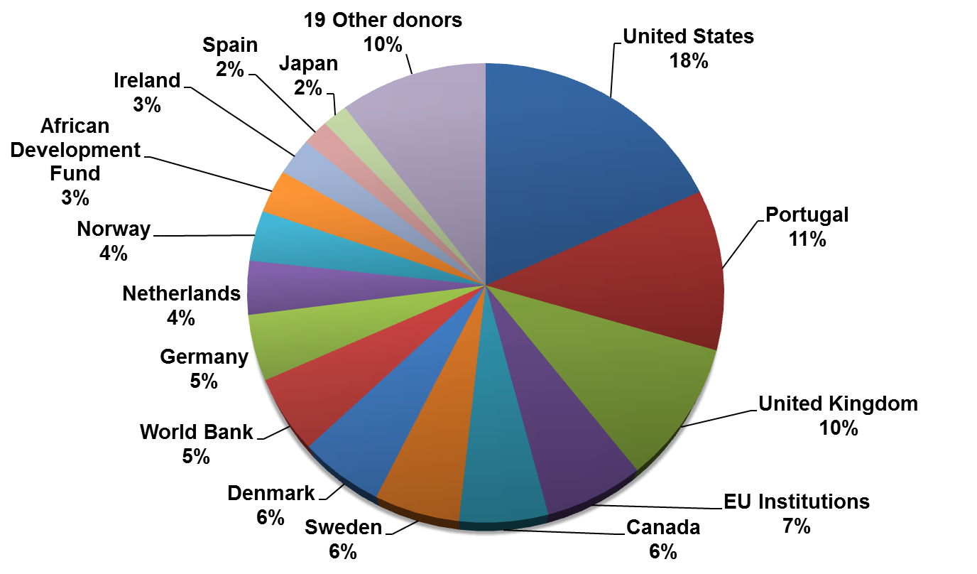
Fragmented aid in Mozambique …
(source aid data OECD/DAC 2011)

Slide 30
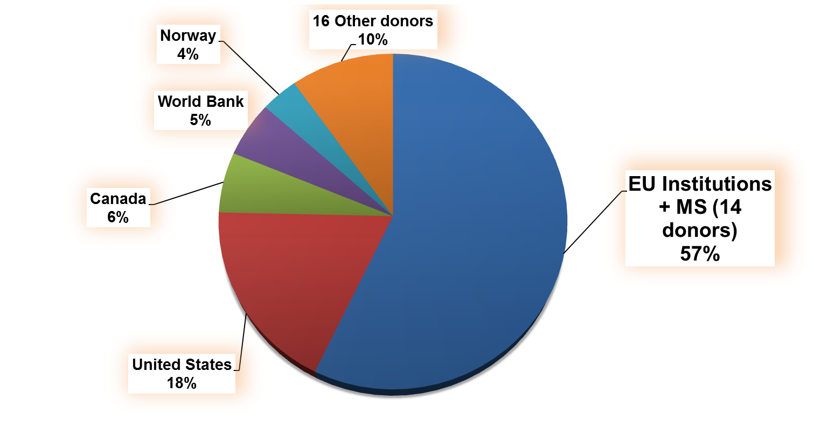
… when EU acts as one in Mozambique
(source aid data OECD/DAC 2011)

Slide 31
Within a sector: Procurement chain of donors in health in Kenya
31
31
Notes:
Aid Effectiveness, EuropeAid
31
Aid Effectiveness, EuropeAid
31

Slide 32
Donor 2
Donor 3
Donor 4
Donor 5
DoL
Donor 1
Donors finance the Government (health) budget, use country systems
and support capacity building
SBS/
Pooled
funding
Government
UCS
Government uses its own procurement
procedures for buying drugs
Drugs
warehousing, organisation, delivery
32

Slide 33
Joint programming support persons in EEAS/VI.B.2 and DEVCO/A2
Alex GERBRANDIJ Marie-Laure DE BERGH | Central, East, Southern Africa, Asia, East Neighbourhood West Africa, Latin America, Southern Neighbourhood | EEAS/VI.B.2
Jost KADEL | Neighbourhood, Latin America and Caribbean regions Burma/Myanmar, Nepal, Pakistan, Yemen | DEVCO/A2
Michael KIROSINGH | West and Central Africa Overall Asia/Pacific contact point Cambodia, Laos, Philippines, Vietnam | DEVCO/A2
Lino MOLTENI | Southern and Eastern Africa Afghanistan, Bangladesh | DEVCO/A2

Slide 34
Further info on:
http://capacity4dev.ec.europa.eu/joint-programming
Notes:
DEVCO- Bernard San Emeterio
34
34

