Slide 1

Developement Aid Support/Knowledge For Development Without Borders (KFDWB)

Slide 2
Sustainable, worth-living integrated development
We do not need to point out anybody, any development organizations, any universities, community practices, NGOs, public and private institutions, government as Millennium Development Goals (MDGs) are applied to all people (Rich and poor) worldwide. We have ALL witnessed or been party to the failure of some Millennium Development (MDGs) Goals to achieve their assigned objectives.

Slide 3
Sustainable, worth-living integrated development
Whatever the sustainable development politics, strategies are, and would be, we have reached a sustainable development era where there is a need of suitable social mechanism support worldwide to connect a global audience to necessary resources while providing a system to translate these goals, data, information and knowledge into sustainable local best practices.
So we are calling on interested parties from all backgrounds who can support, bring creativity, dedication, experience and talent to this program, to assist the hard work of development organizations, local governments, donors, foundations, ONGs, private sectors, for the worth management of, and worth investment in the social, economic and environmental well-being of our lovely planet.
Visit: http://www.developmentaidsupport.org

Slide 4
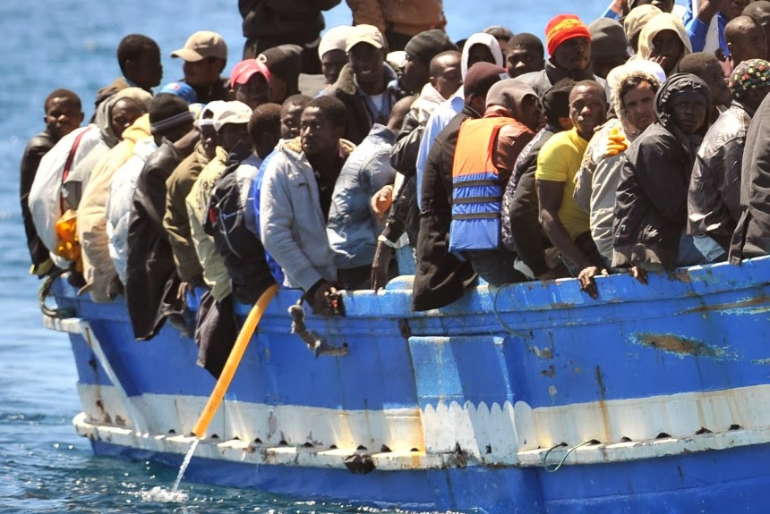
Why the Program KFDWB?
The first challenge is a group of populations with an empty Stomach, a group of populations in "survival mode", a group of populations with false information, and a group of individuals who focused their interests only in "money" and "greedy business" could not take care right about the United Nation's Millennium Development Goals, the worth management of the social and environmental well-being of our lovely planet. Only on the papers and marketing places it would work fine.
If poorest of poor people have trouble meeting basic needs it will affect others parts of the world and societies (e.g. Lampedusa humanitarian crisis – e.g. Spain´s illegal immigration etc).

Slide 5
Why the Program KFDWB?
So, there is the lack of sufficient knowledge and a Global Social Services Support for supporting local people, local governments as well as the workers who work in sustainable and worth-living integrated development.
The facts are showing that the access to the data, information, knowledge and development resources even technologies and money are not enough to guarantee Sustainable Development Goals (SDGs) as long as there is no suitable social mechanism into place to support worldwide the target audiences to translate these Goals, data, information and knowledge into sustainable local best practices.

Slide 6
Why the Program KFDWB?
There is a mass of populations in the world without access to the information and the knowledge about the benefits of the Millennium Development Goals (MDGs).
There is a mass of populations in the world who do not know what the Millennium Development Goals (MDGs) are and mean.
There is a mass of populations in the world who do not know how to put the Millennium Development Goals (MDGs) into practices…

Slide 7
Why the Program KFDWB?
Sustainable Development is not only a process to develop a specific country or continent. It is also about the promoting, the monitoring, the support and the maintenance of the United Nation's Sustainable Development Goals.
The capacities of local governments are sometime limited in resources to cover all the good practices of their Sustainable Development Goals (SDGs). E.g. access to the money and information is not enough. Even microfinance and ICT have shown their limits.

Slide 8
Why the Program KFDWB?
The government may could be changed, but only with good social support mechanism, it is possible to have a sustainable development of our society.
Therefore we need a social mechanism support that informs, supports, engages, and mobilizes poor, rich, business, religion, literate, illiterate, local people and local governments to put right or to translate the SDGs through the MDGs practices into the right local practices worldwide.

Slide 9
What do we do?
We inform worldwide population about meaning and benefits of MDGs. We motivate and engage worldwide population with the best practices of MDGs.
We mobilize local communities, communities' practices, local governments, remotes areas, villages etc. to engage and contribute to the achievement and maintenance of the Millennium Development Goals (MDGs) while not neglecting to help them to access the minimum sociocultural infrastructure that guarantees the human existence requirements.

Slide 10
What do we do?
Our organization teams, mobilize and engage all people without making any distinction from around the world, and considers everybody as part of one family for the good purpose, achievement, monitoring and maintenance of the Millennium Development Goals (MDGs) - which is our social and environmental well-being of our lovely planet.

Slide 11
What do we do?
We report, categorize, classify data, information and knowledge on our integrated central platform from live experience on the grounds that we have and believe in. The data, information and knowledge that we can demonstrate, show live, share with all without restriction..
We know our limit and respect private data, private information and private knowledge.

Slide 12
Example of report file (logfile) that will be stored on our central platform
Log File Reference: | e.g. KFDWB 200774
KFDWB Unit: | e.g. KFDWB - West Africa 034
Knowledge Customizer Name: | e.g. Ms./Mr. Muster man
Region | e.g. Continent: Africa
 | e.g. Division: KFDWB - Centre Africa - West Africa
 | e.g. Regional KFDWB: West Africa ID2007
 | Country: e.g. Muster Country
 | Locality: e.g. Village xxx
Development issue identified | Description: e.g. Sounding alarming no hospital nearby. The villagers’ kids die of malaria or other diseases because there is either no hospital nearby, even they cannot afford the cost when there is a hospital.
 | Priority: high
Number of populations concerned: | e.g. 500.000
Education level of the concerned populations: | e.g. Middle (Most of the populations in the village do not go to school)
Local capacity level of the concerned populations: | e.g. Weak - There are no action, no guidance, no engagement and no mobilization of the populations to undertake the process of having access to a local hospital
Availability of the other basic needs for human existence: | e.g. The populations are living in survival modus (lack of health care, sanitation, clean water, employment, local cooperation, food, inter alia, guidance) etc.
Additional information: | e.g. Inspection, verification videos, reportages, assessments, evaluations, meetings, documentations etc.
Date and Signature:

Slide 13
Some activities
The rain forest will disappear without intervention we will sound the alarm by the local government and international development organizations for intervention.
There are suspicious and unofficial social or environmental activities that could affect the lives of a group of populations and the local environment we will sound the alarm by the local government and local/international development organizations for intervention.
The bridge in a remote area is defect and it affects the lives of the local populations we will sound the alarm by the local government and international development organizations for intervention.

Slide 14
Some activities
The water pumps in the rural community are suffering of the human infrastructures needed for the maintenance. We will sound the alarm by the local government and local/international development organizations for intervention, and follow the access process to the human infrastructures.
Children are not sent to school and are held in slavery we will sound the alarm by the local government and local/international development organizations for intervention, and assist in the process of sending the children to school.
There is a group of populations who could not Keeping Warm in Winter we will sound the alarm by the local government and local/international development organizations for intervention, and follow the process for helping them keeping warm in Winter.
And so.....

Slide 15
How KFDWB could be helpful?
When development issues are earlier correctly identified through a real time data, information and knowledge (Knowledge for development without borders), any solutions to it should be also better carefully discussed as the implementation for any development interventions we choose will be important (time, money, effectiveness, operations and support).
We complete the ongoing efforts and work with international, local populations, development organizations, development agencies, foundations, donors, governments, private and public institutions to identify and to invest in worth sustainable development projects .

Slide 16
Who can profit from the program KFDWB apart from local populations?
We assist Development Organizations, NGOs, Foundations, local governments, Donators, Charity Organizations, private and public institutions etc. to update on real time their aid and Open databases for worth decision making and intervention as we have ears and eyes on the daily on the grounds, wherever and worldwide:
live, right data, information and knowledge acquisition and dissemination of decision analytics at the right time for Development Organizations, NGOs, Foundations, Governments Agencies, Donors, Charity, Organizations, Private and Public institutions etc.

Slide 17
How the data, information and knowledge can profit?
Live reported data, information and knowledge will be used by Open Government Partnership's and non-OPG's in future decisions regarding sustainability and development that will impact the life of our generation and the future of our children.

Slide 18
FAQs
Eyes and ears on the ground worldwide. Are we talking about developing a network of people who are at locations all over the world, who will somehow contact us or website and post information about what is happening in their neighborhood or area that they see?
The activities are carried out on five continents through network, national sections, and its close collaboration with local and regional Medias, local government, private and development organization groups.
We explore all possible sources (SMS, telephone, fax, medias, social network, email, storytelling, workshop, discussions, giving comments/information anonymously, group meeting etc.) of knowledge and information.

Slide 19
FAQs
Will all of our staff be volunteers?
No, to avoid corruption, management and knowledge customizer staff, data, information and knowledge verification staff must be paid.
How do we get funding, and how do we pay them?
KFDWB is an NGO, whose liability is limited solely to the assets of the NGO. The work of the NGO is financed though sustainable development activities (e.g. Social Services support to MDGs) and the contributions of public and private foundations and funds, through public fund-raising and other contributions.

Slide 20
FAQs
How do we verify what they are saying or while giving comments anonymously?
All suspected information and knowledge we receive must be verified with inspection on ground. We report, categorize, classify data, information and knowledge on our a central database as a log file from live experience on the grounds that we believe in, that we can demonstrate, share and show live with all without restriction. We respect private data, private knowledge and private information.
Two people at the same location give two conflicting information. How do we resolve their differences, and how?
We report only what we see, what we can verify and what we can proof.

Slide 21
FAQs
How do we get people to do this watching and reporting? Some kind of advertising, or networking?
We mobilize, engage, encourage and work hands in hands with the local populations, local medias, local NGOs, local governments, private and public institutions, international development organizations, local community practices, etc. to explore on real time accurate data information and knowledge from each corner on the ground.

Slide 22
FAQs
How do we protect people who may give accounts that their government doesn't want them to say?
Our activities worldwide must be legal activities. Our Activities must respect the human rights. To facilitate our activities worldwide we need to be affiliated with the UN as an integrated Global Services support that supports the Sustainable Development Goals (SDG) on the ground through the promotion of simple and good practices of the Millennium Development Goals (MDGs) to reach sustainable, worth-living integrated development.
Local governments should try to support and help us doing great job while protecting our volunteers and staff in difficult situations and operations, as the capacities of local governments are sometime limited in resources to cover all the good practices of their Sustainable Development Goals (SDGs) through the through Simple and Good Practices of the Millennium Development Goals (MDGs).

Slide 23
FAQs
I want to be become a member or want to organize local committee on my country. How do I join or what do I do?
Any individual supporting the aims of KFDWB is eligible for membership and to organize local committee (See detail: conditions of service). The KFDWB is independent of all political, religious and economic interests.
KFDWB, a non-profit organization, was established as a new program to support Sustainable Development Goals (SDGs) through the best practices of MDGs by volunteers in February 2014 with Headquarter in Austria, Vienna.
Subsequently, a support committee for the program would be established in each country. The work of the program as well as support committee is carried out through the NGO with Headquarter in Austria

Slide 24
FAQs
Are we funding development projects?
No, we are supporting on free contract basis agreement ongoing sustainable development projects, private and public investments to match with the local socio-cultural context.
We provide accurate information and knowledge on the socio-cultural context for better evaluation, decisions, and successfully interventions, private and public worth investments.

Slide 25
The Homepage of the Program
The platform of Knowledge For Development Without Borders. The Global Social Services Support worldwide for the forthcoming Sustainable Development Goals (SDGs) through the promotion of simple and good practices of the Millennium Development Goals (MDGs) to reach sustainable, worth-living integrated development. http://www.developmentaidsupport.org

Slide 26
Thank you very much for your time!
We are looking worldwide for honest volunteers, colleagues, friends, institutions, partners, universities, governments, foundations, privates, publics, NGOs, donors, individuals etc. to help us to develop this new program to assist development organizations and local governments for the worth management of the social and environmental well-being of our lovely planet.
Knowledge for Development Without Borders recognizes the individuals that donate their time, resource and energy to help and support Development Organizations and others for the worth management of the social and environmental well-being of our lovely planet.

