Slide 1
2014-2020 ENI CBC Programmes
Overview of the policy and legal framework
Bodil Persson (DG DEVCO)
Seminar Regional Development Plan 2020-2014 for North-East Region Romania
A Start for Growth and Jobs
16 May 2014
Brussels, Belgium
Vanessa De Bruyn (DG DEVCO)

Slide 2
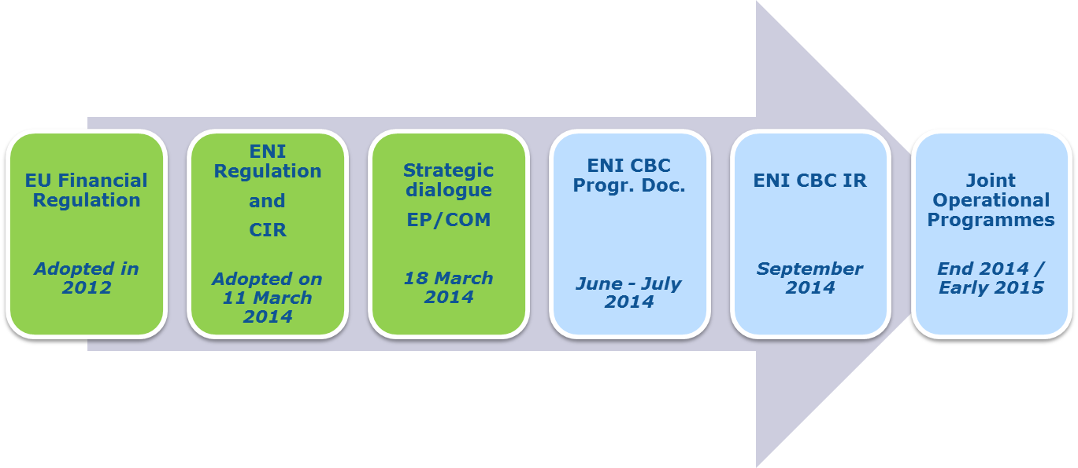
INDICATIVE TIMELINE

Slide 3
ENI CBC Programming Document (PD)
  Establishes individual programmes
  16 programmes along the external border are expected to be set up building on continuity of ongoing programmes
  Identifies the core eligible area (= eligible border regions at NUTS 3 level) for each programme and the options for extending the geographical eligibility
  Defines the ENI CBC strategy (strategic and thematic objectives)
  Specify indicative ENI CBC budget allocations for each programme (+ ERDF funds)

Slide 4

ENI CBC PD: list of individual programmes
Land border programmes:
Kolarctic (FI-RU)
Karelia (FI-RU)
SE Finland-Russia
Estonia-Russia
Latvia-Russia
Lithuania-Russia
Poland-Russia
Latvia-Lithuania-Belarus
Poland-Belarus-Ukraine
Hungary-Slovakia-Romania-Ukraine
Romania-Ukraine
Romania-Moldova
Sea crossing programme:
Italy-Tunisia
Sea Basin programmes:
Mediterranean sea
Black sea
Mid-Atlantic (ES-PT-MO)
(+ Baltic sea – managed by DG REGIO)

Slide 5
ENI CBC PD – Core eligible area
Programme area
At project level:
Major centres
Core eligible area
Activities outside the programme area
Max. 20% of the EU contribution to the programme
+
Adjoining
régions
Extension from NUTS III to NUTS II
(only for sea-crossing programmes)

Slide 6
ENI CBC PD – Strategy (1)
3 strategic objectives
+ menu of 10 thematic objectives
Need for a more focused thematic approach: Selection of 4 thematic objectives by each programme
Not all strategic objectives should be addressed

Slide 7
ENI CBC PD – Strategy (2)
Three strategic objectives:
Promote economic and social development in regions on both sides of common borders
Address common challenges in environment, public health, safety and security
Promote better conditions and modalities for ensuring the mobility of persons, goods and capital
People to people an important horizontal modality for achieving the above

Slide 8
ENI CBC PD – Strategy (3)
10 Thematic objectives:
Business and SME development
Support to education, research, technological development and innovation
Promotion of local culture and preservation of historical heritage
Promotion of social inclusion and fight against poverty
Support to local & regional good governance
Environmental protection, climate change adaptation
Improvement of accessibility to the regions, development of transport and communication networks and systems
Common challenges in the field of safety and security
Promotion of energy cooperation
Promotion of border management, and border security

Slide 9
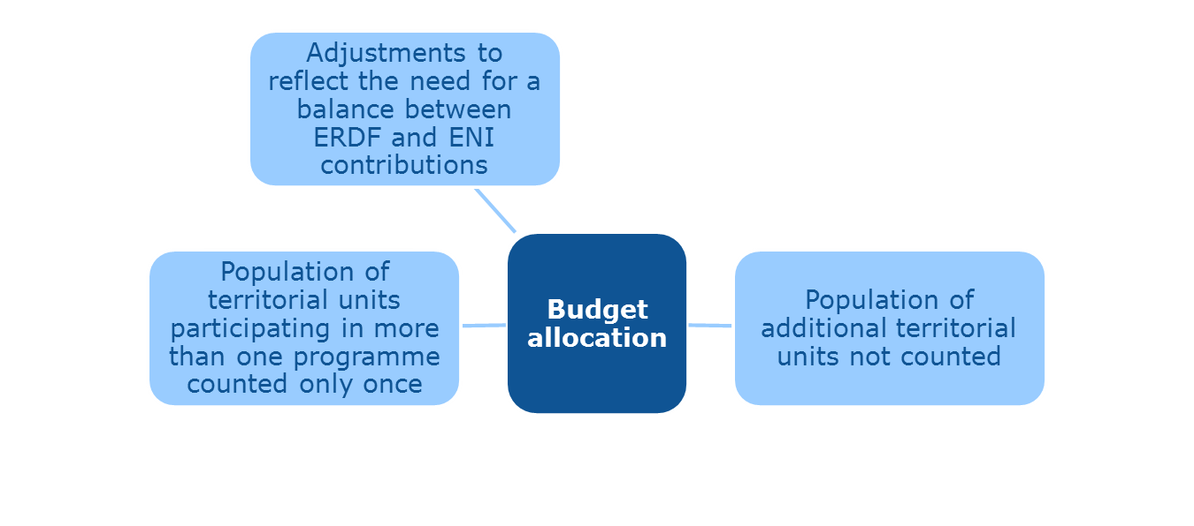
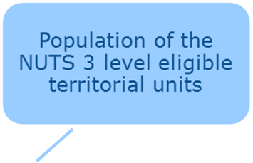
ENI CBC PD – Financial framework
ENI regulation: €15,5 bn → up to 5% to CBC
No individual allocation for CBC programmes yet

Slide 10
ENI CBC Implementing Rules 2014-2020
Alignment on ETC rules – to the extent possible
Deeper shared management mode
2 programme authorities: - Managing Authority (MA)
designated by the hosting MS
- Audit Authority (AA)
Appointment of new management bodies by each participating country to support the MA:
- Control Contact Points (CCP)
- Group of Auditors (GoA)
PRAG no longer compulsory
Increased flexibility and responsibilities
for all participating countries

Slide 11
PROJECTS (1)
GRANTS
Calls for proposals
Direct award
Exceptional and justified cases (monopoly, technical competence)
List included in the JOP (final for large infrastructure projects, indicative for others)
EC approval

Slide 12
PROJECTS (2)
LARGE INFRASTRUCTURE PROJECTS (LIPs)
Financial limit to infrastructure component will be set
Selected by direct award or calls for proposals
→ Full applications for LIPs selected by direct award to be submitted to the EC no later than 31.12.2017
Share of EU contribution allocated to LIPs must not exceed 30%

Slide 13
Thank you for your attention
Vanessa.de-bruyn@ec.europa.eu

