Slide 1
ENI CBC (European Neighbourhood Instrument Cross Border Cooperation): Promoting cooperation at the EU’s external borders
Open Days
7 October 2014
Bodil Persson, European Commission

Slide 2
The Embryonic phase: 2004-2006
Neighbourhood programmes in 2004-2006
Building on Interreg programmes between MS, Tacis, Meda and Phare CBC experiences
For the first time, genuinely joint cooperation put in place on these borders

Slide 3
Coca-Cola Border – YouTube

Slide 4
First generation of integrated CBC between Member States and Partner countries: ENPI CBC 2007-2013
As from 2007 ENPI CBC – Fully integrated projects with one contract covering both sides of the borders
Single set of rules
Pooled ERDF/ENPI funding
Total budget: 950 m EUR (ERDF + ENPI)

Slide 5
2007-2013 ENPI CBC programmes in figures: +/- € 950 M
Land border programmes | Sea crossing programmes
Kolarctic (30.5M€) | Italy-Tunisia (25.2M€)
Karelia (23.2M€) | Spain-Morocco (156.7M) cancelled
 | Atlantic (32.1M€) cancelled
South East Finland-Russia (36.2M€) | Sea basin programmes
Estonia-Latvia-Russia (47.8M€) | Black Sea (25.7M€)
Latvia-Lithuania-Belarus (41.7M€) | Mediterranean Sea (200M€)
Lithuania-Poland-Russia (124.2M€) | Baltic Sea Region (216.8M€)
Poland-Belarus-Ukraine (186.2M€)
Hungary-Slovakia-Romania-Ukraine (68.6M€)
Romania-Moldova-Ukraine (126.7M€)

Slide 6
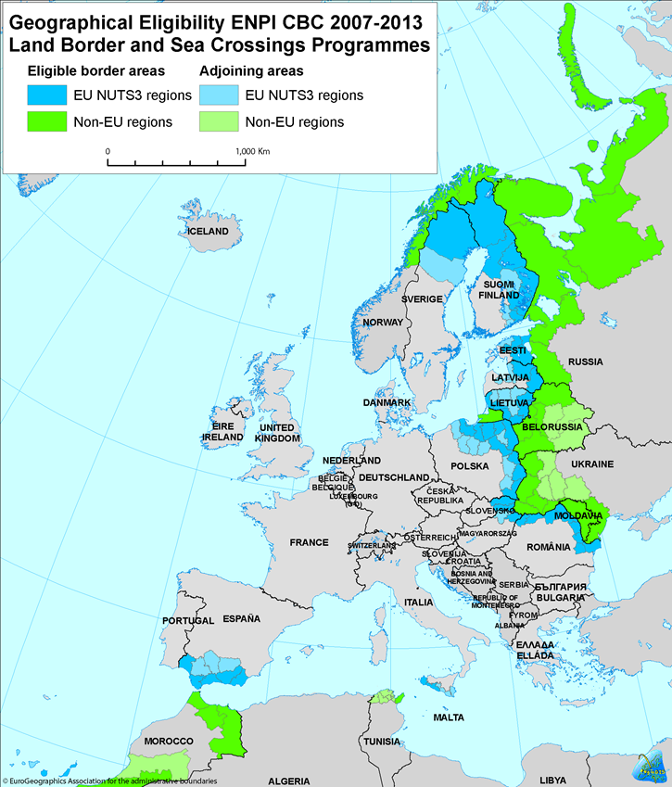
Where do we find the ENPI CBC programmes? Land border and Sea crossing programmes

Slide 7
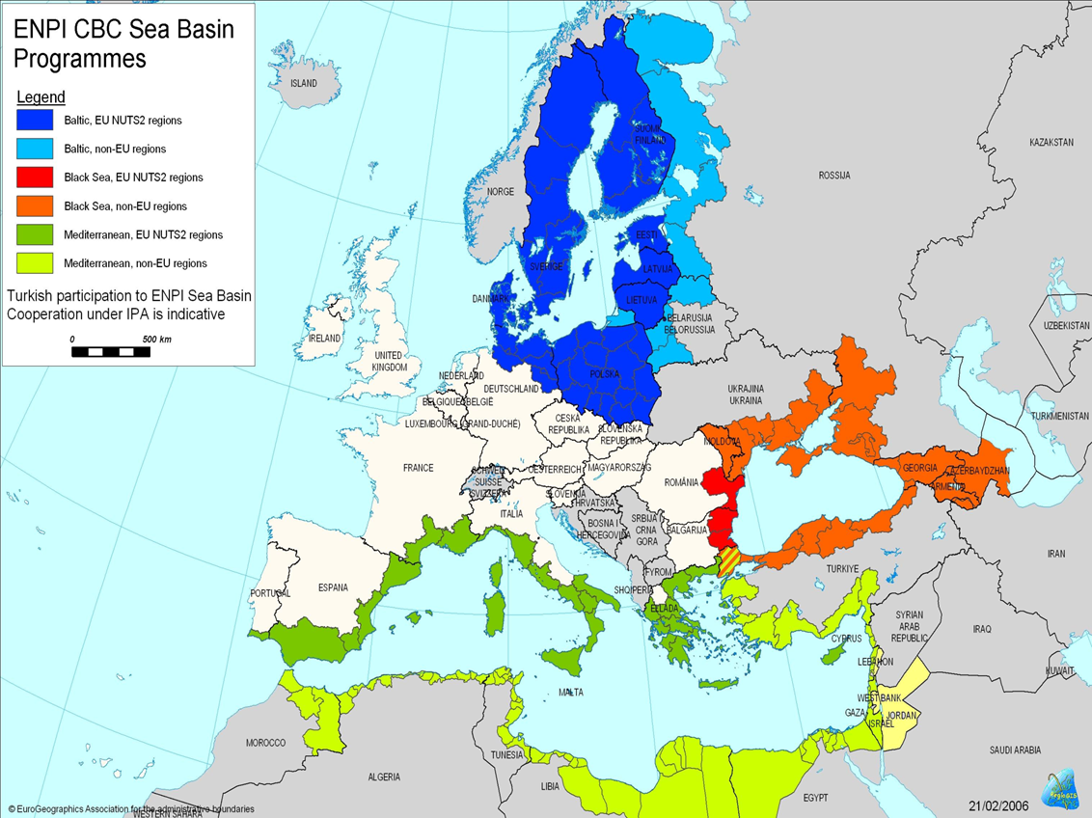
Where do we find the ENPI CBC programmes?
Sea basin programmes

Slide 8
What is the CBC between
Member States and Partner countries for ?
Avoid creation of new dividing lines
Contribute to integrated and sustainable regional development between neighbouring border regions and harmonious territorial cooperation over the borders

Slide 9
How are the CBC programmes MS/PC prepared? What is the Legal framework?
ENPI / ENI regulation: sets the principles of CBC between MS and PC
CBC Strategy paper/programming document : lists the objectives, programmes' areas and budgets
Implementing rules: gives the framework for implementation
JOP: developed by participating countries: Specific objectives, project selection, programme management etc

Slide 10
What makes of CBC MS/PC a 'strange animal' in both the Development and Cooperation and Regional Development worlds?
Shared management with Managing Authorities established in Member States
Full ownership of Partner Countries with decisions taken on an equal basis

Slide 11
What types of Projects did we implement so far?
1."Standard projects" selected via Call for proposals: over 900 ongoing or already finalised
2. Large Scale Projects identified and selected directly by the participating countries – Direct award. Approx. 50 projects
Notes:
Explain LSP : border crossing points, roads etc…

Slide 12
What next? The ENI CBC 2014-2020
Continuity principle
Shared management principle but more financial responsibilities to both MS and PC
17 programmes (3 trilateral split into bilateral and Mid Atlantic Sea Basin)

Slide 13
So far, CBC in a nutshell:
High quality project implementation (confirmed by external monitoring)
Strong comitment at all levels (programme & project) despite a difficult context (political crisis etc)
"CBC" impact to be reinforced (new programmes more targeted)
Capacity building needs at Local level in Partner countries

Slide 14
2014-2020 ENI CBC programmes
Land Border Programmes | Sea crossing Programmes
Kolarctic/Russia | Italy/Tunisia
Karelia/Russia
SE Finland/Russia
Estonia/Russia
Latvia/Russia
Lithuania/Russia
Poland/Russia
Latvia/Lithuania/Belarus | Sea Basin programmes
Poland/Belarus Ukraine | Baltic Sea Region
Hungary/Slovakia/Romania/Ukraine | Black Sea
Romania/Ukraine | Mediterranean
Romania/Moldova | Mid-Atlantic

Slide 15
Want to know more?
http://ec.europa.eu/europeaid/regions/eu-neighbourhood-region-and-russia/eu-support-border-cooperation-eu-neighbourhood-and-russia_en
http://enpi.interact-eu.net/enpi/358
http://capacity4dev.ec.europa.eu/home (Cross-Border Cooperation 'neighbourhood' group soon to come)

