Slide 1
Greening Development Cooperation
Climate change science and planning under uncertainty – module 1b

Slide 2
Structure
Is climate changing? What evidence do we observe?
What are the consequences - Examples
Levels of uncertainty
Notes:
Expansion
Examples:
Groupwork / discussion

Slide 3
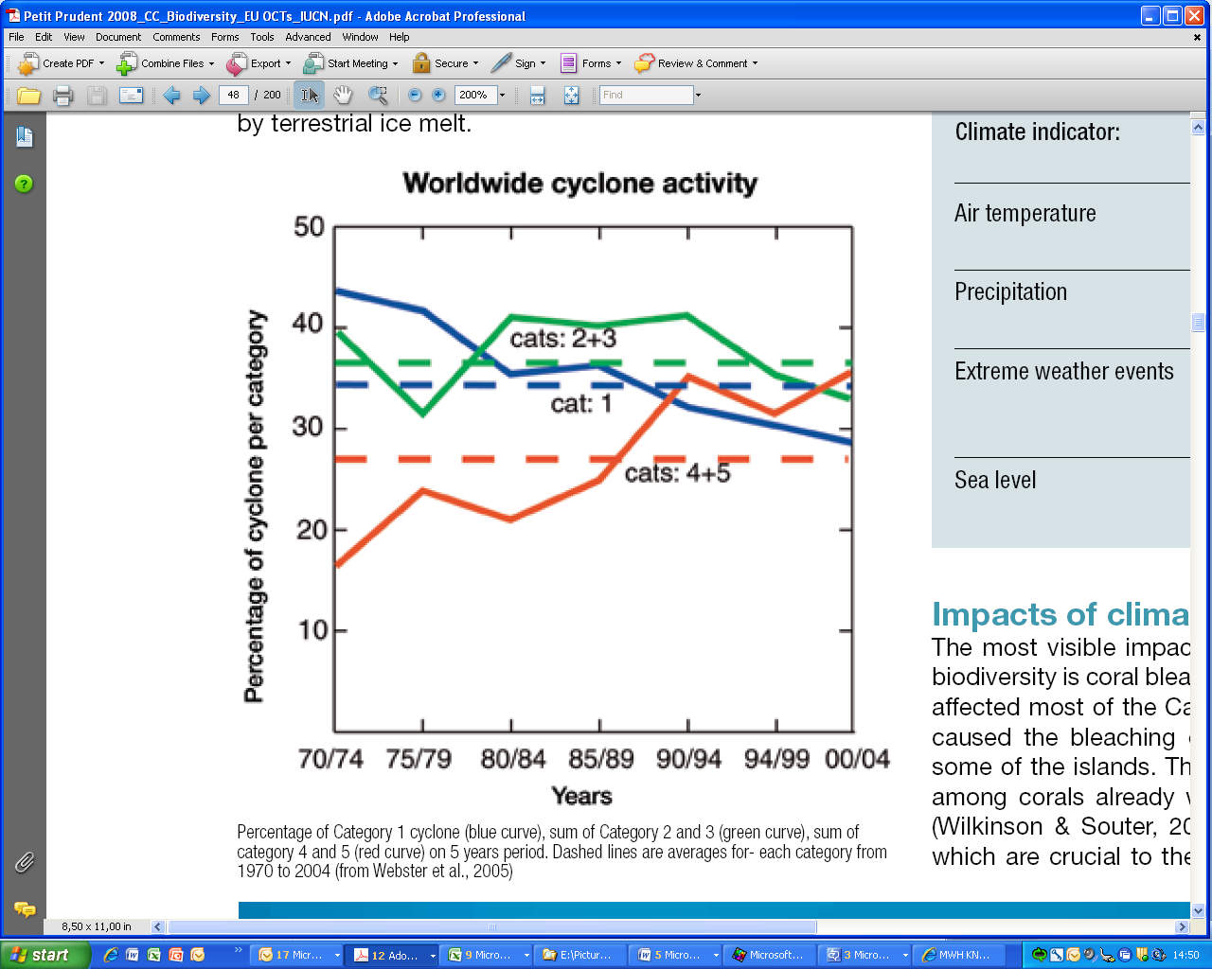
Observations: intensity of cyclones
Worldwide: % of Category 1 cyclone (blue curve), sum of Category 2 and 3 (green curve), sum of category 4 and 5 (red curve) on 5 years period.
(Dashed lines are averages for each category from 1970 to 2004)
Notes:
(Source: Petit & Prudent 2008, p. 42, from Webster et al 2005)
Dashed lines are averages for each category from 1970 to 2004
Expansion
Examples:
Groupwork / discussion

Slide 4
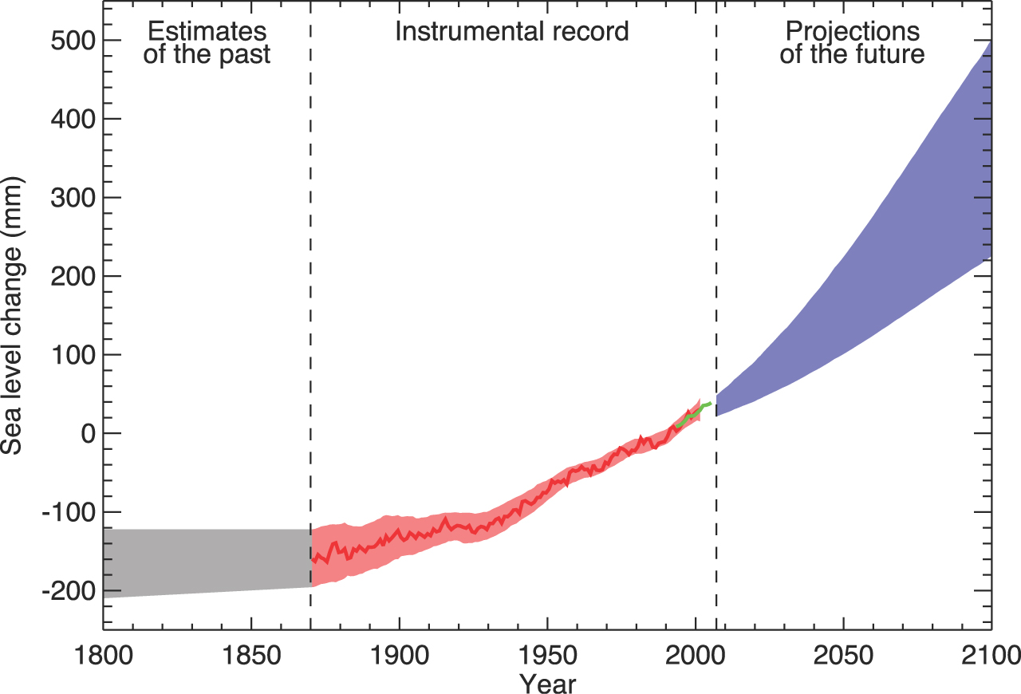
Observations and projections:
Global sea level change
Notes:
IPCC 4AR, WG I report, p. 409 – Legend:
Source: IPCC (2007b) 4th Assessment Report, WG I – FAQ 5.1 Fig. 1
FAQ 5.1, Figure 1. Time series of global mean sea level (deviation from the
1980-1999 mean) in the past and as projected for the future.
For the period before 1870, global measurements of sea level are not available.
The grey shading shows the uncertainty in the estimated long-term rate of sea level change (Section 6.4.3).
The red line is a reconstruction of global mean sea level from tide gauges (Section
5.5.2.1), and the red shading denotes the range of variations from a smooth curve.
The green line shows global mean sea level observed from satellite altimetry.
The blue shading represents the range of model projections for the SRES A1B scenario for the 21st century, relative to the 1980 to 1999 mean, and has been calculated independently from the observations.
Beyond 2100, the projections are increasingly dependent on the emissions scenario (see Chapter 10 for a discussion of sea level rise projections for other scenarios considered in this report). Over many centuries or millennia, sea level could rise by several metres (Section 10.7.4).

Slide 5
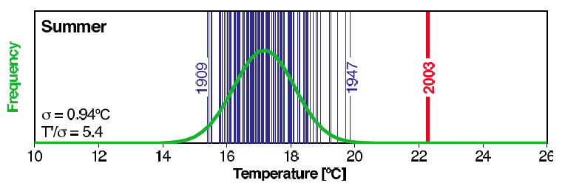
Observed Heat extremes
Summer temperatures in Switzerland 1864-2003
2003
Mean 17°C
Very hot 2003
Double probability of another extreme ‘2003’-summer
Notes:
Source: IPCC AR4 WGI Ch.9 p.696 (Hegerl et al.,2007)

Slide 6
What are the causes of climate change?
Natural variation is an inherent feature of the climate (e.g. driven by solar cycles, earth orbit, volcanoes)
But anthropogenic (man made) emissions of long-lived greenhouse gases in the atmosphere are a major cause of the changes now being observed
Notes:
Expansion
Examples:
Groupwork / discussion
Significant emissions started with the industrial revolution (fossil fuel use, 18th century) but considerably accelerated as from the 1970s (fossil fuel use, agriculture & land use changes). Atmospheric concentrations of the main GHGs now far exceed the natural range over the past 650,000 years.
e.g. CO2 atmospheric concentration: grew from 280 ppm (pre-industrial level) to 379 ppm (2005), with an acceleration in the accumulation rate
e.g. CH4 atmospheric concentration: grew from 715 ppb (pre-industrial level) to 1774 (2005), with a deceleration in the accumulation rate over the past few decades
e.g. N2O atmospheric concentration: grew from 270 ppb (pre-industrial level) to 319 ppb (2005).
OECD (2009a), Section 2: Natural causes of change include ‘the chaotic dynamics inherent to the climate system as well as changes in solar radiation, ocean circulation and reflectance of the earth’s surface.’ Natural shifts in the climate system include ‘phenomena as diverse as the last ice age (...) and fluctuations caused by the El Nino Southern Oscillation (...)’.
Dervis et al. (2009): carbon emissions have increased 145-fold globally since the industrial revolution – and are projected to increase another 54% by 2030.

Slide 7
Future warming
Current policy regimes - warming of 4º C by 2100 (still likely to exceed 4º C)
4º C may not be stable anyway - greater warming plausible
Comparable to ice age - interglacial warming, but faster
World will be warmer than at any time in (at least) the past few million years
Notes:
Expansion
Examples:
Groupwork / discussion

Slide 8
Consequences
Changes in average conditions
Warmer, wetter, drier, higher sea levels - changes in growing seasons, viable ranges of crops, ecosystems, pests, diseases; greater evaporation, changes in water availability, land loss
Changes in climatic extremes
Heat waves, droughts, precipitation, floods, storm surges, fires; changes in storm tracks & behavior - changes in disaster risks
“Abrupt” changes and “singular” hazards
Circulation changes, ecosystem collapse, glacial lake outbursts, arid-humid transitions - rapid & slow onset disasters
Leading to
Impacts on water, food security, health, infrastructure, energy, natural resources, livelihoods, migration, conflicts, growth, trade etc.
Notes:
Expansion
Examples:
Groupwork / discussion

Slide 9
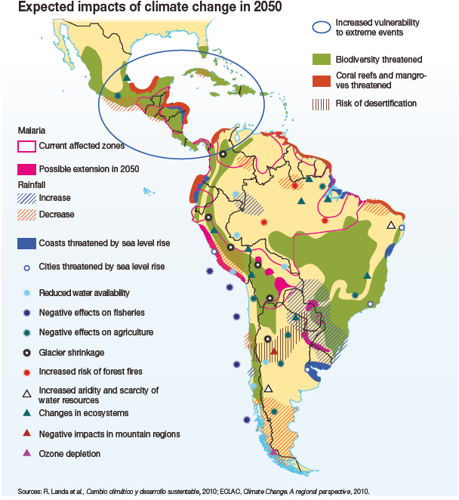
Climate change impacts in Latin America and Caribbean
Notes:
Source: R Landa et al: Cambio climatico y desarollo sustenible, 2010: ECLAC, Climate Change. A regional perspective. 2010.
Expansion
Examples:
Groupwork / discussion

Slide 10
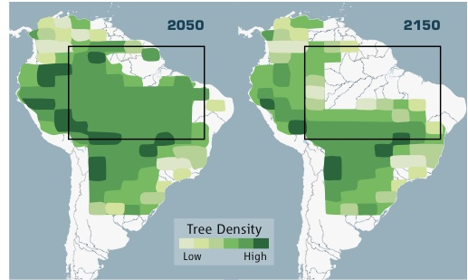
Amazon forest die-back
Massive losses possible for warming > 3° C ^{1,2}
High mortality after 2005 drought³
Up to 40% loss suggested even for strong mitigation⁴
Simulated Amazon evolution to 2150 with zero emissions by 2050, from Science, 20 March 2009
¹Betts et al (2004); ²Cox et al (2004); ³Philips et al. (2009) ⁴ Kintisch, 2009;
IPCC AR4 WGII Ch.4 (Fischlin et al., 2007)
Notes:
Expansion
Examples:
Groupwork / discussion

Slide 11
Possible climate change impacts in Asia
  The numbers of potential ‘forced climate migrants’ by 2050 globally ranges from between 25 million to 1 billion people!!
  In Bangladesh it is estimated that up to 20 million people will be displaced from rising sea levels
  Agricultural productivity in Asia is likely to suffer severe losses because of high temperature, severe drought, flood conditions, and soil degradation
  Frequency of forest fires is expected to increase in boreal Asia
  Grassland productivity to decrease by as much as 40–90%
  1.8 million km2 of farmland could become unproductive in Asia by 2050
  Populations of island states such as Tuvalu, the Marshall Island and Kiribati may become fully submerged
11
Notes:
Expansion
This is an animated slide - Main message is that there many different types of climate change impacts – both in coastal areas and inland
Examples:
Groupwork / discussion
Figure 10.4. Hotspots of key future climate impacts and vulnerabilities in Asia.
http://www.ipcc.ch/publications_and_data/ar4/wg2/en/figure-10-4.html
Source: OECD (2009a), Table 3.1 p. 44
Source: IPCC Fourth Assessment Report (2007). Figure 10.4.
11

Slide 12
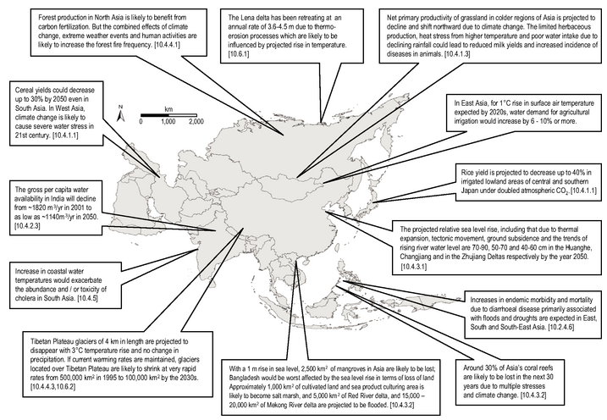
Possible climate change impacts in Asia
Increased forest production in North Asia, but also more fires
40 % decrease in rice yield in Japan
40 % less per capita water in India
30 % loss of coral reefs in SE Asia
12
Notes:
Expansion
This is an animated slide - Main message is that there many different types of climate change impacts – both in coastal areas and inland
Examples:
Groupwork / discussion
Figure 10.4. Hotspots of key future climate impacts and vulnerabilities in Asia.
http://www.ipcc.ch/publications_and_data/ar4/wg2/en/figure-10-4.html
Source: OECD (2009a), Table 3.1 p. 44
Source: IPCC Fourth Assessment Report (2007). Figure 10.4.
12

Slide 13
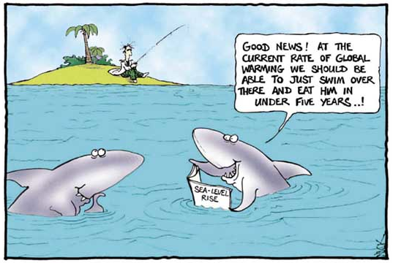
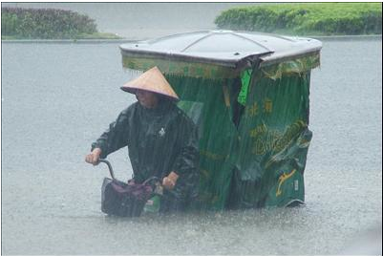
Climate change projections
Notes:
Expansion
Examples:
Groupwork / discussion
Temperatures and sea levels:
consensus that they will increase
magnitude of the increase quite uncertain
Rainfall:
expected to increase overall
but some regions are likely to get more and some less
for many regions in the world, uncertainty about the direction of change
These uncertainties arise from:
Uncertainties in the amount of future emissions;
Uncertainties about the relationship between the rate of GHG emissions and their concentration in the atmosphere;
Uncertainties about the extent of the warming that results from any given change in atmospheric GHG concentration;
The complexities of the climate system.
OECD (2009a), Section 2:
‘In general, high-latitude areas will see increased precipitation; mid-latitude areas will see a mix of changes, many subtropical areas will see a decrease in precipitation, and many equatorial areas could have increased precipitation. There are likely to be substantial variations in changes in precipitation patterns in particular regions within these latitudinal ranges. The seasonality of precipitation patterns is also likely to change in many locations.’

Slide 14
Understanding and planning under uncertainty
Notes:
Expansion
Examples:
Groupwork / discussion

Slide 15
Socio-economic uncertainties:
Population and economic growth,
Technological and societal choices,
International relations
The uncertainties:
  Influence the perception of the level of future GHG emissions
  Therefore influence the perception of the magnitude of climate change and environmental worsening
  Create derived uncertainties about future vulnerability to climate change
Notes:
Expansion
Examples:
Groupwork / discussion
Socio-economic uncertainties (e.g. related to future population growth, economic growth, technological choices, societal choices, international relations):
influence the level of future emissions and thus the magnitude of climate change
also, create uncertainties about future vulnerability to climate change

Slide 16
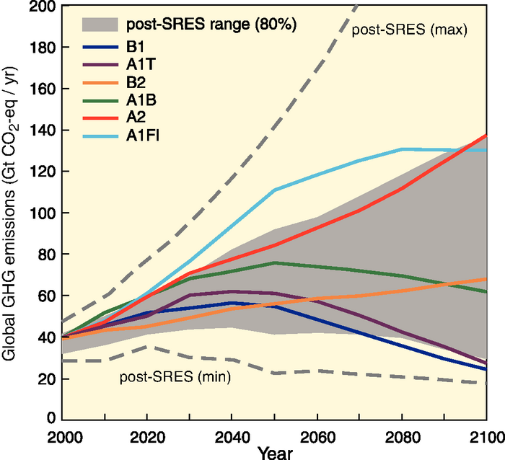
IPCC GHG emission scenarios
Indeed some uncertainty
(SRES: Special Report on Emission Scenarios)
Notes:
Expansion
Examples:
Groupwork / discussion
IPCC Special Report on Emission Scenarios (SRES, 2000): 4 scenario families using different assumptions on the evolution of emission drivers:
* A1: rapid economic growth, population stabilising in 2050, rapid introduction of more efficient technologies (with 3 sub-scenarios: A1FI = fossil-intensive, A1T = non-fossil energy, A1B = balanced use of energy sources).
* A2: rapid population growth, slower & more fragmented economic development, slow adoption of new technologies.
* B1: similar to A1 but more rapid transition to a service and information economy, and reduction in material intensity.
* B2: intermediate population and economic growth, local solutions to economic/social/environmental sustainability.
Higher end of the range: A1FI and A2. GHG concentrations does not stabilise.
Middle-range scenarios: A1B and B2. GHG concentrations stabilise at, respectively, 750 and 650 ppm.
Lower end of the range: B1 and A1T. GHG concentrations stabilise at, respectively, 550 and 650 ppm.

Slide 17
Climate uncertainties
For any given emission scenario, different Atmosphere-Ocean General Circulation Models (AOGCMs) provide different projections of future change
– sometimes very different ones (!)
Notes:
AOGCMs = mathematical representations of the earth’s climatic system, which link the atmosphere, ocean, land, and biosphere both vertically and horizontally in a series of 3-dimensional grid boxes that partition the earth into layers and grids (Jones & Mearns 2004). They simulate future climate change by gradually increasing the level of radiative forcing.
WDR 2010: «Uncertainty: An expression of the degree to which a value (such as the future state of the climate system) is unknown. Uncertainty can result from lack of information or from disagreement about what is known or even knowable. It may have many types of sources, from quantifiable errors in the data to uncertain projections of human behavior. Uncertainty can therefore be represented by quantitative measures, for example, a range of values calculated by various models, or by qualitative statements, for example, reflecting expert judgment. However, in economics, uncertainty refers to Knightian uncertainty, which is immeasurable. This is in contrast to risk, wherein the occurrence of certain events is associated with a knowable probability distribution. »

Slide 18
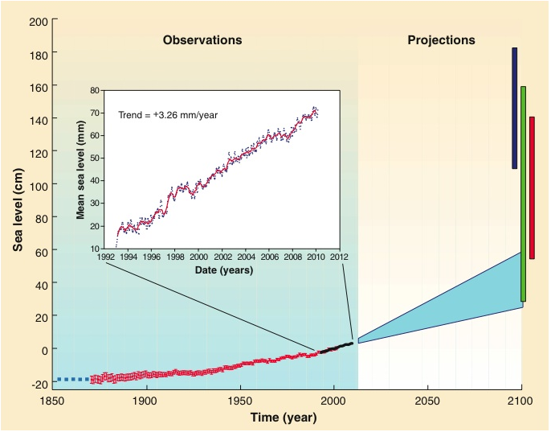
Sea-level rise - uncertainties
IPCC (2007) projections of up to 0.59 m by 2100
Sea level observations to 2009 & projections to 2100.
Light blue zone represents IPCC 2007
Colored bars represent more recent estimates
Notes:
Expansion
Rahmstorf, 2007 (red);
Grinstead et al., 2009 (green);
Vermeer et al., 2009 (dark blue).
Graphic from: Nicholls, R. J and Cazenave, A. 2010. Sea-Level Rise and Its Impact on Coastal Zones.
Science 328: 1517-1520
Omitted certain processes associated with ice sheet dynamics
Examples:
Groupwork / discussion

Slide 19
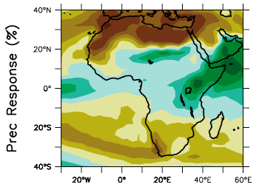
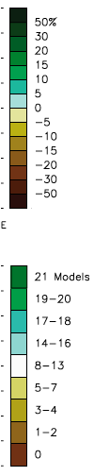
Uncertainty
North Africa & Middle East
Most/all models indicate drying
Observed trends indicate drying
High confidence
Sahel
Models disagree
Some indicate drying, others wetting
Recent trends mixed
Monsoon highly variable
Cannot say how climate will change

Slide 20
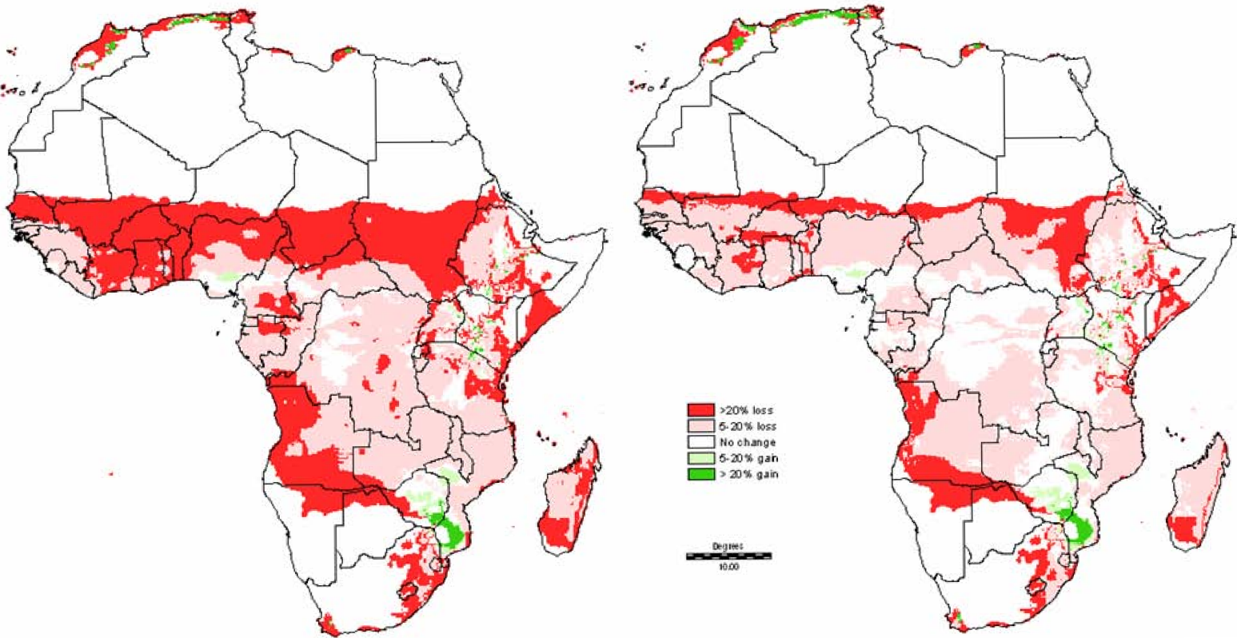
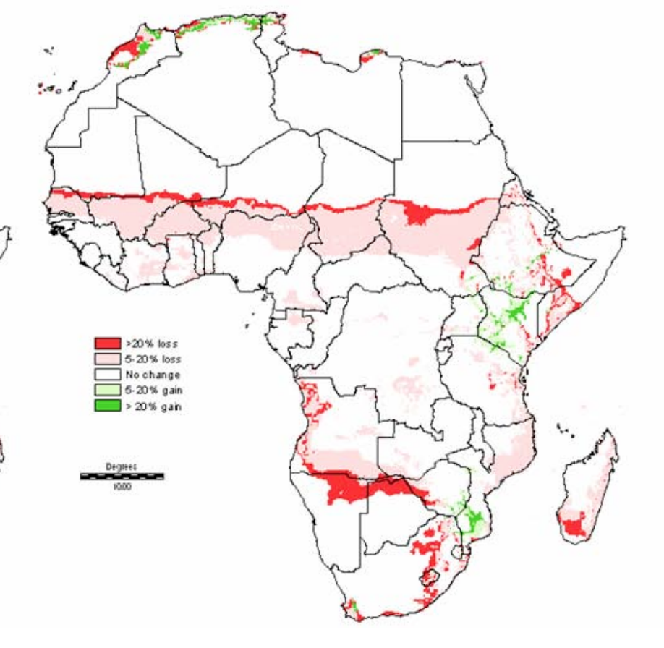
Uncertainty, growing period
One scenario, not alarming
Consensus climate change
Length of growing period change 2000-2050
Notes:
Expansion
Examples:
Groupwork / discussion
Source: Thornton et al (2006), Figure 7(A)

Slide 21
The cost of inaction
Failure to adapt
Failure to reduce emissions
Wasted investments
Increased vulnerability
More harmful impacts
Higher adaptation costs
Uncertainties surrounding climate change are often invoked to justify inaction (!)
BUT, even with uncertainty, some measures are justified
Notes:
Expansion
Examples:
Groupwork / discussion
The uncertainties surrounding climate change are often invoked to justify inaction
In a medium- to long-term perspective, however, inaction now is likely to be more costly:
Even in the face of uncertainty, some types of measures are justified
Adaptation – OECD (2009): “The effect of discounting would normally favour a delay in adaptation (...). However, there is also a class of adaptations where early action is cheaper. They include adjustments to long-term development plans and long-lived infrastructure investments (...). In each of these cases, it will be cheaper to make adjustments early, in the design phase of the project, rather than incur the cost and inconvenience of expensive retrofits.” The same applies to land use policies and long-term development plans.
Mitigation – Stern Review: «The benefits of strong, early action on climate change considerably outweigh the costs». What we do in the next 10 or 20 years can have a profound effect on the climate in the second half of this century and in the next. Mitigation must be viewed as an investment to avoid the risks of very severe consequences in the future.
The social cost of carbon under the business-as-usual scenario is about $85/tonne of CO2 – well above marginal abatement costs in many sectors.
If a path towards stabilisation of atmospheric concentration of GHGs at 550ppm CO2e is adopted, then the net present value of benefits over costs is around $2.5 trillion. With a target of 450-550 ppm CO2e, then the social cost of carbon is in the region of $25-30 per tonne of CO5 – about one-third of the cost under the BAU scenario.
The social cost of carbon is likely to increase steadily over time because marginal damages increase with the stock of GHGs in the atmosphere. Policies should thus aim for a gradual intensification of marginal abatement efforts, while supporting the development of technologies that reduce abatement costs.
The annual costs of stabilisation at 500-550ppm CO2e are estimated to be around 1% of GDP by 2050 - a level that is significant but manageable.

Slide 22
Justified measures in the face of uncertainty
‘No-regret’ measures: those expected to produce net benefits for society even in the absence of climate change
‘Low-regret’ measures: those expected to have an acceptable cost for society in view of the benefits they would bring
‘Robust’ measures: those that produce net benefits or deliver good outcomes across various possible scenarios
Notes:
Expansion
Examples:
Groupwork / discussion
World Bank (2010c):
(No- and) low-regret measures include most of the ‘soft’ adaptation measures, which enhance development and welfare across all or most climate change scenarios including the no-change scenario
‘No-regret’ measures:
those expected to produce net benefits for society
even in the absence of climate change (adaptation) or independently of any ‘reward’ for mitigation (zero or negative net cost at a zero carbon price)
‘Low-regret’ measures:
those expected to have a cost for society, but an acceptable one in view of the benefits they would bring if climate change turns out to produce significant effects (adaptation), or to have a low net cost at zero or low carbon prices (mitigation)
.
Robust’ measures: those that produce net benefits or deliver good outcomes across various possible climate change or carbon price scenarios and economic development scenarios (rather than just under the ‘most likely’ scenario)

Slide 23
No-regret environmental and climate measures
Examples:
  Clean technology in the leather industry
  The Batik-Fridays introduced in some Indonesian ministries (!)
Cooperate with the colleague next to you
Identify No-regret measures within your areas of work and for different purposes
Consider both mitigation and adaptation measures
Make a list and present in plenary
If you find the time, you can also discuss Low-regret and Robust measures.
Notes:
Expansion
Examples:
Groupwork / discussion
World Bank (2010c):
(No- and) low-regret measures include most of the ‘soft’ adaptation measures, which enhance development and welfare across all or most climate change scenarios including the no-change scenario
‘No-regret’ measures:
those expected to produce net benefits for society
even in the absence of climate change (adaptation) or independently of any ‘reward’ for mitigation (zero or negative net cost at a zero carbon price)
‘Low-regret’ measures:
those expected to have a cost for society, but an acceptable one in view of the benefits they would bring if climate change turns out to produce significant effects (adaptation), or to have a low net cost at zero or low carbon prices (mitigation)
.
Robust’ measures: those that produce net benefits or deliver good outcomes across various possible climate change or carbon price scenarios and economic development scenarios (rather than just under the ‘most likely’ scenario)

Slide 24
No-regret measures
Controlling leakages of water pipes
Introducing cleaner technology in enterprises
Picking low hanging energy efficiency options
Considering higher sea levels in urban planning
Additional irrigation infrastructure in regions that already face water scarcity
Improving building insulation in areas with very high or very low temperatures
Notes:
Expansion
Examples:
Groupwork / discussion
World Bank (2010c):
(No- and) low-regret measures include most of the ‘soft’ adaptation measures, which enhance development and welfare across all or most climate change scenarios including the no-change scenario
‘No-regret’ measures:
those expected to produce net benefits for society
even in the absence of climate change (adaptation) or independently of any ‘reward’ for mitigation (zero or negative net cost at a zero carbon price)
‘Low-regret’ measures:
those expected to have a cost for society, but an acceptable one in view of the benefits they would bring if climate change turns out to produce significant effects (adaptation), or to have a low net cost at zero or low carbon prices (mitigation)
.
Robust’ measures: those that produce net benefits or deliver good outcomes across various possible climate change or carbon price scenarios and economic development scenarios (rather than just under the ‘most likely’ scenario)

Slide 25
Scenario-based planning
To support the choice of adaptation measures, scenarios reflecting prevailing uncertainties can be developed, e.g.
1) No change in temperatures
2) Moderate change in temperatures
3) High change in temperatures
1) No change in temperatures and rainfall
2) Temperatures up, rainfall up
3) Temperatures up, rainfall down
Notes:
Expansion
Examples:
Groupwork / discussion
* ‘No change’ (= baseline): based on continuation of historical weather patterns.
* ‘Moderate change’: based on average forecasts of climate change, using available studies and expert knowledge.
* ‘High change’: based on the outer range of climate change forecasts, using available studies and expert knowledge.
* Higher temperatures combined with an increase as well as a decrease in rainfall.
UNDP (2004) – Adaptation Policy Frameworks “Assessing future risks”:
A scenario is ‘a coherent, internally consistent and plausible description of a possible future state of the world’. ‘Scenarios can range from the simple to the complex, and from the qualitative to quantitative, encompassing narrative descriptions of possible futures to complex mathematical descriptions combining mean climate changes with climate extremes.’

Slide 26
Three climate change scenarios for the central regions of Tanzania
No change
 | Scenario 1 No climate
0% | change
 |  | Scenario 2
Average -10% |  | Consensus climate
 |  | change
 |  |  | Scenario 3
Max* |  |  | Severe
-20% |  |  | climate change
Change In average rainfall
Scenarios are built to reflect potential outcome of climate change
0%
+25%
+50%
Change in variability
26
Notes:
Expansion
Examples:
Groupwork / discussion
For Tanzania as a whole, general circulation models predict an increase in rainfall by 2030. However, regional climate models (RCMs), which offer a higher degree of granularity, expect the central regions (Dodoma, Singida, Tabora) to experience a decrease in annual precipitation. This is important since the central regions already face droughts and are the location of most hydropower reservoirs (major dams on the Rufiji river: the Kidatu and Mtera dams provide 50% of Tanzania’s hydropower production capacity).
Source: Economics of Climate Adaptation (2009) – Case study on central Tanzania – Figure 02, p. 126

Slide 27
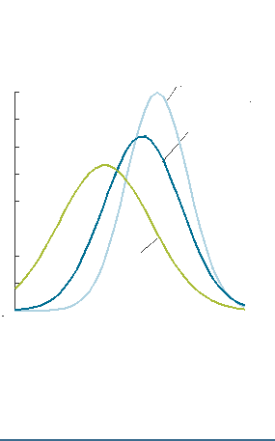
Three climate change scenarios for the central regions of Tanzania
Probability
0.08
0.07
0.06
0.05
0.04
0.03
0.02
0.01
Scenario 1
No climate change
Each scenario has its own distribution of probability for rainfall
Scenario 2 Consensus climate change
Scenario 3 Severe
climate change
0 200 400 600 800 1000
Rainfall, mm
27
Notes:
Expansion
Examples:
Groupwork / discussion
For Tanzania as a whole, general circulation models predict an increase in rainfall by 2030. However, regional climate models (RCMs), which offer a higher degree of granularity, expect the central regions (Dodoma, Singida, Tabora) to experience a decrease in annual precipitation. This is important since the central regions already face droughts and are the location of most hydropower reservoirs (major dams on the Rufiji river: the Kidatu and Mtera dams provide 50% of Tanzania’s hydropower production capacity).
Source: Economics of Climate Adaptation (2009) – Case study on central Tanzania – Figure 02, p. 126

Slide 28
Recap – module 1b
  Is the climate changing – observations
  Causes
  Consequences
  Uncertainty
  Socio-economic uncertainties increase environmental and climate uncertainties – the scenarios of climate development vary a lot
  Inaction is costly. Some measures are justified even in the face of uncertainty

Slide 29
Resources
Climate change
Understanding Climate Change – IPCC
Climate Change in EU Overseas Entities – Petit & Prudent
Integrating Climate Change Adaptation into Development Cooperation - OECD
Uncertainty
Decision Support Planning Methods: Incorporating Climate Change Uncertainties into Water Planning - WUCA
Scenario Planning – IIED
Managing Water under Uncertainty and Risk – WWAP / UNESCO
Uncertain predictions, invisible impacts, and the need to mainstream gender in climate change adaptations - University of Greenwich

