Slide 1
Environment and climate change in development cooperation
The case for integrating environment and climate change – Module 2
Eric Buhl-Nielsen

Slide 2


Structure
  Planet boundaries
  Foot print
  Physical and social limits
  Collective action
  Economic development argument
  Wealth
  Growth
  Combating poverty
  Human development argument
  Health
  Security
  Gender
Notes:
Expansion
The economic and human development argument is optional – depending on the interest of the participants, the working assumption is that they do not need to be convinced but have available in optional slides an argument that they could put to others. The main point is how to convince others.
Examples:
Groupwork / discussion

Slide 3
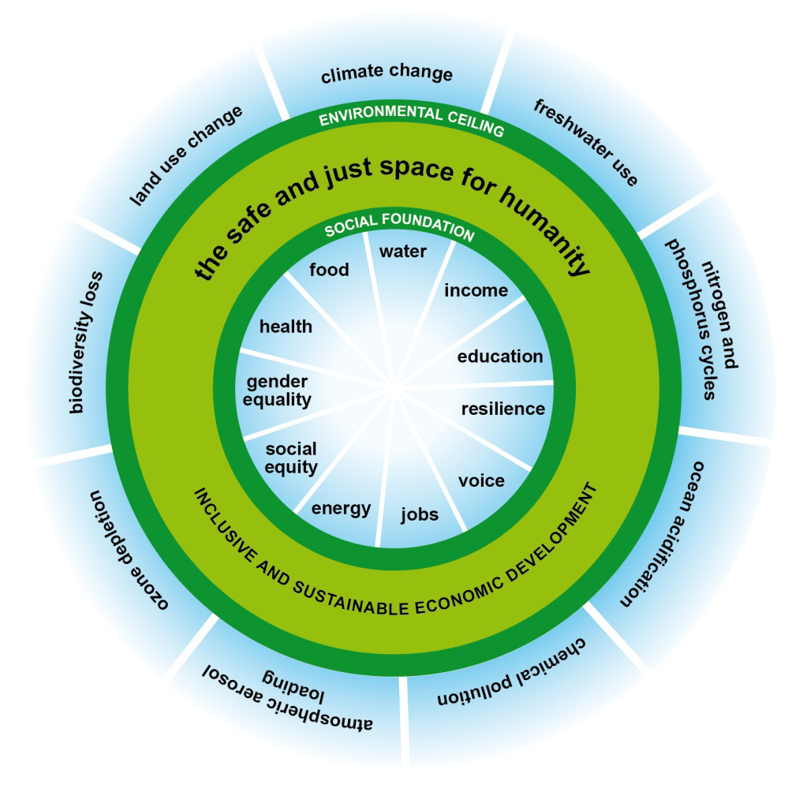
Physical and social limits
Social foundation facts
Food: Providing the additional calories needed by the 13% facing hunger requires 1% greater global food supply.
Income: Ending income poverty for the 21 % on less than $1.25 a day requires 0.2% greater global income.
Environmental ceiling facts
Carbon: 50 %of global carbon emissions generated by 11%;
Income: 57% of global income for top 10%
Nitrogen: 33% of the world’s sustainable nitrogen budget is used to produce meat for people in the EU – just 7 per cent of the world’s population.
Too many are living below the social foundation
Increasing numbers are living beyond the environmental ceiling (the planetry boundaries)
Keeping within the doughnut
Source Oxfam: Kate Raworth
http://www.oxfam.org
Notes:
Expansion
http://www.oxfam.org/sites/www.oxfam.org/files/dp-a-safe-and-just-space-for-humanity-130212-en.pdf
Examples:
Groupwork / discussion

Slide 4
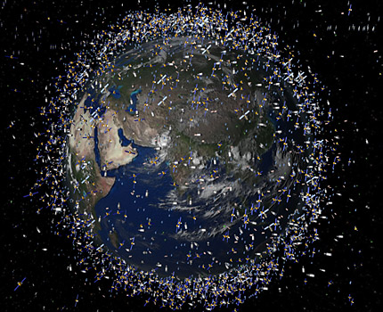
Notes:
Expansion
Examples:
Groupwork / discussion
What is this – space junk – no regulation – it can cost a lot of money – your mobile may not work – has commonalities with the environmental issues on earth
We have an effect on the environment – what we do to the environment has an effect on us
Religious part obvious part

Slide 5
Economic argument – the link between environment and poverty
Satisfying needs
Inequitable distribution
Production
Distribution
Insufficient capital
ENR
Labour
Capital
The environment is one form of capital (“natural capital”)
With insufficient “produced” capital and an inequitable distribution of income and access to services, the environment plays a pivotal role in the livelihoods of the poor.
Improving/preserving the environment contributes to the communities’ resilience towards hazards caused by climate change and other factors.
Notes:
Expansion
Examples:
Groupwork / discussion
Ask for examples ....construction material ....forest products...firewood ...water for farming

Slide 6
Economic argument – national wealth is closely related to natural capital
The environment is disproportionately important in poor nations.
Environmental assets are 26% of national wealth in developing countries and only 2% in OECD countries (World Bank, 2005).
Notes:
The proportion of revenue in tz

Slide 7
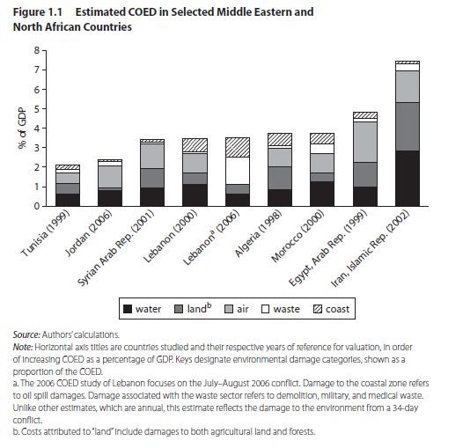
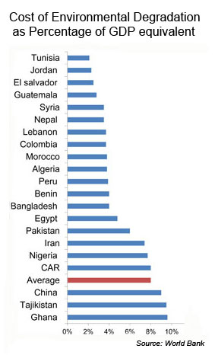
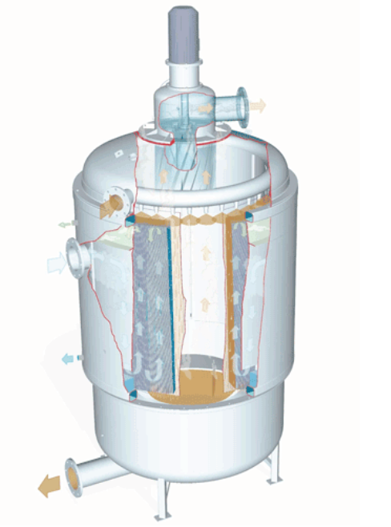
Economic argument – evidence and examples
Country level
Enterprise level
Environtherm – small business green economy opportunities
Case study facts - Karup airport – Helicopter fleet
Cost DKK 2.2 million
Annual net saving: DKK 1.05 million
Payback: 2.1 years
IRR: 90%+
Company facts
Company established 2007/8
Turnover DKK 15 million +
8-10 employees + 30 in sub contractors
Growth trippled in 3 years
Strong export prospects
Notes:
Expansion
If needed the discussion could lead to presentation of the optional slides – at least mention that they are available.
World bank 2005 and 2010
http://www-wds.worldbank.org/external/default/WDSContentServer/WDSP/IB/2010/08/26/000333037_20100826001806/Rendered/PDF/562950PUB0Envi1AUGUST0201011PUBLIC1.pdf
Examples:
Groupwork / discussion
Use buzz groups
Potential questions
What is natural capital, examples?
How important is it in developing countries?
What are ‘environmental externalities’?
What examples are there of the green economy at work?
Is there a tension between economic growth and environment

Slide 8

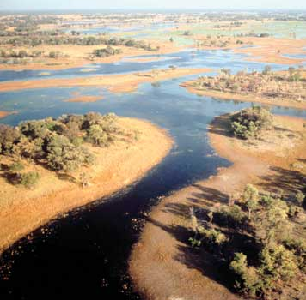
Human development argument - Activity 1 – brainstorm opportunties and challenges based on case study
Health - What are the potential health impacts of environment and climate change?
Sector | Health | Security | Gender | Other
Agriculture
Energy
Private sector
Security - Are there peace and security implications?
Task: in small groups, find two examples of opportunities and challenges for each human development dimension - based on cases from your experience
Gender - What are the gender implications?
http://www.youtube.com/watch?feature=player_detailpage&v=mhQ3z5EBdco
http://www.youtube.com/watch?v=rktPAsqdqp4&feature=player_detailpage
Quality of life – other implications?
Notes:
Expansion
If needed the discussion could lead to presentation of the optional slides – at least mention that they are available.
Examples:
Groupwork / discussion
Use buzz groups
Potentially could use the Kenya sugar SEA study

Slide 9
Activity 2 how sectors impact and are affected by climate change/ environment
 | CC Adaptation |  | CC Mitigation
Sector | Impact on | Affected by | Impact on | Affected by
Agriculture
Energy
Private sector
 | Environment
Sector | Impact on | Affected by
Agriculture
Energy
Private sector
Task: in small groups, find two examples for each situation based on the Sugar Industry case study (– or cases from your experience)

Slide 10
Activity 3 Economic /human development arguments –convincing others
In your experience:
What are strong and weak points of the argument(s)?
What are the common obstacles and barriers to making the case?
What are the tools available to the EU?
What are the entry points and approaches?
Who are the allies in making the argument?
Notes:
Expansion
Policy dialogue is a main tool
Technical assistance and financing of studies where data/information is weak
Examples:
Groupwork / discussion
Use buzz groups

Slide 11
Making the case – different strategies for interacting in different partner situations
1
Probably no need to intervene – light catalytic support
high
3
1
2
Provide support of a capacity development nature e.g. systems, tools, institutional change
Capacity
3
Make the case, understand the underlying interests, provide information to change perceptions, ally with and support the willing, policy dialogue
Low
4
2
4
Difficult starting point – some conditionality might be needed – combination of capacity support and changing perceptions – start simple
Low
high
Committment

Slide 12
Activity 3 making the case to others
Based on the Sugar Industry case study - A role play is made where different participants assume the roles of:
Decision makers - Sugar industry owner/ manager/ farmer / delegation/sector ministries (energy, agriculture, industry)/
Advocates for mainstreaming - Environment agency (NEMA)/ EU delegation/civil society

Slide 13
Activity 4 – challenges & opportunities
Form 3 to 4 groups of people knowledgeable and/or involved in a particular sector based on an actual development cooperation case.
For that sector (or project):
Challenges
Task 1 – Brainstorm 3 environmental & climate change related challenges/problems
Task 2 – Suggest measures to address the challenges
Task 3 – Suggest entrance points for influence (i.e. to adopt the measures)
Opportunities
Task 3 - Brainstorm 3 opportunities for the sector to improve the environment and either mitigate or improve adaptation to climate change
Task 4 – Suggest measures of ensuring that the opportunities are implemented
Task 5 – Suggest entrance points for influence (i.e. to adopt the measures)
Notes:
Would benefit by asking participants to prepared some cases in advance with action fiches and other supportive material
Implications of their suggestions – moneywise and otherwise (are they practical and who is likely to want to do it)
Can use sector scripts + guidance notes

Slide 14
Module 2 – recap of main messages
Planet boundaries – one school of thought – the footprint – the limits – collective action is challenging
Economic development argument – the chain of wealth- growth – poverty reduction are interlinked with environment, climate
Human development argument – health – security – gender – are interlinked with environment and climate
Many examples of sector wide aspects - Direct and indirect impacts - multiple impacts –Opportunities
Why integrate? – because environment and climate change projects are not enough by themselves.

Slide 15
Resources
Integration and mainstreaming
  Web-site for Environmental Mainstreaming – IIED
  http://www.environmental-mainstreaming.org/
  Guidance on Integrating CC Adaptation Into Dev. Co-operation – UNEP
  http://www.oecd.org/document/40/0,3343,en_2649_34421_42580264_1_1_1_1,00.html
  Poverty and Environment Initiative - UNDP- UNEP
  http://www.unpei.org/
Climate change
  Guidelines on integration of environment and climate change in development cooperation – EU
  http://ec.europa.eu/europeaid/infopoint/publications/europeaid/172a_en.htm
  Climate change sector scripts / Sector guidance notes (under preparation) – EU
  http://capacity4dev.ec.europa.eu/public-environment-climate/document/climate-change-sector-scripts-introduction-and-key-concepts

Slide 16
Resources (continued)
Climate Change (continued)
  A map of EU climate change actions – EU
  http://ec.europa.eu/europeaid/climate-change-actions/
  Website on climate and environment - EU capacity4DEV
  http://capacity4dev.ec.europa.eu/public-environment-climate/
  Global Climate Change Alliance – GCCA
  http://www.gcca.eu/
Greening economy
  Report on Green Economy – UNEP
  http://www.unep.org/greeneconomy/
  Green Growth knowledge platform - OECD and World Bank
  http://www.oecd.org/document/7/0,3746,en_2649_37465_49310791_1_1_1_37465,00.html
  Shaping Climate Resilient Development – The Economics of Climate Change
  http://media.swissre.com/documents/rethinking_shaping_climate_resilent_development_en.pdf
Notes:
56. We affirm that there are different approaches, visions, models and tools available to each country, in accordance with its national circumstances and priorities, to achieve sustainable development in its three dimensions which is our overarching goal. In this regard, we consider green economy in the context of sustainable development and poverty eradication as one of the important tools available for achieving sustainable development and that it could provide options for policy making but should not be a rigid set of rules. We emphasize that it should contribute to eradicating poverty as well as sustained economic growth, enhancing social inclusion, improving human welfare and creating opportunities for employment and decent work for all, while maintaining the healthy functioning of the Earth’s ecosystems.

Slide 17
Optional slides

Slide 18
Environment a source of wealth
The environment is disproportionately important in poor nations. World Bank figures suggest that environmental assets amount to 26% of national wealth in developing countries, as opposed to 2% in OECD countries (World Bank, 2005).
Economic development argument
more
Notes:
Expansion
Examples:
Groupwork / discussion

Slide 19
Green accounting
Standard measures of wealth accumulation ignore:
Depletion and damage natural resources (forests and oil)
Investment in people
The genuine saving rate corrects for this by adjusting for loss of natural capital and growth in the value of human capital (health and education)
Genuine savings
Increase in produced capital
Decrease in natural capital
+
Increase in Human capital
=
-
back

Slide 20
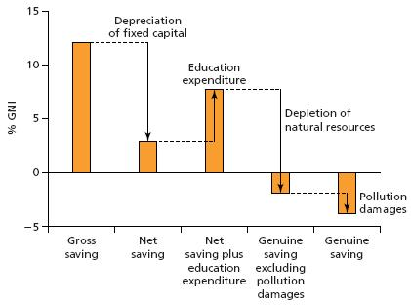
Green Accounting: genuine savings
back

Slide 21
Green economy - examples
  Initiatives
  Brazil – trade in ethanol fuel, technology and flex-fuel vehicles;
  China – production and export of solar technology;
  Guyana – new industries in aquaculture, forest products, ecotourism, ethanol and export of fruits/vegetables;
  Mexico and Costa Rica – ecotourism;
  UK and Germany – new high-tech energy industries and green services sector with opportunities in export and expertise
  National Plans
  South Africa Green Economy Plan Initiative
  Korea’s National Strategy for Green Growth
  China’s Green Jobs Programme
  Egypt’s Green Transformation Strategy
  Viet Nam’s Green Growth Strategy
Economic development argument
Notes:
Expansion
A lot of initiatives are being undertaken – some countries have made plans
Examples:
Groupwork / discussion

Slide 22










  PRIVATE SECTOR
  WHY would it care..
  Environmental rationale
  Economic rationale  opportunity
    Resource / energy (cost) efficiency
    Market requirements / customer demands
    Competition/Competitiveness
    New markets
    New products

Slide 23
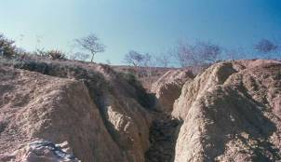
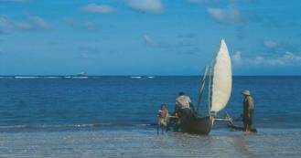
Background: declining resources….
The majority of rural poor depend directly on natural resources for their livelihoods – yet:
Economic development argument
  1/3 of global land area threatened by desertification
  28% of global fish stocks overexploited
  14 m ha of tropical forests lost each year …
Consequences: poverty now, increasing difficulties in the future
Notes:
Expansion
This and the next two slides are re-working of the arguments on poverty – it gives the participants a chance to reflect and and to link poverty and climate change
Examples:
Groupwork / discussion

Slide 24
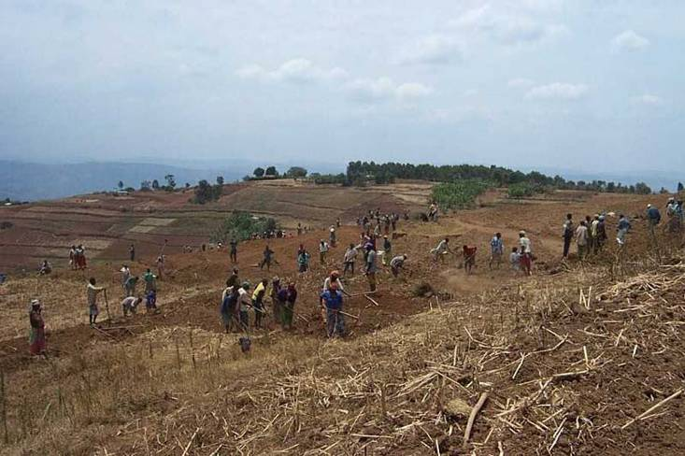
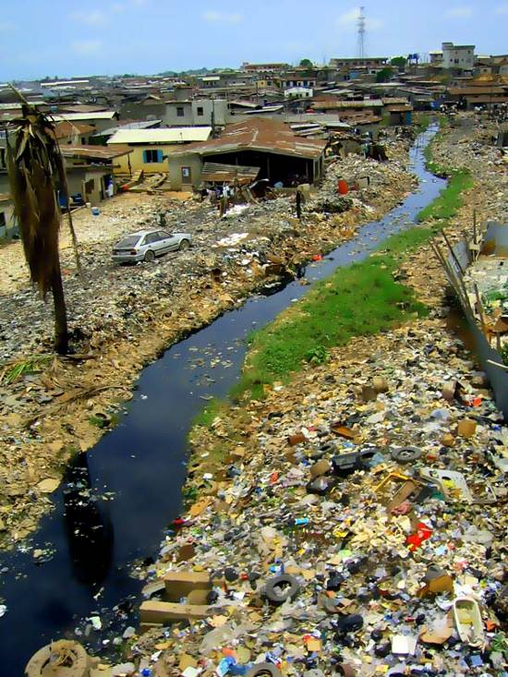
A vicious circle…
In turn, poverty may lead populations to deplete their natural resources and exacerbate the degradation of their environment
Economic development argument
© EC / O. Lehner, 2003
© EC
Poverty as such may be a cause of environmental degradation, as well as a consequence
Notes:
Expansion
Examples:
Groupwork / discussion

Slide 25
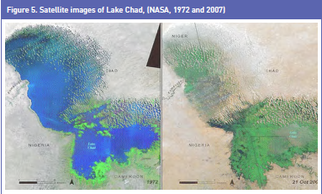
… aggravated by climate change
Economic development argument
Source: FAO 2009
Notes:
Expansion
Examples:
Groupwork / discussion
Put in Lake Chad - or video

Slide 26
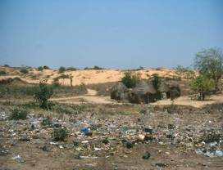
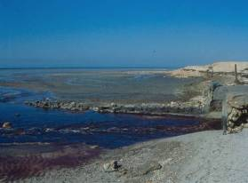
Environment /climate and health
Do environmental and climate related factors have effects on health?
  Nutrition (quality of soils, availability of water, …)
  Air quality
  Water quality
  Waste management
  The reproduction cycles of parasites and disease vectors
  Other?
Human development argument
© Jean-Paul Ledant
Notes:
Expansion
Examples:
Groupwork / discussion
Anything missing? _ Noise - any other factor?

Slide 27
The environment & climate are linked to security
25m environmental ‘refugees’, perhaps 50m by 2010 and 250- 1000m people displaced by climate change by 2050
Conflicts over access to natural resources: land, …
Conflicts aggravated by the scarcity of natural resources: water, …
Conflicts fed by the exploitation of natural resources
In return, conflicts affect the environment
Human development argument
Notes:
Expansion
Examples:
Groupwork / discussion

Slide 28
Climate conflict interactions (MOD, UK)
Human development argument
Water Scarcity
Demography
Crop Decline
Hunger
Coastal Risks
Recent Conflicts
Notes:
Expansion
Examples:
Groupwork / discussion

Slide 29
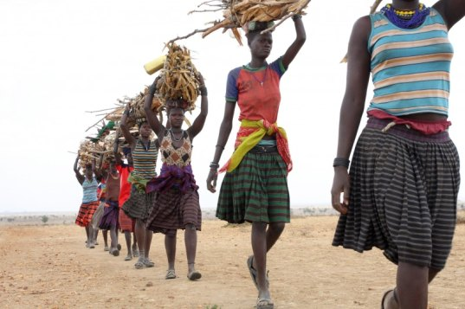
Gender
dimension
Human development argument
Environment, climate change,
poverty and gender
Source: oxfam America
http://inhabitat.com/research-shows-climate-change-disproportionately-affects-women/
more
Notes:
Expansion
Examples:
Groupwork / discussion
Could be turned into an exercise where participants need to find other areas of environment and climate change that affect women
Water – collection
Domestic Waste management
Health care as result of illness from environmental causes
Reliance on natural resources for informal income
Substitution of small animal rearing instead of poaching (men have to be involved)
Fishing stock reduction means less time at home for fishermen
Environmental disasters amplify existing inequalities
Indoor cooking gives woment respiratory diseases
http://www.youtube.com/watch?feature=player_detailpage&v=mhQ3z5EBdco
http://www.youtube.com/watch?v=d8Vg8iz3ZS8&feature=player_detailpage
http://www.youtube.com/watch?v=rktPAsqdqp4&feature=player_detailpage

Slide 30
The economic case for a sustainable management of resources – an example
Case study: conversion of a mangrove into an intensive shrimp farming area (Thailand)
The study compared the net benefits of preserving the mangrove for sustainable exploitation by local populations, and of conversion to intensive shrimp farming:
From a financial point of view
From an economic point of view (i.e. taking into account the true economic value of the two options)
Economic development argument
Source: Sathirathai, S. and E. Barbier (2001)Valuing mangrove conservation in Southern Thailand, Contemporary Economic Policy 19 (2): 109-122
Notes:
Expansion
Examples:
Groupwork / discussion

Slide 31
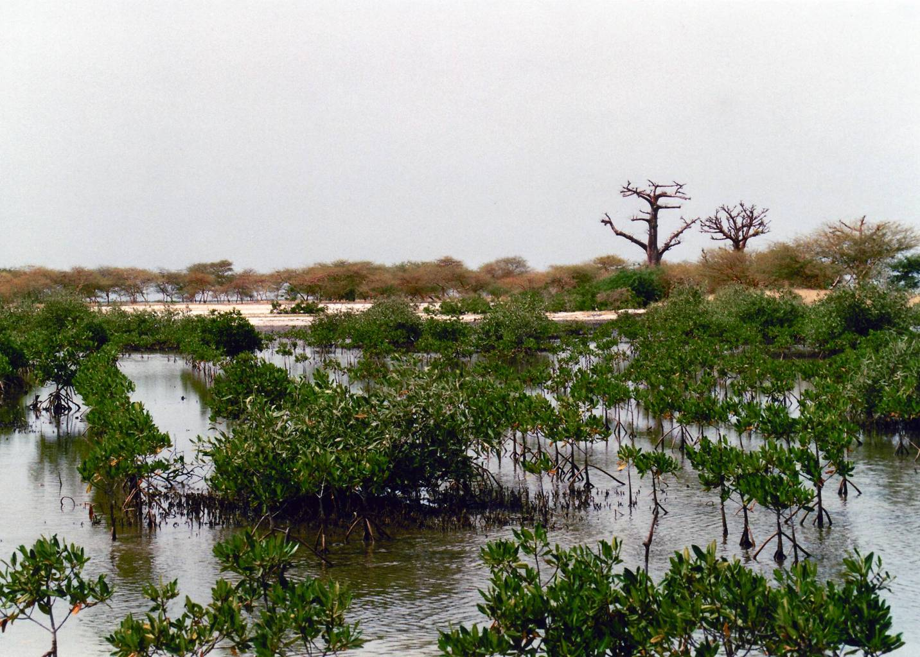
Economic development argument
© EC/F. Lefèvre
Notes:
Expansion
Examples:
Groupwork / discussion

Slide 32
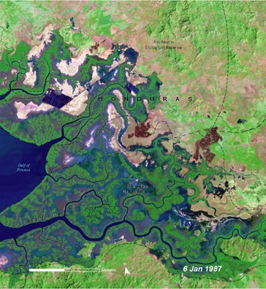
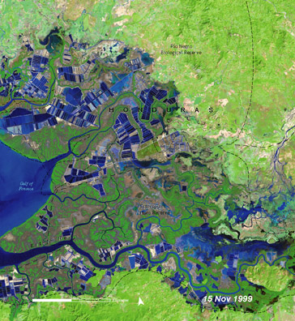
Example of what can happen in shrimp farming
Economic development argument
Source: Millennium Ecosystem Assessment; Sathirathai and Barbier 2001
Notes:
Expansion
Examples:
Groupwork / discussion
From MA State and Trends Box 5.2. Data from the study by Sathirathai, S. and E. Barbier 2001. Valuing mangrove conservation in Southern Thailand. Contemporary Economic Policy 19 (2): 109-122.

Slide 33
Mangrove conversion: financial perspective
$4,000
Value
(annually per ha)
Economic development example
$2,000
Net profit: $2,000
Timber and non-timber products ($88)
0
Mangrove
Shrimp farm
Notes:
Expansion
Labour is a factor
Examples:
Groupwork / discussion

Slide 34
Mangrove conversion: economic perspective
$4,000
Total (~$3,850)
Value
(annually per ha)
Coastal protection (~$3,680)
Economic development example
Total ($70)
$2,000
Fishery nursery ($69)
Net profit: $2,000
Less subsidies(-$1,700)
Timber and non-timber products ($88)
Less pollution costs (-$230)
0
Mangrove
Shrimp farm
Notes:
Expansion
Examples:
Groupwork / discussion
Ask before coastal protection and then after

Slide 35
Activity 2a A multi-sectoral approach is needed Example: tropical deforestation
Biodiversity loss
GHG emissions
Fewer forest products
More floods
Disappearing forests
Clearing for agriculture
Timber overexploitation
Demographic
pressure
Soil
erosion
Road
building
Economic
pressures
Weak
regulation
Social sectors
Agriculture
Transport
Trade - Mining
Governance
Notes:
Expansion
Need an example that shows how the sectors benefit from the environment rather than impact on them. More likely to be taken into account. Also change the discourse: environment as a burden or as an opportunity. … could use FLEGT
Examples:
Groupwork / discussion
FLEGT (Forest Law Enforcement, Governance and Trade )
A key element of the FLEGT Action Plan is a voluntary scheme to ensure that only legally harvested timber is imported into the EU from countries agreeing to take part in this scheme.

Slide 36
Activity 2a - A positive multi-sectoral approach - tropical forestation
Biodiversity
Less GHG
forest products
Floods control
sustainable forests
Sustainable agriculture
Sustainable Timber exploitation
Notes:
Expansion
Examples: Develop this to a postive tree...What interventions are required
Groupwork / discussion

Slide 37
Economic argument - examples
Sector | Natural capital | Green economy | Poverty alleviation
Agriculture | Forest resources – China, Grain-to-Greens Programme | Giant Panda tourism; alter-native income– China GTGP | Avoided soil erosion; less floodings – China - GTGP
Energy | Amazonian ’Water pump’ – Amazon Basin | Solar panel production - China | Amazonian ’Water Pump’ – Amazon Basin
Tourism | Coral reefs - Samoa | Eco-Tourism – Costa Rica | Wildlife Conservancies - Namibia
Trade | The invisible economy | Organic production - Georgia | Fair trade coffee production - Uganda
Notes:
Tanzania – forest resources http://bankofnaturalcapital.com/2010/10/21/restoring-woodlands-in-tanzania/
Invisable economy - http://bankofnaturalcapital.com/category/natural-capital/
China runs one of the largest PES schemes worldwide, the Grain-to-Greens Programme (GTGP). Its main objective is to tackle soil erosion, believed to be the principal cause of
extreme flooding in 1998, by planting trees or maintaining pasture on cropland with steep slopes to prevent soil erosion. By the end of 2006, the GTGP had contributed to the conversion
to forest of 9 million ha of cropland. The GTGP is expected to generate conservation benefits and improve degraded ecosystem services, especially in regions in global biodiversity
hotspots such as Wolong Nature Reserve (one of the largest reserves for endangered giant pandas). Participating households receive an annual payment equivalent of US$ 450 per ha for
a fixed 8-year period for converting cropland to forest and keeping the converted plots forested. The GTGP has already generated positive impacts on panda habitat.
Adapted from: Chen et al. 2009
Five countries share the Amazon basin. Amazonia’s forests evaporate roughly eight trillion tonnes of water each year (IPCC 2007b) which falls as rain, helps maintain the forests and is transported to the Andes and
down to the Plata River Basin, where agriculture, hydropower and industry generate about US$ 1 trillion for these countries (Vera et al. 2006). The region’s food, energy and water security are thus underpinned by
the Amazonian ‘water pump’. National and international PES could help to maintain this critical service.

Slide 38
Human development - examples
Sector | Health | Security | Gender
Agriculture | Nutrition -Nepal | Food security and conflict – Horn of Africa | Fisheries exhaustion burden on women headed households Philippines
Energy | Indoor cooking – respiratory diseases, Sudan | Conflict over transboundary Hydropower- Tajikistan | Fire wood collection – rural Africa
Water | Water quality - Bangladesh | Migration during drought | Water collection – rural Africa
Governance |  | Cattle theft and violence - Uganda
Notes:
Philippines – see video http://www.youtube.com/watch?v=rktPAsqdqp4&feature=player_detailpage
Sudan – see video http://www.youtube.com/watch?feature=player_detailpage&v=mhQ3z5EBdco
Tajikstan Conflict over transboundary hydropower see economist article
Bangladesh – see arsenic contamination of water supplies
Indonesia: District and provincial government policy makers in Sumatra, Indonesia are integrating ecosystem services and biodiversity into Sumatra’s next land-use plan. This ecosystem-based spatial plan guides local government planners in decisions on whether, and where, to award concessions for economic activities, such as oil palm and pulp and paper plantations. An ecosystem service mapping and modeling tool called InVEST was used to assess the quantity and location of high quality habitat, carbon storage and sequestration, annual water yield, erosion control, and water purification under two scenarios, representing implementation of the current government spatial plan and an ‘Ecosystem Vision’ of sustainable land use that better balances environmental, social and economic considerations. This information is helping to design and locate the best areas for forest restoration, payments for carbon and watershed services, and best management practices for forestry and plantations. http://www.naturalcapitalproject.org/pubs/NatCap_InVEST_Tool_Description_All_TEEBcases_2010.pdf

Slide 39
Why integrate environment and climate change? Is transforming economic models important?
Economic development argument – wealth, growth, income poverty reduction
Human development argument - gender, health, peace and security, vulnerability
... and because addressing environmental/climate change issues through projects is not enough
Notes:
Expansion
To kick-start this process, the EU Heads of State and Government set a series of demanding climate and energy targets to be met by 2020, known as the "20-20-20" targets. These are:
A reduction in EU greenhouse gas emissions of at least 20% below 1990 levels
20% of EU energy consumption to come from renewable resources
A 20% reduction in primary energy use compared with projected levels, to be achieved by improving energy efficiency
56. We affirm that there are different approaches, visions, models and tools available to each country, in accordance with its national circumstances and priorities, to achieve sustainable development in its three dimensions which is our overarching goal. In this regard, we consider green economy in the context of sustainable development and poverty eradication as one of the important tools available for achieving sustainable development and that it could provide options for policy making but should not be a rigid set of rules. We emphasize that it should contribute to eradicating poverty as well as sustained economic growth, enhancing social inclusion, improving human welfare and creating opportunities for employment and decent work for all, while maintaining the healthy functioning of the Earth’s ecosystems.
At least 20% of the EU budget to be dedicated to climate change under cohesion, research and innovation, agriculture and external aid
Examples:
Groupwork / discussion
Other...(Q: what % of the EU development budget should be allocated to climate change under external aid: Q what did Rio say about the green economy?)

Slide 40
Activity 1: MDGs.....................SDGs
Eradicate extreme poverty and hunger
Achieve universal primary education
Promote gender equality and empower women
Reduce child mortality
Improve maternal health
Combat HIV / AIDS, malaria and other diseases
Ensure environmental sustainability
Develop a global partnership for development
Climate change
Environment
Notes:
Expansion
Examples:
Groupwork / discussion
How do cc/env affect the MDGs – one example for each from 2 tables.
Green postive
Red negative

Slide 41
Activity 3
– Poverty – Environment – Climate change - Gender
What other sectors/areas of development have a gender dimension when it comes to integration of environment and climate change?
Health
Water
Agriculture
Fisheries
Energy
Waste management
What are the gender issues ? Give examples from your experience
back
http://www.youtube.com/watch?feature=player_detailpage&v=mhQ3z5EBdco
http://www.youtube.com/watch?v=rktPAsqdqp4&feature=player_detailpage
Notes:
Maybe show the video - earlier on when talking about gender - to break the flow. Needs real life examples rather than theoretical discussion.

