Slide 1
Paris, Accra, Busan

Slide 2
Paris Declaration of 2005
Provides foundation for aid effectiveness agenda.
Introduces aid effectiveness principles which remain valid after Busan.
Agrees on commitments how to change aid management and delivery practises.
Defines a global monitoring framework with 12 indicators and their targets with 2010 deadline.
Focuses on partner country – donor partnership.

Slide 3
Accra Agenda for Action - 2008
Reviews the slow progress made since Paris.
Agrees on 'beginning now' –commitments to accelerate progress.
Widens the focus from partner country –donor relation to include civil society representatives.
Recognises South-South cooperation, contributions of middle-income countries and global funds.
Agrees on aid effectiveness priorities in countries in fragile situations.

Slide 4
Global performance in Paris targets
Only one target achieved within 12 indicators – Coordinated capacity development
Considerable variations in results between different partner countries and donors
In many cases partner countries have shown stronger progress than the donors.

Slide 5
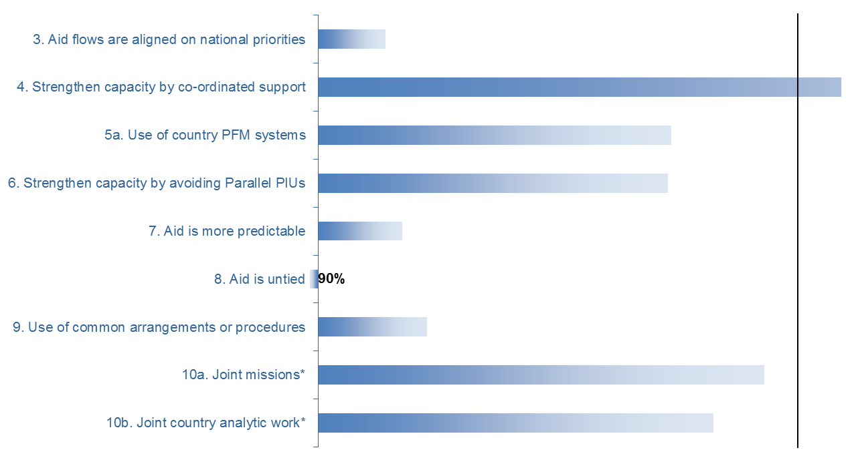
EC and EU MS performance in Paris targets
2005 Baseline
2010 Actual
2010 Target
46%
51%
85%
50%
40%
61%
47%
58%
638
213
44%
49%
72%
>90%
47%
51%
66%
39%
28%
40%
46%
63%
66%

Slide 6
Busan High Level Forum: EU priorities
(Council Conclusions of Oct 2011)
Broaden cooperation with all relevant development partners
Reaffirm aid effectiveness principles
Focus and deepen commitments
Strengthen the engagement of all relevant national stakeholders
Engage with private sector
Adopt a new approach to fragile states
Strengthen implementation at country-level
Streamline the global governance structure
Priorities still valid after Busan

Slide 7
EU deliverables in Busan
EU Transparency Guarantee
The EU is committed to improve the availability, predictability and disaggregation of aid information.
The EU will promote strengthened capacity of the OECD/DAC in statistics and analysis on global aid flows and increased transparency as an issue of key priority with all partners we work with.
Joint Programming
Joint analysis/response to partner countries’ national plans
In-country division of labour for all sectors of intervention
Indicative financial allocation per sector and donor
Not bilateral implementation plans
Approach: Synchronisation, flexibility, open to other donors while EU as a driving force

Slide 8
Main outcomes of Busan HLF
Inclusiveness: common goals and shared principles – differential commitments (emerging economies, private sector, CSOs,…)
Focusing and deepening aid effectiveness commitments: ownership, accountability for results, transparency, reduced fragmentation, New Deal for fragile states
Conceptual shift from aid to aid and development effectiveness: aid as a catalyst – development financing beyond aid - focus on development results
New governance structure: Global Partnership for Effective Development Cooperation, supported by OECD and UNDP

Slide 9
The five Paris principles remain valid after Busan, but their focus develops
Ownership: Democratic ownership
Alignment: Effective Institutions
Harmonisation: fragmentation, aid orphans
Managing for results: measurement, reporting
Mutual accountability: not only for commitments, but also accountability for results

Slide 10
Development effectiveness in Busan outcome document
South-South cooperation: make fuller use, encourage networking and peer learning, strengthen local and regional capacities
Private sector and development: strengthen engagement and enable participation of private sector in development policy design
Combating corruption and illicit flows: intensify efforts to fight corruption and illicit flows
Climate change finance: support integration of national climate change policy in national development plans, predictability and transparency

Slide 11
Global Partnership for Effective Development Cooperation
Busan outcome document:
  New, inclusive and representative structure
  Light working arrangements with regular ministerial engagement
  Support and ensure accountability at the political level
  Forum for exchange of knowledge and review of progress
  Support function provided by OECD and UNDP
  Overall objective: support country level implementation

Slide 12
Governance structure of the Global Partnership

Slide 13
Ministerial Meetings
Open to all endorsing Busan outcome document.
Core function is to provide political support to country level implementation of Busan commitments.
Steering Committee
15 members from the main constituencies, membership is based on representation. COM represents the EU.
Main tasks are to i) prepare high level meetings and ii) direct work of the OECD/UNDP support team.
Members of the Steering Committee will ensure links with other forums/processes.
Co-Chairs
Three co-chairs: i) partner country, ii) emerging economy, iii) donor.
Role to provide leadership for the Global Partnership and chair both ministerial and Steering Committee meetings.

Slide 14
Country level implementation
Country level implementation is a priority after Busan.
Some key entry points for country level action:
Supporting partner country leadership; capacities of core institutions, ability to track results
Strengthening and establishing accountability and results frameworks
Reducing fragmentation, division of labour activities to enhance in-country transparency and predictability (including mapping climate change financing at the country level).

Slide 15
Monitoring framework after Busan
Busan outcome document
  Country level monitoring: Accountability frameworks with indicators responding to specific country needs
  Global level monitoring: Selective and relevant indicators and targets to monitor progress; arrangements will be reviewed in the context of post-MDG framework
No more globally administered monitoring process like in Paris monitoring.
Data collection: Globally agreed indicators are integrated into country level accountability frameworks which provide data for global level in connection to ministerial meetings. Some data (for example untied aid) is collected from existing global data sources.

Slide 16
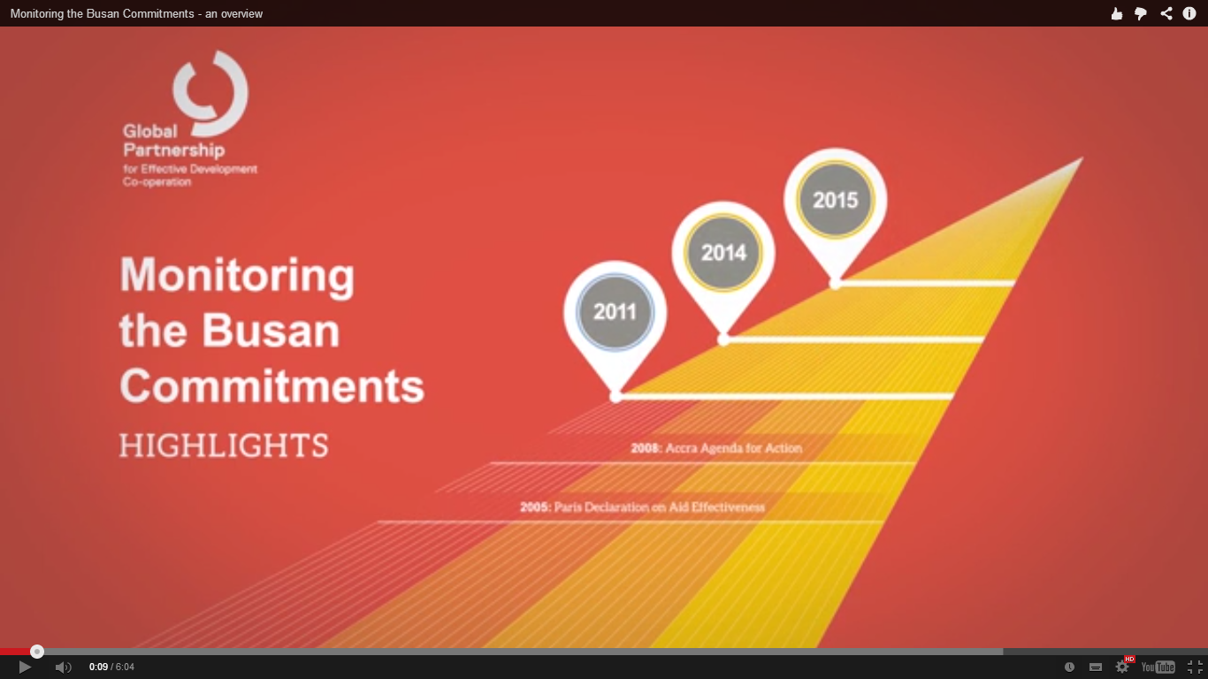
Notes:
http://effectivecooperation.org/

Slide 17
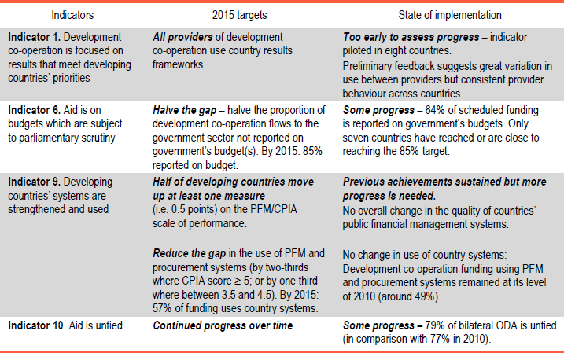
Busan indicators, targets & monitoring:
Ownership and Results

Slide 18
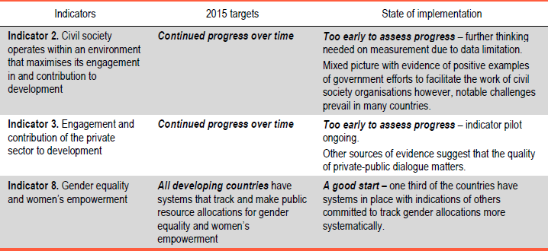
Busan indicators, targets & monitoring:
Inclusive development partnerships

Slide 19
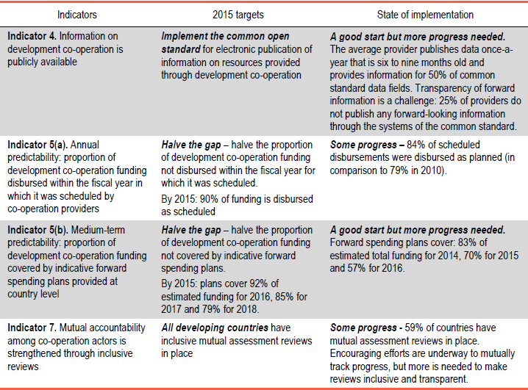
Busan indicators, targets & monitoring:
Transparency and accountability

Slide 20
Mexico High Level Meeting in April 2014
5 Topical plenary sessions (& 37 focus sessions):
Progress in Busan implementation
Domestic resource mobilisation
Middle income countries
South-South cooperation and knowledge sharing
Private sector

Slide 21
Mexico High Level Meeting in April 2014
EU deliverables:
« The Busan Commitment: An Analysis of EU Progress and Performance »
EU Aid Explorer

Slide 22
Mexico High Level Meeting in April 2014
Communiqué:
No new commitments
Aim to accelerate implementation
Annex of 39 concrete, voluntary initiatives
Differences of opinion:
China & India: link to post-2015 agenda
Brazil & Argentina: « common but differentiated responsibilities »

