Slide 1
Use of Country Systems Capacity Development Modes of Aid Delivery

Slide 2
Busan Outcome Document: Use of Country Systems
19. (…) We will build on our respective commitments set out in the Paris Declaration and Accra Agenda for Action to:
Use country systems as the default approach for development co-operation…
Assess jointly country systems using mutually agreed diagnostic tools. Based on the results of these assessments, providers of development co-operation will decide on the extent to which they can use country systems.

Slide 3
Busan Outcome Document Use of Country Systems (ctd.)
… Where the full use of country systems is not possible (…) the use and strengthening of country systems should be placed within the overall context of national capacity development for sustainable outcomes.

Slide 4
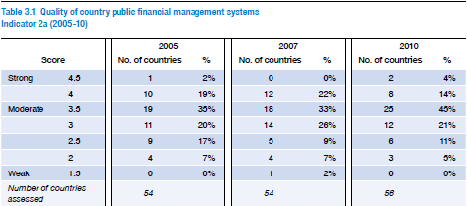
Paris Declaration Monitoring: Use of country systems

Slide 5
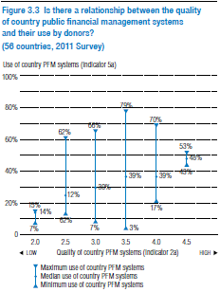
Paris performance Use of country systems

Slide 6
EU performance in Using Country Systems
What country systems?
Public Financial Management Systems
Auditing Systems
Procurement Systems
Social and Environmental Impact Assessment Systems
M&E Systems

Slide 7
EU performance in Using Country Systems according to the OECD-DAC Monitoring of the Paris Declaration
Performance Data only available for
Use of Public Financial Management Systems (PFM)
Use of Procurement Systems
PFM: 41% in 2005, 49% in 2010, Target 2010 was 53%, new target will be defined.
Procurement: 42% in 2005, 47% in 2010, no absolute target yet

Slide 8
Using Country Systems: Aid Modalities & Capacity Development
Using country systems is related to
Aid Modalities
Political Will to use CS
Country Systems Performance
CD is to improve performance of country systems
CD is like a red ribbon through the Busan Outcome Document

Slide 9
Use of country systems: Capacity Development
Council Conclusions on an Operational Framework on Aid Effectiveness (November 2009)
“EU Member States and the Commission will (…) support partner-country capacity development for improving the quality of country systems”

Slide 10
What is Capacity Development ?
Capacity Development (CD) is:
- a key driver of aid and development effectiveness
- an endogenous process that needs to be owned
- a key driver of impact and sustainability
Capacity development is at the core of EU external cooperation (Agenda for Change – increasing the impact of EU policy requires capacity)
Notes:
Capacity development (CD) is a key driver of aid and development effectiveness:
Helping to develop the capacity of its partners to design, implement and report on their development policies is an overriding objective of EU development assistance.
It is moreover recognised as being of strategic importance to achieving the objectives of the Agenda for Change, particularly with respect to poverty reduction, protecting and engendering fundamental rights and the promotion of domestic accountability, and promoting inclusive and sustainable growth.
The EU is committed to working with partners to develop their capacity in ways that are context sensitive and country driven, reflecting partner country ownership and leadership and a commitment to mutual accountability for results.
Capacity development is at the core of EU external cooperation. When partners, institutions and sectors have capacity, they have the vision and the means to initiate and effect transformational change. The EU aims to support the development of this transformational capacity and in so doing encourage an internal process that is self-generating and self-adjusting. In this way, both the process of capacity development and the end results are owned and sustained by the relevant partners and stakeholders

Slide 11
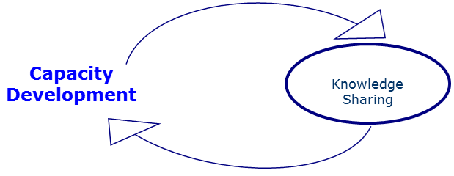
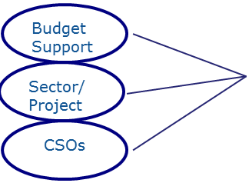
Many ways of supporting CD
If Capacity Development support is successful, it creates an exit opportunity from the traditional aid relationship speeding up institutional development and consolidation
Notes:
Capacity development features in most EC support. Some examples:
Budget support actions have as a primary objective to strengthen governance and core government systems, support sector reforms or improve sector delivery systems.
In fragile environments, it contributes to essential state building processes.
Most project assistance addresses the need for sustainability by including capacity development objectives, whether in terms of skills development or institutional strengthening. A key objective of EU support to Non-state actors, is to improve their capacity to engage in the development process, either as providers of services or as participants in domestic accountability.
At regional level, assisting regional economic communities (RECS) to effectively facilitate the process of regional integration is a key capacity development objective.
CD is not synonymous with Technical Cooperation:
- Capacity can be developed in many different ways. Whilst technical cooperation can contribute to CD, other approaches can be equally important such as financial or budget support, advocacy or experimentation. It is also important to note that whereas the deployment of TA is often done to develop capacity, it can also support other purposes.
Effective institutions and policies are indispensable for country ownership and the delivery of sustainable development results (in line with the Busan declaration "Partnership for Effective Development Co-operation" ). That is why quality of CD processes must be ensured for the sake of sustainability and impact (see methodology).
The opportunity framework and the quality of the learning process act as the catalysers of the Capacity Development process, including the acquisition of the specific capabilities and their transformation or mainstreaming into overall capacity.

Slide 12
… and why is it important?
The capacity of project partners is a key factor influencing the likely achievement of results.
Enhanced capacity generates sustainable results.
Ownership is only possible if the capacity is there.
Hence, flexibility is needed to:
- understand capacity development as a process to achieve change and reform
adapt objectives and timeframe to the context
facilitate innovative approaches to capacity development
Notes:
The capacity of project partners is a key factor influencing the likely achievement of results. Projects supported by the EU are implemented by national partners who can be state actors or non-state actors. The selection of partners will be guided by the context analysis, policy dialogue and an assessment where the mandates lie for carrying out the cooperation objectives in the selected sectors. It is important that partners have the capacity to implement the cooperation objectives or can, through the cooperation assistance, develop the necessary capacity.
Capacity development is necessary for sustainable development results and particularly for: i) setting the ground for a "smooth exit" of development partners from the programme / project and ii) mitigating the distortion effects of development aid (e.g. partner dependency, short-term results, disempowered institution).
Ownership is only possible if capacity is there. Executive leadership from national partners needs good capacity at different levels (managerial, administrative, technical etc).
The European Commission has a long history of dealing with Capacity Development. In 2008, the Commission made an important step in the aid effectiveness agenda, launching its strategy on Technical Cooperation (called backbone strategy).
Last year, at the High Level Meeting on Aid Effectiveness in Busan, Partner Countries promoted a more open approach to Capacity Development. Indeed, Capacity Development should be more than technical assistance and more than training. It is the wider process of supporting Partner institutions to achieve change and reform.
The Agenda for Change of the European Commission stated that one of its priorities is increasing the impact of EU policy. Increasing the impact will only be possible if there is capacity in the partner countries: national development plans behind which we can align, and effective country organisations which can implement those plans.

Slide 13
CD: a key issue for all
Court of Auditors (2007/2011)
Busan (2011)
Agenda for change (2011)
OECD Peer review (2012)
EU Delegations and colleagues from HQ
Notes:
Different challenges have been raised by different groups of actors (Court of Auditors report 2007 and revision 2011; OECD peer review in 2012, European Parliament or EU Delegations). The general feeling is that Capacity Development support is not always well managed.
For instance, the 2012 DAC’s Peer Review of the European Union, notes that, since the last review 5 years ago, important steps have been taken in order to promote aid effectiveness, impact and coherence. Nevertheless, it also points out several challenges still ahead.
Recommendations: To consolidate progress in making development co-operation more effective, the EU institutions should now:
• Examine ways to make EU project approaches more effective, timely and flexible, and increase use of programmatic approaches; both approaches will continue to be needed given the range of contexts in which the EU operates.
• Implement the strategy for reforming technical co-operation and review how EDF cells, which support National Authorising Officers, could be better integrated into national administrations and contribute more to broad state capacity development
- Alternatives: Local expertise, Public expertise, NSAs, foundations, universities…

Slide 14
CD is a learning process
From technical cooperation to Capacity Development
Backbone strategy (2008)
Guidelines on Technical Reform (2008)
CD Toolkit (2010)
Training and knowledge sharing
Notes:
As a response, in 2008, the Commission made a bold step in the aid effectiveness agenda, launching its strategy on Technical Cooperation which was further completed with a Work Plan and a Toolkit.
The Backbone Strategy provides the overall approach for a change process that will evolve over time through the implementation of a set of actions and internal learning.
The Guidelines on "Making Technical Cooperation more effective" represent a building block in the implementation of this Strategy by offering operational guidance on programme design and management.
The Toolkit for Capacity Development presents the approach and the tools to support and increase demand-orientation and effectiveness of capacity development support, including technical cooperation. They also provide guidance for assessing capacity and help partners to develop strategies and programmes for capacity development, particularly at sector level.
The Backbone Strategy articulated the change agenda in alignment with international agreements (Paris Declaration, Accra Agenda for Action, and the Busan Outcomes Statement)
Subsequently guiding principles and operational guidelines for have been introduced making TC more effective in support of capacity development

Slide 15
Understanding and meaning of key terms Variations often exist between governments, between donors and between government and donors
Notes:
Experience shows that there are differences in understanding of key concepts such as capacity development both in governments, between governments, between donors and between governments and donors.
Some practicioners can understand Capacity Development as a reform process (meaning the action of changing an institution or practice). Others do associate reform with more radical change and in particular new technology, new processes and procedures while CD is associated with incremental or evolutoniary change, focussing on the people, the organisations and environment.
The emphasis on the need for clear definitions may appear innecessary but without a common understanding and agreement on these, expectations are unlikely to be achieved.
Capacity is not only about skills and procedures, but also about incentives and governance.

Slide 16
Recognising the role of an external partner to CD processes
Capacity
Outputs
Outcomes
Wider impact
Recurrent inputs
Internal resour-ces
CD processes
CD support
Notes:
Donors can promote and accompany, but can’t “do” it
They can provide access to resources, ideas, connections and opportunities BUT no substitution for commitment, energy, motivation
“Support for capacity development” refers to the contribution an external partner makes to already existing and locally driven capacity development. The Commission is committed to play this support role, but must contend with a number of challenging questions:
• What expertise and facilitation skills does it require?
What approaches and modalities to select to best support CD objectives?
• How to adapt PCM procedures in ways that accommodate the uncertainties of change processes?
• How to manage the trade-off between investments in the often complex and long processes of capacity development, and meeting short-term expectations to see quick concrete results, and meet disbursement targets?

Slide 17
How does the EC support CD? (1/3)
Guiding principles
Methodology / 5 Technical Cooperation Quality criteria:
Fits with the context
Ownership
Results orientation
Harmonized support
Programme Implementation arrangements
CD
enabling
factors
Notes:
The EC tries to support capacity Development by offering operational guidance on how to design, implement and review CD interventions. It does so through the lens of 5 quality criteria, initially developed to improve the quality of EC technical cooperation but which have been adapted to support capacity development in general. These quality criteria are relevant across the cycle of operations, take account of the different approaches and modalities, and provide additional perspectives on how to conduct dialogue, country and sector context analysis and address issues of quality.
The 5 quality criteria are:
QC 1- fitting into the context (for instance through Political Economy Analysis)
QC2- Ownership: Policy dialogue as a facilitation process
QC3-Results orientation: CD planning and measurement (methodology in progress..)
QC4-Harmonization: coordination (i.e. joint programming)
QC5-PIA : alingnment with the budget process of the country (use of country systems)

Slide 18
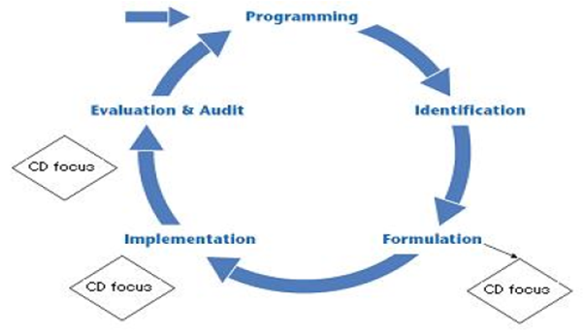
How does the EC support CD? (2/3)
Quality assessment tools
The EC has developed tools for monitoring the quality of implementation, which provide the framework for good design
The Quality Grid
The QSG
The ROM
The annual EAMR
RAC evaluation
The novelty of the EC approach lies on translating the Aid Effectiveness principles into quality criteria to be mainstreamed into the EC Project Cycle and be monitored regularly
Notes:
Different quality assessment tools have been consolidated throughout these last years in order to assess and monitor capacity development internally and at the different stages of the project cycle.
These tools allow to address quality criteria since the very beginning of the project cycle and to monitor them all along the life of the action.
Data are analysed on a yearly basis and results try to orientate further guidance.

Slide 19
How does the EC support CD? (3/3)
3. Knowledge sharing
Sharing knowledge on EU development can improve the Quality of Aid and increase our impact in terms of Capacity Development
It also has a transformational effect at various levels
It is promoted by Capacity4dev.eu which supports the quality of aid, good practice and capacity development
3 pillars :
Consolidate knowledge and build Institutional Memory
Support Thematic Expertise, break down the silos
Support good practice and innovation exchange / help identify specialists
Notes:
The knowledge sharing platform capacity4dev.eu emerged back in 2009 as a direct outcome of the Backbone Strategy on the Technical Cooperation Reform, and has since continuously evolved to become European Commission's knowledge sharing platform on development and cooperation.
Through this tool the EU is trying to consolidate and capitalise knowledge generated within its network to enhance the quality and impact of its work on development cooperation.
Capacity4dev responds to 3 major challenges faced:
Consolidate its knowledge and preserve its institutional memory. Indeed as the staff turnaround is very high (over 20% of the staff leaves its post or the commission every year) and the use of short term or externally contracted staff is around 50%, there is a need for a system that will help knowledge retention and capitalisation over a much larger part of the knowledge created in-house. Capacity4dev offers through its advanced groupware the possibility to manage knowledge exchanges in a much more efficient and user-friendly way.
Help bridge the thematic and geographic silos. It is often the case that thematic and geographic experts spend most of their time within their thematic area or geographic field and lack horizontal access and visibility of the work done in other fields and regions. Nevertheless this horizontal view is extremely important as all themes are intertwined and what happens in one region often impacts or influences what happens in another. Through various techniques (including thematic and geographic taxonomies, user profiling against interests and expertise etc) capacity4dev helps bring to the surface knowledge that is relevant to the practitioners beyond their core theme or geographic focus.
- Facilitate cross-learning and knowledge exchange between EU Institutions staff and other development professionals and experts. Beyond the need to better capitalise on the knowledge within the EU Institutions and Delegations, it is absolutely crucial that an active knowledge exchange is set-up among EU Institutions practitioners and those of other Organisations, private sector, NGOs, academics etc., to help boost the quality and impact of our policies and actions, as well as improve coordination among donors.

Slide 20
The 5 CD Quality Criteria

Slide 21
QC 1-Fitting with the context
Key task throughout the life of programme, not just when design is done
Assessing context: understanding drivers, opportunities and constraints to change; what can/ cannot be done ; mapping stakeholders.
Assessing capacity: unpacking nature of capacity challenge focusing on both strengths and weaknesses.
The role for the EC is not to bring in external TA to conduct the assessment but to support and facilitate self-assessment
Notes:
Taking account of context and capacity is a key task in any intervention aimed at promoting capacity development. It is particularly important during programming and design but should continue to be a focus of attention throughout the life of any programme, to ensure that support remains relevant and can be adapted to changing circumstances and needs. Adequate appreciation of context and capacity is essential if external CD support is to m
Assessing the context can help understand the drivers and constraints to change that influence what can/ cannot be done, including the opportunities for change. Context assessment can also be used to map the various stakeholders that are involved (formal and informal) and to understand the influence that they can exercise over the envisaged change. ake a meaningful and sustainable contribution.
Assessing Capacity: the main purpose of assessing capacity is to understand the nature of the capacity challenge to be addressed. A comparatively broad-brush assessment may be all that is needed at the programming and identification phase in order to form a general picture of the need (or as part of the eligibility assessment for budget support, whereas during formulation, a more intensive exercise might be required in order to support the formulation of programme objectives and performance indicators. During implementation, capacity assessment can serve as a helpful tool to facilitate the process of change, and to monitor progress.
The assessment should focus on both strengths and weaknesses, and should consider capacity in relation to current and projected levels of performance. In designing a capacity assessment, the following questions should be considered:
What existing (baseline) information on capacity is available and what has been the experience of previous assessment exercises?
How can the assessment be used to increase awareness and interest among stakeholders for capacity and change?
What level and depth of information is needed to help set the agenda for change and to specify results?
How can the assessment be used as a framework to support change, monitor progress over time and report on results?

Slide 22
QC 2- Adequate demand, commitment and ownership from the country partners
Success depends on partner ownership + commitment to the change process. EU plays a facilitating role
Key indicators of ownership
Who brings the issue of capacity to the table? | There must be a degree of initiative from country stakeholders to signal ownership. If donors are driving the attention to CD in policy- or programme development, then ownership is unlikely.
Who does the assessment of options and scenarios? | It is better if country actors choose policies, actions and priorities for CD, based on their own assessment of the likely benefits and costs.
How solid is the support behind the proposed programme? | If country decision makers reach out to build a domestic constituency (e.g. among the urban or business elite, labour unions or parliamentarians) for reform and CD, thereby investing political capital, then ownership is likely.
How engaged are senior managers in design process? | The more detail senior partner representatives can personally explain the kind of service/regulatory outputs they aim at, and how they will organize and manage the CD processes and the external support to these processes, the more likely is ownership.
Notes:
Success depends critically on partner ownership of and commitment to the change process. Moreover, any external support aimed at facilitating a country driven change process can only be effective if it is based on genuine demand.
Three perspectives can help judge the degree of partner ownership and commitment for change, including the credibility of the proposed reforms and demand for external assistance. These are: (1) Change Readiness (2) Practical Ownership and (3) Demand for External CD Support.

Slide 23
QC 3- Clear link to results and expected outcomes
3 challenges:
(i) defining CD results, not TC inputs
(ii) uncertainty and complexity of change process
(iii) delivery vs. capacity
Getting process right:
(i) specify results
(ii) choose CD strategy
(iii) decide who does what
Guiding questions for formulating CD objectives
Who or what (organisation, target group, sector, etc.) needs capacity?
Why is the capacity needed – for what purpose?
What type of capacity is needed in order to achieve the purpose?
Notes:
Specifying results lies at the heart of good design.
Lesson learned:
Overly structured intervention plans can end up constraining, rather than enabling the emergence of capacity

Slide 24
QC 4- Harmonised support
Put all harmonization options on the table with partners:
Full partner implementation
Pooling of funds, administered by the partner
Harmonisation around objectives/results/sectors, individual supply
CD support delegated to one agency (not an end in itself)
Keep other donors in the loop when CD is considered
Start harmonizing CD in assessments
Help partners play a stronger role in implementing CD
Promote mutual accountability for CD results
Notes:
List of potential entry points for promoting harmonised CD support:
1: Put all harmonisation options on the table during dialogue with partner, and continue to review options throughout the project cycle
Options include:
CD Support fully managed by the partner;
Pooling funds from several donors administered jointly or by the partner;
Inclusion of capacity development activities as part of what is funded through sector budget support
CD support delegated to one or a few Development partners on behalf of a bigger group that are able to provide greater flexibility and/ or has untied procurement rules;
Harmonisation around an agreed set of programme objectives and results with donors bringing their individual CD support to the programme
2: Improve coordination and information exchange when stand-alone support is the preferred option
Inform other donors about the support in preparation. Where relevant, invite them to participate in the design process. Verify whether other donors are providing support in the same sector/area; circulate Terms of Reference for comments and assess risks of overlap and fragmentation with the partner.
Assist the partner with the practical coordination of the different types of support. For example open a private group on Capacity4Dev for sharing draft terms of reference and other documents with other donors and the Partner
3:Explore opportunities to carry out shared activities to reduce fragmentation
If CD support in the area or sector is fragmented, start harmonising CD support around a joint agenda for analytical and advisory work, joint reviews and evaluations.

Slide 25
QC 5- Appropriate Project Implementation Arrangements
Preferable conditions:
Avoid Parallel Project implementation Units, unless perfectly justified, and desired by domestic stakeholders
Primary accountability is to domestic stakeholders
How well is the support integrated into the country institutional set-up ?
Can the implementation mechanisms be closer to country systems ? Procurement, accountability mechanisms (Budget, Parliament, Court of Auditors)
Issue of salary top-ups and related incentives has been addressed?
EU/donor role is limited to oversight
Notes:
Defining PIA => 5 key parameters
1. Governance and accountability
Who should oversee and govern programme implementation?
Who should the programme be accountable to in the country system?
Take care to avoid duplication
2. Management set-up
Who will perform daily programme management functions?
With what authority over resource management functions?
A part-time or full time function?
3. Logistical autonomy & embeddedness
Does the programme require own vehicles, office equipment, ancillary staff, or can it share resources with others?
Legitimacy, sustainability, efficiency
4. Relations between TC experts, partners and EC
If contracted by the EC (or another donor), who are the experts taking instructions from and to whom are they accountable?
Trust, accountability and confidentiality
5. EC’s and other donors’ roles
Should donors play a role at all in the PIA – and if so, which role?
Policy dialogue, negotiating results framework, M&E

Slide 26
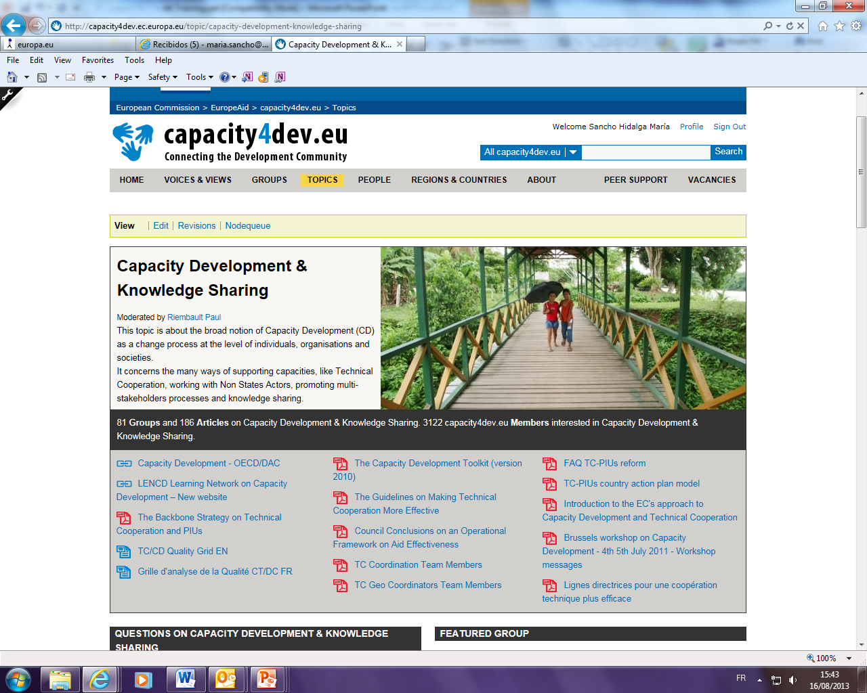
More information available at:
Unit 06- Quality and Results
DEVCO L-41 09
Head of Sector: Paul Riembault
Quality Manager Officers: Zane Rungule & María Sancho Hidalga
Capacity4dev Project Manager: Christoforos Korakas
Capacity4dev collaborator: Sorina Juglan

Slide 27
Aid Modalities
in the
Aid Effectiveness Context

Slide 28
The project approach
Disadvantages
Advantages
Fragmentation: gaps & overlaps unless heavy coordination
Transaction costs: lots of admin for donors, headaches for gvmts
Undermines state: in cases of parallel infrastructure
Help people fast: when they need it & the gvmt can’t / won’t
Tangible: down-to-earth, practical, visible
Notes:
So are projects actually a good idea? [First ask participants to throw out what they think are the pros and then the cons]. The pros:
Help people fast: where people are really suffering and where the Government can’t or won’t help, you need to get your support there fast and using your own machine.
Versatile: in theory with a project you can customise, adapt, and quickly learn as you don’t have to consult anyone else.
Tangible: you are doing something down-to-earth, visible, with tangible results.
Not endorsing the Government: if you dislike the Government or if it doesn’t come up to your standards, it’s a good way to still help the people.
Civil society: when supporting NGOs, it often makes sense to use a project as these are organisations that are by definition outside of Government and whose independence and capacity you are trying to promote.
The cons:
No ownership or accountability: neither the beneficiaries nor the Government have a say.
Fragmentation: there is a tendency for lots of individual initiatives with gaps and overlaps unless you spend a lot of effort on coordination.
High transaction costs: for running lots of stand-alone initiatives and for monitoring them as a Government.
No donor say on policy: unlike with budget support, you are no longer buying a seat at the top decision making table.
Undermines the state: you create parallel infrastructure to implement your projects rather than building national infrastructure.
Not sustainable: and even if it is, often you’ve only helped one area or one group.
Big problems need big solutions: some say donors should concentrate on working with Government, on the macro-stuff. Small projects should be left to NGOs.
It depends: projects can be designed in line with national policy, coordinated with other donors etc. but, due to their nature, they have a tendency not to be.

Slide 29
Programme-based approaches (PBA) OECD DAC Definition
(i) leadership by the host country or organisation;
(ii) a single comprehensive programme and budget framework;
(iii) a formalised process for donor co-ordination and harmonisation of donor procedures for reporting, budgeting, financial management and procurement; and
(iv) efforts to increase the use of local systems for programme design and implementation, financial management, monitoring and evaluation.

Slide 30
PBA: pros & cons
Advantages
Disadvantages
Ownership: government sets sector policy priorities
Transaction costs: one goal, framework, measurement systems & donors coordinate
Alignment & harmonisation: all together, to some extent use of gvmt systems
MFR & MA: one set of results & measurement framework
Coordination costs: taking account of others isn’t always easy
Financing: relative high transaction costs, pool funding - high coordination costs
Notes:
So are they actually a good idea? [First ask participants to throw out what they think are the pros and then the cons]. The pros:
Ownership: Government sets sector policy and priorities.
Transaction costs: should be lowered with one goal, one framework for action, one performance measurement system and donors coordinating themselves.
Alignment & Harmonisation: all are working together towards one goal and hopefully at least some are using Government systems to do so. If not, they will at least be using some national machinery such as indicators.
Managing for Results & Mutual Accountability: we have one set of results, one measuring system and we meet regularly to discuss how we’re doing.
And the cons:
Ownership: in practice donors often push for a big say in sector policy rather than following behind. Negotiating with them can take a lot of Government’s time, not to mention its independence.
Coordination costs: negotiating who does what and how is much harder than just doing your own thing. Different donors have different ways of working and different priorities and having to coordinate your work with others can therefore take a significant amount of resources.
Pool funds, PBAs are heavy: money given by one donor to a pool fund managed by another often comes with lots of demands for donor-specific reporting and accountability. The resulting designs can be quite clumsy and administration-heavy.
Not Budget Support: being involved in a sector-wide approach is often used an excuse for not doing budget support. But if you agree with the sector strategy etc then why not do budget support?
It depends: overall then, it depends how you do it, how coordinated it really is, how many different instruments and programmes are used to support it, how much leadership the Government chooses / is allowed to take.

Slide 31
Budget support
A Modern Approach to Budget Support
Differentiating EU Budget Support: a summary
Good Governance and Development Contract: general budget support will be provided when there is trust and confidence that aid will be spent pursuing the fundamental values of human rights, democracy, and rule of law.
Sector Reform Contract: sector budget support in order to address sector reforms and improve service delivery. Useful tool even where conditions do not permit use of GGDC.
State Building Contract: used to provide budget support in fragile situations.

Slide 32
Main Messages of the Budget Support Communication (10/2011)
Continued importance of budget support instrument
Stronger link with EU fundamental values (human rights, democracy and rule of law)
Greater differentiation of budget support operations, allowing the EU to respond better to political, economic and social context of partner country
Strengthened eligibility criteria and more rigorous assessment
Stronger focus on accountability and transparency (new eligibility criterion)
Strengthened risk management framework
Continued emphasis on results, performance tranches, government ownership and predictability
Strengthened EU Coordination
(Council Conclusions on BS Mai 2012; EU BS Guidelines to be finalised in 2012)

Slide 33
Budget support
Advantages
Disadvantages
Implementation of key aid effectiveness principles: ownership, alignment, harmonisation, MA
Uses state structures: capacity, legitimacy, transparency, accountability
Less transaction costs: national or sector strategy, indicators, reporting
We do something BIG: reform orientation, supporting structural change
Interventionism – non-ownership Conditions for cash, political pre-conditions on EU fundamental values (GBS, Good Governance and Development Contract)
Predictability: policy conditions, sensitive triggers
Visibility: might be more difficult to maintain than in project support
Notes:
So, is it a good idea? [First ask participants to throw out what they think are the pros and then the cons]. The pros:
Paris in a can: it certainly seems to tick all the boxes. The Government uses donors’ funds directly to implement its own strategy so surely it’s 100% owned, aligned and harmonised. And we’re directly targeting results and being held accountable for them.
Reinforces the state: instead of bypassing it. So we help improve the capacity, legitimacy (services delivered by Government) and accountability of the state.
Less transaction costs: instead of lots of different initiatives with their different administration requirements, we are just using the national strategy and systems.
We do something BIG: we’re doing the most macro and most sustainable thing possible – directly supporting Government in implementing its national poverty reduction strategy.
Less hassle: great for donors, no heap of projects to manage, easy to spend and once it goes to Government it’s their responsibility.
Doing what we said: as we saw in the ideas module, doing more budget support features in almost all the international commitments on aid effectiveness.
The cons:
Neo-colonialism? All these conditions and policy for cash – is Government forced into a policy straight-jacket and the citizen-state contract weakened?
It’s all our fault? As you don’t know where your cash goes, you can be portrayed as an accomplice in anything bad that the Government you’re financially supporting does. Legally no – it’s the Government’s responsibility to use the money properly once you pay them - but the taxpayer and press won’t see it that way.
Predictability? Donors put various conditionalities on BS, many of which are vague and some of which are political. And they have sensitive trigger fingers, especially at headquarters, and / or heavy and unpredictable administration. So you get “aid shocks” when money that was expected suddenly isn’t paid. This is much more potentially damaging than not paying a project as you are affecting the national budget and the delivery of public services.
Transaction costs? Different aims, indicators, and reporting formats of different General Budget Support donors, the insistence on detailed monitoring by donors, and the placing of in-Ministry consultants to “help” can actually mean managing a budget support operation has quite high transaction costs for both donors and Government.
Visibility: donors lose visibility of funds and achievements to claim as their own to their domestic electorates.


Slide 34
The European Commission can delegate authority to manage funds to another donor and can also be delegated authority by another donor.
Delegated cooperation
Advantages
Specialisation: more of what everyone is good at doing; concentration on three sectors per country is easier (=> new programming instructions on DCI and EDF)
Coordination: less gaps & overlaps, more trust
Economies of scale: bigger programmes, lower overheads
Transaction costs: less actors
Disadvantages
Control? trusting procedures of other donors
Less visibility Especially in the context of silent partnerships
Logic of EC-MS delegation MS pay us, we pay them, … efficient?

