Slide 1
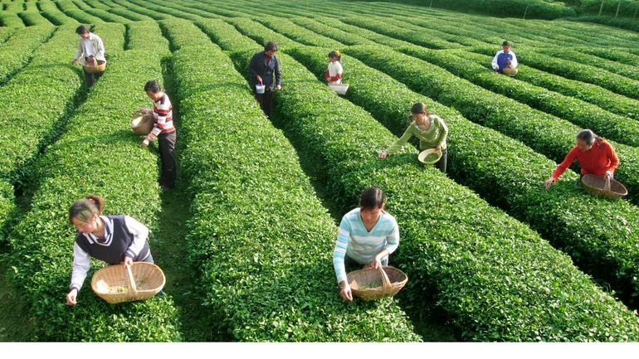
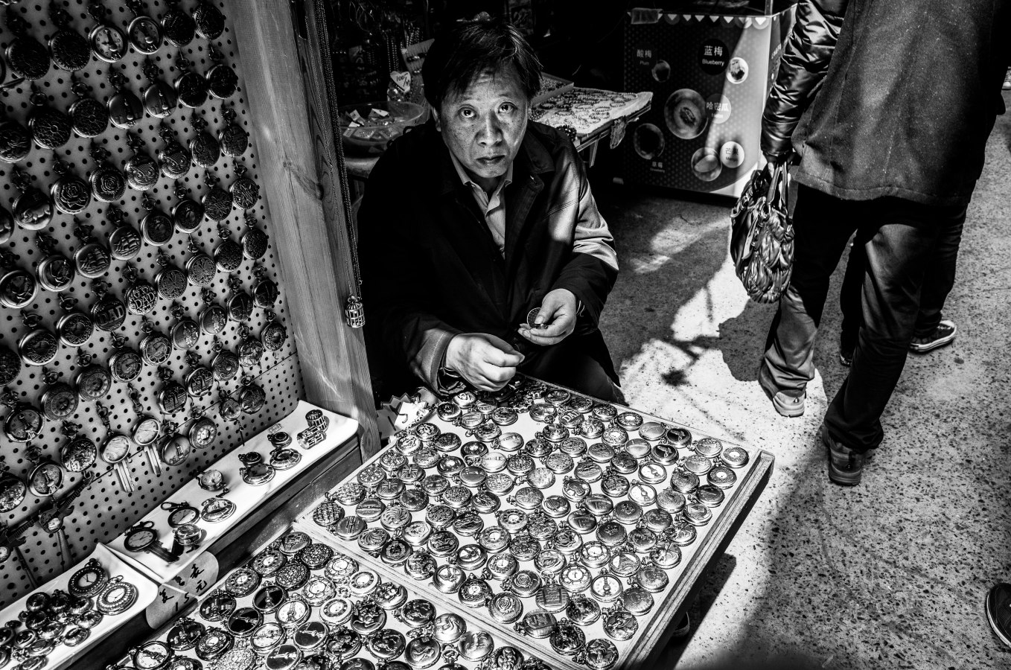
Joint Programming Nepal

Slide 2
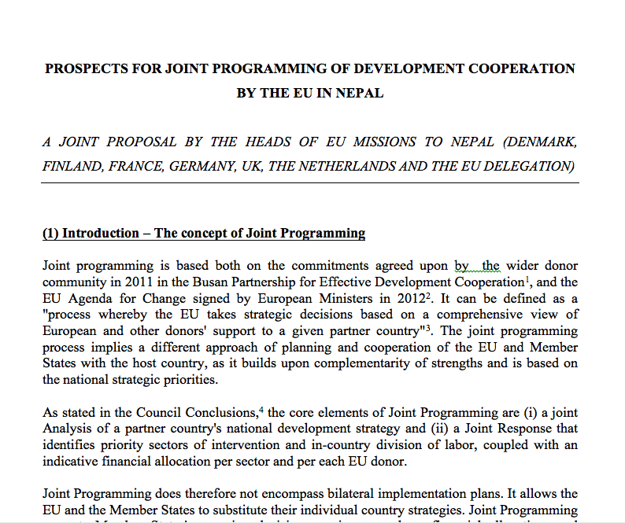
Back in 2013….

Slide 3
Selling Points
Ownership & alignment ⬆
Predictability & transparency ⬆, transaction costs ⬇
Aid fragmentation ⬇
Impact & value for money ⬆
Influence & visibility ⬆
Pressure to do everything yourself ⬇

Slide 4
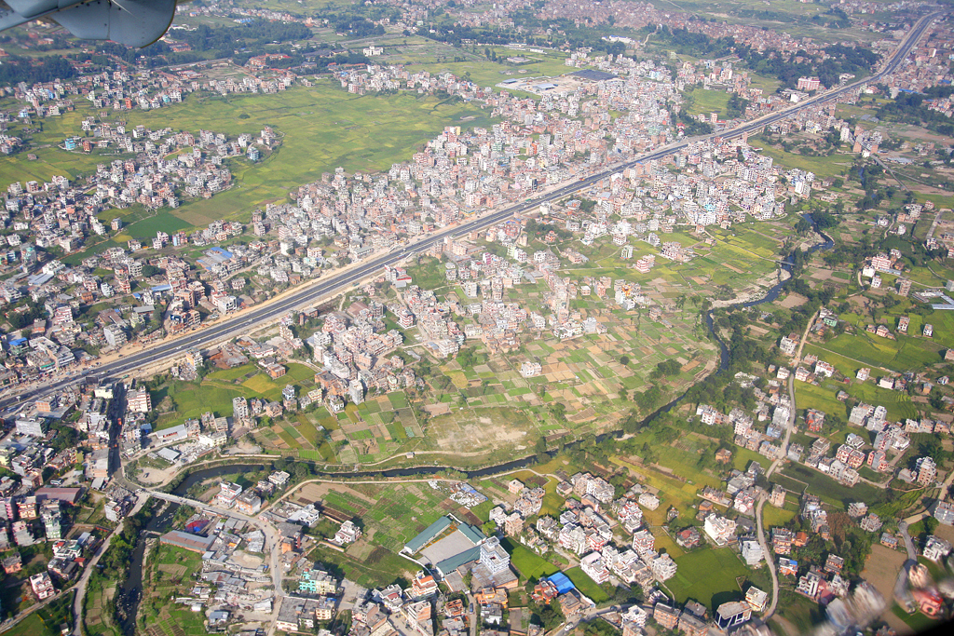
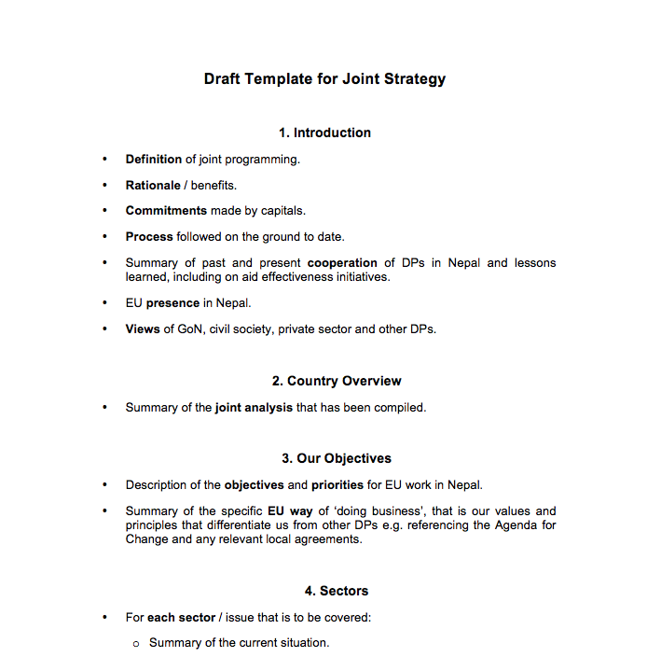
Consultancy Support

Slide 5
Lessons

Slide 6
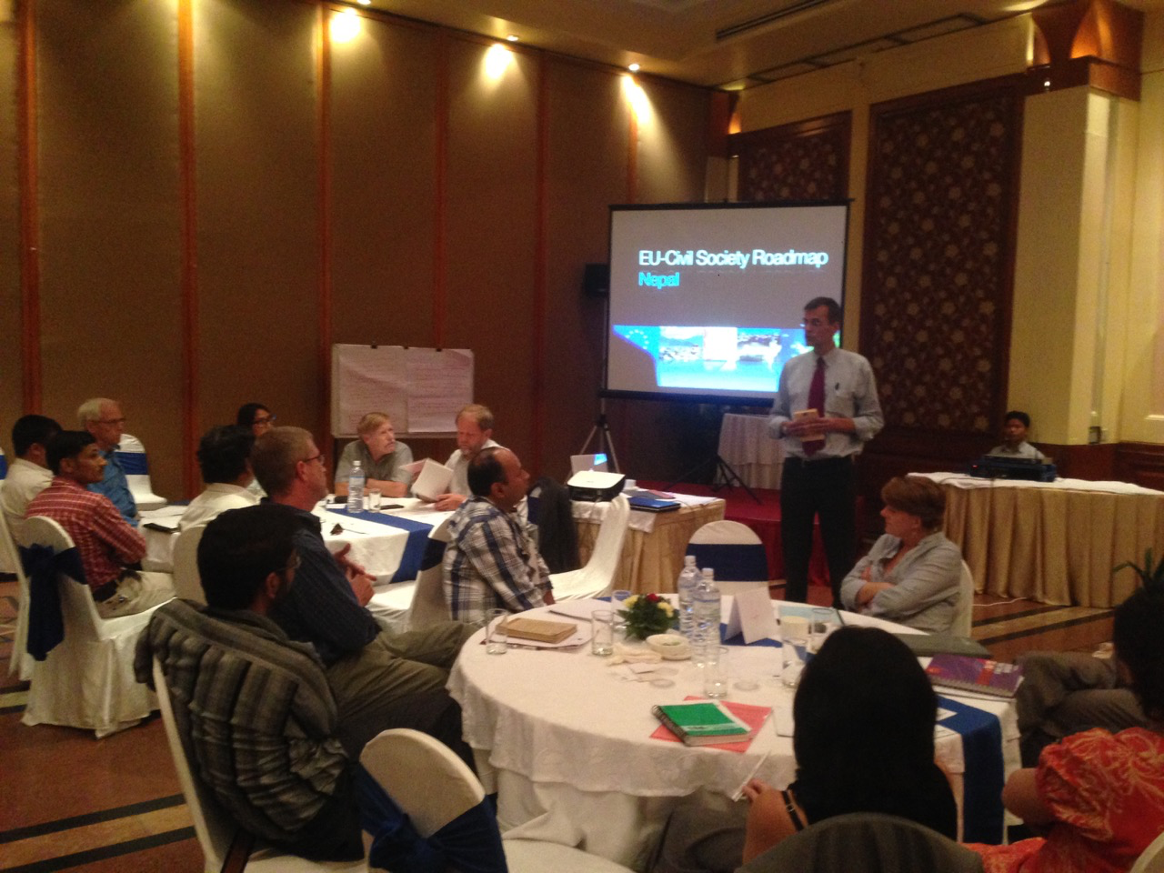
More is more.
Less is more.
Joint Strategy
For
Nepal
2016-22

Slide 7
Aligning the Timing
 | 2010 |  | 2011 | 2012 | 2013 |  | 2014 | 2015 | 2016 |  | 2017 | 2018 | 2019 |  | 2020
GoN |  | Three Year Plan |  |  |  | Three Year Plan |  |  |  | Three Year Plan
EU
DE
DK
FI
NL | TBA
UK
CH
NO

Slide 8
Division of Labour
 | EUD | DE | DK | FI | NL | UK | CH | NO | TOTAL
Agri / RD |  |  |  |  |  |  |  |  | 3
Education |  |  |  |  |  |  |  |  | 4
Employment |  |  |  |  |  |  |  |  | 2
Energy |  |  |  |  |  |  |  |  | 4
Enviro |  |  |  |  |  |  |  |  | 3
Health |  |  |  |  |  |  |  |  | 2
Trade / PSD |  |  |  |  |  |  |  |  | 4
Transport |  |  |  |  |  |  |  |  | 1
Vocational Tr. |  |  |  |  |  |  |  |  | 2
WASH |  |  |  |  |  |  |  |  | 2
TOTAL | 4 | 3 | 2 | 3 | 3 | 5 | 4 | 3

Slide 9
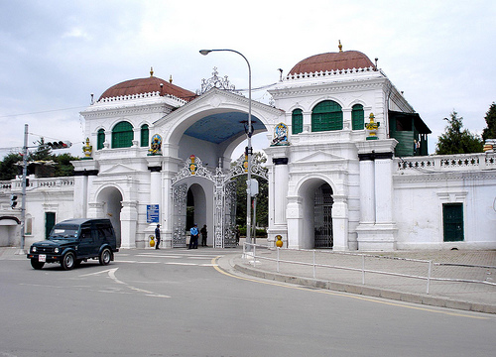
The Limits of Ownership
Joint Strategy
For
Nepal
2016-22

Slide 10
The Limits of Ownership

Slide 11
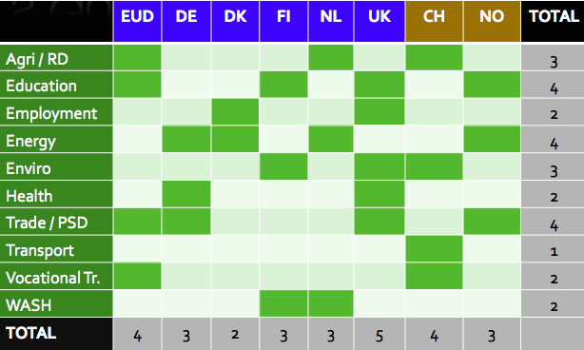
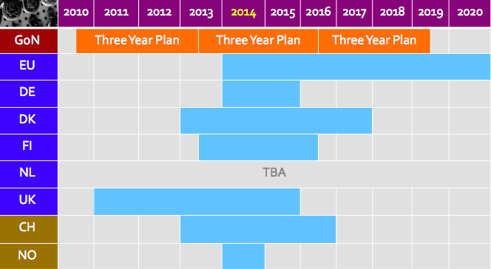
The Communication Gap
Joint what?
Dear Capitals….

Slide 12
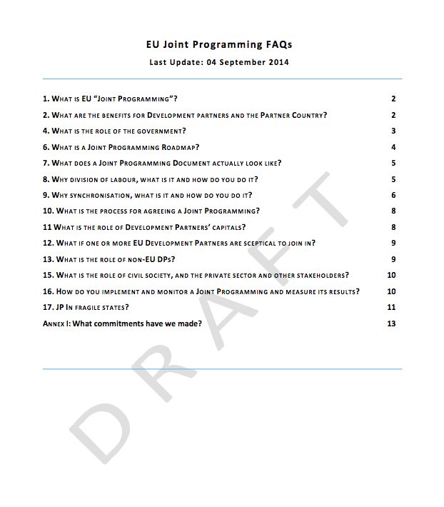
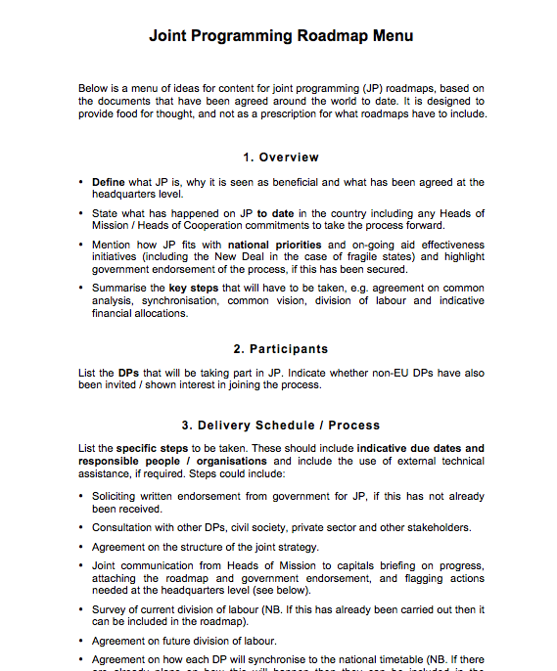
EU Joint Programming Guidance Pack

Slide 13
Thank You consultancy@andybenfield.com

