Slide 1




Bilateral Collateral

Slide 2


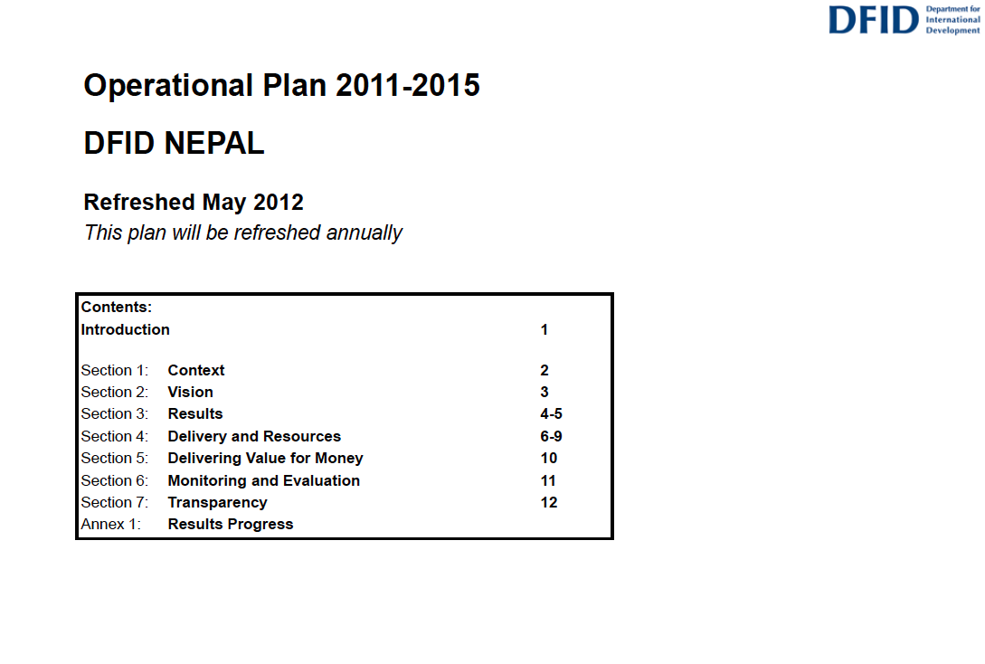


Common Sense?
Joint Strategy
For
Nepal
2016-22

Slide 3

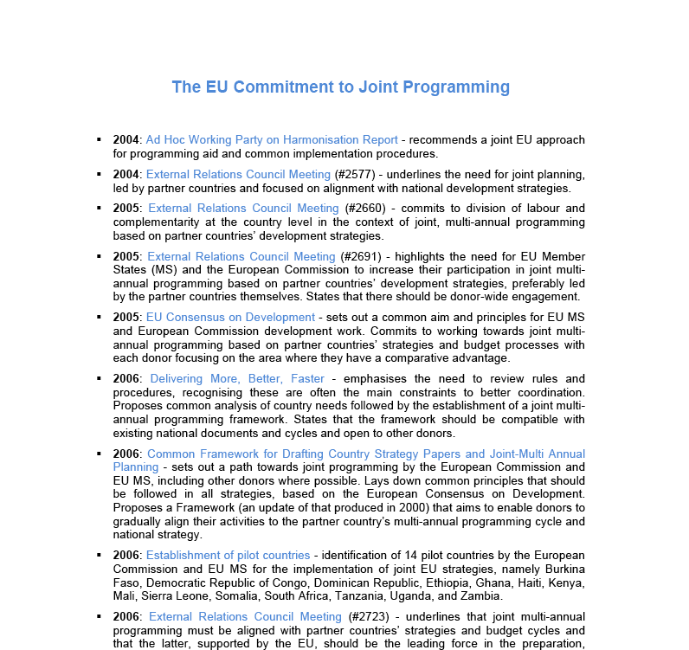
Commitments

Slide 4





Joint Strategy
For
Nepal
2016-22
CONTENTS
- Analysis
- The EU Way
- Sectors
- Common Positions
- Results
“The strategy would not go into details of how individual DPs carry out their work, i.e. aid modalities, individual initiatives to be pursued… instead left to bilateral implementation plans”

Slide 5

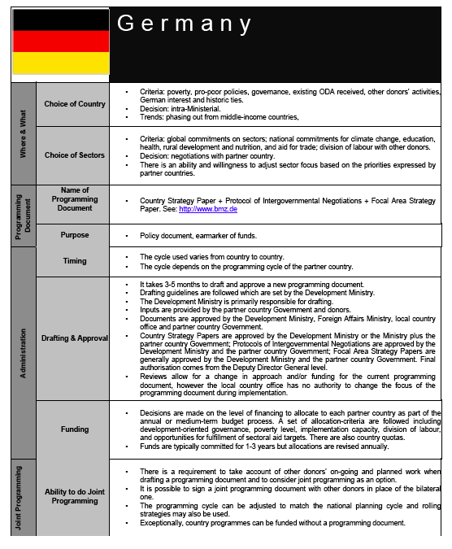
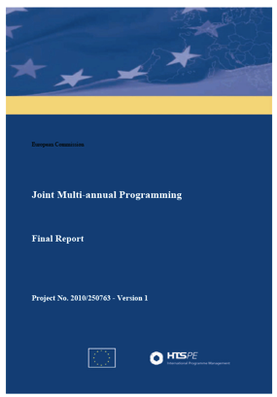
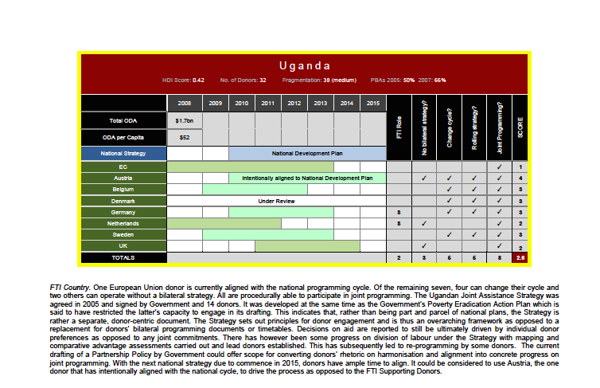
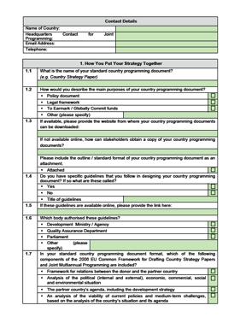
The JP Study

Slide 6
The JP Study
A joint strategy should = change on the ground: “so far, so bad”
“While documents purporting to be joint programmes were found in many countries, these were largely compendia of bilateral strategy papers or general statements of intent and principles”
Problems: include keeping bilateral strategies & synchronisation

Slide 7
The JP Study
“70% of EU MS don’t need a bilateral strategy if there’s a joint one”
“50% make their main programming decisions on the ground”
“58% can synchronise to the partner country planning cycle”

Slide 8

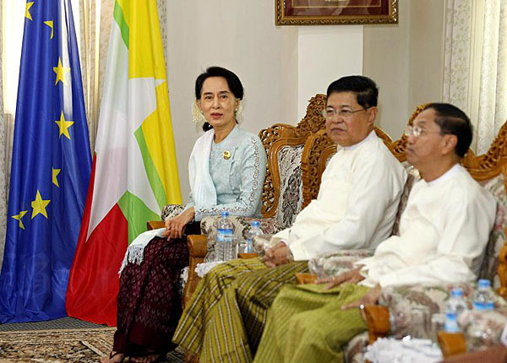
In Practice - Myanmar

Slide 9
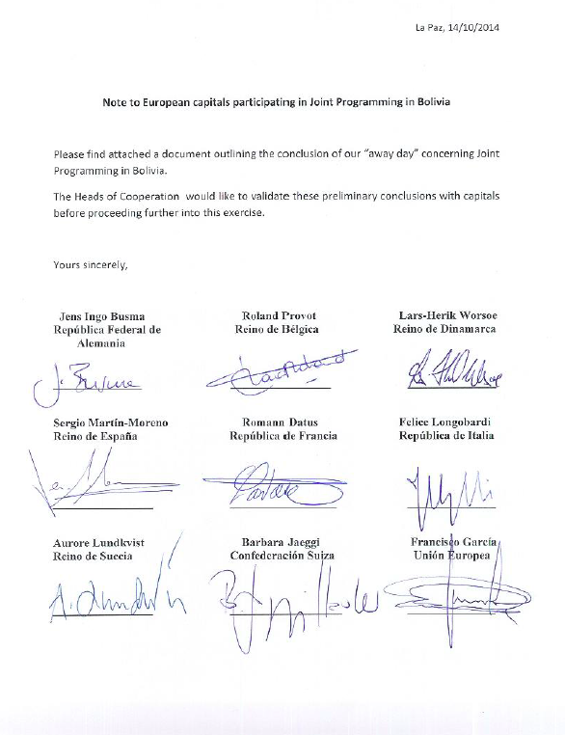
In Practice - Bolivia
“Each capital is asked to confirm whether this will be possible and whether any additional content would be needed in the joint strategy to facilitate such replacement.”

Slide 10

In Practice - Nepal
Joint Strategy
For
Nepal
2016-22
Risk Analysis
Value for Money
Operating Costs & Efficiency Savings

Slide 11
Thank You
consultancy@andybenfield.com

