Slide 1
Управление качеством воздуха в странах Восточного региона RPP3 – Final Training on THOR modelling system and Study Tour for air quality experts on urban transport issues
Follow up THOR-AirPAS Training Course on high resolution urban air quality modelling and urban planning.
23 September, 2014, Copenhagen, Denmark

Slide 2
Agenda:
9:00 – 10:00: Short presentation from each country:
Experience and status using the THOR-AirPAS.
10:00 – 12:00: Model evaluation and calibration of UBM and OSPM.
12:45 – 14:00 & 15:00 – 16:00: Air quality mapping of the entire pilot city.
14:00 – 14:30: “Examples of the use of UBM and OSPM modelling for scenario calculations and environmental assessment for various authorities as customers” (Steen Solvang Jensen, ENVS, AU.)
12:00 – 12:45: Lunch 14:30 – 15:00: coffee break

Slide 3
Planned follow up training workshop in Denmark:
Preparation from you
Make one document pr. country (mainly tables and graphics) which describe your experience with the THOR-AirPAS system + based on the document prepare one short presentation pr. country (max.10 min.).
Minimum requirements:
Description of your experience with the THOR-AirPAS system.
Minimum one UBM and one OSPM simulation (2dim. or contour plot) compared with measurements if possible.
Description of your future plan with the THOR-AirPAS system, and how to accomplish these goals.
The document + short presentation shall be send to ago@dmu.dk or agr@auhe.au.dk no later than Sept. 15, 2014

Slide 4
9:00 – 10:00: Short presentation from each country, max.10 min.:
Current status of your activities with the THOR-AirPAS.
Future plans with THOR-AirPAS.
Highest challenges with using TOR-AirPAS.
Armenia
Azerbaijan
Belarus
Georgia
Moldova
Ukraine

Slide 5
Wednesday September 24:
Workshop Venue: Risø, Roskilde
Bus Transport from Hotel Copenhagen Strand (Havnegade 37)
Bus depart at 08:00

Slide 6
Управление качеством воздуха в странах Восточного региона RPP3 – Final Training on THOR modelling system and Study Tour for air quality experts on urban transport issues

Slide 7
Objective RPP-3 project:
To build/implement the integrated monitoring system THOR (THOR-AirPAS) in the ENPI east countries which can be used for:
high resolution urban air quality modelling,
urban assessment,
urban planning / traffic planning,
etc.
After the end of the project the system can be operated by local civil servants, and the local civil servants can setup the system in other cities in the ENPI countries.

Slide 8
24 September, Objective:
Use of THOR(-AirPAS) for integrated monitoring for air quality surveillance in Denmark.
9:00 – 10:00: “The concept of integrated monitoring and the role of air quality modeling with the THOR system” by Jørgen Brandt, ENVS (co-developer of THOR-System).
10:00 – 10:30 & 13:00 – 13:30: Short presentations from Ukraine, Moldova & Georgia – Belarus, Azerbaijan & Armenia: Experience with THOR-AirPAS
11:00 – 12:00: “Using THOR-AirPAS as air pollution assessment and urban planning system down to the street canyon based on an example from one of the RPP3 pilot city“ by Matthias Ketzel, ENVS.
13:30 – 14:30: “The links between effective urban modelling systems (THOR) and policy development at the municipal level” by KE4 Nataliia Ivanenko
15:00 – 16:30: “Design of the Danish air quality monitoring network, pollution trends and experience from air quality management & Visit to the rural monitoring station at Risø (Roskilde) and Laboratories at ENVS” by Claus Nordstrøm
10:30 – 11:00 & 14:30 – 15:00: coffee break 12:00 – 13:00: Lunch

Slide 9
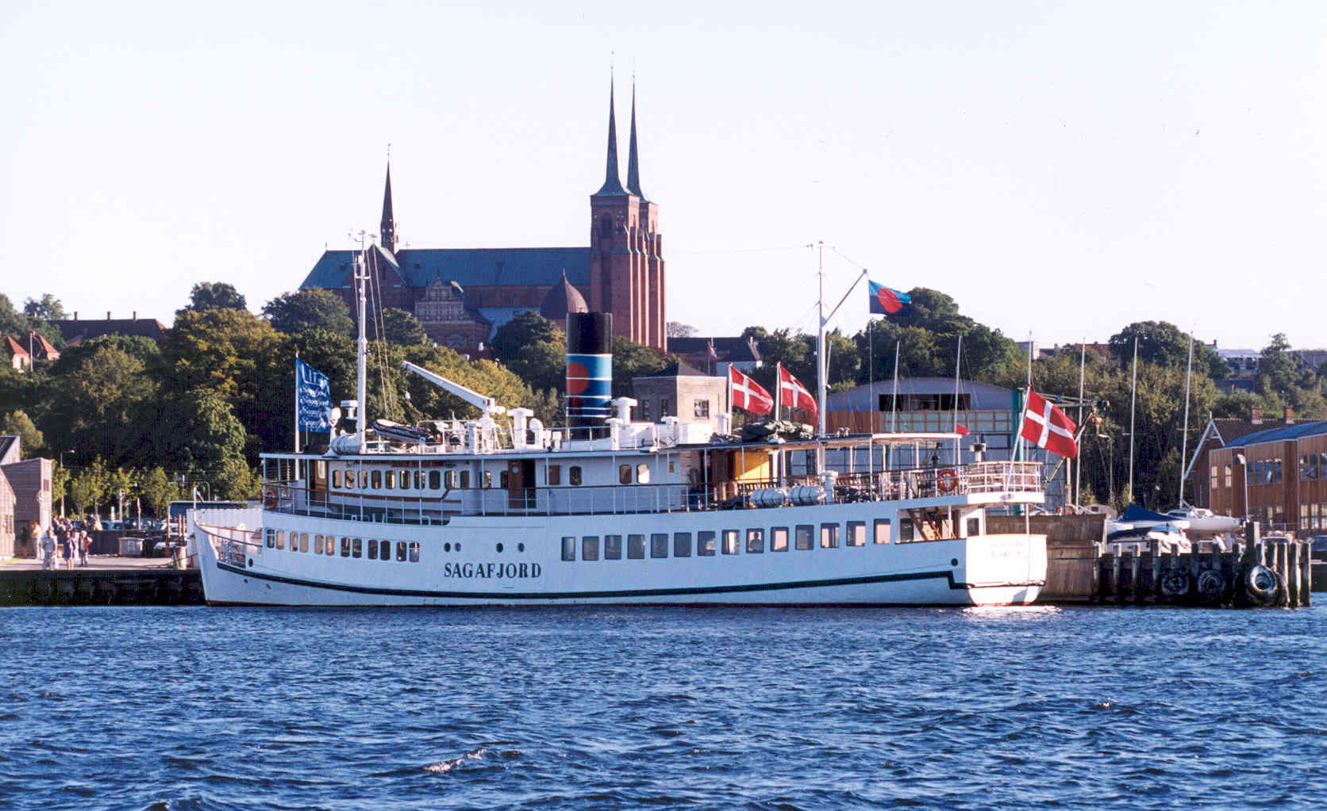
Workshop dinner Sagafjord: 18:00 – 21:30
Bus transport back to hotel

Slide 10
24 September, Objective:
Political initiatives to make Copenhagen greener.
(Initiatives where AQ modelling are/can be applied)
Pick up at 9:00 at the hotel by Matthias Ketzel.
9:00 – 10:30: Visit the urban canopy measurement station at H.C. Andersens Boulevard
10:30 – 11:30: Visit to Danish EPA:
“Air Quality regulation and management in Denmark (How are measurements and model results used in political decision making)” by Katja Asmussen.
11:30 – 12:15: Lunch at Danish EPA
13:00 – 14:30: Visit to Technical and Environmental Administration, Copenhagen municipality:
”Copenhagen as European Green Capital in 2014 (initiatives to improve the environment in Copenhagen)”, by Lene Bjerg Kristensen.
“The Climate Plan 2015 for Copenhagen Municipality (Making Copenhagen fossil free)”, by Morten Højer.

Slide 11
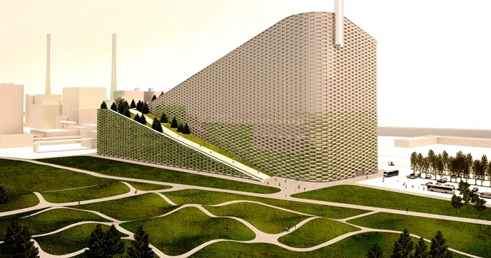
Visit to Amager Resource Center: 15:00 – 17:00
Focus “Amager Bakke” – ready for use 2017
New energy plant facility in Copenhagen how it will be included in the city's cycle with respect to both waste, energy and culture.

