Slide 1
GCCA Intra-ACP Programme
ACP Consultative meeting in preparation
of the UNFCCC COP20
28th October, 2014
ACP House, Brussels
Overview of key issues for COP20
Hernan Carlino

Slide 2
Contents
Background
The outcomes of Warsaw
Expectations for Lima
Key issues
  ADP negotiations
  Finance
  REDD

Slide 3
I. Background
The latest findings of the AR5 of the Intergovernmental Panel on Climate Change (IPCC) confirm that warming of the climate system and observed changes are unprecedented over decades to millennia, impacts are occurring now, many natural and human systems are increasingly vulnerable, and further warming will make the consequences of climate impacts worse and politically unacceptable given their potential to hamper governance.

Slide 4
I. Background
On the other hand the UN Climate Summit in New York last September and the surrounding events have undoubtedly ‘shifted the ground of possibility on climate change’:
  public mobilization in 160 countries around the world to underscore the need that we must address climate change.
  announcements on action from corporations, finance institutions and subnational governments, indicating that through collective action we have the capital, the mechanisms and the technology to address climate change.
  more than 100 Heads of State and Government presented their efforts to increase resilience and reduce greenhouse gas emissions.

Slide 5
II. The outcomes of Warsaw
Negotiations focused on the implementation of agreements reached at previous meetings and addressed the pathway to Paris and climate financing.
COP19 adopted an ADP decision that invites parties to initiate or intensify domestic preparations for their intended nationally-determined contributions, and resolves to accelerate the full implementation of the Bali Action Plan and pre-2020 ambition.
Parties also adopted a decision establishing the Warsaw international mechanism on loss and damage, and the “Warsaw REDD+ framework.

Slide 6
III. Expectations for Lima
The Executive Secretary of the UNFCCC has recently stated that parties must work in Lima to find a path that:
  Must be nationally equitable and globally responsible;
  Must provide a strong collaboration platform that ensures that no one is left behind; and
  Must have clear markers in the near and in the long term.
In addition, there is a need to bring the Doha Amendment to the Kyoto Protocol into force; 144 ratifications are necessary to bring the second commitment period of the Kyoto Protocol into force.

Slide 7
III. Expectations for Lima
Substantive outcomes expected from Lima, as defined by incoming COP20 President:
  First, in the definition of the information that all of countries will submit next year as part of intended nationally determined contribution.
  That COP20 concludes with a text on the elements that is clear, structured and substantive, not just a list of ideas: meaning the components of content and form that we can agree on in Lima in order to provide a strong basis for negotiations next year;
  What will be our decision on Workstream 2: a concrete plan to deal with the pre-2020 period including actions to ensure compliance with existing obligations, and the implementation of policy options with the greatest potential

Slide 8
III. Expectations for Lima
Need to move forward on the three tasks that have been outlined by the ADP Co-Chairs:
  Advance its work toward the 2015 agreement;
  As mandated in Warsaw, agree on a draft decision identifying the information that Parties will provide when putting forward their INDCs;
  Agree on a draft decision on pre-2020 action that consolidates the work done by the ADP under workstream 2 and sets the basis for continuing work on pre-2020 action beyond the life of the ADP.

Slide 9
IV. Theorical approaches to an agreement
A primary goal of the negotiations is to develop a 2015 agreement that will maximize reductions in greenhouse gas emissions over time.
Achieving this is function of the ambition of the agreement, but also of the level of participation and compliance by states.

Slide 10
IV. Theorical approaches to an agreement
According to Bodansky and Diringer, international agreements can serve a contractual, prescriptive, or facilitative function.
In the present international context, the contractual and prescriptive models seem not to be politically realistic.

Slide 11
IV. Theorical approaches to an agreement
The 2015 agreement may include a variety of different instruments—for example:
  A core legal instrument.
  Annex(es).
  Ancillary instruments whose content is nationally- determined, such as schedules, registries, or INF documents.
  COP decisions addressing particular issues in greater detail, such as accounting, accountability, and so forth, to be adopted either at COP-21 or thereafter.
  A political declaration

Slide 12
IV. Theorical approaches to an agreement
Legal, political, and policy are relevant to decisions about which instruments to include, where to address a given issue, and when, including:
  Legal character—Some parts of the outcome can be made legally binding and others not. The character depends both on the type of instrument in which it is included, and whether it is formulated in legally-binding terms.
  Fixed vs. changeable—Different instruments can have different amendment rules.
  Top-down vs. bottom-up: some elements of the outcome can be internationally negotiated, while others can be nationally determined.
  Optionality.

Slide 13
IV. Theorical approaches to an agreement
Legal, political, and policy are relevant to decisions about which instruments to include, where to address a given issue, and when, including:
  Readiness
  Credibility
  Parity
  Ratifiability

Slide 14
Key Issues: ADP negotiations
Introduction
Workstream 1
Workstream 2
Timelines

Slide 15
V. Key Issues: ADP negotiations
Introduction
The Durban outcomes covered a wide range of topics, notably the establishment of a second commitment period under the Kyoto Protocol, and agreement to launch the ADP.
The Ad hoc Working Group on Enhanced Action under the Durban Platform (ADP) was established by decision 1/CP.17 in 2011 “to develop a protocol, another legal instrument or an agreed outcome with legal force under the Convention applicable to all Parties.”

Slide 16
Key Issues: ADP negotiations
The mandate of the ADP is to conclude its work no later than 2015 at COP 21.
The objectives are to begin implementation of the new agreement in 2020, while enhancing mitigation ambition before 2020.
The sixth part of the second session of the ADP focused on preparing key documents for the 20th session of the Conference of the Parties (COP 20) to take place in Lima, Peru.

Slide 17
V. Key Issues: ADP negotiations
Workstream 1
  Workstream one addresses paragraphs 2 to 6 of decision 1/CP.17 (the 2015 agreement)
  Legal form: some parties have expressed a preference for a legally-binding agreement while other countries prefer to study the content of the agreement before agreeing to its legal form.
  Differentiation: Developed countries want an agreement with little or no differentiation among countries

Slide 18
V. Key Issues: ADP negotiations
Workstream 1
  Intended Nationally Determined Contributions (INDCs)
    The key issues being discussed regarding INDCs are their scope and the information to be provided. There is no agreement on if there will be common metrics. Some countries support differentiation: instead of a mitigation target, developing countries could list their mitigation policies or activities in their INDCs.
  Elements of the new agreement: mitigation, adaptation, finance, technology development and transfer, capacity building, transparency of action and support, review of contributions.

Slide 19
V. Key Issues: ADP negotiations
Workstream 2
  The Doha Amendment
    The Doha Amendment establishes a second commitment period for the Kyoto Protocol, to begin in 2013 and end in 2020. To enter into force, the Amendment requires 144 ratifications. As of 30 September 2014, 18 countries have ratified the Amendment.
    Outstanding technical issues may be slowing the ratification of the Amendment.

Slide 20
V. Key Issues: ADP negotiations
Workstream 2
  Thematic Expert Meetings (TEMs): It is unclear how the outcomes of the TEMs will be captured in UNFCCC decisions or how the results will be measured.
  It is unclear if the TEMs are initiating new activities that lead to new emissions reductions that would not have otherwise occurred.
  There have also been calls to link this technical process to the political process and for moving away from information sharing to on the ground implementation. Also for a work plan on TEMs to be agreed to by COP 20.
  .

Slide 21
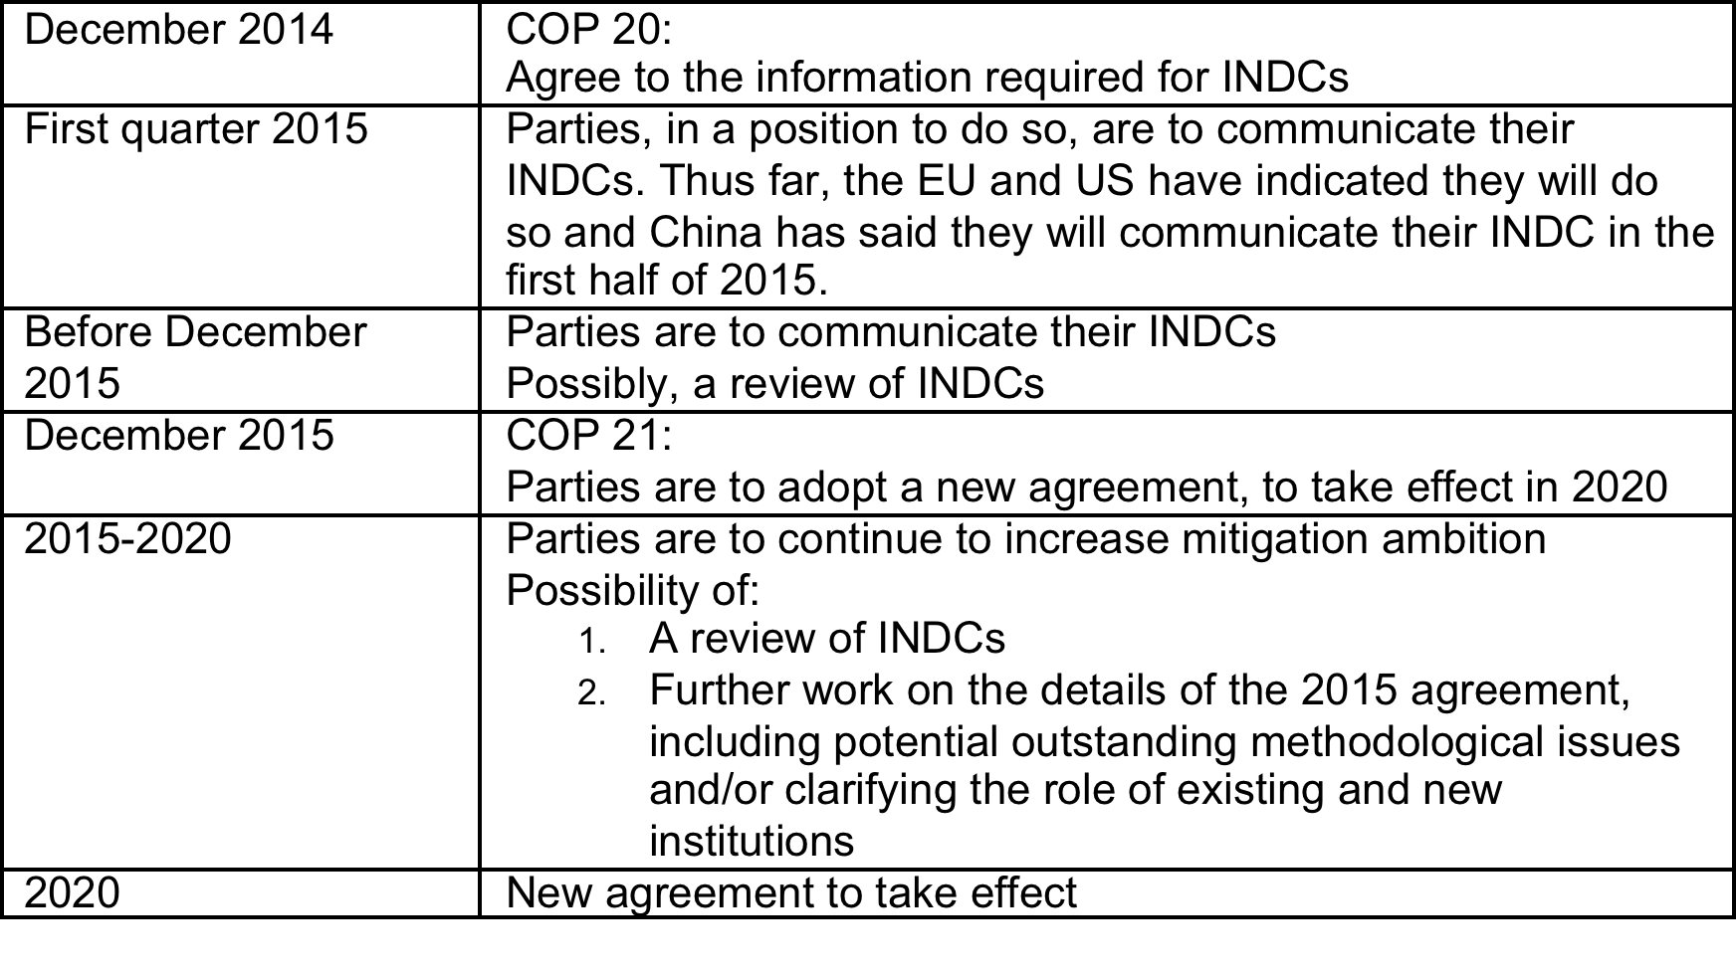
Timelines and deliverables

Slide 22
Thank You
Contact details:

