Slide 1
SITUATION OF PERSONS WITH DISABILITIES IN DEVELOPING COUNTRIES
THE RATIONAL FOR INCLUSIVE DEVELOPMENT

Slide 2
Overview session 1
Who are persons with disabilities?
What do data tell us about persons with disabilities?
Persons with disabilities, poverty and vulnerability
Group work

Slide 3
Who are persons with disabilities?

Slide 4
As per the CRPD (Article 1)
Persons with disabilities include
those who have long-term physical, mental, intellectual or sensory impairments
which in interaction with
various barriers
may hinder their full and effective participation in society on an equal basis with others.

Slide 5
Persons, environment, social participation
PERSONAL FACTORS
ENVIRONMENTAL FACTORS
Barriers / Facilitators
Interaction
- Social participation +

Slide 6
Interaction with the groups
With cards with personal factors (rich, blind, girls….) and environmental factors (no accessibility, good primary health care, disaster…), the facilitator and the participants explore how different interactions lead to different level of participation

Slide 7
PERSONAL FACTORS
ENVIRONMENTAL FACTORS
Physical/body function/activity limitations
Accessibility
Policy/legal
Disability is a restriction of participation due to an interaction between persons with impairment and barriers
Socioeconomic
Socio-economic
Services
Interaction
- Social participation +

Slide 8
Four approaches to disability
Convention
Time
Charity approach
Medical approach
Social approach
Human rights approach

Slide 9
Charity approach
Poor people, we should help them, if we can and want to…
Charity house

Slide 10
Charity approach
They need our help, sympathy, charity…
Who is the duty bearer on disability issues:
Benevolent persons, charity houses, homes, foundations, religious institutions …
How this approach proposes to treat disability:
Persons with disabilities inspire compassion
Persons with disabilities cannot take care of themselves
Persons with disabilities are in a tragic situation
How this approach sees disability:
Collect and give money to provide for persons with disabilities.
The quality of the “care” is less important
Persons with disabilities are objects of benevolence

Slide 11
Medical approach
Rehabilitation centre
Poor people, we should fix them, so they can participate.

Slide 12
Medical approach
Persons with disabilities need as much rehabilitation as possible to reach the best extent of normality, in order to access rights and participate in society
Who is the duty bearer on disability issues:
Doctors and health authorities
Often health ministry
How this approach proposes to treat disability:
Persons with disabilities play the passive role of patients
Persons with disabilities need to be cured
How this approach sees disability:
Persons with disabilities are considered abnormal
Persons with disabilities are unable to live independently

Slide 13
Consequences of charity/medical approaches
Optional benevolence instead duty/rights
Stigmatization
Submission / Disempowerment
Forced institutionalization
Segregation
Dependence
Image disparagement
Low self-esteem

Slide 14
Social approach
We need to eliminate the barriers to enable the participation of persons with disabilities.
Hospital
School

Slide 15
Social approach
Eliminate environmental barriers that constrain the participation of persons with disabilities, including attitudinal barriers
Who is the duty bearer on disability issues:
State, all ministries, society
How this approach proposes to treat disability:
Disability is the result of a wrong way of organizing society: thus, persons with disabilities face bias and barriers that prevent their equal participation
How this approach sees disability:
Disability is not an individual problem and mainly lies in the social environment that can be limiting or empowering depending on many factors
Enable the participation of persons with disabilities in public policymaking
Make all public services and polices accessible and inclusive
Persons with disabilities can and should participate in society
Ensure accessibility

Slide 16
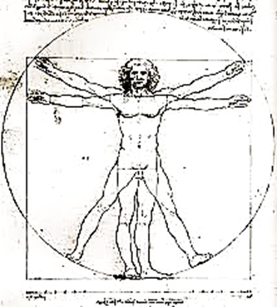
Persons with disabilities are part of human diversity
Being human has a broad spectrum of possibilities
MANY WAYS OF WALKING
MANY WAYS OF SEEING
MANY WAYS OF THINKING
MANY WAYS OF COMMUNICATING
MANY WAYS OF INTERACTING
Etc.

Slide 17


Human rights approach
We, persons with and without disabilities, are part of the same society and we have the same rights and obligations
State
Equal participation
Non- discrimination
Convention Now!

Slide 18
Human rights approach
Enforce laws to ensure full inclusion in all social aspects (school, family, health care, community, work, …)
Who is the duty bearer on disability issues:
State, all ministries and society
How this approach proposes to treat disability:
Ensures full and equal enjoyment of all human rights to persons with disabilities, and promotes respect for their inherent dignity
How this approach sees disability:
Apply policies to raise awareness
Respect equal recognition before the law
Focuses on equal opportunities, non-discrimination on the basis of disability and participation in society
Requires authorities to ensure rights and not restrict them
Views persons with disabilities as rights-holders
Regulate the private sector

Slide 19
The virtous circle of inclusion
States ensure access to support services respecting and enabling choice
States ensure Non discrimination, Accessibility, Awarenes raising
COMMUNITIES
Persons with disabilities
The environnement
More participation of persons with disabilities in community
More confidence,
more opportunities,
More engagement, more awareness, more accessibility, more support

Slide 20
Diversity of persons with disabilities, support needs and barriers removals
Blind persons
  Blind persons may require training in mobility, specific daily living activities related skills, access to assistive devices and personal assistance, and of course accessibility, including information in most accessible formats such as braille, large print, audio, electronic text, of community services and places, including transportation.
Deaf persons
  Deaf persons need to receive community services in sign language and to be able to express themselves freely in sign language when interacting with e.g. support service personnel who should be proficient in sign language. Deaf persons may benefit from assistive devices in living independently.
Deafblind persons
  Deaf blind persons may require training in mobility, specific daily living activities related skills, access to assistive devices, personal assistance and interpreters, and of course accessibility of community services and places, including transportation

Slide 21
Diversity of persons with disabilities, support needs and barriers removals
Persons that are hard of hearing
  Persons who are hard of hearing may require access to hearing aids, assistive devices, and captioning as well as accessibility of public places and accommodation.
Person with intellectual disabilities
  Persons with intellectual disabilities may require training and counseling in daily living skills, personal assistance or community support network. It implies also significant awareness and shift of attitudes within community to understand the different abilities and support needs that person with intellectual disabilities might have.
Persons with low vision
  Persons with low vision may require training in mobility, access to assistive devices, specific daily living activities related skills, availability of personal assistance at some point, and of course accessibility of community services, including access to information, and places, including transportation.

Slide 22
Diversity of persons with disabilities, support needs and barriers removals
Persons with physical disabilities
  Persons with physical disabilities may require assistive devices, adaptation of their home, as well as personal assistance support and counseling for performing their activities of daily living depending of their level of support needs. It is important to note that while accessibility of housing, transport and other community services and facilities will progressively decrease the need for support for many of them, the provision of personal assistance according to person’s choice will always be a key element for those with higher support needs.
Person with psychosocial disabilities
  Persons with psychosocial disabilities may choose to access personal assistance, peer support or community support network, crisis planning, peer crisis respite, and a wide range of practices that meet the person on his or her own terms to provide meaningful support as an alternative to the medical model of mental health. Such practices include, for example, family group conferencing for supported self-decision in a crisis situation, personal advocacy (Personal Ombud/PO), and support groups for people who hear voices or who have unusual beliefs or fears (labeled as delusions or paranoia). They also include mental health services that are based in community organizing work and promotion of mental well-being. It implies also significant awareness and shift of attitudes within community to understand the support needs that person with psychosocial disabilities might have.

Slide 23
What the data told us about persons with disabilities?

Slide 24
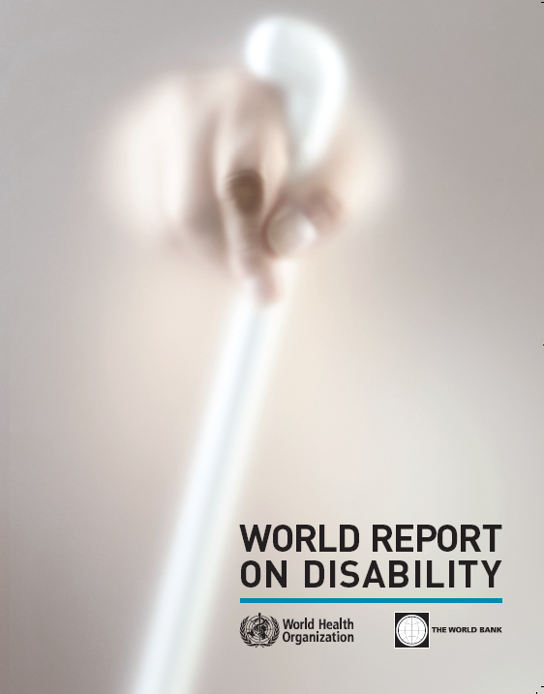
World Disability Report
A key publication – published by the World Health Organisation and the World Bank in 2011. Collected data from developed and developing countries.

Slide 25
What does the World Disability Report say?
Higher estimates of prevalence
    1 billion people (15%), of whom 110-190 million adults have very significant difficulties in functioning.
    What does this means to us?
Growing numbers of persons with disabilities
    Due partly to ageing populations, increase in chronic diseases, injuries from road traffic crashes, disasters etc..
    What about prevention?
Inequalities
    Disproportionately affects vulnerable populations: women, poorer people, older people.
    Not all people with disabilities are equally disadvantaged.
    What does that mean to us?
Notes:
The World Disability Report gives information about people with disabilities as a group. Since the 1970s, WHO has been saying that 10% of the population are disabled. Now, through analysis of the World Health Survey (WHS), the Global Burden of Disease (GBD) Survey, and national surveys, a more accurate estimate is 15% or one billion people.
Secondly, the World report gives information on trends: there are increasing numbers of PWD, because people are living longer (and older people have a higher risk of disability) and because chronic diseases such as arthritis, diabetes and heart diseases are on the rise.
Finally, disability is very diverse and affects people unequally. Poor people, women and older people are more likely to experience disability. And while disability correlates with disadvantage not all people with disabilities are equally disadvantaged. School enrolments differ among impairments. Those most excluded form the labour market are people with intellectual impairments and people with mental health conditions.

Slide 26
World Disability Report 2011 some key findings
Prevalence – in all countries disability had higher prevalence in vulnerable groups – e.g. women and older people; disability rates are higher in developing countries – e.g. in people aged 60 years and over 43.4% in lower income countries compared with 29.5% in higher income countries.
Community living support - Even in high-income countries, between 20% and 40% of people with disabilities do not generally have their needs met for assistance with everyday activities. In the United States of America, 70% of adults rely on family and friends for assistance with daily activities.

Slide 27
World Disability report
Some key findings (2):
Employment
People with disabilities are more likely to be unemployed and earn less compared to non-disabled people even when they are employed. This worsens with the severity of the impairment. Across 51 countries employment rates for men with disabilities were 52.8% (64.9% for non-disabled men) and 19.6% for women with disabilities (29.9% for non-disabled women). In OECD countries, employment rates for people with disabilities (44%) is slights over half that for people with disabilities (75%).
The gap is widened further as people with disabilities need more resources to achieve the same living standards as those without disabilities, but are less likely to be employed.

Slide 28
World Disability report
Some key findings (3):
Health – people with disabilities often do not receive needed health care. Half of disabled people cannot afford health care compared to a third of non-disabled people. People with disabilities are more than twice as likely to find health-care providers' skills inadequate. Disabled people are four times more likely to report being treated badly and nearly three times more likely to be denied health care.
Rehabilitation services – in many countries rehabilitation services are inadequate. Data from four Southern African countries show only 26–55% of people received needed medical rehabilitation, while only 17–37% received needed assistive devices (e.g. wheelchairs, prostheses, hearing aids).

Slide 29
A note on collection of data on disability
Comprehensive global data on the prevalence, socio-economic status of people with disabilities and barriers that prevent their participation is growing but is still limited. This is due to:
(1) Variance in definitions and classification of disability.
(2) Lack of questions of disability in census collection.
(3) Limited data availability (particularly in developing countries) on areas outside traditional areas of governments measurement e.g. social protection and employment.
Progress are in their way

Slide 30
Disability, poverty and vulnerability

Slide 31
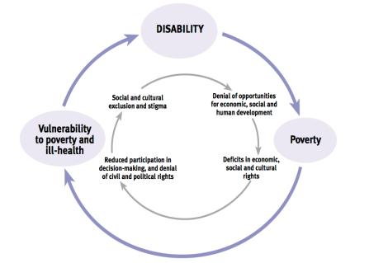
The Cycle of Poverty
More intense experience of poverty (WHO 2011).
Attitudinal + structural barriers limit opportunities to escape poverty.
Those who are poor are more likely to become disabled, those who are disabled are more likely to be poor.
Leads to vulnerability and exclusion (Mitra,Porsarac & Vick, 2011).

Slide 32
Disability and the MDGs
Poverty
Disability is more common among women, older people and poor households (“Facts about Persons with Disabilities,” 2012).
More likely to be unemployed, be lower paid, have fewer promotion prospects and less job security (Murray, 2012).
ILO estimates the cost of exclusion in terms of lost productivity and increased welfare could be between 1 to 7% of GDP
(op.cit)
80% of people with disabilities live in developing countries (“Facts about Persons with Disabilities,” 2012).
Education
An estimated one third of the world’s out of school children live with a disability (UNESCO, 2010)
Being disabled more than doubles the chance of never enrolling in school and in some countries it is a more significant factor in exclusion from education than gender (2010 MDG Report)
Having a parent with a disability who is poor, increases the likelihood of seven to sixteen year olds never having been to school by 25% in the Philippines and 13% in Uganda (UNESCO, 2010, p184).
Household surveys suggest that disability has a greater impact on access to education than gender, household economic status or rural/urban divide.
(Filmer, D. (2005). World Bank Discussion Paper)

Slide 33
Disability and the MDGs
Gender equality
Increased risk of gender-based violence, sexual abuse, neglect, maltreatment and exploitation (Kvam, & Braathen, 2006)
Every minute more than 30 women are seriously injured or disabled during labour
(World Bank, 2012)
Lack access to economic decision making (O’Reilly, 2003).
Health and HIV
Poorer health outcomes due to lack of access to information, prevention and treatments (WHO,2011).
60-80% infant mortality rates in some least developed countries (Eide, & Loeb, 2005).
Women with disabilities often considered to be sexually inactive (Maxwell, Belses, & David, 2007).
Insufficient access to information leads to high rates of HIV infection (WHO, 2009)

Slide 34
Cost of exclusion / Gain of inclusion
(from Lena Morgon Banks and Sarah Polack, London school of hygiene and tropical medicine, 2014
Exclusion from education may lead to lower employment and earning potential among people with disabilities. Not only does this make individuals and their families more vulnerable to poverty, but it can also limit national economic growth.
  In Bangladesh, reductions in wage earnings attributed to lower levels of education among people with disabilities and their child caregivers were estimated to cost the economy US$54 million per year.
However, promoting inclusion can lead to substantial gains:
  In Nepal, the inclusion of people with sensory or physical impairments in schools was estimated to generate wage returns of 20%.⁵
  In Bangladesh, children who were provided with assistive devices (hearing aids or wheelchairs) were more likely to have completed primary school compared to those who did not receive any supports

Slide 35
Cost of exclusion / Gain of inclusion
(from Lena Morgon Banks and Sarah Polack, London school of hygiene and tropical medicine, 2014
In Bangladesh, estimates indicated that exclusion of people with disabilities from the labour market results in a total loss of US$891 million/year; income losses among adult caregivers adds an additional loss of US$234 million/year.
In Morocco, lost income due to exclusion from work was estimated to result in national level losses of 9.2 billion dirhams (approximately US$1.1 billion).
The most comprehensive ILO study on ten low and middle-income countries in Asia (China, Thailand, and Viet Nam) and in Africa (Ethiopia, Malawi, Namibia, South Africa, Tanzania, Zambia and Zimbabwe) found that economic losses related to the exclusion of persons with disabilities from the labour force are large and measurable, ranging from between 1 and 7 per cent of Gross Domestic Product (GDP).

Slide 36
Group work
For 20mn, in small groups and based on their experiences participants have to describe the barriers to inclusion and participation of persons with disabilities in low and middle income countries with regards to access to services, inclusion and participation
  Distinction between general and disability-specific issues
  Attention to diversity of people with disabilities and underrepresented groups
Feedback

Slide 37
Sources
Convention on the Rights of Persons with Disabilities
OHCHR, OHCHR Training Package on the Convention on the Rights of Persons with Disabilities, module 1
  http://www.ohchr.org/EN/Issues/Disability/Pages/TrainingmaterialCRPDConvention_OptionalProtocol.aspx
Training Inclusion of Persons with Disabilities in Development Cooperation, EC, 2012
International Disability Alliance, submission to OHCHR on article 19, October 2014

