Slide 1
Update on
Ebola Preparedness missions in Africa
2 December 2014

Slide 2
Strategic Approach
Two major objective
Urgent readiness for Ebola
  All Countries
  Focus on Africa
    15 countries of highest concern
    All other countries
Most fundamental, long term objective, health security
  Health systems broadly
  Key capacities
    Alert – surveillance – labs –EOC -- communications

Slide 3
Strategic Approach
Principles
  Engage major international partners
  Build on previous assessment & existing work
  Use multiple approaches to rapidly scale up
    Baseline support for all countries
      Standards, guidance, tools …..
    Country specific support depending on need
      Country visits, simulation exercises to test existing plans, identify & close specific gaps
  Partner communications & outreach

Slide 4
A Consolidated Checklist for
Ebola Virus Disease Preparedness
Component | What this component is about | Why this needs to be in place and ready
Overall coordination | These are all efforts to clarify roles and responsibilities of national authorities and international partners in preparedness activities under a shared set of objectives. | This will allow to minimise duplication of efforts and ensure maximum impact from limited resources that are currently available.
Rapid Response Team (RRT) | RRT is a group of experienced experts that are on stand-by and can reach any part of the country within 24 hours. Their actions will help to contain/stop an outbreak early on. They will survey the first case(s), provide health care in a central facility, engage with the community and carry out infection, prevention and control measures. | As countries will not know exactly in which geographical area a first case will emerge, a fully operational RRT is critical to be able to act immediately once a suspicious case is reported. They will act as an initial stabilising resource in the earliest phase of the outbreak.
Public awareness and community engagement | These are efforts to promote the understanding of at risk communities on Ebola and address any stigma hampering EVD emergency healthcare and effective surveillance. Instead, the community has a crucial role in the alert. | In currently affected countries, health centres have been attacked as people were highly afraid and false rumours about the disease spread.
Infection Prevention and Control | This is to develop optimum IPC capacity and support facilities to ensure safe working conditions within healthcare facilities and social mobilization. | The ongoing epidemic in West Africa have caused considerable fatality of healthcare workers (average rate of infections 5-6%). IPC and safe working conditions are critical components to deliver emergency healthcare.
Case management a) Ebola Treatment Centre (ETC) | These are all efforts to develop or repurpose an existing facility as EVD ETC to treat 15 patients and have them fully operational. It includes the physical infrastructure as well as the capacities of staff to manage EVD cases. | The lack of functional ETCs in the beginning of an outbreak can lead to a small outbreak getting out of control. Therefore, having at least one fully operational ETC facility before a first case occurs is important to contain an outbreak early on.
Case management b) Safe burials | These are efforts to ensure safe burial with due regard to local custom and religion while safe handling of deceased is necessary to prevent wider transmission to communities. | Unsafe burial of Ebola victims has caused considerable community infection during burial ceremonies and is one of the main risk factors.
Epidemiological Surveillance | This is a cross-country effective alerting/notification system to immediately investigate a person for potential EVD. | The key to success in controlling EVD is largely dependent on timely and accurate community based surveillance.
Contact Tracing | These are all efforts that need to be in place to identify and track the chain of transmission within the first 72 of reporting a confirmed/suspected case. | Rapid contact tracing and immediate monitoring is essential to stop/limit the transmission to other people. .
Laboratory | These are all efforts to ensure that samples are safely taken and transported to laboratories which are ready to swiftly analyse them. | Rapid confirmation of cases is crucial to contain an outbreak, trace contacts and provide emergency healthcare.
Capacities at Points of Entry | Efforts to get Points of Entry ready to deal with an Ebola case once it occurs. This includes the preparation of facilities as well as increasing staff capacity. | An effective targeted screening at Point of Entries will help to prevent cross border transportation of infections.

Slide 5
Country Visits
Objectives
  Assistance to go from current situation to operationally ready
  Deliverables/indicators over 30, 60 and 90 days
  Facilitate medium – longer term capacity strengthening (e.g., IHR, health systems …. )
International Teams
  5-10 persons per team
  WHO & partners
Status
  12 missions conducted in this order: Mali and Cote d'Ivoire
  Ghana, Mauritania , Cameroon and Guinea Bissau
  Benin, Senegal, Burkina Faso and Gambia
  Togo, CAR
  Niger will take place next week

Slide 6
Key findings of the missions (1)
Mali mission report available on WHO web site:
http://www.who.int/csr/resources/publications/ebola/preparedness/en/
Overall assessment: preparedness plan exist and activities have been implemented
Common areas for improvement include:
Coordination
  Establish an Emergency Operation Center – Establish incident management system
Rapid Response Teams
  Formalize the composition and train the team
Social mobilization
  Activate social mobilization committees, finalize operational plan
Infection prevention and control
  Need PPE, training, additional isolation units

Slide 7
Key findings of the missions (2)
Case management
  Establish Ebola Treatment Centers ready to function and meeting the standards
Surveillance
  Establish or strenghthen call center
Contact tracing
  Train and strenghten logistics capacities for contact tracing
Laboratories
  Finalize agreement for transport, train staff , identify partners for capacity building
Capacities at points of entry
    Strengthen procedures, prepare isolation units, provide PPE
Budget
  Update budget of the plan, develop detailed task-based budget, prioritize and organize the budget

Slide 8
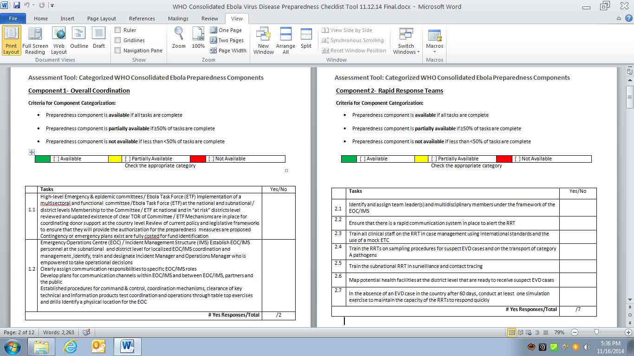

Slide 9
Ebola Preparedness – WHO Priority Countries*
 | Available (All Tasks in Component are available) |  | Partially Available (≥ 50% of tasks in component are available) |  | Not Available (< 50% of tasks in component are available)
 |  |  | Mali | Cote d’Ivoire | Cam-eroon | Ghana | Maur-itania | Guinea- Bissau | Benin | Burkina Faso | The Gambia | Senegal | Togo | CAR | Ethop-ia | Niger | Niger-ia | DRC | South Sudan
WHO Visit Date (2014) |  |  | 10/20- | 10/27- | 11/10- | 11/10- | 11/10- | 11/12- | 11/17- | 11/17- | 11/17- | 11/17- | 11/24- | 12/1- | 12/1- | 12/10-
 |  |  | 10/24 | 10/31 | 11/14 | 11/14 | 11/14 | 11/18 | 11/21 | 11/21 | 11/21 | 11/21 | 11/28 | 12/5 | 12/5 | 12/17 | TBD | TBD | TBD
WHO Preparedness Components | Overall Coordination
 | Rapid Response Team (RRT)
 | Public Awareness & Community Engagement
 | Infection Prevention and Control
 | Case Management Ebola Treatment Center
 | Case Management Safe Burials
 | Epidemiological Surveillance
 | Contact Tracing
 | Laboratory
 | Capacities at Points of Entry
 | Overall Budget for Outbreak
*Based on assessments conducted during WHO Preparedness Support Team Visit using WHO Consolidated Preparedness Checklist updated: 12/2/2014

Slide 10
Next steps
  Publish all reports
  Update budget and define priorities
    Consultant posted in each WHO CO to follow up
  Identify partners who can contribute to training activities and capacity building (human and financial resources)
  Finalize standard training material and approaches (on-going)
  Monitor the implementation 30/60/90 days after the mission

