Slide 1

French Response to Ebola Crisis
Notes:
MCW = Medical Care Workers
FRC = French Red Cross
EPRUS = (Etablissement de Preparation et de Reponse aux Urgences Sanitaires)
ETU=EBOLA treatment Units (CTE en français)
MoH=Ministry of Health
DHS=Defense Health Service
MoFAID = Ministry of Foreign Affair and International Development

Slide 2
French Response to Ebola Crisis
An ongoing crisis
A coordinated response – five pillars:
  Support political coordination in Guinea
  HWs mobilisation, training, and protection
  Diagnosis and Treatment
  Sensitization, education and prevention
  Disease control measures
Notes:
MCW = Medical Care Workers
FRC = French Red Cross
EPRUS = (Etablissement de Preparation et de Reponse aux Urgences Sanitaires)
ETU=EBOLA treatment Units (CTE en français)
MoH=Ministry of Health
DHS=Defense Health Service
MoFAID = Ministry of Foreign Affair and International Development

Slide 3
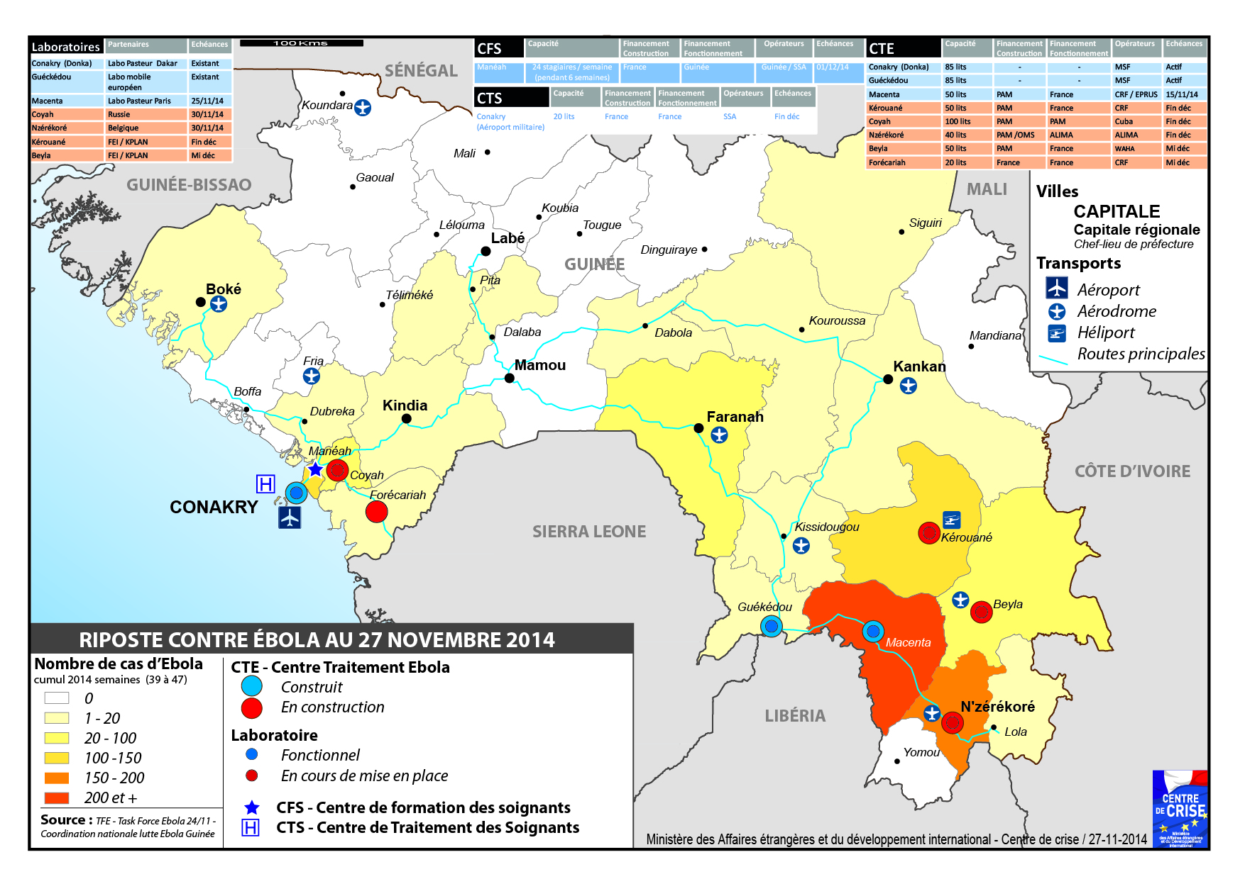

Slide 4
Political Coordination
1 Medical Officer advising the National Coordinator
Surge capacity in Conakry
      5 pers. including 2 medical officers
      Support national coordination in Guinea
      Enhance coordination with UNMEER, EU, regional authorities
      Information collection and diffusion
UNMEER

Slide 5
Health workers
Mobilization – 155 French workers
    57 Health workers (through EPRUS)
    66 Civil protection officers
    32 Defense ministry officials
Training
    Training center in France (Nogent-le-Rotrou) (English/French)
    Training center in Conakry (Guinean health workers)
Protection
    Dedicated treatment unit for Guinean HWs in Conakry
    Medical evacuations - field / international
    Dedicated treatment in France

Slide 6
Diagnosis and Treatment
Laboratories
    Donka de Conakry
    Mobile EU lab Guéckédou (additional mobile EU lab in development)
    Macenta ETU
    Beyla ETU – under construction
    Kerouane ETU - under construction
    Institut Pasteur – under construction
ETU
    Macenta (50 beds, open 14 November);
    Beyla (30-50 beds, opens mid-December) ;
    Kérouané (30-50 beds, opens end of December);
    Renovating the Forecariah transit center (20 beds, completion mid-December).

Slide 7
Sensitization, Education and Prevention
Major prevention measure
Integrated approach at the local level
    Fighting stigma with an ETU open day
    Local education leadership by traditional medicine practitioners
    Tracing contact with the disease
    Disinfection of contaminated areas
Country-level
    Mobilization of Canal France International for education (television, radio, press).

Slide 8
Disease control measures
Conakry international airport
    3 dedicated Medical staff – in cooperation with CDC
    Thermometers
Arrival in France (Orly and Roissy)
    Travelers from Ebola-affected countries are screened for symptoms and asked to fill out a questionnaire

Slide 9
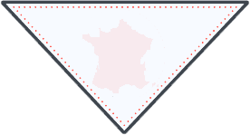
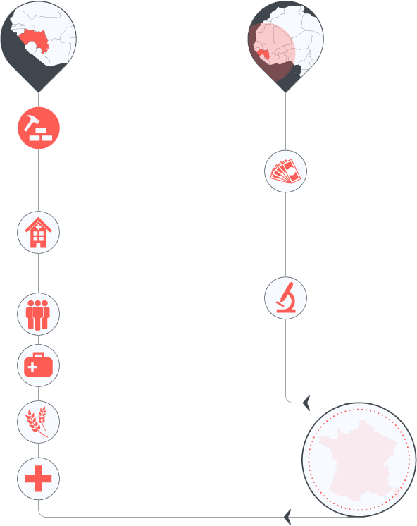
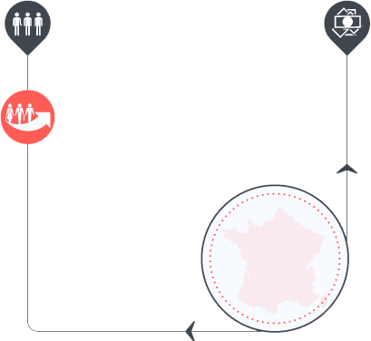

French EBOLA response
More than
110
MILLIONS
Euros
EBOLA RESPONSE IN WEST AFRICA
INTERNATIONAL ORGANIZATIONS
GUINEA
WEST AFRICA
Technical Assistance
ETUs
Macenta (30-50 beds)
Kérouané (20 beds)
Beyla (20 beds)
Financing by French Government
150 French HCW & 800 Guinean
French Experts embedded in UNMEER
Financing extra support to WHO
Financing of prevention plans EBOLA outbreak (Mali Liberia Cameroun & Ivory Coast)
Training Center
France & Guinea
7days, 50 instructors for each
200 trainees/month
First course Nov 15th
More than
5
MILLIONS
Euros
20 beds
30 French HCW & 50 Guinean
Estimate Opening Dec
Conakry Medical Unit
Strengthen labs in 7 countries in West AFRICA
Supply PPE and medical assets
MEDICAL EVACUATION
Supply extra food aid
More than
105
MILLIONS
Euros
Medical evacuation within Guinea
MEDEVAC coordination through EU Mechanism
Emergency transport and hospitalization in France HIA Begin at Paris
HIA Sainte-Anne at Toulon
Strengthen basic health services

Slide 10
Ongoing needs
More partners in Guinea
Co-Financing : 30 million euros
Supplies : additional PPEs
FMTs with French language capacity

