Slide 1


UK’s Ebola Crisis Response and Regional Prevention and Preparedness

Slide 2
Agenda
The state of the virus
UK’s response in Sierra Leone
Regional response
Research
Vaccines
Next steps – asks and global contributions

Slide 3
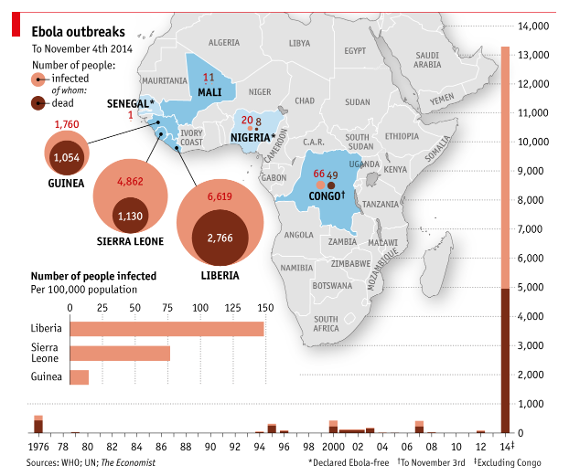
The Ebola Virus
Notes:
Source – the Economist

Slide 4
The UK’s Strategy in Sierra Leone and Beyond
Reduce transmission in hospitals in SL
Kerry Town Treatment Centre
1. Reduce transmission rate to below 1 in Sierra Leone
Reduce transmission at funerals (safe burials) in SL
5 Ebola Treatment Centres and HR
Laboratories
Reduce transmission in the community in SL
Community Care Centres
2. Tackle wider consequences of Ebola in SL
Urgent Needs – including call for proposals
Mitigate immediate negative impacts in SL
Safe Burials and Social Mobilisation
Joint Inter-Agency Task Force
Plan for recovery and development in SL post crisis and also in health system strengthening
3. Prevent spread to the wider region
Support to the NERC and DERC
Support to UNMEER and the UN system
Ensure high risk countries are well prepared to rapidly tackle any outbreak
Delivering existing portfolio in SL
4. Stimulate global public goods to tackle this and future epidemics
New projects to tackle immediate negative impacts (not yet approved)
Deliver effective vaccines to affected countries as quickly as possible
Stronger preparedness in countries at high risk of spread
Vaccine and beyond Ebola
Notes:
1. Reduce transmission rate (R0) of Ebola to less than 1 in S
2. Tackle wider consequences of Ebola in Sierra Leone
3. Prevent spread to the wider region
4. Stimulate global public goods to tackle this & future epidemics
13 Ebola response projects
Do not send

Slide 5
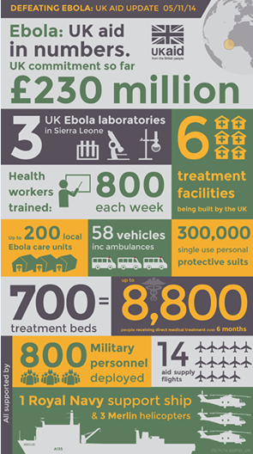
Overview of the UK’s support in Sierra Leone
Notes:
The UK has committed £230m to the response in Sierra Leone. This includes:
Supporting 700 treatment beds to help up to 8,800 patients over 6 months;
Shoring up the country’s stretched public health services to help contain the disease.
Opening up to 200 Community Care Centres where people who suspect they might be suffering from the disease can seek swift and accurate diagnosis and appropriate care;
Building, running and staffing three new labs in Sierra Leone
Supporting NGOs on the ground to work with people to agree practices which will allow them to honour their friends and relatives, while ensuring bodies are safely buried;
Doubling the number of burial teams in Freetown – and providing twenty more across the country. We have already made extensive progress on this, with UK support IFRC burial teams in the western area, which accounts for approximately a third of Sierra Leone’s population, are now burying 100% of reported bodies within 24 hours.
Supporting Government of Sierra Leone’s command and control capability
Engaging religious leaders and achieving endorsement of safe burial practices through the Social Mobilisation Action Consortium (SMAC), which builds a community-led response to the risks of Ebola and monitors how individuals respond.
£5 million aid match for the Disasters Emergency Committee (DEC) appeal on the Ebola outbreak.
More than 800 Ministry of Defence personnel will be deployed in total to help with the establishment of Ebola Treatment Centres and the Ebola Training Academy. This includes the deployment of RFA Argus and three Merlin helicopters, which arrived in Sierra Leone on 30 October.
UK Staffing in Sierra Leone - 449 UK military personnel deployed. A further 8 MoD staff are based in Ghana, Liberia and Senegal.
Modes of transmission
Why serious
Exponential growth weeks doubling RO greater than 1

Slide 6
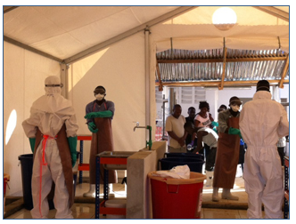
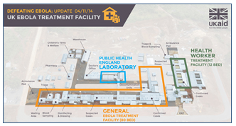
Sierra Leone – The UK’s Interventions
Building, running and staffing 3 labs in Sierra Leone, CCCs and staff training
labs
Scaling up safe burials through IFRC, JIATF and other NGOs (with significant increased coverage in safe burials in the Freetown area)
Social mobilisation (for early isolation and safe burials) through the social mobilisation action consortium and faith based consortium
Supporting Sierra Leone’s command and control, through support to the National Emergency Response Centre
Notes:
A 4-pronged approach and then move onto discuss the treatment centres.
The Kerry Town complex includes an 80 bed treatment facility to be managed by Save the Children and a 12 bed facility staffed by British Army medics specifically for health care workers and international staff responding to the Ebola crisis. The 12 bed facility is expected to expand to 20 beds in the New Year.
The construction of the treatment facility was funded by us and designed and overseen by British Army Royal Engineers. It is the first of six centres to be built by Britain in a bid to contain, control and defeat Ebola in Sierra Leone.

Slide 7
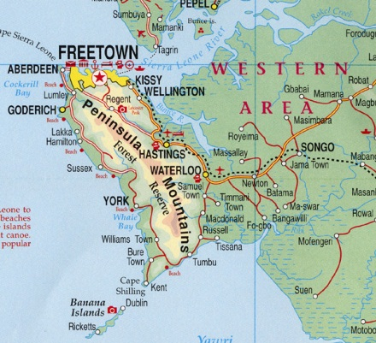
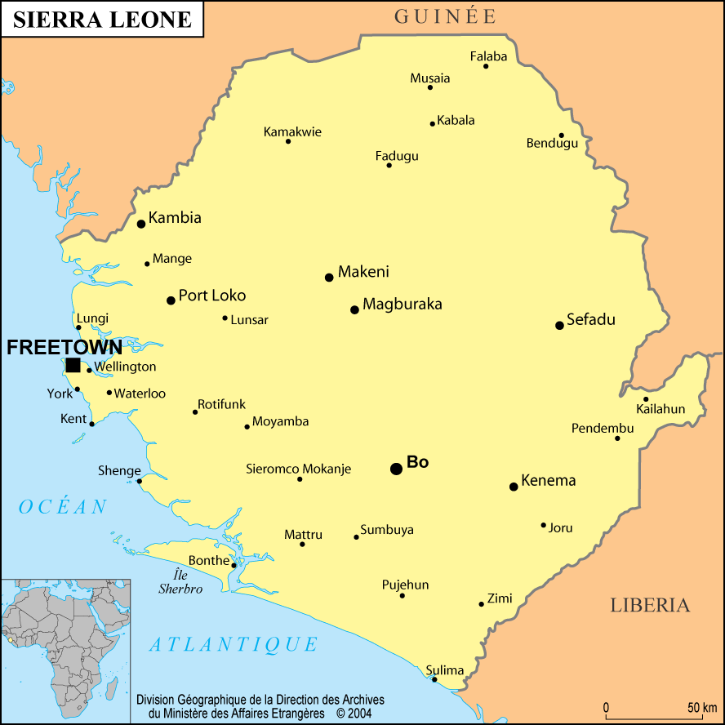
Plans for Treatment Centres
Goderich
Port Loko
Makeni
Hastings
Moyamba
Kerry Town
LOCATION | CAPACITY | PARTNER | CONSTRUCTION COMPLETE | FIRST PATIENT
Kerry Town | 80 bed + 12/20 bed for health workers | Save the Children MoD | 24 October Additional works 2 Nov | 27 October (lab only) 5 November
Hastings | 100 bed | RSLAF/Kings | 17 November | 27 November
Goderich | 100 bed | Emergency | 22 November | 30 November
Makeni | 100 bed | IMC | 17 November | 27 November
Port Loko | 100 bed | GOAL | 17 November | 27 November
Moyamba | 100 bed | Medicins du Monde | 22 November | 30 November

Slide 8
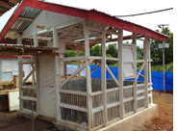
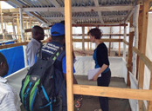
Plans for Community Care Centres
Supporting the scale up of CCCs
  These are open in Port Loko (Kabantama and Lunsar)
  CCCs up and running across Freetown
The UK has five Community Care Centres (CCC) up and running in the Freetown area, with 10 more coming online in the next few weeks.
Notes:
Construction has begun on two more facilities in Freetown and:
Port Loko
Makeni
Moyamba.
These facilities will take the number of UK-supported beds to over 700, providing direct medical care to up to 8,800 patients over six months.

Slide 9
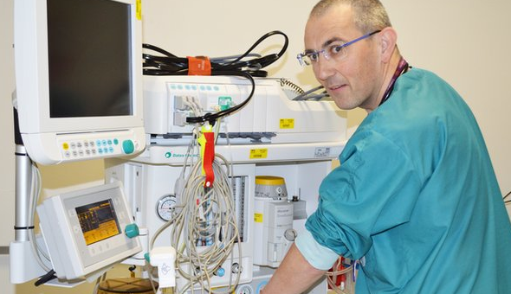
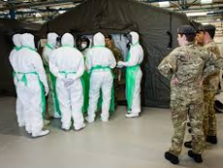
Staff Deployment and Training
    International staffing requirements
    More than 1,000 NHS staff now volunteered
    Norway signed an agreement with DFID to support the UK response
    Cuba and Australia sending staff
    National staff
    DFID is in close contact with MoH officials in Sierra Leone to gain clarity on the number and type of health staff available to work in UK-funded ETCs and the wider response
    Training clinicians, non-clinicians and ‘train the trainers’ have been trained
    Supporting WHO training centre in Freetown
    Pre-deployment training in the UK
    MoD has run training for 160 staff deploying to work in the Kerry Town facility

Slide 10
Support for Labs and Testing
Prompt diagnosis is an important enabler for effective Ebola response:
  Ebola-positive → isolate and treat/refer
  Ebola-negative → send home and observe (reduce risk of infection at facility; free up beds); treat for other conditions
  Test bodies and determine appropriate dead body management
  Surveillance/epidemiology
Challenges:
  Currently not enough capacity (tests/day)
  Weak coordination/logistics (transport samples to labs; communicate results).
  Reports of 5+ days sample-to-result; goal should be <24hrs
UK response | Progress
1. Add more labs Public Health England labs (co-locate at ETCs) will more than quadruple current capacity. | PHE team in-country. Kerry Town lab Two other PHE labs will open in 5-6 weeks – plus equip/train for one more.
2. Bring in other partners | US Dept of Defense offering 2-3 mobile labs. In discussion with other partners.
3. Establish coordination and logistics system | Government and technical leads identified; design workshop started today. Aiming to complete within 1 week then roll out immediately.

Slide 11
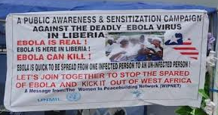
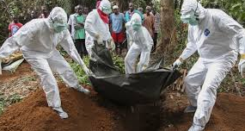
Burials and Social Mobilisation
Safe Burials
Supporting burial teams nationally
Supports 3 core functions: burial command centre; effective burial team management; and cemetery management
Funding the SMAC consortium and social mobilisation on burials is underway to provide accurate information, dispel misconceptions and increase demand for service
The Western Area (Urban) Burials Command Centre is reporting that 100% of bodies reported are buried within 24 hours (WA CC 08/11)
Social Mobilisation
DFID’s six-month funding to SMAC (£3.2m) will be through lead agency Goal
SMAC has launched in Bo, Makeni, Bombali, Kailahun and Port Loko last week
Ebola Joint Inter-Agency Taskforce Centre (JIATF) in Freetown
JIATF teams are supporting the establishment of the National Ebola Response Centre in Freetown as well as District Ebola Response Centres in Western Area, Port Loko, Moyamba, Bomabli and Tonkalili

Slide 12
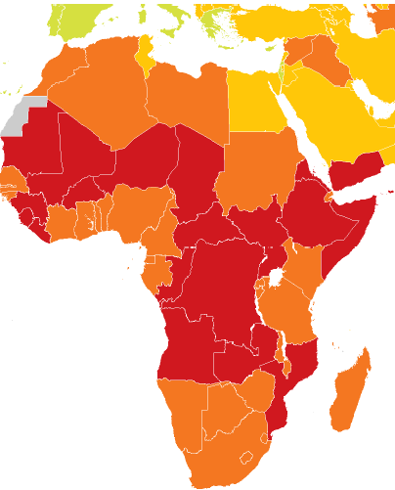
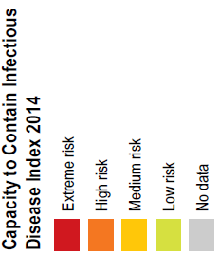
Regional Response and Preparedness
There is a strong risk that Ebola will spread
UK approach to preventing and minimising Ebola impact beyond Sierra Leone, Liberia and Guinea
Countries at highest risk of Ebola importation linked through transportation networks with Guinea, Liberia and Sierra Leone, especially to Cote D’Ivoire, Mali and Senegal.
Nigeria, Ghana, Ethiopia and Kenya are also at high risk as African transport hubs
15 countries identified as high risk by WHO
WHO priority countries: Mali, Cote d’Ivoire, Guinea Bissau, Senegal, Benin, Burkina Faso, Cameroon, Central African Republic, DRC, The Gambia, Ghana, Mauritania, Nigeria, South Sudan and Togo
  Rest of Africa with transport links: Somalia, Ethiopia, Kenya and Uganda

Slide 13
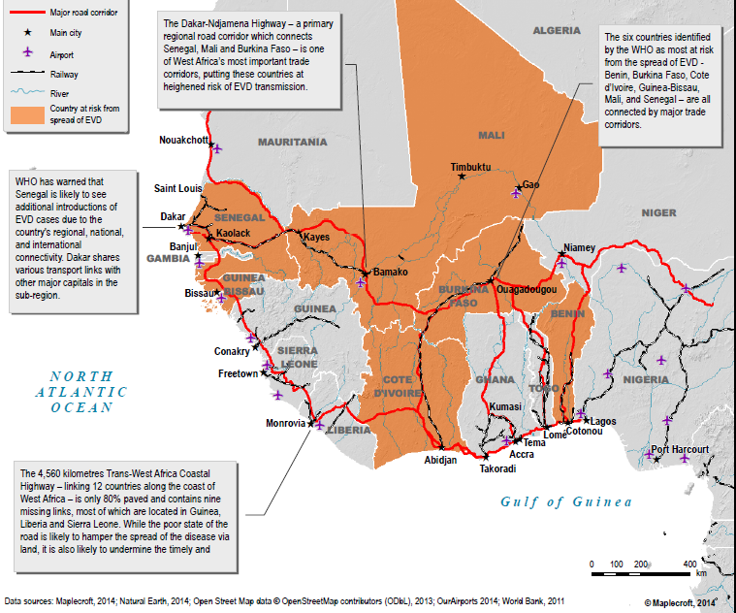
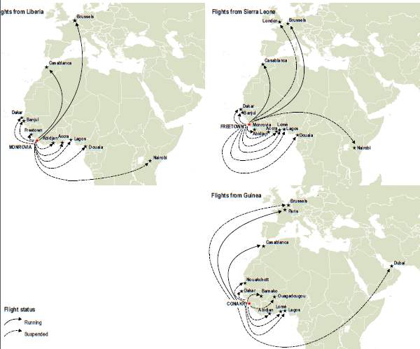
Maps of Transport Hubs and Corridors
Air corridors from Guinea, Liberia and Sierra Leone
Land corridors in Africa

Slide 14
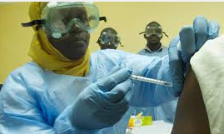
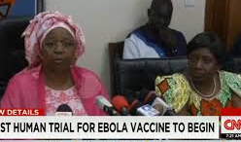
Research, Evidence and the Vaccination Development
Supporting research with Wellcome Trust
At least one potential vaccine could be available for use or further trials in January on a scale sufficient to apply to health workers across Guinea, Liberia and Sierra Leone (NIH, GSK, WHO)
Larger scale production may prove possible from early 2015. Rapid diagnostic tests for Ebola
The UK is investing in research into a number of rapid diagnostic tests for Ebola.
  A rapid diagnostic test if used as part of a good diagnostic and isolation strategy could considerably simplify identifying community cases and reduce the transmission rate

Slide 15



International Response
Strengthening preparedness and surveillance to fill strategic gaps in the 15 high risk countries
Directly affected countries – Sierra Leone, Guinea and Liberia
Priority 1 - Mali, Cote d’Ivoire, Guinea Bissau, Senegal,
Priority 2- Benin, Burkina Faso, Cameroon, Central African Republic, DRC, The Gambia, Ghana, Mauritania, Nigeria, South Sudan and Togo
Notes:
Asks – we still need – health workers – granulated ch

