Slide 1
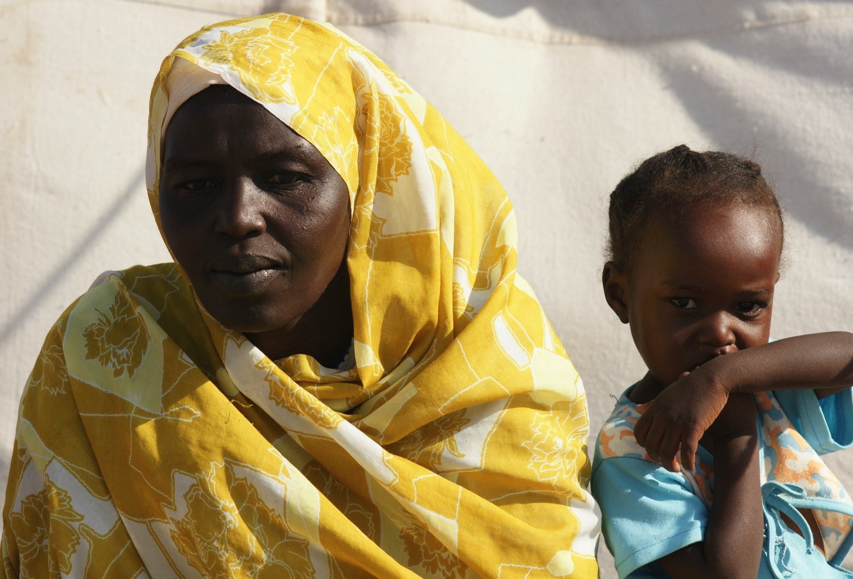
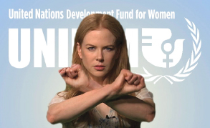
25th November 2013
EU Initiatives on Gender Equality in Development
International Day for the Elimination of Violence Against Women Issue
25th November 2014
Women, War & Conflict
‘Women & War: Women and Armed Conflicts and the Issue of Sexual Violence’
In this issue: Pg. 1 Women, War & Conflict
Pg. 1 Get Cross!
Pg.2 Ebola in West Africa: Women on the Frontline
Pg.3 capacity4dev.eu
Pg. 3 Girl Summit: A Future Free from Genital Mutilation and Child, Early and Forced Marriage
Pg. 4 The Bekou Trust Fund in CAR
©EuropeAid
Get Cross!
Take a stand against the use of sexual violence as a tactic of war by adding your crossed arm picture to this international campaign.
The European Institute for Security Studies and International Committee of Red Cross organised a recent colloquium, entitled 'Women & War: Women and Armed Conflicts and the Issue of Sexual Violence’ . Taking place in Brussels in September, the event focused on the challenges for the EU, humanitarian organisations and other actors on the topic of women and war.
The debates addressed the issues of the protection of women in armed conflicts, of sexual violence in armed conflicts and the role of women in peace building processes.
Armed conflicts affect women and men differently. Although women are not inherently vulnerable, they frequently face heightened danger in these situations of violence including the increased risk of sexual violence. Security concerns, the destruction of infrastructure and separation from male relatives can drastically affect women's socio-economic and personal safety.
Furthermore, women do not belong to a homogeneous group: depending on the cultural and social context of their country, their religious identities and other factors related to their personal circumstances such as age, level of education and marital status, women will have different needs and vulnerabilities and will be able to deploy different coping mechanisms and levels of resilience. Understanding and taking these specifics into proper consideration, and involving them in the design of the activities are essential steps when working to respond to their needs and strengthen their abilities in a sustainable manner.
Based on their capacity of resilience, women can also be important actors in conflict and post-conflict situations for their families and communities. Women often play key roles in rebuilding communities and facilitating political and social reconciliation. The issues surrounding women in armed conflict as well as the specific issue of sexual violence in armed conflict, pose numerous challenges to policy makers and humanitarian actors
http://www.stoprapenow.org
Stop Rape Now is part of the UN Action Against Sexual Violence in Conflict and just one part of UNiTE activities to raise public awareness and increase political will and resources for ending all forms of violence against women and girls.
http://www.un.org/en/women/endviolence/
Or, find out more on the UNiTE Facebook page https://www.facebook.com/SayNO.UNiTE
On twitter: @UNAction #stoprapenow
Editorial Committee: European Union, DEVCO: Marina Marchetti, Virginie Ramey
EU Gender Communication and Training Team: Thera van Osch, Eva Dalak and Sarah Simpson
Contributors: Julia Chambers, Virginie Ramey, Elisa Nieto Maestro, Maxence Daublain, Cristina Pol (EU Del, Guinea Bissau)
November 2014
| 1

Slide 2
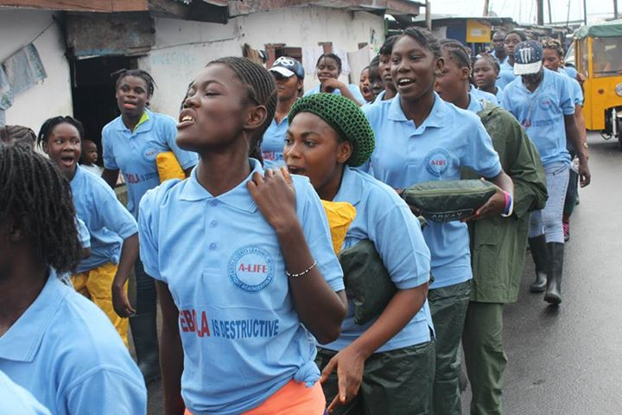
Ebola in West Africa: Women on the Frontline
As the Ebola epidemic continues to rage in West Africa, women are bearing the brunt of this deadly disease because they care for the sick, prepare the dead for burial and conduct much of the cross-border trade in the region.
Tens of thousands have died in this Ebola outbreak. But women tend to be disproportionately affected, accounting for 55 to 60 percent of deaths in the current epidemic in Liberia, Guinea and Sierra Leone, according to the United Nation’s children’s fund, UNICEF. Some statistics gathered in Liberia calculate put the figure as high as 75%.
When a family member falls ill, it’s the women who prepare the food for the invalid, feed them, clean them, wash their clothes or bathe them. Traditionally, in this region older women prepare bodies for funerals, washing and cleansing the corpse ahead of burial. And petty trade, which is an economic mainstay in the region and mostly conducted by women, increases their exposure and transmission of the disease.
Similarly, nurses and cleaners in hospitals are more likely to be women than men. And they are less likely to be provided the protective clothing and other equipment than the doctors they work alongside.
Such roles heighten women’s risk of infection with the Ebola virus, which spreads through direct contact with bodily fluids like blood, urine, faeces and vomit.
In some instances, women are being targeted in a bid to contain the spread of this disease, which has killed tens of thousands of people in this outbreak alone and still shows no signs of abating.
A special task force set up by the government of Liberia is enlisting women to spread information through their communities about how the disease is spread and simple steps that can be taken to protect against infection.
But the negative affects of Ebola on women aren’t limited to a heightened risk of infection.
Sierra Leone has one of the highest maternal mortality rates in the world. Some 890 Sierra Leonean women die for every 100,000 live births, according to the UN, compared to 370 per 100,000 live births in nearby Senegal or 8 per 100,000 live births in Belgium.
Sierra Leone and its partners have made a great push to improve maternal health and survival rates, notably by encouraging women to go to hospital to have their babies.
But the Ebola outbreak has closed many health facilities in the region to all admissions other than Ebola-related cases. Newspapers carry reports of pregnant women dying in taxis as they are unable to access hospital services in a difficult labour. In other cases, women are too scared of Ebola infection to go near a hospital or clinic to deliver their baby.
With no end in sight to the current outbreak, Ebola looks set to continue to take a heavy toll on the populations and especially the women of Guinea, Liberia and Sierra Leone.
On 17 September, 150 adolescent girls trained by UNICEF and implementing partners marched across West Point community in Monrovia to launch Adolescents Leading the
©UNICEF Liberia/2014/Cgriggers
Intensive Fight against Ebola, or ‘A-LIFE’. Equipped with awareness materials, these girls are now going from door-to-door in West Point, a densely populated lower-income urban community, to educate their parents, family members and friends about Ebola and how it can be prevented.
Gender and the post-2015 Development Agenda
Over 140 leaders from around the world, along with representatives from UN agencies and civil society and women’s organizations, came together on 22 September for a Special Session of the General Assembly on the Follow-up to the Programme of Action of the International Conference on Population and Development beyond 2014.
The UN General Assembly Special Session reviewed progress on commitments made 20 years ago at the International Conference on Population and Development (ICPD), held in Cairo in 1994. That gathering affirmed the close links between sustainable development, reproductive health and gender equality.
"As we celebrate the twentieth anniversary of the Cairo Conference and look ahead to the future, we cannot afford to short-change development," said Ban Ki-moon, Secretary-General of the United Nations, as he opened the Assembly’s special session.
Senior Government officials from 90 countries participated in the session. Overall, they agreed that population concerns must be at the core of the post-2015 development agenda and cited the need for universal access to basic services such as health care and education. They shared respective national trends in maternal and infant mortality, fertility, contraceptive use, ageing and HIV/AIDS prevalence, as well as programmes for family planning and sex education, among other areas.
Several speakers voiced strong support for sexual and reproductive rights, and representatives from developing countries appealed for reliable financial and technical aid to implement their respective sustainable development agendas.
The European Union and its Member States highlighted the fact that "we cannot expect progress in development unless human rights, women's empowerment and gender equality are upheld as essential preconditions for equitable and inclusive sustainable development".
With the Cairo Programme of Action as its guide, the international community must confront challenges caused by rising inequality, urbanization, migration, population ageing and the largest generation of young people in history, as well as hammer out…. (continued page 3)
November 2014
| 2

Slide 3
Gender and the post-2015 Development Agenda (continued)
Keep up to date with latest news, events, reports and publications by visiting your dedicated Public Group on Gender on the European Commission’s capacity development and knowledge sharing site, capacity4dev.eu.
Are you marking International Day for the Elimination of Violence Against Women with a special event? If so, we’d love to know more, please share details and photographs online.
http://capacity4dev.ec.europa.eu/public-gender/
An ambitious post-2015 development path and a meaningful climate change agreement before the end of next year. "As we advance on all these fronts, we have to remember the vision of Cairo, especially the priority it placed on reproductive health," said Ban Ki-moon.
The EU statement moved on the same direction, stressing that "universal access to comprehensive sexual and reproductive health, provided inter alia through integrated quality health care, is one of the highest priorities for the global agenda beyond 2014 and is essential to sustainable development and poverty eradication".
Girl Summit: A Future Free from Genital Mutilation and Child, Early and Forced Marriage
A woman in Salbal Village, Sudan @EuropeAid
©EuropeAid
This summit, organised by the UK, brought together community leaders, the private sector, approximately 50 governments and numerous international organisations to build on current efforts and rally a global movement to end Female Genital Mutilation (FGM) and Child, Early and Forced Marriage (CEFM) in a generation, everywhere, forever.
It built on the activities of many developing countries where governments and local communities are already tackling these practices as well as the major work being done by international and local organisations.
Millions of women and girls are being prevented from achieving their potential as a result of FGM and CEFM, however a positive trend is being witnessed across Africa, Europe, the Middle East and South Asia, as opposition to these practices grows.
The European Union participated to this Summit in order to get behind, support and accelerate internationals efforts to end FGM and CEFM and was represented by its Special Representative for Human Rights, Mr Stavros Lambrinidis.
The outcome document of the Summit, "The Girl Summit Charter on Ending FGM and Child, Early and Forced Marriage", was accompanied by individual commitments made by governments, international bodies and NGOs. Some 9 of the 20 governments that signed the Charter are on the list of countries in which FGM has been documented as a traditional practice: Burkina Faso, Ethiopia, Ghana, Guinea, Guinea Bissau, Kenya, Senegal, Somalia and Yemen.
The EU has committed more than € 100 million for the next 7 years to gender equality and child -wellbeing under its funding instruments and the newly established Global Public Goods and Challenges programme.
The EU insisted on its efforts to implement the Action Plan towards the elimination of female genital mutilation both within the EU and globally with a particular focus on prevention. FGM and CEFM will be raised in the political and human rights dialogues with relevant partner countries, where these practices still exist, and launch a global diplomatic outreach on violence against children with a specific focus on those two traditional harmful practices.
Inside the EU 28 Member States, the EU will develop e-learning modules for professionals working with those affected by or at risk of FGM.
Finally, € 4.5 million will be invested for EU Member States' awareness-raising campaigns on violence against women, including FGM, as well as projects led by grassroots organisations aimed at combating FGM and other harmful practices.
In order to track and promote progress on commitments, the event organiser -UK government – indicated that those commitments will be time-bound and tracking will be continued on an annual basis for the length of the timeframe of the commitments.
The first web-based annual update will be published in July 2015. The global process for tracking progress on commitments made during and after the Girl Summit 2014 will promote country ownership and mutual accountability; recognise and promote progress; and be integrated into existing mechanisms on FGM/C and CEFM.
For further information on the individual commitments expressed visit during the Girl Summit 2014:
https://www.girlsummit2014.org/Commitment/Show
https://www.gov.uk/government/topical-events/girl-summit-2014
November 2014
| 3

Slide 4
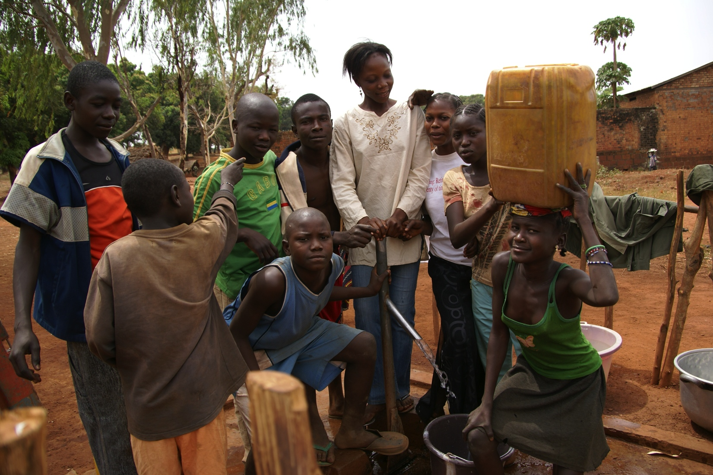
The Bekou Trust Fund: Supporting the economic recovery of women and girls in CAR
"Women and girls suffer sexual violence, personal insecurity and displacement associated with conflict, [and] the women of CAR are among the worst affected by poverty"
http://genderindex.org/country/central-african-republic
©EuropeAid
The European Commission, Germany, France and the Netherlands has set up the first European Union Trust Fund; the aim of which is to promote the stabilisation and reconstruction of the Central African Republic (CAR).
The Fund has been named Bêkou, which means 'hope' in Sango, a local language. It aims to avoid a fragmentation of aid and support, and to lead to a more effective and efficient approach to development by the international community.
Since independence in 1960, CAR has suffered ongoing political turmoil, civil unrest and armed conflict. Instability in neighbouring countries also affects the country. Recent tensions reached crisis point in 2013. Towns are often divided along ethnic or religious lines and violence can be a daily occurrence due to militias, the availability of small arms, the breakdown of the country's social and economic fabric and to the weak capacity of those institutions that could otherwise attempt to mediate or mitigate emerging conflict.
Women and girls suffer disproportionately from the crisis.
In addition to their daily struggle for subsistence, poor women and girls in CAR are routinely targeted and face physical and sexual violence in their homes and communities. They are extremely vulnerable to rape, abduction, sexual exploitation and abuse.
The enabling environment for their economic and social empowerment is extremely challenging. Though CAR has ratified CEDAW and its 2004 constitution affirms the equality of human beings before the law, it still has a number of discriminatory laws and customary practices.
Given the current situation in CAR and the pressing needs of women and girls, and given the strong political will demonstrated by the
government of CAR, the Bekou Trust Fund has made women's economic empowerment a priority over the next two years.
In addition to mainstreaming gender across its work, the Fund will support a project targeted at supporting women and girl's economic empowerment in CAR. The complex context and multitude of interrelated social, cultural and political issues and challenges call for a comprehensive approach to seeking to improve gender equality and women's empowerment in CAR.
The project will take on a holistic approach to women's economic empowerment by providing basic services, life skills training and access to economic assets, where feasible. It will do so in a way that also engages the wider community and seeks to challenge social norms.
The project is being designed to ensure that it applies itself to the current social, political and economic context of the country.
For further information visit: http://ec.europa.eu/europeaid/subsites/trust-fund-bekou_en
The EU Delegation in Guinea Bissau is supporting a number of activities to combat violence against women and end female genital mutilation.
Read more on capacity4dev.eu:
http://capacity4dev.ec.europa.eu/public-gender/blog/eu-delegation-gender-activities-guinea-bissau
Want to tell colleagues about your activities? Sign up and share on capacity4dev.eu
November 2014
| 4

