Slide 1
Air Quality Governance in the ENPI East Countries
Recommendations for integrated permitting authorities
Monika Pribylova
2 October 2013

Slide 2
Relevant administrative authorities (RAA)
– who are they?
It depends on the scope of integration of the integrated permit and by national division of functions and competencies between various ministries and subordinated administrative bodies.
In the system with full integration, RAA can be the following:
• Air protection authority
• Water protection authority including river basis authorities and sewerage authorities if separate
• Waste management authority
• Nature protection authority
• Health authorities,
• Energy saving authority,
• Agriculture authorities (e.g. veterinary authority)
• Municipal and local administration bodies
Notes:
There should be link to media legislation – what is replaced – the authority should be RAA

Slide 3
RAA‘s Role
Ensure that the final IP conditions will take into account the protection requirements within the competence of each specialized RAA
Main functions:
Consideration of the application for integrated permit and applications for its subsequent changes
Issuing statements and proposing permit conditions

Slide 4
Relations between RAA and stakeholders

Slide 5
Work scope in preparatory phase
Preparatory tasks of the RAA for implementation of the IP:
Get in touch with the IP authority on the relevant level
Propose appropriate organization and appoint staff for consultations during IP procedure
Participate in the pilot project for simulation of the permitting procedure
Establish administrative mechanism for consultations with the IP authority (prepare guidance with procedure for application review, list of decisions/approvals replaced by IPs within the competence of RAA,…)
Train personnel

Slide 6

Work scope in implementation phase
consultations during and possibly also before the IP procedure
elaboration of statements with proposal of permit conditions related to the competence of the specific RAA in the environmental protection
cooperation on variation of permit conditions in case the permitting authority requests it
cooperation with enforcing authority and BAT support body

Slide 7

Binding or guiding character
of RAA statements
Permitting procedure should allow negotiation about permit conditions, but legally binding requirements cannot be softened.
the RULE:
if RAA requires sth. more then set by legislation, then RAA needs good justification for it and should be ready to negotiate the date and scope of compliance with these requirements.
The EP law can specify which statements are binding.

Slide 8
Organizational setup
possibilities of the RAA relation with the IP authority:
RAA is in the same authority as the IP authority (e.g. various departments within the Ministry of environment at central or regional levels)
RAA is subordinated organization to the IP authority (e.g. authority with delegated powers from Ministry of environment; e.g. River basin authority)
RAA is different authority which is under the jurisdiction of other ministry (e.g. Health authorities, municipalities)

Slide 9

What staff to involve in consultations?
No need for new staff!
Officers dealing with permits and approvals, which are replaced by the integrated permit
RAA staff does not need to be organizationally separated from the existing departments or units.
RAA needs to appoint a coordinator, who will be the contact point for the IP authority and who shall be responsible for coordination of the other appointed CAA staff in the agenda of IP consultations.

Slide 10
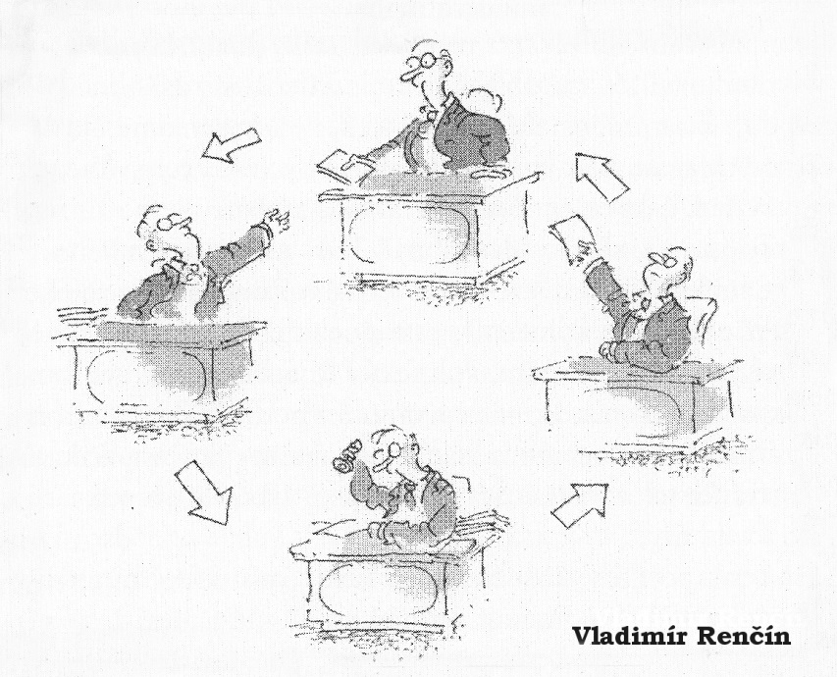
Discussion
Which authorities (RAA) are/will be consulted during IP procedure in your country?
How much binding are/ will be statements of RAA?

