Slide 1
Practical use of newly developed BAT conclusions
Valts Vilnītis

Slide 2
What are BAT conclusions?
«BAT conclusions» - a document containing the parts of a BAT reference document laying down the conclusions on best available techniques.
According to Article 14(3) of the IED, BAT conclusions shall be the reference for setting the permit conditions to installations covered by the Directive.

Slide 3
BAT conclusions
Iron and steel production
Manufacture of glass
Production of cement, lime and magnesium oxide
Production of chlor-alkali
Tanning of hides and skins

Slide 4
Practical use – LV example (1)
«Law on Pollution» sets framework for use of BAT conclusions in Latvia (relevant to Annex I activities) (included as of 06.03.2013.).
BAT conclusions are translated and transposed to national legal system through Cabinet Regulations, which also set timeframe for application to the existing installations.
In specifying special requirements applicable to the Annex I polluting activities, BAT conclusions shall be taken into account.
ELVs of polluting substances in a Category A permit (i.e. Annex I permit) shall be determined so that in normal operating mode of the installation they would not exceed the ELVs specified in the BAT conclusions (derogations possible if costs are incommensurately high in comparison to the threat to the environment).

Slide 5
Practical use – LV example (2)
In carrying out activities, which do not have applicable BAT conclusions at the time when the permit is issued or reviewed, information regarding the BAT, which has been published by the EC or international organisations, shall be used.
Operator can decide to use other comparable technologies, which provide at least such level of environmental protection as the one ensured when applying BATs.
Regional Environmental Board may take a decision regarding the review of the conditions of permit after new BAT conclusions are published in the EU OJ, ensuring that the conditions of the permit are reviewed and the installation is complying not later than 5 years after publication of the conclusions.

Slide 6
Practical use – LV example (3)
Even prior to implementation of IED Latvian legislation on pollution envisaged concordance with BREF for Annex I activities in the framework of IPPC system. As mentioned above, where no BAT conclusions are present, BREF shall be used.

Slide 7
Practical use – LV example (4)
Cabinet Regulations 1082 «Procedure by Which Polluting Activities of Category A, B and C Shall Be Declared and Permits for the Performance of Category A and B Polluting Activities Shall Be Issued» provide form for A category permit.
As of 09.04.2013. A permits include section 16¹ «Conditions for A category installations in accordance with which the conformity with ELVs, provided in BAT conclusions, is determined».

Slide 8
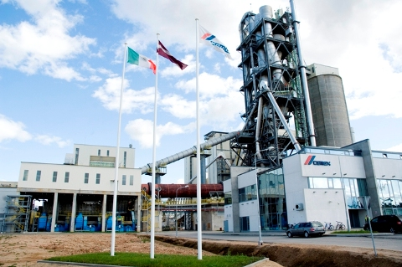
CEMEX cement production plant (1)
A category polluting activity permit – 02.03.2009.
Issued prior to new BAT conclusions requirements were introduced.
Following the legal requirements, permit relied on BATs, using BREFs.
Section 10 of the permit provides that selecting best available technologies the operator has used BREF «Reference Document on the Best Available Techniques in the Cement and Lime Manufacturing Industries» (2001) as a basis.

Slide 9
CEMEX cement production plant (2)
BAT has been applied with regard to the following aspects:
  Use of raw materials;
  Energy consumption;
  Selection of process;
  General technology;
  Technologies for reduction of NOx emissions;
  Technologies for reduction of SO2 emissions;
  Technologies for reduction of dust emissions;
  Reduction of other emissions;
  Waste;
  Noise;
  Odour.
ELVs as determined in the permit correspond to the ELVs derived from BREF document.

Slide 10
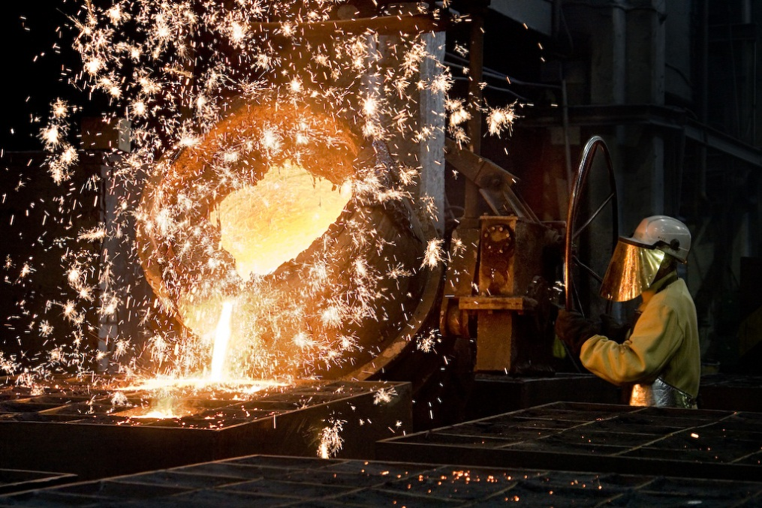
Liepājas metalurgs metallurgical company
Insolvency procedure;
New A category permit issued 17.02.2014. (first permit integrating BAT conclusions requirement);
Permit includes table on compatibility with requirements encompassed in «Reference Document on Best Available Techniques in the Ferrous Metals Processing Industry», mentioning that the plant’s processes comply with all of the relevant BAT requirements.

