Slide 1
Building public support for global development in the US, UK, France and Germany
An overview for the EYD 2015 Enlarged Stakeholder Group
Brussels, 9 December 2014

Slide 2
The Narrative Partners

Slide 3
The Debate is negative and broken
People know little or nothing about the progress we’ve made
The conversation focuses on what doesn’t work and what is wasted
Many supporters are fatigued, detractors are emboldened
Aid is seen as a good idea done badly

Slide 4
Our arguments are diffuse
Emotional
Moral responsibility
Compassion/pity
Women & Girls (change-agents creating virtuous circle)
Universalism – we all deserve the same things
Universalism – we all want the same things
Human Right
Have / Have nots
Fairness, Equality, Equity
Empowerment / Teach a man to fish
Women & Girls (as social justice)
‘Them’ as change-agents
Social Justice
Human potential
Freedom / Individualism / personal agency
Empowerment (for us to make a difference)
Them
Hope /optimism
Us
A cry for Aid Reform
Lasting change not handouts
Women & Girls (as efficacy)
Investment (for them)
Expertise – we know what needs to be done
Progress / success stories
Investment (for us)
Simplicity (big problems, simple interventions)
Myth busting
Efficacy
Rational
Self-interest

Slide 5
Our Ambition
Transform the way the sector talks about itself.
Reverse the decline of public support for our work.
Create a climate that helps us all be more effective.
Bring coordination and consistency to our approach.

Slide 6
The Narrative Project
Oct. 2013
We identified a new narrative as a top priority
Dec. 2013
Narrative Working Group launched
Feb - May 2014
Research fieldwork and analysis
June 2014
Working Group reviewed research and narrative structure
July 2014
Research, narrative and recommendations shared with partner orgs
Nov 2014
User guide released by Working Group

Slide 7
OUR AUDIENCE

Slide 8
The Engaged Public is Quite Small
To qualify, people must:
Have some self-declared knowledge about development
Pay some attention to related media coverage
Believe that development-related issues are at least somewhat important
8
Base is adult population in each country.

Slide 9
Three Segments within the Engaged
9
Base is adult population in each country, and then Engaged Public in each country.

Slide 10
Audiences for this Research
MUST be engaged with these issues to qualify for the research.
Pros
Positive about development
Liberal and well-educated
Consume a lot of news media
High perceived social capital
Skeptics
Skeptical about development
Older
More conservative
Care considerably less about other social causes
Swings
Undecided about development
Generally younger than the Pros
Similar politically to the Pros
Care about other social causes, but a little less than Pros

Slide 11
Insights & Implications

Slide 12
Key Insights
1
Public attitudes are negative and entrenched
2
Swings are a reachable audience
3
Self-reliance and independence are most effective narratives
4
Progress alone isn’t effective
5
Empowering women and girls resonates
6
People need to believe that they can make a difference
7
We can successfully rebut attacks
Notes:
Go through this quickly.

Slide 13
Insight
Audiences don’t believe that things have improved in the developing world – and this view is particularly hard to change.
1
2
3
4
5
6
7

Slide 14
Insight
We can double the number of our supporters if we can convince the undecided ‘Swing’ audience
1
2
3
4
5
6
7

Slide 15
Insight
The best arguments for development stated independence & self-reliance for people in the developing world as the end goal of this work.
1
2
3
4
5
6
7

Slide 16
Insight
The best messages about the progress were specific, relatable, and emphasized loss aversion and choice.
1
2
3
4
5
6
7

Slide 17
Insight
Gender equality is a compelling issue for our public audiences across donor countries because they can relate to it.
1
2
3
4
5
6
7

Slide 18
Insight
If we can convince people that they can make a difference, this belief will drive them to take action.
1
2
3
4
5
6
7

Slide 19
Insight
When we rebut the attacks from our critics, we can be successful in changing people’s minds.
1
2
3
4
5
6
7

Slide 20
THE NARRATIVE

Slide 21
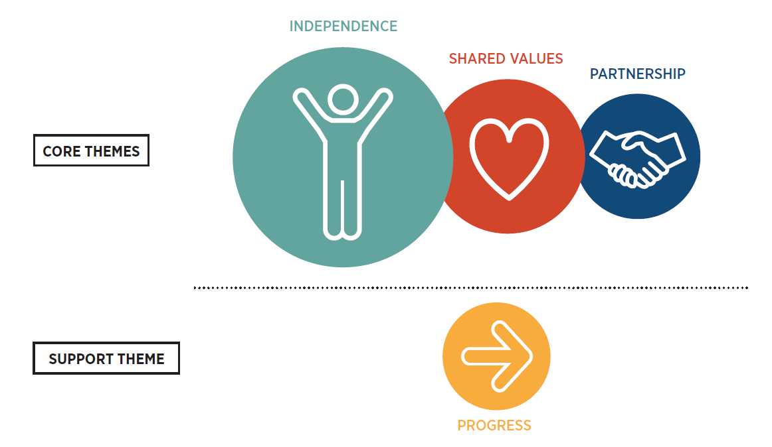
Narrative Themes

Slide 22
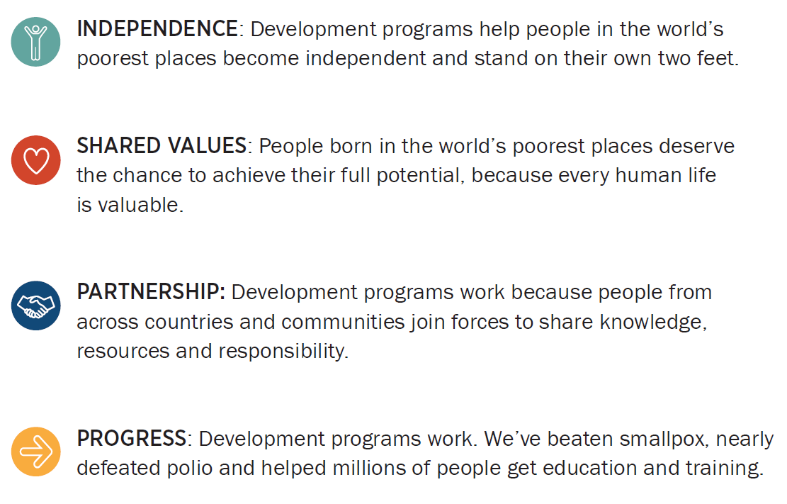
Narrative Messages
TAGLINE:
Building the foundations of independence.

Slide 23
Always Emphasize our Goal: Self-reliance
Do
Don’t
Position the end goal of development as the best way to give everyone a chance to become self-reliant.
Relate practical development support goals to a broader story of growing self-reliance around the world.
State abstract goals like ‘ending poverty’ as our ambition. These concepts act as triggers for Skeptics who, when provoked, are quick to point out unrealistic objectives as reasons not to support development programs.

Slide 24
Reframe the Moral Wrong as Wasted Potential, Not Helpless Suffering
Do
Don’t
Harness the most resonant moral case for development support: opportunity is unfairly distributed around the world and, people do not choose where they are born.
Provoke indignation about the immense waste of unrealized human potential caused by random circumstance around the world.
Invoke pity for the poorest people, or for helpless human suffering. This sentiment deepens the hopelessness many people feel—especially Swings and Skeptics—about the potential impact of development support.

Slide 25
Reframe the World’s Poorest People as those who Share Values
Do
Don’t
Talk about people in developing countries as individuals who share our values—ingenuity, determination, pride and persistence—who were born into unlucky circumstances.
Portray people in developing countries as helpless, voiceless “others” who need to be rescued.
Using terms such as “the world’s poorest” is not forbidden, but they should only be used in combination with messaging that invokes shared values such as dignity and pride.

Slide 26
Show that Development Works Through Partnerships
Do
Don’t
Highlight the active role poor people and developing countries take in achieving self-reliance and building their own futures.
Show that expertise, effort, investment, risk and responsibility are all shared.
All our audiences believe change is more likely when the countries and people are visibly working together, and each are held accountable.
Position donor countries, celebrities or NGOs as heroic providers of benefits and solutions for poor people.
Development support is not a one-way street.

Slide 27
Use Progress as a Tool— Not a Story Itself
Do
Don’t
Use progress stories when they have context and are shared in alignment with beliefs people already hold about the world.
Frame progress in terms of risk of attrition: if we stop now, we will not only fail to make more progress, we will lose all the gains we’ve made over the last few decades.
Try to persuade people with progress without framing your story through a shared value/theme first.
Progress stories are important because they show that development works, aid is effective, and things can change. Progress is not the story itself.

Slide 28
DISCUSSION

Slide 29
Discussion points
Which parts of the narrative theme are most interesting and/or helpful to you?
How is this similar or different to our existing messaging and approach?
What seems challenging for you to use in your work?
What would help you use these insights more easily and more often?
What can we do together to encourage use of the narrative approach?

Slide 30
appendix

Slide 31
A Comprehensive Approach
The primary objective was to learn something new about how to change public attitudes – rather than greater understanding of existing attitudes.
Pre-research
Audit existing research
Create arguments to test
Qualitative
Focus groups with stimulus
Quantitative
1200 person online interviews per country
Engaged Public sample
Analysis
Perception shifts
Advocacy actions
Propensity to donate
Post-research
Create the narrative
Text analytics

Slide 32
The Final Four Frames
Autonomy
Self-sufficiency, enduring change, and pride
Partnership
Joint-effort, mutual self-interest and equality
Progress
Improvement in circumstances, success stories and persistence
Morality
Urgency of the need, ethical and injustice

Slide 33
The Narrative Formula
SHARED GOAL OF SELF-RELIANCE
MORALITY AS INEQUITY
PARTNERSHIP
PROGRESS
Emphasizing self-reliance as the end goal unites all audiences and recruits the most Swings
Reframe people in need as individuals who share our values and potential but have very different challenges
Explain that this work is done through partnerships, where donor and developing countries share expertise, investment and responsibility

Slide 34
Insight
Audiences don’t believe that things have improved in the developing world – and this view is particularly hard to change.
1
2
3
4
5
6
7

Slide 35
Public Attitudes are Negative
Poor countries tend to stay poor.
Despite billions in aid, the poorest people around the world are not much better off than they were 20 years ago.
Most of the countries that were poor 30 years ago are still poor today.
Base: US, UK, France, Germany Gen Pop (all adults) sample. Sample size 1,000 + in each country. Online. Fieldwork January 7th-13th 2014

Slide 36
Changing These Opinions is Hard
Proportion that agree ‘Foreign aid is a big waste’
No statistically significant change in any audience group over the course of the survey
Top 2 shown (Strongly agree + Somewhat agree)
Pros
Swings
Skeptics
Indicates a statistically significant change from pre to post at the 90% confidence interval
Q#. QBL4 /QPS6 / QPST6. Please indicate the extent to which you agree with the idea that foreign aid is a big waste.

Slide 37
Insight
We can double the number of our supporters if we can convince the undecided ‘Swing’ audience
1
2
3
4
5
6
7

Slide 38
Three Segments within the Engaged
38
Base is adult population in each country, and then Engaged Public in each country.

Slide 39
Likelihood to Donate to Charity Increases Among Swing Audience
Likelihood to donate to a charity or non-profit organization
Showing Top 3 (10 – Very likely to donate to an NGO + 9 + 8)
Pros
Swings
Skeptics
Indicates a statistically significant change from pre to post at the 90% confidence interval
Q#. QBSR5 /QPS3 / QPST3. Thinking about charitable giving to help in developing countries, please indicate how likely you would be to donate to a charity or non-profit organization (i.e. NGO) that works on international development programs, where a score of 0 means that you are ‘Not at all likely to donate to an NGO’, and a score of 10 means you are ‘Very likely to donate to an NGO’. Where would you place yourself on this scale?

Slide 40
Insight
The best arguments for development stated independence & self-reliance for people in the developing world as the end goal of this work.
1
2
3
4
5
6
7

Slide 41
Autonomy & Partnership Were the Strongest Frames Tested
NARRATIVE INDEX SUMMARY Ranked by Pro Index Score Index Score: Affinity + Net Convincing + Support Government Funding + Likely to Donate + Likely to Take Action
Mean | 311 | 179 | 102 |  | 262 | 226 | 187 | 212
Range | 300-319 | 160-193 | 84-127 |  | 254-266 | 212-253 | 172-194 | 189-224
AUTONOMY | 319 | 193 | 127 |  | 266 | 253 | 191 | 224
MORALITY | 313 | 182 | 84 |  | 254 | 224 | 192 | 217
PARTNERSHIP | 312 | 181 | 98 |  | 266 | 214 | 194 | 217
PROGRESS | 300 | 160 | 98 |  | 262 | 212 | 172 | 189
Pros
Swings
Skeptics
Top scoring narrative
Bottom scoring narrative
Narrative test. See NARRATIVE & MESSAGING INDEX SCORE METHODOLOGY for Index score components
Base: Engaged Public in each country. Sample ~1200 in each country. Fieldwork from May 14 – 29, 2014

Slide 42
Insight
The best messages about the progress were specific, relatable, and emphasized loss aversion and choice.
1
2
3
4
5
6
7

Slide 43
Our Audiences Don’t See Evidence of Positive Change
I feel the emphasis is too much on suffering. I know this is reality, but
most people are desensitized to it - they see it on their TVs, and they don't care. There needs to be an emphasis on the global family, and on the actual successes.
Despair. I find it overwhelming and discouraging. We hear about everything that's wrong in the world every single day in the news and it
makes me feel useless and unable to help. I think that using positive images of how we ARE helping would be much more beneficial.
Well, I agree and also I'm fed up with being constantly approached. Once you turn on the television or the radio or even read a newspaper, as if it was an obligation.
You didn't give. You bastard.
So for 45 years, people have paid development aid. And some countries or most countries are still poor, apart from very few exceptions. And most countries are even worse off than before. So, for 45 years, you have done an experiment and this experiment was, if we pay money, they develop. And what we've got at the moment is the following. We've got 45 results from Africa and 45 results showing us that it's not working. And that's enough. That's enough of an argument. An argument
against development aid.
Swing
Swing
Skeptics
Skeptics

Slide 44
Insight
Gender equality is a compelling issue for our public audiences across donor countries because they can relate to it.
1
2
3
4
5
6
7

Slide 45
Women & Girls (in a Values Framing) is the Best-performing Message Among Swings
Index Score
Message test. See NARRATIVE & MESSAGING INDEX SCORE METHODOLOGY for Index score components
Base: Engaged Public in each country. Sample ~1200 in each country. Fieldwork from May 14 – 29, 2014

Slide 46
Insight
If we can convince people that they can make a difference, this belief will drive them to take action.
1
2
3
4
5
6
7

Slide 47
There is Deep Skepticism that Individuals or Their Governments Can Make a Difference
Pros
Swings
Skeptics
Pros
Swings
Skeptics
QBSR4. Thinking about you personally, how much of a difference do you think you can make to reducing poverty in poor countries? Please use the following scale where 0 means that you ‘can’t make any difference at all’ and 10 means that you ‘can make a great deal of difference’. [% Top 3 (10 – can make a great deal of difference+ 9 + 8)/ % Bottom 3 Box(2+1+0- can’t make any difference at all)]
QBSR3. Thinking about the [Country] Government, how much of a difference do you think it can make to reducing poverty in poor countries? Please use the following scale where 0 means that you ‘can’t make any difference at all’ and 10 means that you ‘can make a great deal of difference’. [% Top 3 (10 – can make a great deal of difference+ 9 + 8)/ % Bottom 3 Box(2+1+0- can’t make any difference at all)]
Base: Engaged Public in each country. Sample approx 1200 in each country. Fieldwork from May 14 – 29, 2014

Slide 48
Our Frames and Messages Were Effective at Changing People’s Views of Their Own Impact
Personal impact on reducing poverty in poor countries
Showing Top 3 (10 – You can make a great deal of difference + 9 + 8)
Pros
Swings
Skeptics
Indicates a statistically significant change from pre to post at the 90% confidence interval
#. QBSR4 /QPS2 / QPST2. Thinking about you personally, how much of a difference do you think you can make to reducing poverty in poor countries? Please use the following scale where 0 means that you ‘can’t make any difference at all’ and 10 means that you ‘can make a great deal of difference’.
Base: Engaged Public in each country. Sample ~1200 in each country. Fieldwork from May 14 – 29, 2014

Slide 49
Insight
When we rebut the attacks from our critics, we can be successful in changing people’s minds.
1
2
3
4
5
6
7

Slide 50
Even the Most Powerful Attacks Fail to Stand Up Against an Effective Rebuttal
THE ATTACK & THE REBUTTAL
Attack: It’s a hopeless and bottomless pit. Year after year, money pours into places in need but things never get any better. In the last 50 years almost one trillion dollars in aid has gone to Africa and yet still all we see is the same images of suffering. Corruption means hardly any money reaches people in need anyway.
Rebuttal: When the number of children dying from preventable causes has declined from 17 million in 1990 to nearly 7 million in 2013, how can anyone say that it isn’t working? If you only see suffering, you’re missing the bigger picture. We have cut extreme poverty in half across the globe. AIDS is no longer a death sentence. We have defeated smallpox. Many countries who received Aid no longer need it. There is still much to do, but what we have achieved should fill us with hope.
THE SCORES AFTER SEEING BOTH
OPPONENTS
SUPPORTERS
Pros
Swings
Skeptics
QAR1/4. How convincing do you find the content of this statement? [% Top 2 (Very convincing + Somewhat convincing) - % Bottom 2 Box (Not very convincing + Not at all convincing)]
QAR2/5. How much more or less likely would you be to support government funding for global development programs based on this statement? [% Top 2 (Much more likely + Somewhat more likely) / % Bottom 2 Box (Somewhat less likely + Much less likely)]
QAR3/6. How much more or less likely would you be to donate to a charity or non-profit that works on global development programs based on this statement? [% Top 2 (Much more likely + Somewhat more likely) / % Bottom 2 Box (Somewhat less likely + Much less likely)]
QAR7. Who do you agree with more?
Base: Engaged Public in each country. Sample ~1200 in each country. Fieldwork from May 14 – 29, 2014

Slide 51
THE NARRATIVE

Slide 52
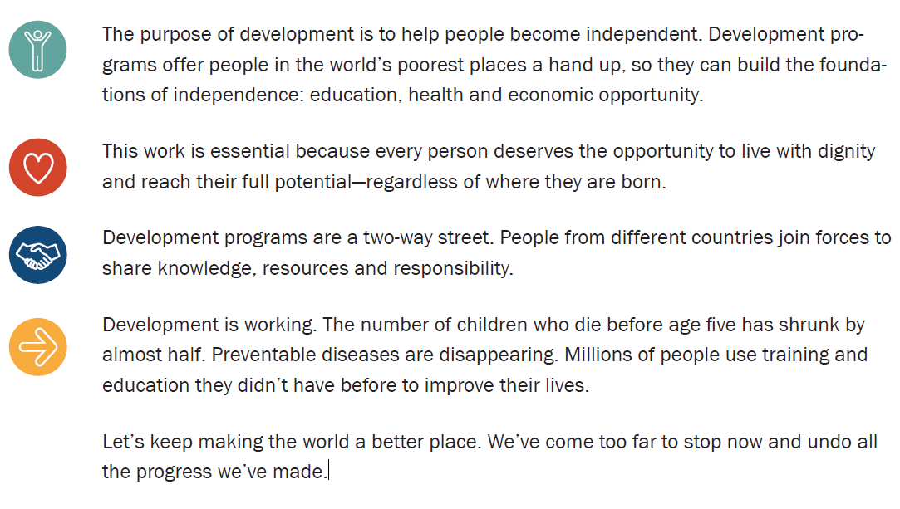
The narrative in long-form

Slide 53
examples

Slide 54
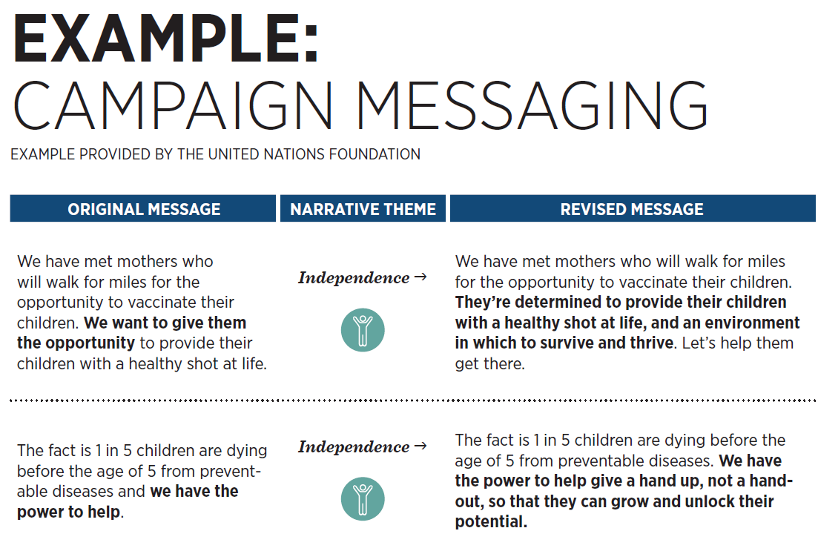

Slide 55
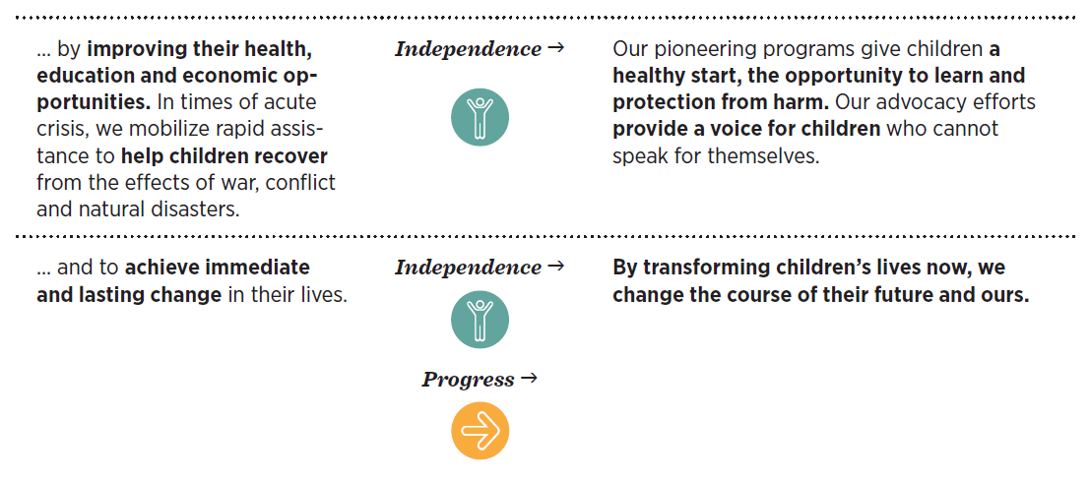

Slide 56
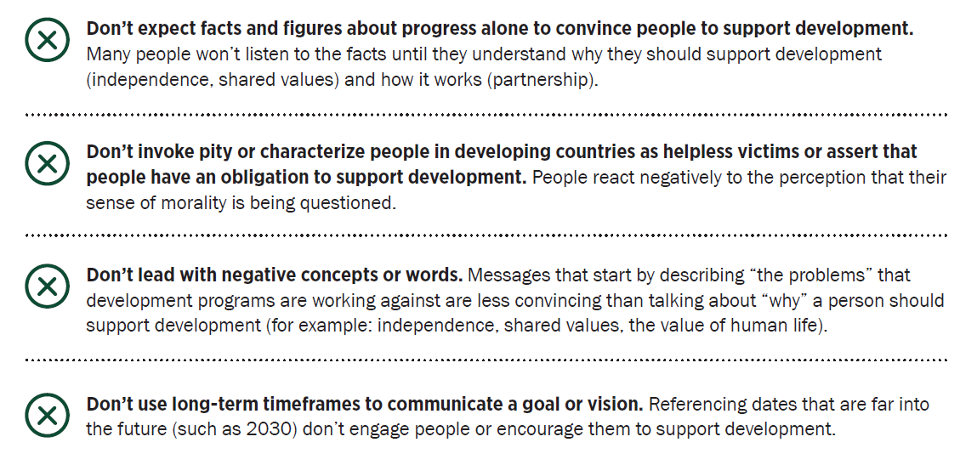
Don’t do these things

Slide 57
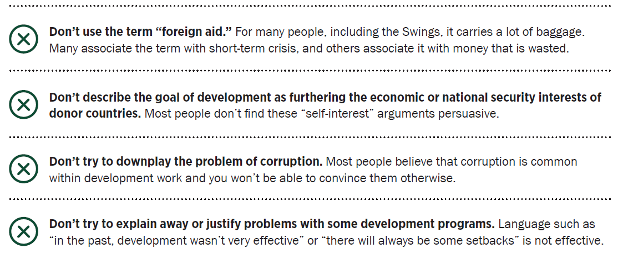
Or these…

