Slide 1
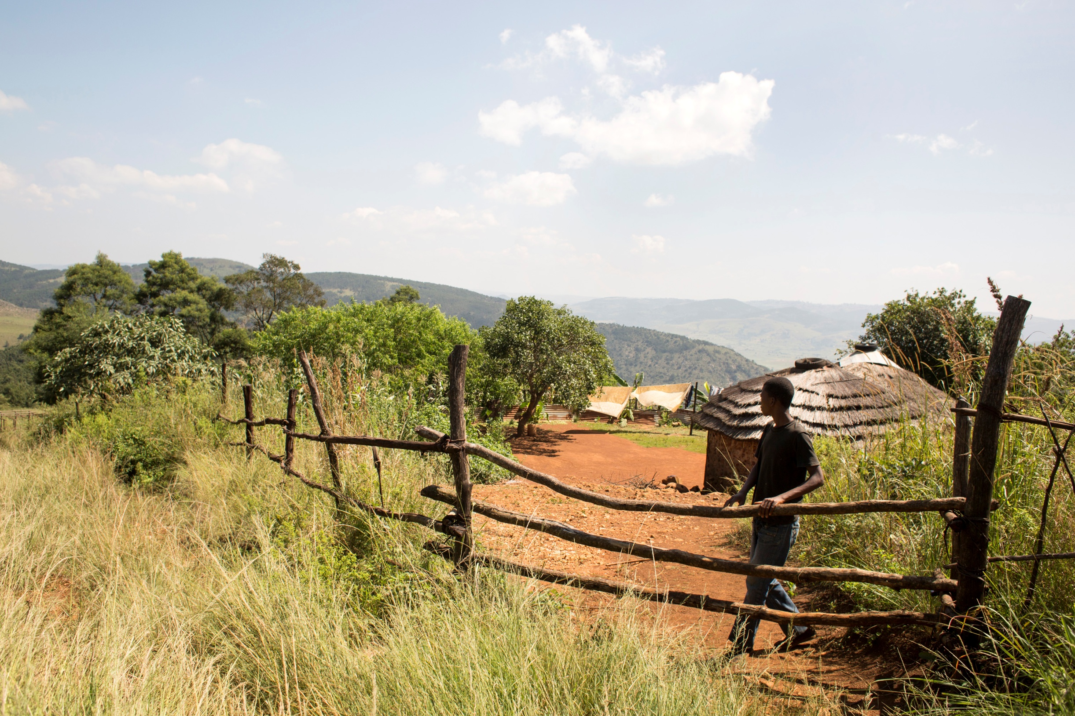
FAO and European Year for Development
Notes:
Goodmorning, ladies and gentlemen
My name is Maarten Roest
I am in charge of communications at the Brussels office of FAO, the UN’s food and agriculture organization.
I thank you for this invitation to explain what the European Year for Development means for FAO and how we can contribute.

Slide 2
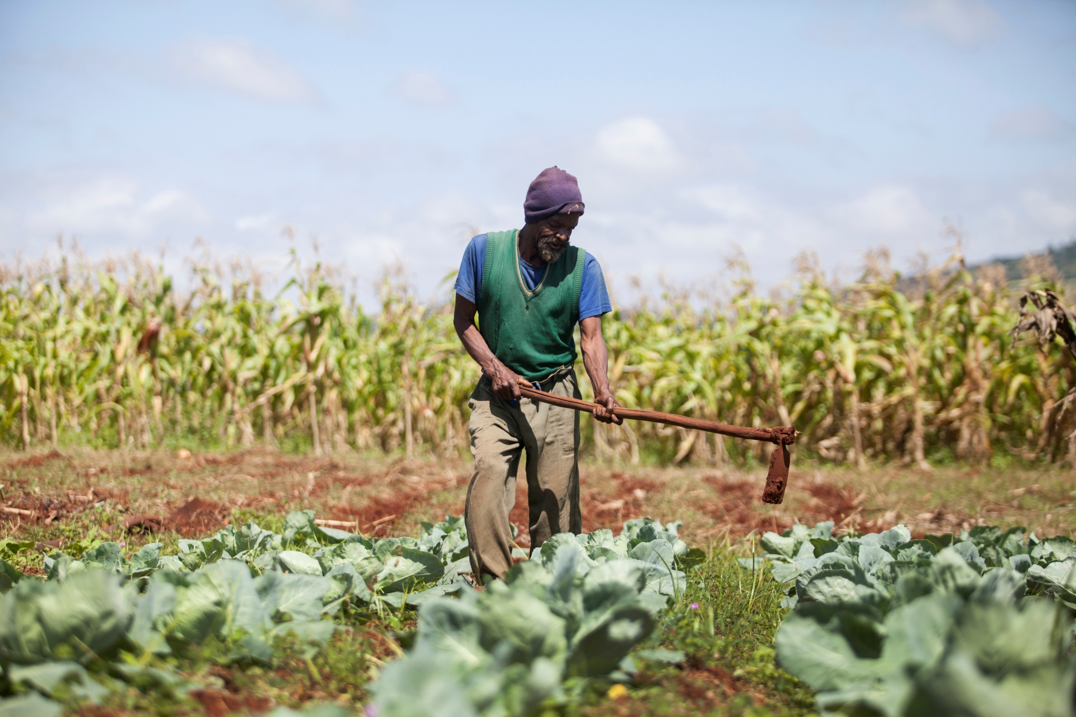
Malindane
Notes:
I would like to start by telling you a story.
This is Malindane.
He is a small farmer from Swaziland.

Slide 3
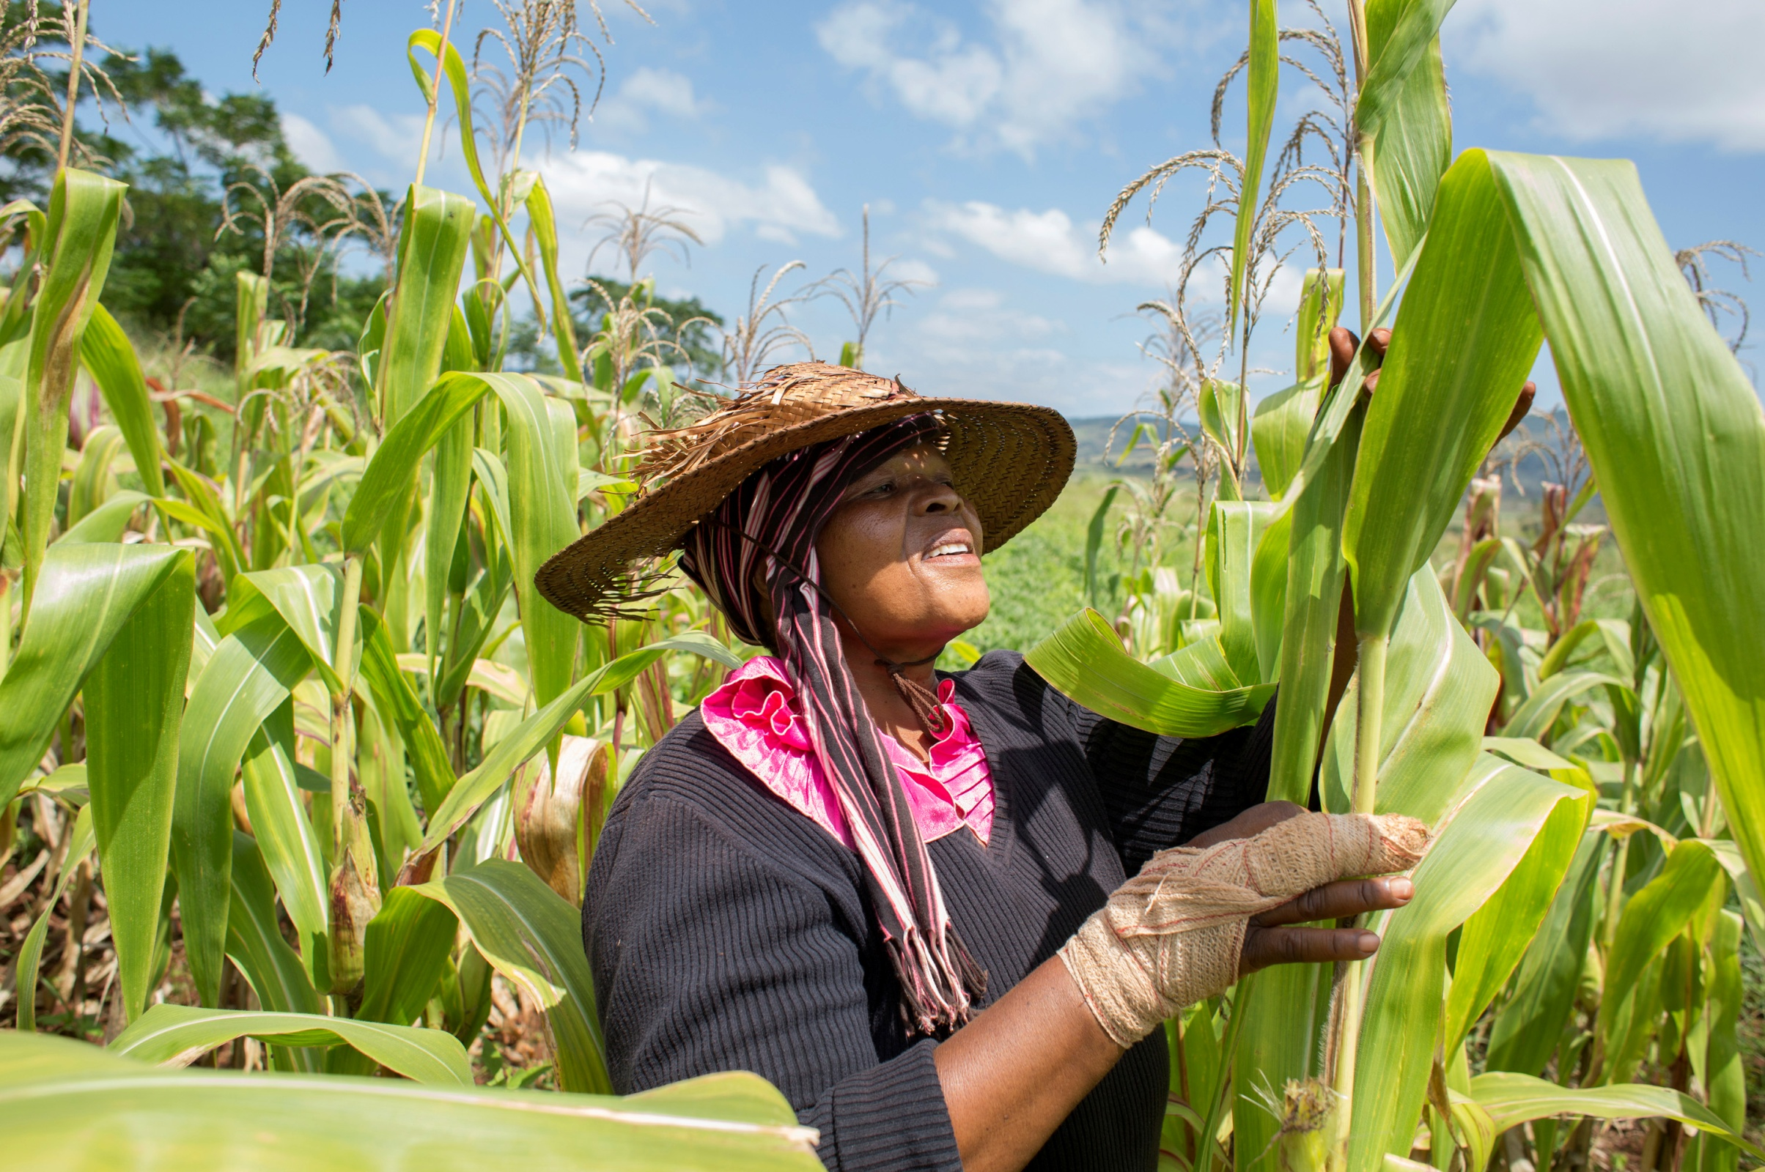
Simiso
Notes:
And this is Malindane’s wife Simiso.
Together, they grow their own food.

Slide 4
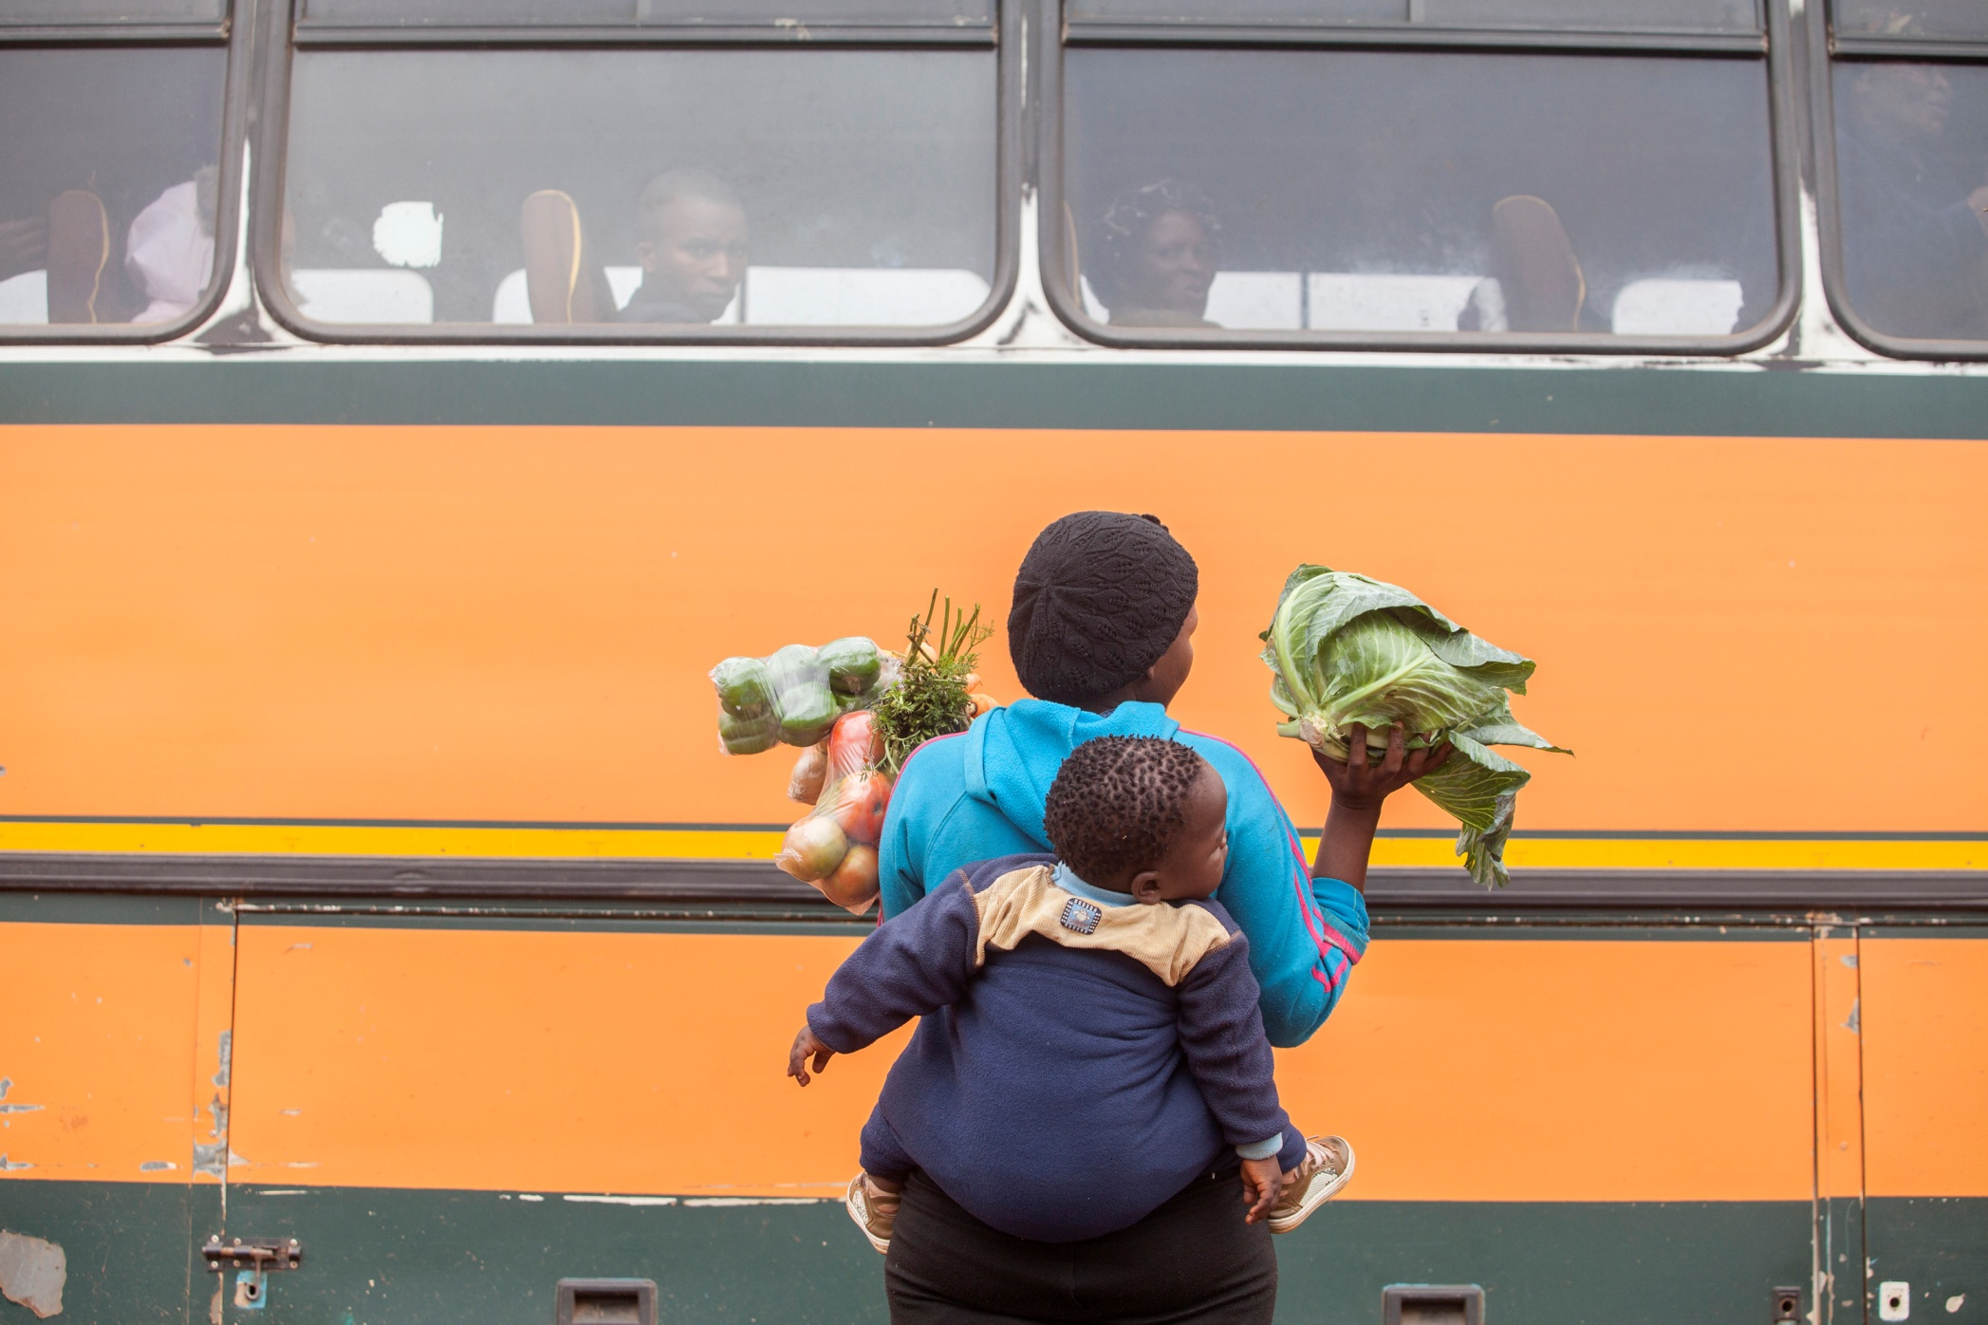
Zamokudhle
Notes:
Every day, their daughter Zamokudhle goes down to the road to sell their surplus of vegetables.

Slide 5
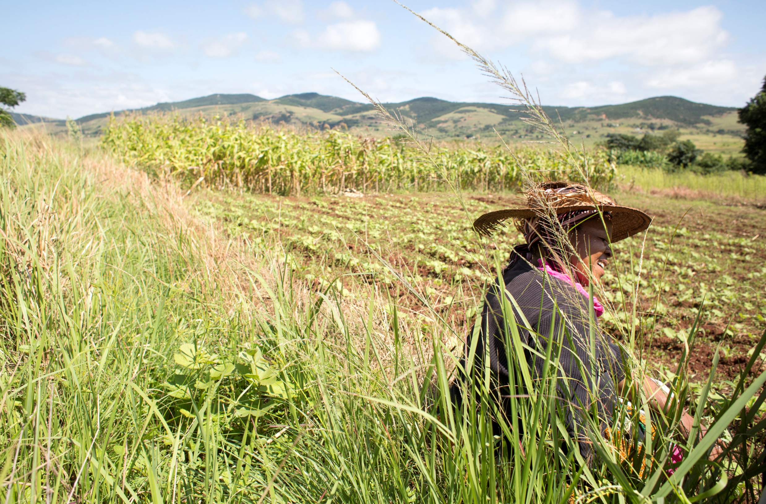
Revitalising agriculture in Swaziland
Notes:
The fields of Malindane and Simiso are irrigated thanks to a dam uphill.
Recently, the dam was rehabilitated under a vast programme of the government, the European Union and FAO to revitalise agriculture in Swaziland.

Slide 6
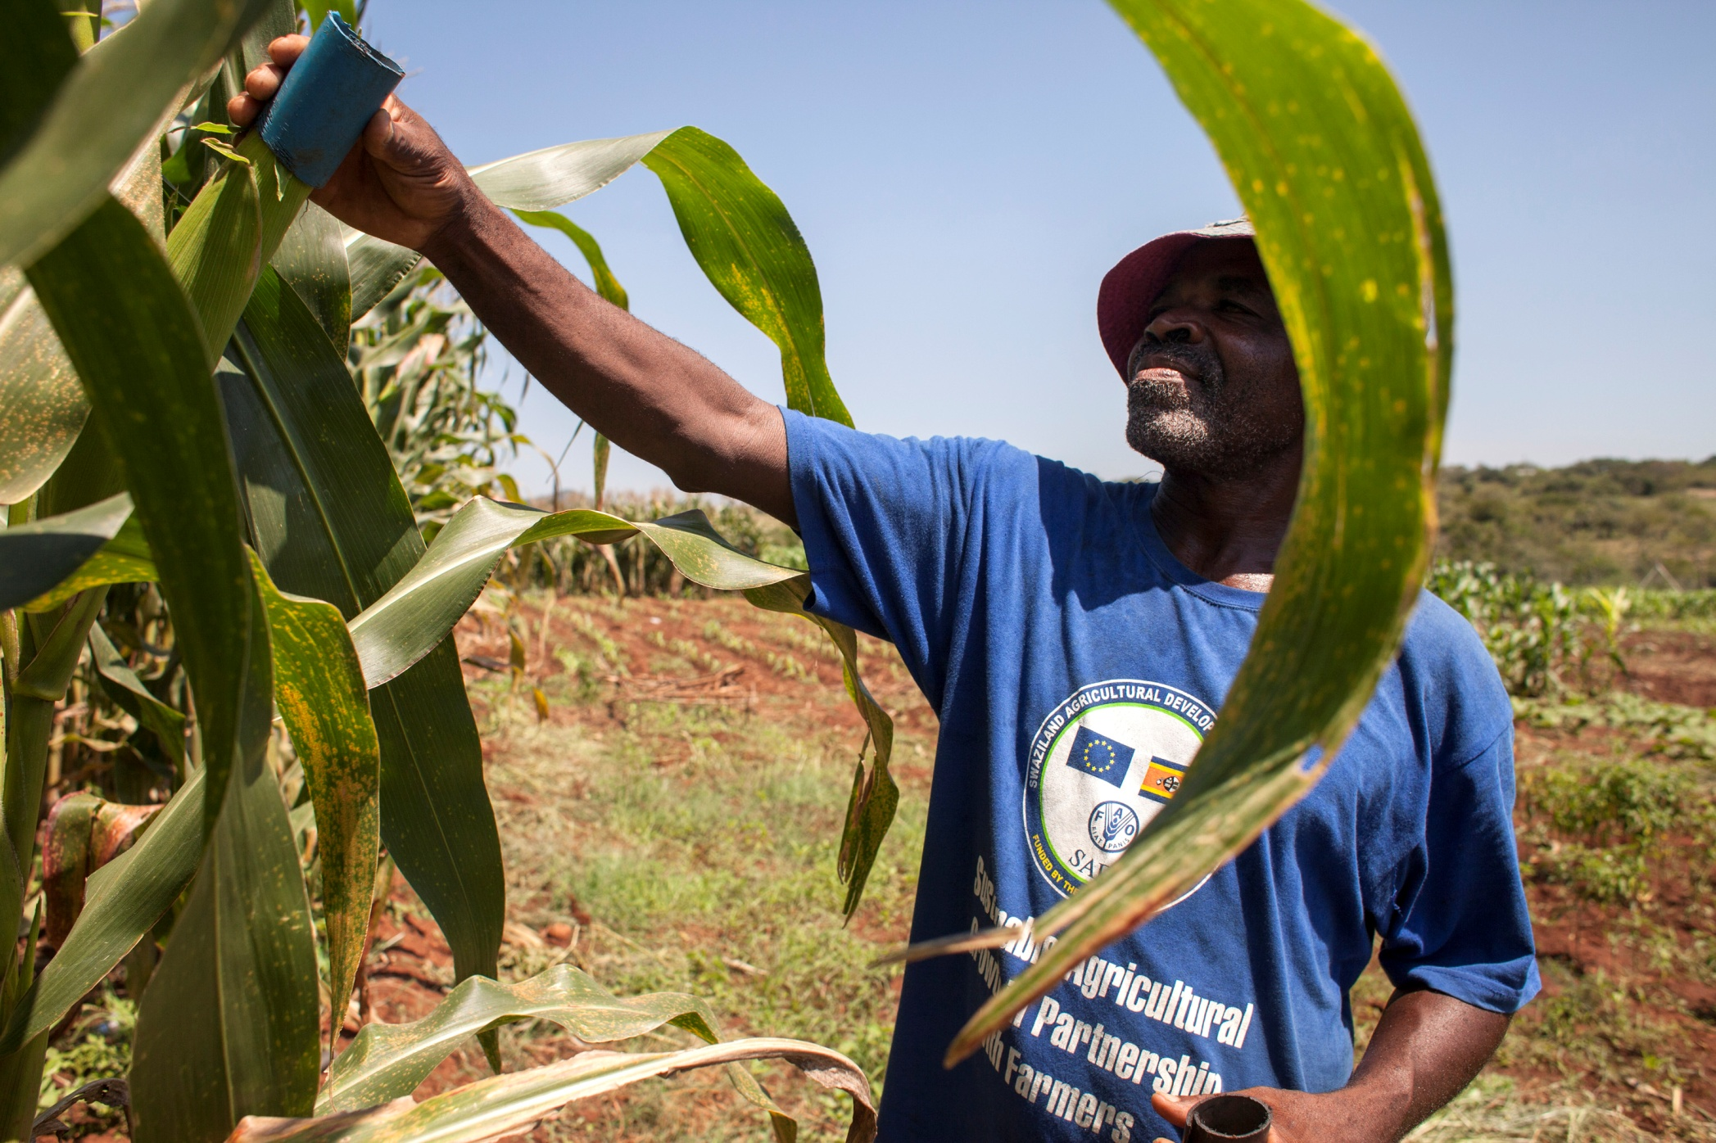
Swaziland Agricultural Development Project
Notes:
Most people in Swaziland live off the land.
But economic slowdown, a devastating AIDS pandemic and, more recently, droughts linked to climate change, have made it hard for small farmers to support themselves and their families.
FAO estimates that 1 in 3 people don’t have enough to eat.
So, the programme’s first objective is to help small farmers grow more and more nutritious food.

Slide 7
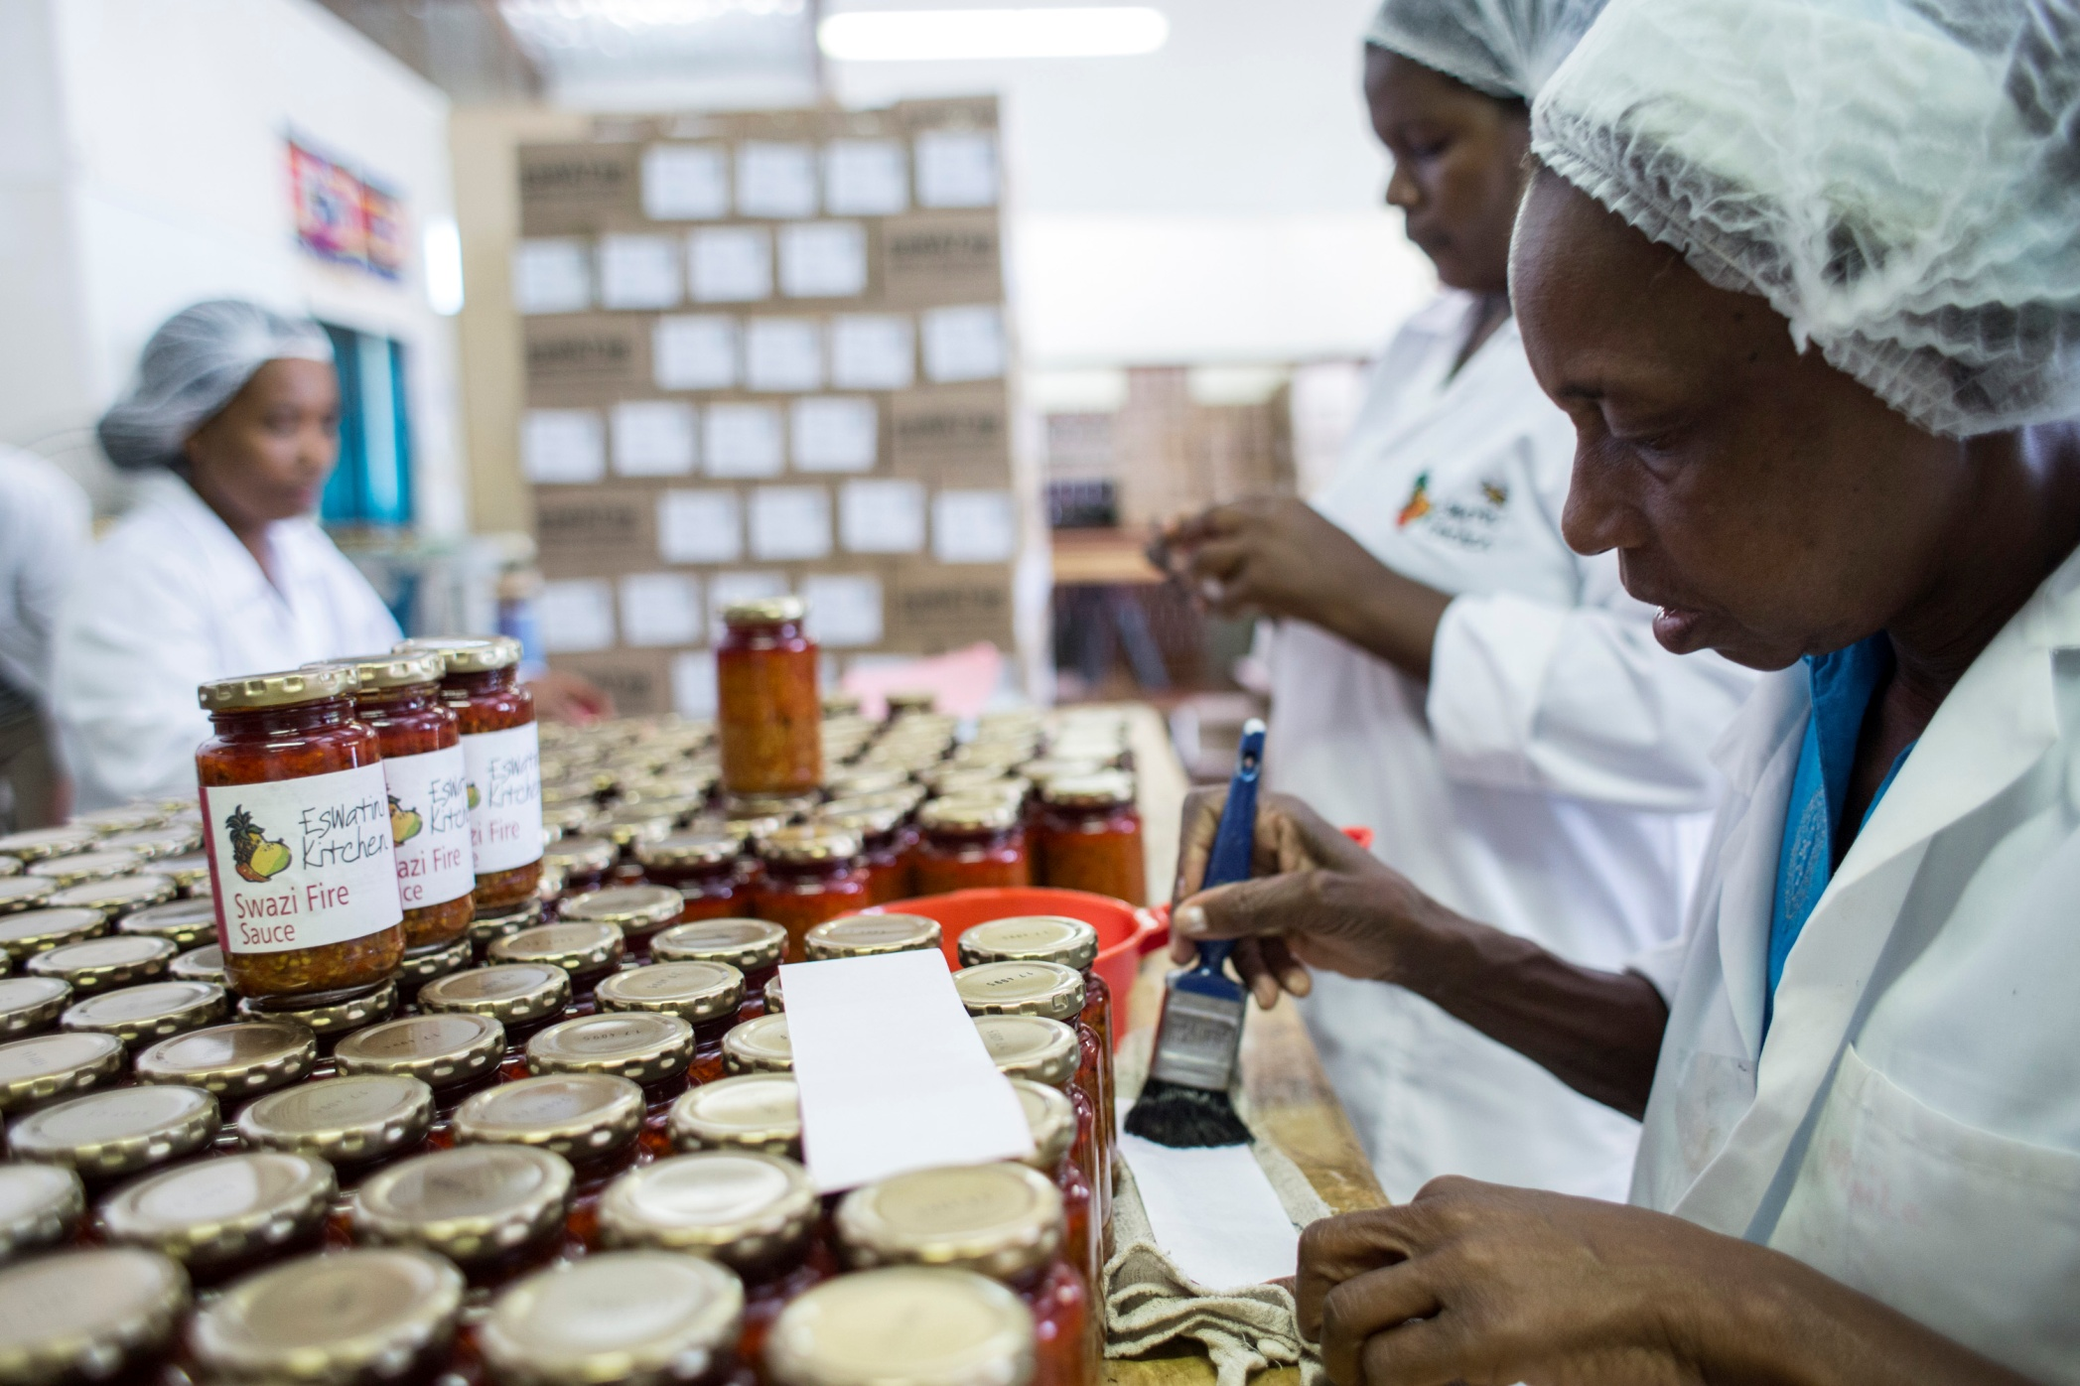
Eswatini Kitchen
Notes:
But it also wants to help farmers sell what they produce.
Eswatini Kitchen is a Swazi factory that makes sauces and jams with the produce of local farmers.
These products are sold in Swaziland, neighboring South Africa, and across the globe through fair trade networks.
Recently, they came all the way to Brussels for UN Day, demonstrating their products to the public on Grand Place.
Among them was Belgian development minister De Croo.
He learnt how this example of European solidarity has helped farmers far away in Africa.

Slide 8
EU and FAO
Strategic partnership to alleviate rural poverty and hunger
Food security and nutrition, sustainable and climate smart agriculture, resilience building
Notes:
The European Year for Development presents an excellent opportunity to show European citizens what FAO does in partnership with the European Union.
The EU is one of FAO’s most important partners in promoting sustainable rural development in the fight against hunger.
Our cooperation is focused on key issues, such as food and nutrition security, on sustainable and climate smart agriculture and on strengthening people’s resilience to shocks, such as caused by climate change.

Slide 9
EU-FAO stories in 2015
Hunger reduction (MDG-1), ahead of post-2015 summit, September
Food security, October: EXPO concert, Kapuscinski lecture, social media
Desertification, November, Great Green Wall, COP Paris
Notes:
There are lots of interesting stories to tell in 2015.
For example, we can tell what the EU and FAO have done to accelerate the achievement of MDG-1c - that is hunger reduction.
And it’s important to show results now that the MDG’s are drawing to a close and the post-2015 agenda will be set.
We can also show how our joint efforts to combat desertification are contributing to a Great Green Wall across the Sahel.
And in October, all eyes will be on food security and nutrition.
It’s the theme of the month of the European Year for Development.
It’s also World Food Day, extraordinarily celebrated in Milan at EXPO.
The EU, FAO and the Italian government are working on a concert there with a very promising list of stars.
Our DG may deliver the Kapuscinski Development lecture – but no promises.
And we have been invited to curate EYD’s social media with WFP.

Slide 10
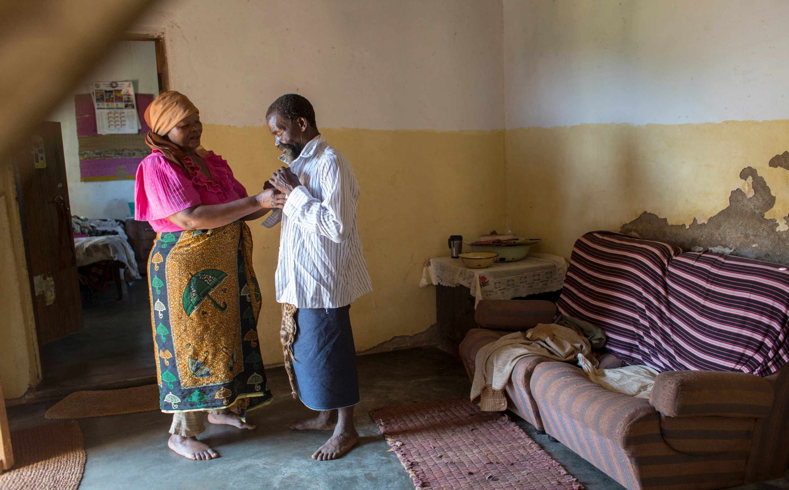
It’s all about people
Notes:
In the end, development is all about people.
People like Malindane and his wife.
That is why story-telling is so powerful.
To show what solidarity really means.

Slide 11
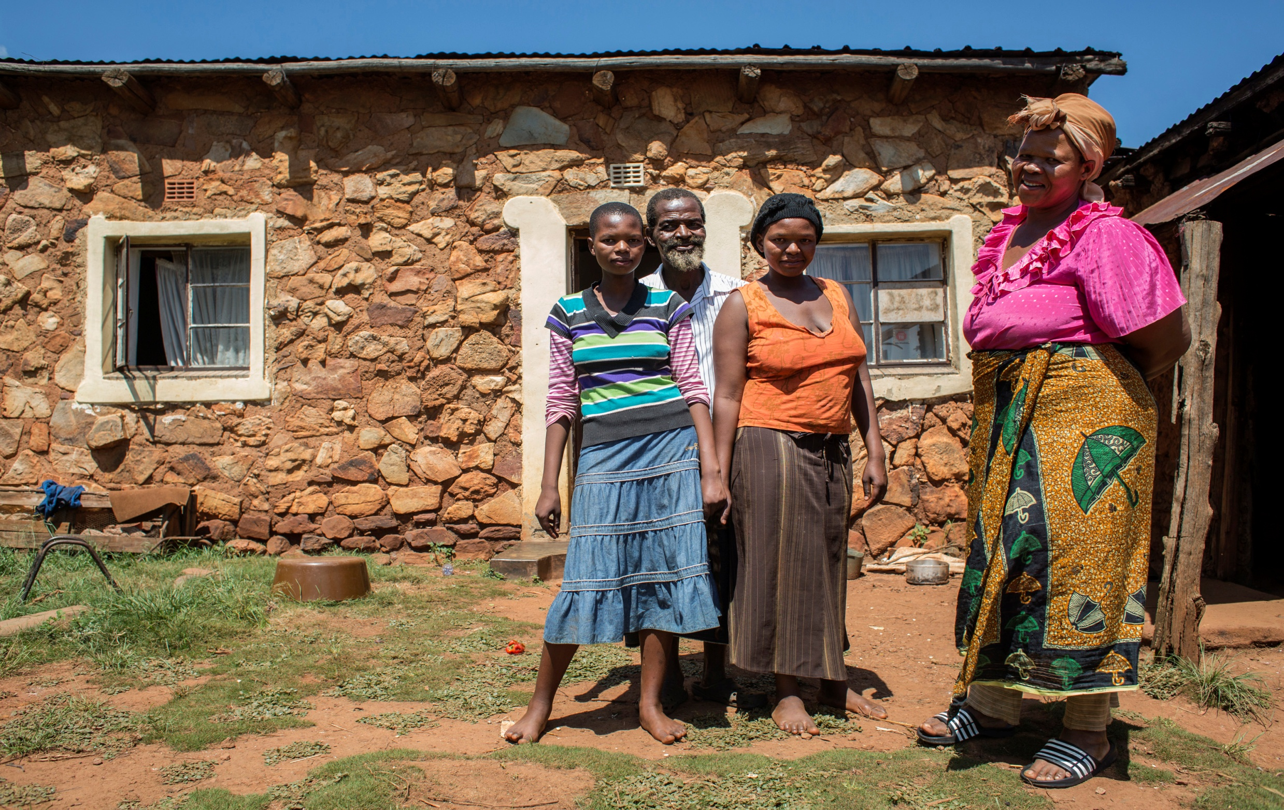
Ever stronger partners
Notes:
Malindane says that he is blessed with his wife and daughters. And with the water from the dam.
Simiso agrees: Malindane is blessed – with her.
Zamokudhle, their daughter, would welcome alternative marketing for their vegetables.
Because she hopes to take up schooling again to become a home economics teacher.
Her younger sister Senani wants to go to university when she finishes high school next year.
My own story goes back to 2006 when FAO started a comprehensive visibility programme on its partnership with the European Union.
The partnership has grown stronger ever since.
2015 surely looks like a very promising year to draw Europe wide attention to it.
Thank you very much.

