Slide 1
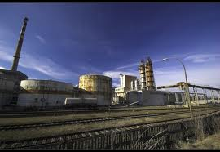

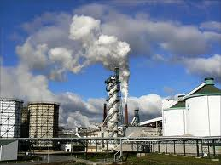
BAT assessment methodology
Monika Přibylová 24/4/2014

Slide 2
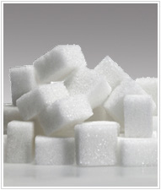
Content
The aim of BAT assessment methodology
Steps in BAT assessment
Practical example of BAT assessment – Czech sugar plant

Slide 3

Purpose of BAT assessment methodology
the identification of ways to improve the effectiveness of installation operation that should be applicable to a particular site.
The identification of improvements in according to BAT concept is carried out through comparison of existing and potential possibilities, selection and financial appraisal of the suitable options.
Notes:
Article 2/12 of the IPPC Directive
‘best available techniques’ means the most effective and advanced stage in the development of activities and their methods of operation which indicate the practical suitability of particular techniques for providing in principle the basis for emission limit values designed to prevent and, where that is not practicable, generally to reduce emissions and the impact on the environment as a whole:
‘techniques’ shall include both the technology used and the way in which the installation is designed, built, maintained, operated and decommissioned;
(b) ‘available techniques’ means those developed on a scale which allows implementation in the relevant industrial sector, under economically and technically viable conditions, taking into consideration the costs and advantages, whether or not the techniques are used or produced inside the Member State in question, as long as they are reasonably accessible to the operator;
(c) ‘best’ means most effective in achieving a high general level of protection of the environment as a whole.
In determining the best available techniques, special consideration should be given to the items listed in Annex IV;

Slide 4
General BAT assessment scheme in a sugar plant – identification of sources of BAT information
Notes:
What to compare/assess?

Slide 5
Information sources for
BAT assessment and determination
ВАТ Reference Documents (BREF) as benchmark http://eippcb.jrc.es/reference/
Criteria for identifying/evaluating BAT (Annex III of the IED Directive)
Other BAT related guidance (UK guidance notes, IFC sectoral guidelines,…)
Cleaner technology methodology
…

Slide 6

Steps for BAT assessment
Basic technical description and capacity parameters as a source of BAT´s identification
General BAT assessment
Define key performance indicators (KPIs)
Detailed technological and operational description and BAT assessment
Summary of identified BAT
Proposal of improvement plan

Slide 7
Basic technical description and capacity characteristics
principles of sugar production and power production,
number days per year of operation,
capacity of sugar bulbs per day processing,
fuel consumption and performance of power plant,
capacity of lime production in tones of lime per day,
capacity of WWTP in m3/day,
Mass and energy balances

Slide 8
Description of main technologies
For the elementary/general BAT assessment
Necessary data: basic process/block scheme drawing and description of main installations/technologies
Examples:
water based transport of sugar bulbs,
five stages evaporator with thermo compression,
WWTP with first anaerobic stage and second aerobic stage with closed circle of water through sedimentation basin,
black coal power plant equipped by fabric filters for flue gas cleaning

Slide 9

Key Performance Indicators
Definition of KPIs throughout the plant to be used to report and monitor performance
Main KPI = values related to 1 t of processed raw material or 1 t of product, and efficiency of production,
Examples:
consumed beets / 1t of sugar,
consumed water/ 1t of sugar,
consumed natural gas 1/t of sugar,
COD in waste water
Sources of KPI: e.g. BREFs, IFC EHS Guidelines for Sugar Manufacturing.
Notes:
Plant = zavod

Slide 10
Detailed technological and operational description and BAT assessment
Detailed description of whole plant include:
management system,
way of technology control – number of control places,
way of sugar bulbs and main raw materials supply,
description of supplementary processes – laboratory, waste management,
reporting and monitoring system at different levels.

Slide 11
BAT improvement plan
1. summary of identified BAT in all technological/technique levels - description of proposed techniques & related KPI´s
2. improvement proposal
Selection of measures, which bring the best effect for the plant – i.e. for each identified measure calculation of:
  investment and operational costs,
  expected savings and benefits, and
  payback period
In case the plant breaches the legal requirements the identified improvements which ensure the compliance with legal requirements have to have the preference in the implementation.
3. action plan proposal – allocation of reasonable time for implementation of proposed improvement measures investment plan
Notes:
10.000 EUR

Slide 12
Linkage between
EMS and BAT determination
Integrated and preventive approaches form the basis of both systems.
Assessment of enviro. aspects and impacts is necessary for both EMS set up and BAT assessment.
EMS monitoring and reporting requirements can be used for BAT comparison.
EMS Programs may correspond to BAT improvement programs
EMS helps in preparing BAT determination and implementation
Notes:
Main EMS Principles
Priority of pollution prevention
Assessment and management of existing environmental aspects
Continual improvement
Compliance with existing legal requirements
IP – integrated permit

Slide 13
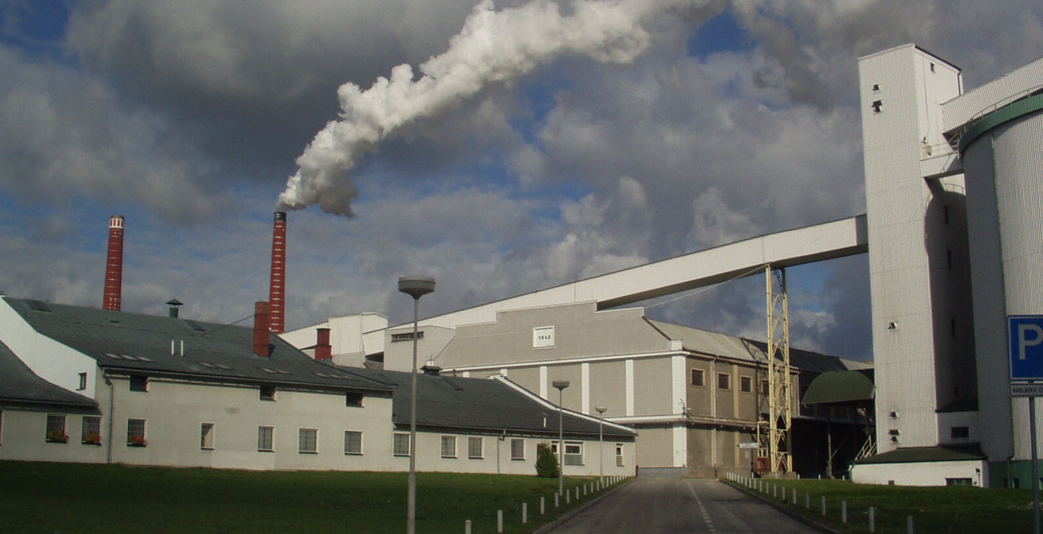
Example of BAT assessment:
Sugar plant with capacity 7000 t beets processed per day, CR in 2005

Slide 14
Relation among installations and identification of sources of BAT information

Slide 15
Relevant BREFs for sugar plant BAT assessment
Sectoral BREFs (current status):
Sugar plant
Food, Drink and Milk Industries (2006)
Animal feed production
Food, Drink and Milk Industries (2006)
Power plant and generator
Large Combustion Plants (2006)
Lime production
Cement, Lime and Magnesium Oxide
Manufacturing Industries (2013)

Slide 16
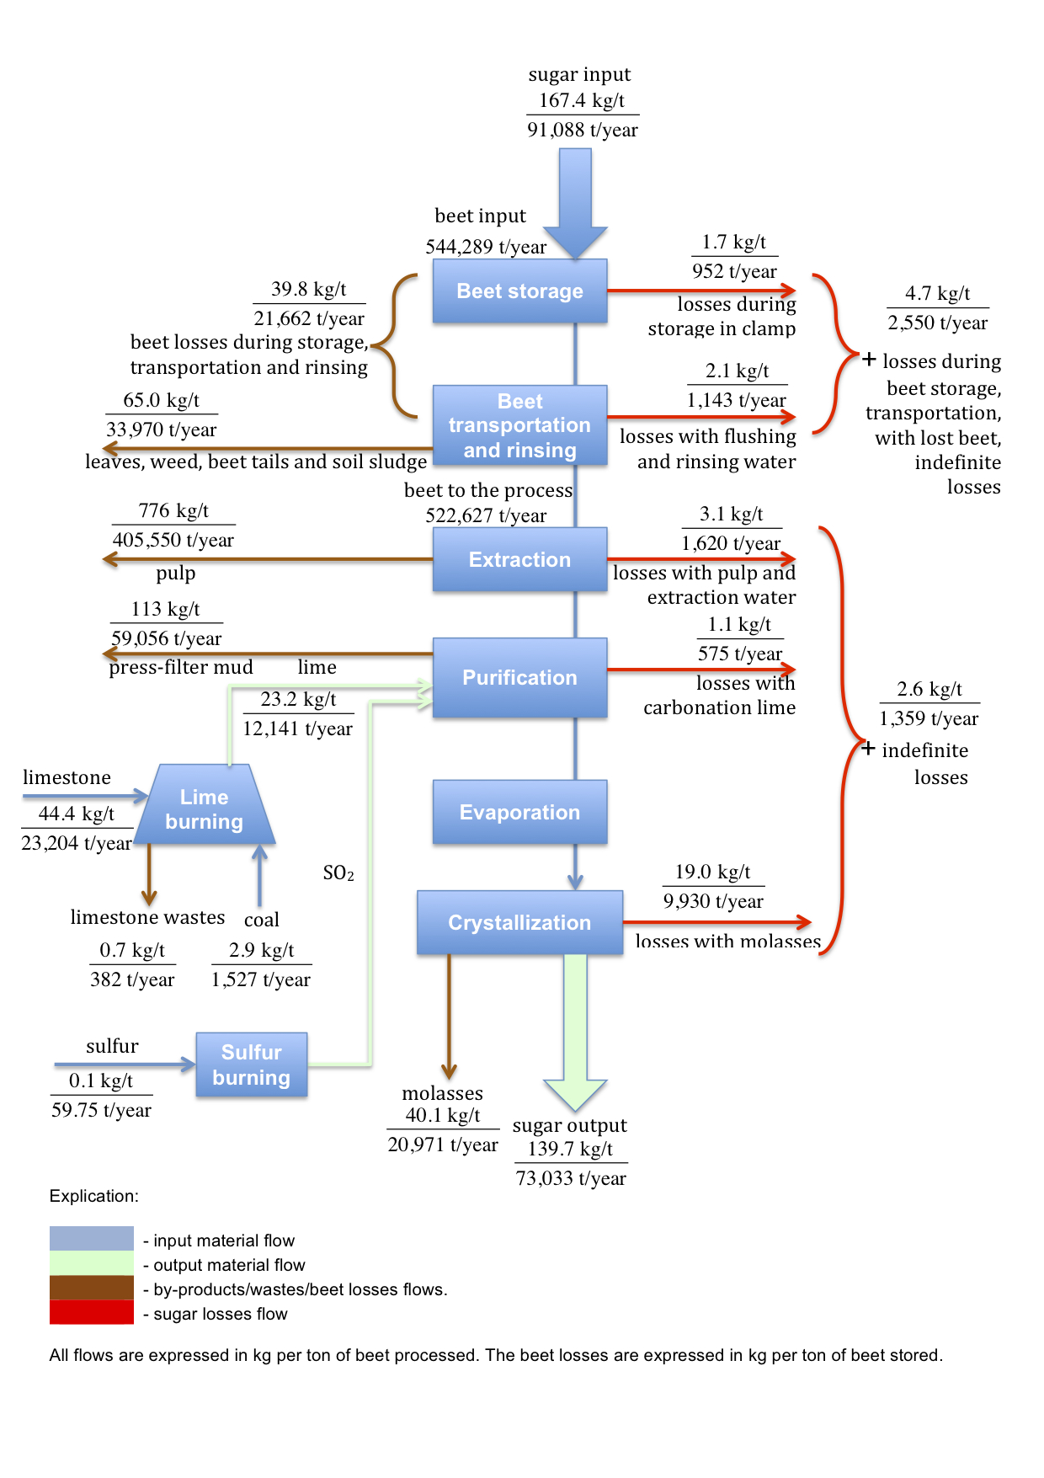
Example of mass balance: sugar production

Slide 17
BAT assessment – Sugar production
Technical solution | Achieved emissions | BATs associated emission values | Justification of the difference
Waste waters quality | The waste waters emission levels are slightly higher than the BATs associated emission values | Parameter Concentration(mg/l) BOD5 <25 COD <125 TSS <50 pH 6 – 9 Oil and grease <10 Total N <10 Total P 0.4 – 5 (BREF FDM Table 5.1: Typical FDM waste water quality after treatment) | Not in line with BAT
Fresh water consumption/t bp | 0,3 m³/t bp Data source: measured value | 0,25 – 0,4 m³/t bp (FDM BREF ch . 4.7.7.3) | In line with BAT
Energy consumption | 310,6 kWh/ton beet Data source: energy balance | 232 – 367 kWh/t bp (FDM BREF ch. 3.3.8.1.4) | In line with BAT

Slide 18
BAT assessment – Energy and steam production
Technical solution | Achieved emissions | BATs associated emission values | Justification of the difference
Gas burners | Low-NOx burners are not used | Use of low-NOx burners (LCP BREF ch 7.5.4, table 7.37) | Not in line with BAT
Energy efficiency of natural gas utilization in boilers | 92,25 – 92,55% Data source: Protocol from measurement | 75 – 85 % (LCP BREF ch 7.5.2, table 7.35) | In line with BAT
NOx in gas–fired boiler | 132 – 196 mg.m-3 Data source: Protocol from measurement | 50 – 100 mg.m-3 (O2ref = 3 %) (LCP BREF ch 7.5.4, table 7.37) | Not in compliance (No low-NOx burners)
CO in gas–fired boiler | 0 – 42 mg.m-3 Data source: Protocol from measurement | 30 – 100 mg.m-3 (O2ref = 3 %) (LCP BREF ch 7.5.4, table 7.37) | In line with BAT

Slide 19
BAT assessment – Lime production
Technical solution | Achieved emissions | BATs associated emission values | Justification of the difference
Mixed feed shaft kiln (MFSK) | Two mixed feed shaft kilns (MFSK) with capacity 100 and 60 t/day Fuel: black coal | MFSK with output 60 – 200 t/day Fuel: Lump coke (metallurgical coke), anthracite (CLM BREF ch. 2.2.7.1, 2.2.10.3) | In line with BAT Note: As fuel is used hard coal with very high calorific value
Thermal energy consumption | 4065 MJ/t Data source: Energy balance | 3400 – 4700 MJ/t (CLM BREF 2.5.3, tab 2.42) | In line with BAT
Electricity consumption | 25 kWh_{e}/t Data source: Energy balance | 5 – 15 kWh_{e}/t (CLM BREF 2.3.2.1) | Slightly higher Not in line with BAT
Consumption of limestone | 2,08 t Data source: Material balance | 1,4 – 2,2 t of limestone per t of lime (CLM BREF 2.3.1) | In line with BAT
CO content in flue gases | Collector, discharge of excess gases - 10930 mg/m3 Data source: Protocol from measurement | Generally 100 – 2500 mg/m3 For MSFK 1-6%, which corresponds to 12500 – 75000 mg/m3 (CLM BREF 2.3.3.4.2) | In line with BAT

Slide 20
BAT assessment – Animal feed production
Technical solution | Achieved emissions | BATs associated emission values | Justification of the difference
High temperature drying of sugar beet pulp | Gas-fired co-currently operated rotary drum drier | In high temperature drying (HTD), the drying gas, e.g. air or flue-gas, is heated to a temperature of up to 950ºC by direct firing and then cooled to approximately 100 ºC by evaporation of water from the pulp in the drier. (FDM BREF ch 4.7.7.1.2) | In line with BAT
Energy consumption/ evaporated water in the beet pulp driers | 3,35 MJ/kg water Data source: Energy balance | 0,556 – 0,972 kWh/kg water 2,0 – 3,5 MJ/kg water (FDM BREF ch. 4.2.) | In line with BAT
Dust from high temperature drying of beet pulp | 43,9 – 45,2 mg.m-3 Data source: Protocol from measurement | 50 – 60 mg.m-3 wet dust and 0.08 kg TOC/t of sliced beet under reference conditions 12 vol-% O2 content of air (FDM BREF ch 4.7.7.1.2) | In line with BAT

Slide 21
BAT Improvement Plan
Area of non-compliance | Technical solution | Date
Old gas burners with high NOx emissions | Introduction of low-NOx burners | Boiler 1 – till the end of 2005 Boiler 2 – till the end of 2006 Boiler 3 – till the 31. 10. 2007
Waste waters quality – low efficiency of waste water treatment plant | Reconstruction of waste water treatment plant, introduction of anaerobical stage, utilizing of biogas in boilers | In progress, in operation till the 31. 10. 2007
Higher electricity consumption of the lime production | Replacement of old electro engines and introduction of frequency control of big engines | Step by step since now till 31.10. 2007

Slide 22
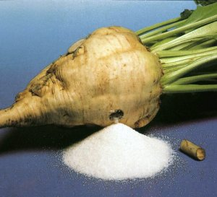
Děkuji za pozornost

