Slide 1
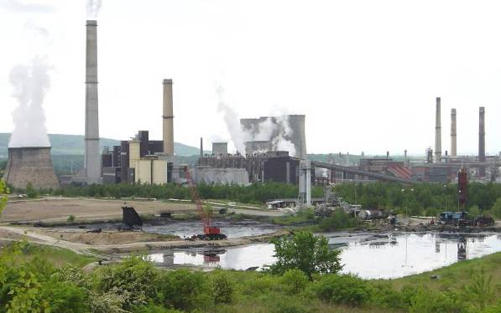
Remediation of Contaminated Sites
Complex and complicated process comprising of:
Preparatory activities (investigation, risk assessment, feasibility study, designing etc.)
Implementation of suitable remediation measures
Post-remedial activities (monitoring etc.)

Slide 2
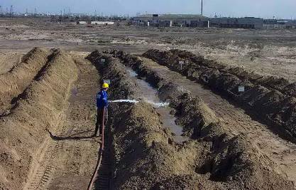
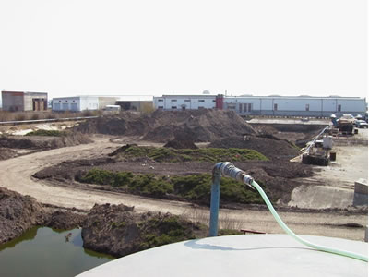
Possibilities of contaminated soil remediation
„Ex situ“ methods:
Contaminated soil (or waste) is removed from the site and transported for subsequent treatment or disposal to a permitted facility (landfill, bioremediation plant etc.)
„In situ“ methods:
The level of soil pollution is reduced down to the acceptable concentration limits by application of a suitable process (physical, chemical or biological) without excavation of the contaminated soil.

Slide 3
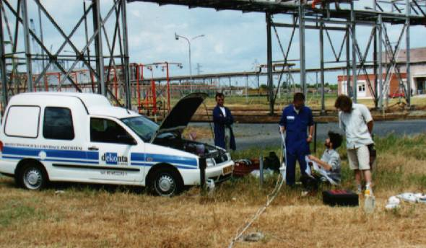
Possibilities of contaminated groundwater remediation
A. Pump-and-treat“ methods:
Contaminated groundwater is extracted from suitably situated wells, treated and subsequently discharged or infiltrated.
B. Chemical oxidation - oxidizing agents injected to
contaminated soil are chemically destructing present organic pollution.
C. Other methods for groundwater remediation:
„In situ“ bioremediation
Air sparging, Bio-slurping
Biological reductive dechlorination
Application of nanoparticles
Enhanced natural attenuation
Notes:
The following methods are applied by DEKONTA for treatment of extracted groundwater:
􀂃 Gravity separation
􀂃 Air (or steam) stripping
􀂃 Sorption
􀂃 Coagulation
􀂃 Flocculation
􀂃 Neutralization
􀂃 Chemical oxidation
􀂃 Chemical reduction
􀂃 Biological treatment
􀂃 Reverse osmosis

Slide 4
Methods eliminating migration of contaminants
based on installation of barriers eliminating migration of contaminants from polluted area to surrounding environment. Contaminants are not actively removed from the place of their occurrence.
The following methods are applied:
Installation of insulation capping systems over old landfill sites etc.
Installation of underground sealing wells around contaminated areas
Operation of hydraulic barriers
Installation of reactive barriers

Slide 5

Dekuji za pozornost
For information about baseline report legislation and guidance contact mpribylova@seznam.cz
For more information about site remediation see www.dekonta.cz

