Slide 1
AIR QUALITY GOVERNANCE AND CLIMA EAST: OPPORTUNITIES FOR COOPERATION
Dr. Mikhail Kozeltsev, Key Expert
24 April 2014, Batumi, 4th Workshop IPPC and Permitting System

Slide 2

Issues for discussion
  Air quality policy vs climate change mitigation:
    Mutual benefits and conflicts
  Why are we looking for interrelations between the two projects?
    Clima East would appreciate evaluation of mitigation impacts of AQG project recommendations on environmental technologies and policy solutions on a country basis

Slide 3
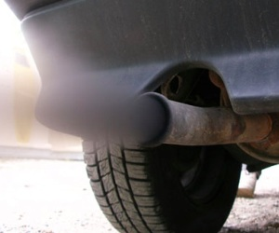

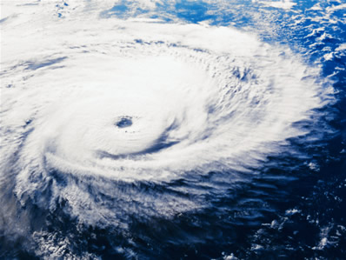
Environmental and Climate Policies: differences
Global vs local physical impacts, mostly
Pollutants:
  Air quality and harmful health impacts
Greenhouse gases:
  Global warming
  But there are exceptions. Some GHGs are considered as pollutants, e.g. methane

Slide 4
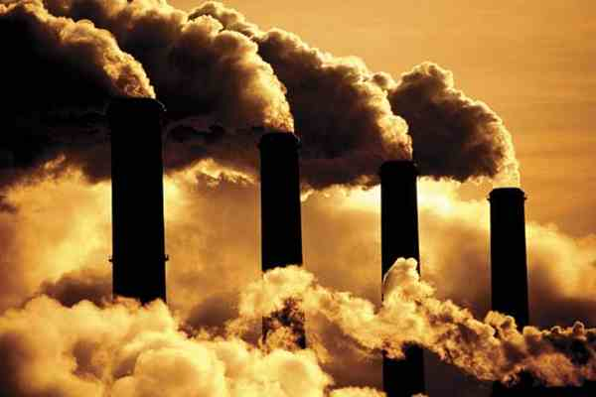
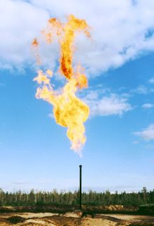
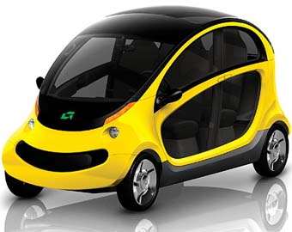
Environmental and Climate Policies: inter-linkages
Examples of policy options:
  Energy efficiency improvements:
  less CO2 emission, better air quality in urban areas
  Utilization of associated petroleum gas:
  less methane and CO2 emission, less local pollution
  Transport – hybrid engines or gas-fuelled:
  less CO2 emission, less NOx, soot, CO and health risks

Slide 5
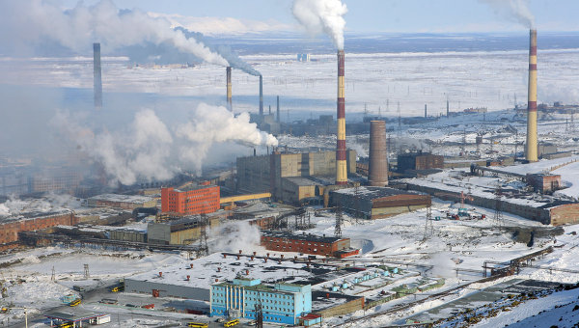
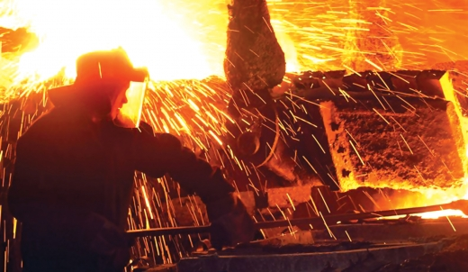
Environmental and Climate Policies: conflicts
  Norilsk Nikel Case:
  Massive reduction of SOx emissions may lead to sharp growth of CO2 emissions
  $5 billion project on high temperature combustion of SOx with huge fossil fuel use and extra CO2 emissions

Slide 6
Co-benefits of mitigation policy
Reduction of GHG emissions and associated decline of pollution, human health risks, etc.
In Russia, active mitigation policy (prevention of coal use doubling) may lead to reduction of 40,000 premature deaths per year*
Co-benefits of CO2 emission reduction confirmed by numerous health risk assessment studies in Russian cities
* Climate Change: the Look from Russia, 2003
6

Slide 7
EU climate and air quality: convergences
EU energy-climate policy goals:
  ~80% reduction of GHG emissions by 2050 compared to 1990
  Halve imports of oil and gas compared to today
  Saving € 400 billion of EU oil and gas import bill in 2050, equivalent to > 3% of today’s GDP
Air quality and health benefits: € 27 billion in 2030 and € 88 billion in 2050
7

Slide 8
EU 2050 Low carbon economy roadmap
Coordinated analytical framework (Europe 2020 Resource efficient Europe flagship initiative)
Framework also used for sectoral initiatives, e.g.
  Transport 2050 White Paper
  Energy Roadmap 2050
Based on extensive economy-wide global and EU level model-based scenario analysis, including
co-benefit analysis
8
Notes:
With its Roadmap for moving to a competitive low-carbon economy in 2050, the European Commission has looked beyond these short-term objectives and set out a cost-effective pathway for achieving much deeper emission cuts by the middle of the century. All major economies will need to make deep emission reductions if global warming is to be held below 2°C compared to the temperature in pre-industrial times.
The Roadmap is one of the long-term policy plans put forward under the Resource Efficient Europe flagship initiative intended to put the EU on course to using resources in a sustainable way.
The Roadmap suggests that, by 2050, the EU should cut its emissions to 80% below 1990 levels through domestic reductions alone. It sets out milestones which form a cost-effective pathway to this goal - reductions of the order of 40% by 2030 and 60% by 2040. It also shows how the main sectors responsible for Europe's emissions - power generation, industry, transport, buildings and construction, as well as agriculture - can make the transition to a low-carbon economy most cost-effectively.
Towards a low-carbon society
In a low-carbon society we will live and work in low-energy, low-emission buildings with intelligent heating and cooling systems. We will drive electric and hybrid cars and live in cleaner cities with less air pollution and better public transport.
Many of these technologies exist today but need to be developed further. Besides cutting the vast majority of its emissions, Europe could also reduce its use of key resources like oil and gas, raw materials, land and water.
Innovation, green growth & jobs
The transition to a low-carbon society would boost Europe's economy thanks to increased innovation and investment in clean technologies and low- or zero-carbon energy.
A low-carbon economy would have a much greater need for renewable sources of energy, energy-efficient building materials, hybrid and electric cars, 'smart grid' equipment, low-carbon power generation and carbon capture and storage technologies.
To make the transition the EU would need to invest an additional €270 billion or 1.5% of its GDP annually, on average, over the next four decades. The extra investment would take Europe back to the investment levels seen before the economic crisis, and would spur growth within a wide range of manufacturing sectors and environmental services.
Up to 1.5 million additional jobs could be created by 2020 if governments used revenues from CO2 taxes and from auctioning of emission allowances to reduce labour costs.
Saving energy and resources
Energy efficiency will be a key driver of the transition. By moving to a low-carbon society, the EU could be using around 30% less energy in 2050 than in 2005. Households and businesses would enjoy more secure and efficient energy services.
More locally produced energy would be used, mostly from renewable sources. As a result, the EU would be less dependent on expensive imports of oil and gas and less vulnerable to increases in oil prices. On average, the EU could save € 175-320 billion annually in fuel costs over the next 40 years.
Cleaner air
Greater use of clean technologies and electric cars will drastically reduce air pollution in European cities. Fewer people would suffer from asthma and other respiratory diseases; considerably less money would need to be spent on health care and on equipment to control air pollution. By 2050, the EU could save up to €88 billion a year in these areas.

Slide 9
Welcomed AQG project’s inputs for Clima East
Evaluation of carbon “footprint” of AQG recommendations for BAT improvements in selected industries and transport country-by-country
Assessment of climate change mitigation policy implications of AQG proposals on regulatory policy improvements
9
Notes:
With its Roadmap for moving to a competitive low-carbon economy in 2050, the European Commission has looked beyond these short-term objectives and set out a cost-effective pathway for achieving much deeper emission cuts by the middle of the century. All major economies will need to make deep emission reductions if global warming is to be held below 2°C compared to the temperature in pre-industrial times.
The Roadmap is one of the long-term policy plans put forward under the Resource Efficient Europe flagship initiative intended to put the EU on course to using resources in a sustainable way.
The Roadmap suggests that, by 2050, the EU should cut its emissions to 80% below 1990 levels through domestic reductions alone. It sets out milestones which form a cost-effective pathway to this goal - reductions of the order of 40% by 2030 and 60% by 2040. It also shows how the main sectors responsible for Europe's emissions - power generation, industry, transport, buildings and construction, as well as agriculture - can make the transition to a low-carbon economy most cost-effectively.
Towards a low-carbon society
In a low-carbon society we will live and work in low-energy, low-emission buildings with intelligent heating and cooling systems. We will drive electric and hybrid cars and live in cleaner cities with less air pollution and better public transport.
Many of these technologies exist today but need to be developed further. Besides cutting the vast majority of its emissions, Europe could also reduce its use of key resources like oil and gas, raw materials, land and water.
Innovation, green growth & jobs
The transition to a low-carbon society would boost Europe's economy thanks to increased innovation and investment in clean technologies and low- or zero-carbon energy.
A low-carbon economy would have a much greater need for renewable sources of energy, energy-efficient building materials, hybrid and electric cars, 'smart grid' equipment, low-carbon power generation and carbon capture and storage technologies.
To make the transition the EU would need to invest an additional €270 billion or 1.5% of its GDP annually, on average, over the next four decades. The extra investment would take Europe back to the investment levels seen before the economic crisis, and would spur growth within a wide range of manufacturing sectors and environmental services.
Up to 1.5 million additional jobs could be created by 2020 if governments used revenues from CO2 taxes and from auctioning of emission allowances to reduce labour costs.
Saving energy and resources
Energy efficiency will be a key driver of the transition. By moving to a low-carbon society, the EU could be using around 30% less energy in 2050 than in 2005. Households and businesses would enjoy more secure and efficient energy services.
More locally produced energy would be used, mostly from renewable sources. As a result, the EU would be less dependent on expensive imports of oil and gas and less vulnerable to increases in oil prices. On average, the EU could save € 175-320 billion annually in fuel costs over the next 40 years.
Cleaner air
Greater use of clean technologies and electric cars will drastically reduce air pollution in European cities. Fewer people would suffer from asthma and other respiratory diseases; considerably less money would need to be spent on health care and on equipment to control air pollution. By 2050, the EU could save up to €88 billion a year in these areas.

Slide 10
Further steps
  Obvious inter-linkages between our projects
  Need for consideration of mutual interpenetration:
    Climate change mitigation policies and environmental and technological policies
  Proposal:
    Joint workshop for discussion of the projects’ adjacent areas and impacts

Slide 11
How to contact us
info@climaeast.eu
Clima East Office
c/o Milieu Ltd
Rue Blanche n 15
1050 Brussels, Belgium
Project website (English and Russian):
www.climaeast.eu

