Slide 1
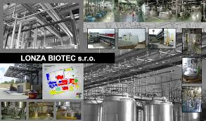
Experience with Integrated Inspection and IP revision in CR
Monika Přibylová

Slide 2
Lonza Biotec
Biochemical substances production for pharmaceutical and cosmetic industry
Established in 1992 on in former botechnology research institure
2002 – expansion and modernisation – EIA, IPPC
Main installations with env. impact:
fermentors,
boilers for steam production,
waste water treatment plant
Storage of chemicals

Slide 3
IP history
1st IP issued in 2003 – 14 pages of conditions
Till now 6 modifications of IP (intensification of WWTP, additional processes, modification of chemical storage,…)
Integrated environmental inspection 1x3 years
Last integrated inspection in 9/2013 (water, air, waste inspectors on site)

Slide 4

Result of inspection
Inspection protocol – revision of compliance of all IP conditions
No breach of compliance
About 1/3 of conditions is not relevant any more – in some case inspectors proposed to delete or modify the condiotions
Protocol sent only to the operator
„It is recommended to modify this condition!“

Slide 5
Application for 7. IP change
Recategorisation of air pollution sources + new conditions according to new air law,
Deleting some air emission sources from the permit as they have not been installed
Inclusion of 2nd emergency energy source (diesel engine)
Additional monitoring requirements due to the baseline report
Update of operation rules for air pollution sources
Deleting or modification of conditions which are not relevent according to recommendations listed in the inspection protocol

