Slide 1



Emission of pollutants into the atmosphere
Katarina Mareckova
ETC ACM , Umveltbundesamt
24 Sept 2012, Chisinau
ENPI workshop

Slide 2
Content
Introduction
What is NIS and why we need it
Estimation and reporting of emissions
Status of reporting in EECCA

Slide 3
What is National Inventory System (NIS)
A national inventory system incorporates all the elements necessary
  to estimate,
  report
  and archive emissions (and sinks), i.e.
Legal arrangements
Institutional arrangements
Procedural arrangements
High quality inventory that meets needs of policy-makers, researchers and public
Notes:
An NIS is a written account of all arrangements that are needed for preparing and maintaining the inventory. The NIS addresses which institutions (or individuals) do what, what legal systems (formal commitments) need to be in place, and how the inventory preparation should proceed, not just once, but also in following years. The key word is “sustainable.”
The definition of “making arrangements” is preparation or planning. For Parties that have not prepared a comprehensive and sustainable inventory, the NIS would be a detailed and written plan. For Parties that have a sustainable inventory system in place, the NIS would be a detailed and written account of what is now in place and how it needs to be maintained.
NIS is defined in Article 5, par.1, Kyoto Protocol and described in FCCC/CP/2001/13/Add. 3

Slide 4
Institutional and procedural arrangements
Data providers (StatOff, Industies, …
Cooperating institutions
Leading institution
Team coordinator
Universities
Consultants
Sectoral experts
QA/QC manager
DB manager
Research inst.
Strategy / workplan in place
QA/QC plan developed
Documentation and Archiving system in place
Reporting system in place
Notes:
defining tLegal entity: main coordinator/project manager identified
Team of experts with delegated responsibilities established
Cooperating institutions identified and involved in the system (contracts, memorandum of understanding, etc.)
Work plan / Strategy in place
Archiving system established
QA/QC plan developed/implemented
Reporting system in place
he responsibilities e.g. legal entity responsible for (annual /regular) compilation /reporting of GHG

Slide 5
Legal arrangements
(Act , decree,…)
Ensures resources
Ensures access to inventory data for inventory compilers
Establish system for collecting the data
Define responsibilities (legal entity)
Notes:
Legislation in place (Act, Decree,….)
defining the responsibilities e.g. legal entity responsible for (annual /regular) compilation /reporting of GHG inventories
ensuring resources
establishing system collecting the data required for inventory (e.g. National statistical office, Ministries,… )
providing access to the data for inventory compilers

Slide 6

Inventory process, Inventory cycle
Assessment of current status
Develop improvement strategy
Inventory Planning
High quality inventory that meets needs of policy-makers, researchers and public
Inventory Management
Inventory Preparation
Notes:
An NIS is a written account of all arrangements that are needed for preparing and maintaining the inventory. The NIS addresses which institutions (or individuals) do what, what legal systems (formal commitments) need to be in place, and how the inventory preparation should proceed, not just once, but also in following years. The key word is “sustainable.”
The definition of “making arrangements” is preparation or planning. For Parties that have not prepared a comprehensive and sustainable inventory, the NIS would be a detailed and written plan. For Parties that have a sustainable inventory system in place, the NIS would be a detailed and written account of what is now in place and how it needs to be maintained.
NIS is defined in Article 5, par.1, Kyoto Protocol and described in FCCC/CP/2001/13/Add. 3

Slide 7
What is an emission, emission source
Releases to air occurring by anthropogenic activities (combustions of fuels, agriculture activities, mining, industrial processes, leakages from equipment's, pipelines…)
Natural emissions (volcano eruptions, forest fires, releases from soil, vegetation,..
Type of source
  Point sources
  Area sources
  Linear sources
  (diffuse emissions)

Slide 8

Emission estimation
Direct measurements of emissions e.g. from chimney measurements , biogas measurements from landfills, etc…
Estimation by calculation
  Emission factor (mass pollutant per unit activity)
  Activity data
Inverse modeling (e.g. based on air quality measurements)

Slide 9
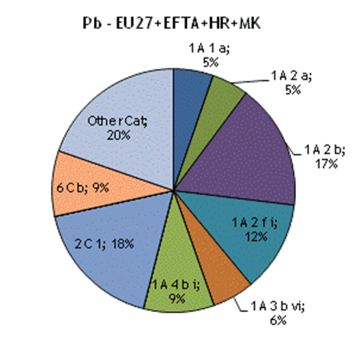
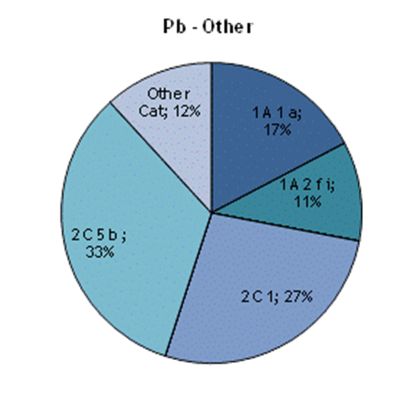
Concept of Key categories
(80% to national total)
1A1a Public Electricity and Heat Production”,
“1A fi Stationary Combustion in Manufacturing industries and Construction: Other”
“2C1 Iron and Steel Production”.
1A2b Stationary Combustion in Manufacturing Industries and Construction: Non-ferrous Metals
1A4bi Residential: Stationary plants

Slide 10
Existing reporting formats http://www.ceip.at/reporting-instructions/annexes-to-the-reporting-guidelines/
NFR09 sectors, categories
(E-PRTR activities, UNFCCC CRF categories,…)

Slide 11
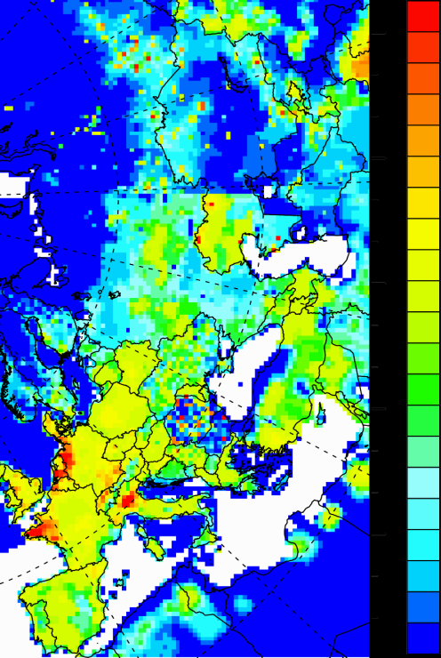
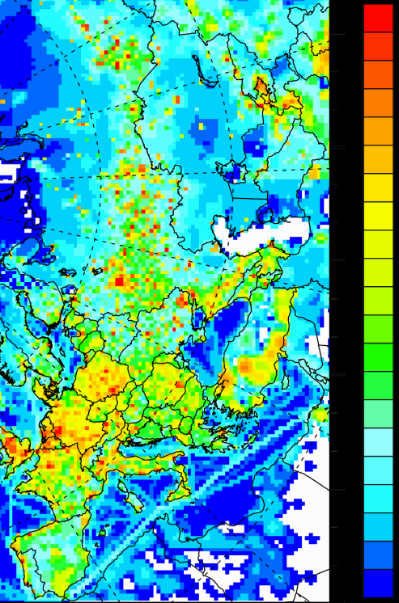
Spatial distribution of emissions
SOx
NH3

Slide 12
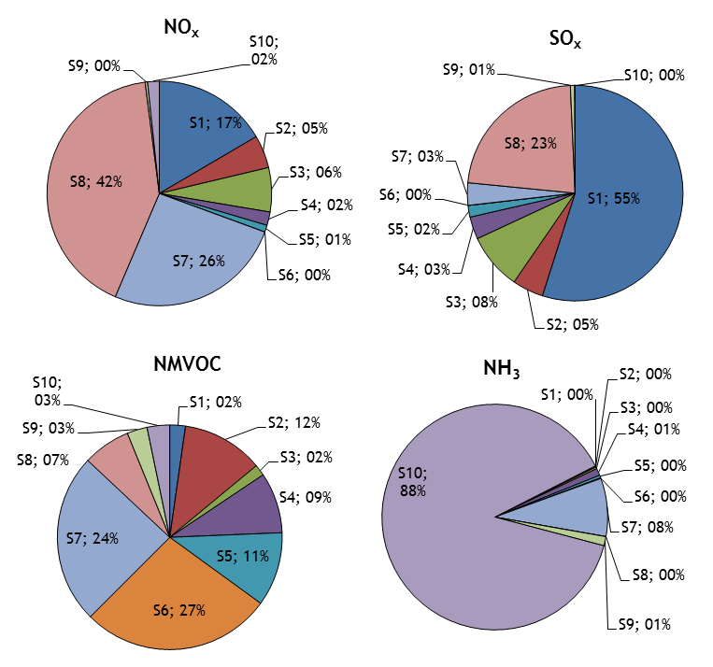
Gridded emissions - Contribution of SNAP (GNFR) sectors to total emissions
S1- Combustion in energy and transformation industries,
S2-Non-industrial combustion plants,
S3-Combustion in manufacturing industry,
S4-Production processes,
S5-Extraction and distribution of fossil fuels and geothermal energy
S6-Solvent use and other product use,
S7-Road transport
S8-Other mobile sources and machinery,
S9-Waste treatment and disposal
S10-Agriculture

Slide 13
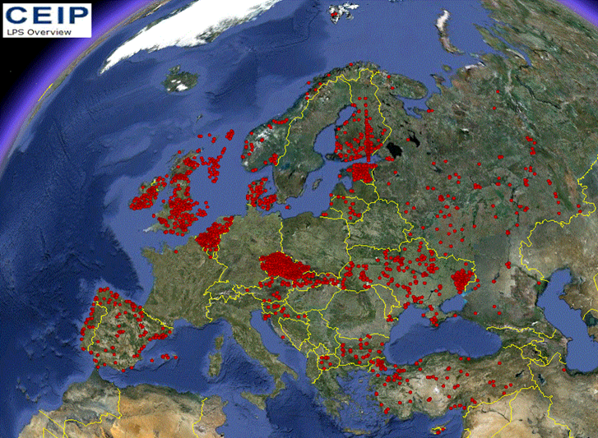
Reporting of LPS

Slide 14
Quality parameters of emission inventory
Quality control
T TCCCA
Timeliness
Transparency
Consistency
Comparability
Completeness and
Accuracy
Review process of emissions inventories is established under all Conventions and protocols
  Automated tests on imported of the data
  Semi-automated tests on completeness, consistency
  In-depth review of methods, EF and AD, documentation

Slide 15
Review process under CLRTAP/EEA – T TCCCA
Methods and procedures for the technical review of air pollutant emission inventories reported under the Convention and its protocols (Review Guidelines EB.AIR/GE.1/2007/16)
  Stage 1 - automated tests, Country reports posted on the web during March
  Stage 2 - S&A country reports posted in May
  http://www.ceip.at/review-results/review-results-2012/
  Stage 3 – Centralised in - depth review of selected inventories
Summary of S1 and S2 findings:
In CEIP/EEA technical report Inventory review 2012 http://webdab1.umweltbundesamt.at/download/Reports/2012/InventoryReport2012_forWeb.pdf
Notes:
Timeliness, Transparency consistency, comparability , completeness and accuracy

Slide 16
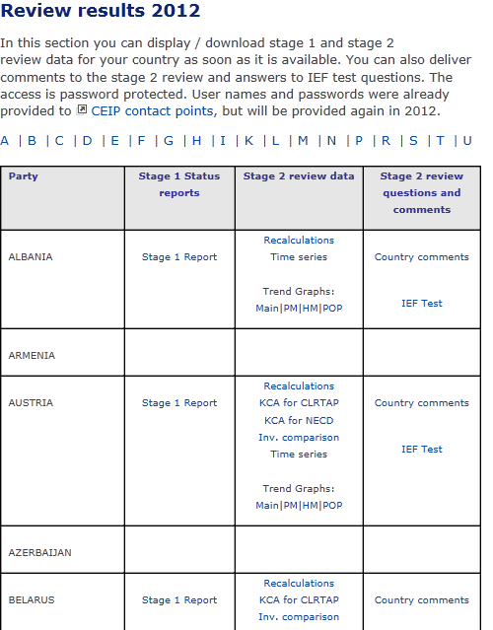
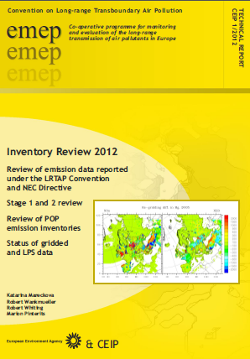
Review results S1 – S2
http://www.ceip.at/review-results/review-results-2012/
EEA & CEIP report Inventory Review 2012

Slide 17
Stage 3 in-depth centralized review
Centralized review is review of quantitative and qualitative information of selected inventories by pollutant, country or sector
Joint activity of EMEP/CEIP , EEA and Parties
The work plan is (annually) approved by the EMEP EB
  CEIP
    Coordination of the whole process
    Technical support of ERT
    Communication with Parties
    Publication of final reports
  CEIP/TFEIP/EEA
    Guidance for reviewers, transcripts and templates for review reports
  http://www.ceip.at/review-of-inventories/centralised-review-stage-3/
Notes:
Invitations sent out by CEIP by 5 May

Slide 18
Stage 3 review - long term plan
2013 | Belgium, France , Latvia, Lithuania, Monaco, Norway, Poland, Portugal, Romania, Sweden
2014 | Bulgaria, Cyprus, Denmark, Finland, Hungary, Ireland, Italy, Kazakhstan, Russian Federation, Spain
2015 | Armenia, Azerbaijan, Belarus, Czech rep., Greece, Germany, Netherlands, Slovakia, Slovenia, and Ukraine
2016 | Bosnia and Hercegovina, Croatia, Estonia, Kyrgyzstan, Luxembourg, FYR of Macedonia, Republic of Moldova, Switzerland, United Kingdom and Turkey
2017 | Albania, Austria, Georgia*, EU, Iceland, Liechtenstein, Malta, Montenegro, Serbia

Slide 19
Assessemnt of IIRs
Transparency / user friendliness
Design
IIR Template
No. of pages
NIS/ Inst. arrangements
KCA
Completeness info.
Uncertainty info.
Trends explanation
Improvements
Methodology description
Recalculations expl.
Planned improvements
Documentation/ references
Projections
Gridded/ LPS
Reporting last 5 years
Reporting 1995-2012
Completeness of data in WebDab

Slide 20
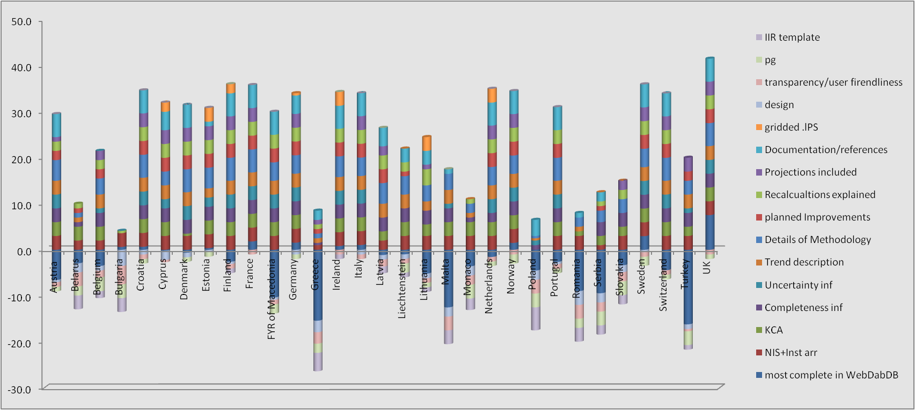
Assessement of IIRs

Slide 21
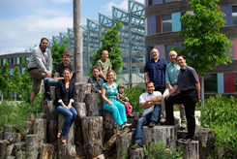

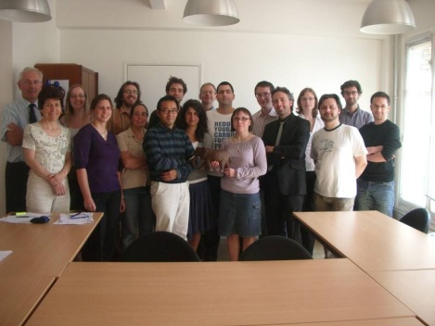

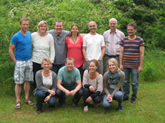

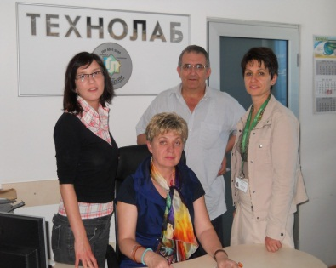
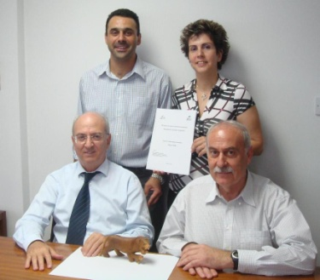
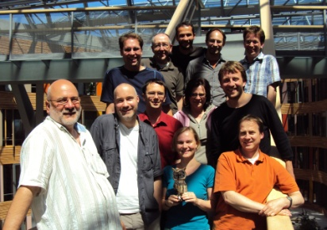
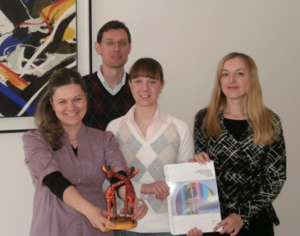
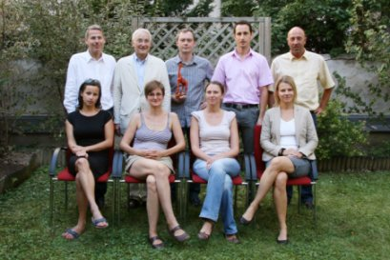
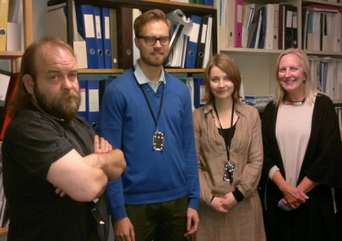
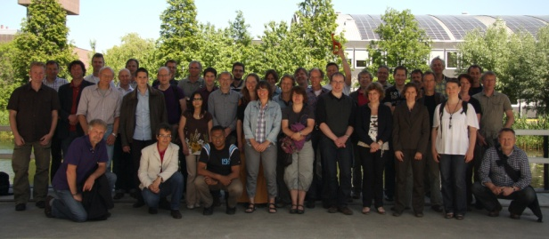
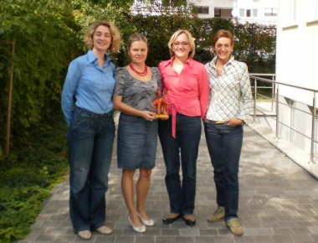
IIR AWARDS 2010-2012

Slide 22
Reporting of emissions, reporting obligation
LRTAP Convention (21 pollutants: acidifying, ozone precursors, PM, HMs, POPs); 51 Parties
  8 protocols
UNFCCC (GHGs: CO2, N2O, CH4, F-gases) 123 Parties
  Kyoto protocol
Montreal protocol – Ozone depleting pollutants
Aarhus Convention -
  E-PRTR protocol – industrial point sources – 91 pollutants
…….
EIONET framework (EEA) – annual priority data flows
Notes:
The European Environment Information and Observation network (EIONET) and EEA

Slide 23
Data flow
MS inventories
MS inventories
MS inventories
Parties to the CLRTAP
UNECE Secretariat
Notification forms
inventories
Country reports
testing
RepDab
Central DB
Status reports
EMEP SB
Eurostat
EMEP EB
Gridded data
Surrogate data
review
UNFCCC
CRF
modelers
EEA, ETC ACC

Slide 24
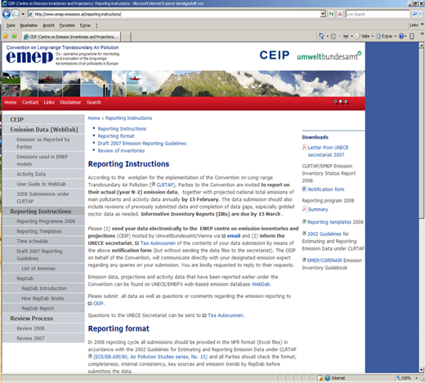
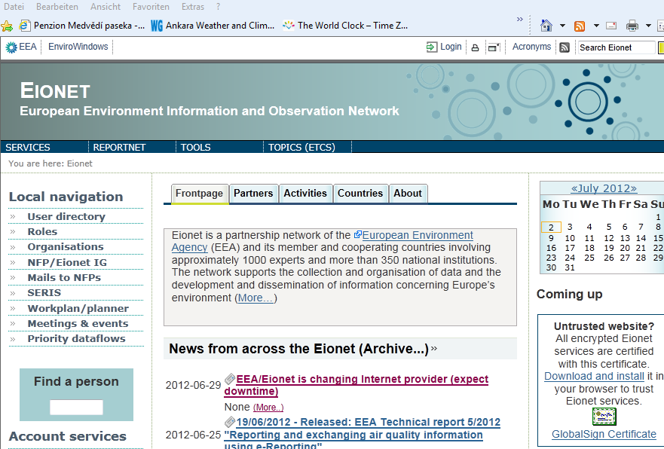
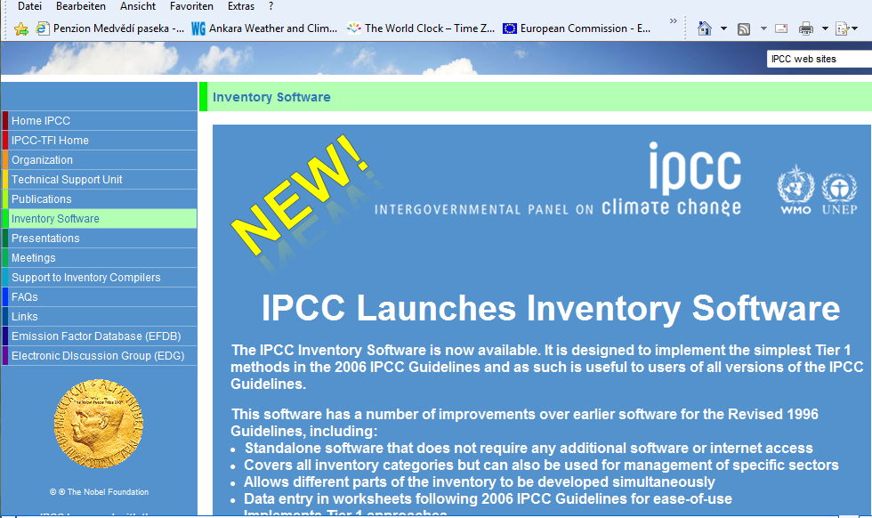
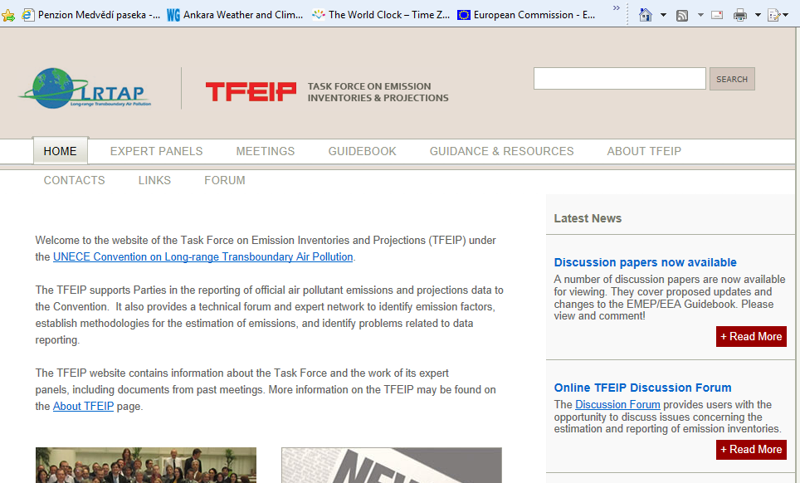
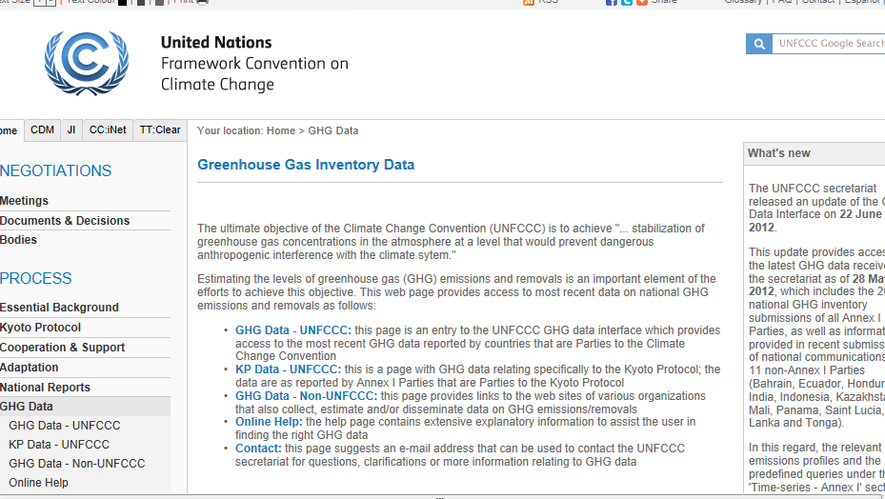
Resources for emission inventory compilers:

Slide 25


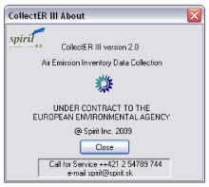

Existing Guidance, Guidebooks and Tools
EMEP/ EEA Inventory Guidebook EN and RU
http://www.eea.europa.eu/publications/emep-eea-emission-inventory-guidebook-2009
http://www.eea.europa.eu/publications-ru/emep-eea/
EMEP Emission Reporting Guidelines EN and RU
ECE/EB.AIR/97
http://www.ceip.at/fileadmin/inhalte/emep/reporting_2009/Rep_Guidelines_ECE_EB_AIR_97_e.pdf
Annexes to the Guidelines I to VI including:
  reporting formats (NFR09 tables)
  IIR template
CollectER emission inventory DB
COPERT road transport software

Slide 26

Completeness of data in CEIP DB
Status as of 1-09-2012
NFR09
NFR02
SNAP
National Total

Slide 27
Emission trends 1990-2012

Slide 28
Emission trends 1990-2012
Note: Azerbaian and Ukraine did not report.

Slide 29
Emission trends 1990-2012
Note:, Armenia, Azerbaian and Georgia, did not report.

Slide 30
Emission trends 1990-2012
Datapoint of Armenia in 2007 was 3476%
Note: Azerbaian and Georgia did not report.

Slide 31
Discussion items
How to improve quality of reported emissions
How to ensure /improve communication between data providers and inventory compilers
Where are the problems ?
  AD : accessibility, availability, completeness, confidentiality, …..
  EFs : applicability, uncertainty,….
  Tools: guidance, software, literature, database,..
  Legal barriers,…
  awareness of stakeholders (decision maker, data providers…)
What can we do?

