Slide 1
Air Emissions from Stationary Fuel Combustion
Training Workshop Moldova, Chisinau, Sept 2012

Slide 2
Content
Concepts and Methodology
Large point sources
General Methodologies (tier methods)
Simple example calculation
Experience
Appendix: Introduction to energy statistics

Slide 3
Key categories
Key categories are emissions sources which contribute to 80% of total national emissions
Trend assessment
Definition of category
Use of NFR sub-categories is sometimes too detailed
E.g. Road transport could be aggregated to one category (1.A.3.b)
Higher „Tier“ methods should be used for key categories

Slide 4
Allocation of emissions
Emissions are allocated to sources where the emissions occur
Emissions from electricity or district heat production are allocated to power plants (NFR 1 A 1 a) and not to end consumers (industry, households).

Slide 5
Characterization of emission sources
Diffuse sources (area sources)
Large point and diffuse sources
Methods from the EEA/EMEP Guidebook on Emission Inventories
Combination of point with diffuse sources

Slide 6
Diffuse sources
Area/diffuse sources are sources which include a lot of installations without knowledge of location, e.g.:
Residential combustion (heatings)
Commercial and Institutional combustion (heatings)
Transport and other mobile machinery
Small industrial boilers < 50 MW_{th}
Solvent and Product use
Agriculture
Other Fugitive (VOC and Particulates)

Slide 7
Large point sources (LPS) (1)
Large point sources are specified by their capacity and contribute to a high share of total national production capacity (up to 90%). Smaller sources are considered as diffuse sources.
Because the high local contribution the location (long/lat coordinates) and stack height (EMEP defines height classes up to >200 m) is needed by air quality models.
When dealing with point sources double counting must be avoided with area sources.
A lot of legislation (directives) exists which takes focus on LPS.
At national, federation or UN level
Very detailed and sometimes ‚tricky‘ in a technical way and sensitive because economic interests of well organized industries/industrial associations.
Legislation is not consistent but industries are interested in harmonisation.

Slide 8
Large point sources (LPS) (2)
Examples for detailed directives are the IPPC (integrated pollution prevention and control) and IED (industrial emissions directive) which provide capacity thresholds and emission limit values (ELVs), e.g.:
Powerplant or industrial boilers >= 50 MW_{th.}
Iron and steel, cement, lime, glass manufacturing plants which exceed a daily/yearly production threshold.
All oil refineries
Emissions of main pollutants (CO, NOX, SO2, Dust) are calculated by means of continuous measurements of flue gas concentrations (e.g mg NO₂/Nm3 flue gas)
Standards for measurement methods and calculation of emissions must be defined by legislation.

Slide 9
Large point sources (LPS) (3)
Verification (QA/QC) of reported emissions is needed
Capacity, fuel and process material input/output must always be collected together with emissions.
Calculation of implied emissions factor over time series and comparison with other plants, national studies or with guidebook or other countries is highly recommended but needs a lot of resources for inventory compilers including documentation and review (Inventory report).
A comparision of the reported concentrations with emission limit values (ELVs) from directives is recommended.

Slide 10
Methodologies for area sources
The EMEP/EEA air pollutant emission inventory guidebook (GB) provides different Tier methods.
Tier 1
Multiply statistical data with default emission factors from GB
High uncertainty
Dont‘use for key categories
Tier 2
Consider different technologies (e.g. boiler type, flue gas cleaning)
Optional: Use of country specific emission factors
Tier 3
Calculation models (e.g. transport model)

Slide 11
Tier 1 method
Use default emission factors from guidebook and multiply with activity rate. Emissions from a specific source, fuel, pollutant and year are calculated by formula:
E_{Source,Fuel,Pollutant,Year} = AR_{Source,Fuel,Year} x EF_{Source,Fuel,Pollutant}
E.....emissions [kg]
AR...activity rate =fuel consumption [TJ]
EF....emission factor [kg/TJ]
For fuel combustion activities the activity rate is always the fuel input.
Guidebook Tier 1 emissions factors are commonly not consider abatement technologies which may lead to overestimation of industrial sources.

Slide 12
Tier 2 method (1)
The tier 2 method needs fuel consumption by technology and emissions factors which are related to the technology.
E_{Source,Fuel,Pollutant,Year} =
∑_{Technology} (AR_{Source,Fuel,Technology,Year} x EFSource,Fuel,Technology,Pollutant)
For each technology the activity rate (AR) must be known (e.g fuel consumption, product input/output, deposited waste, number of animals)
Emission estimates are more accurate than using a Tier 1 method but data collection is more expensive.

Slide 13
Tier 2 method (2)
Technologies are mostly related to specific categories and fuels, e.g.:
Residential heating – solid biomass
Central heating
Fire places
Electricity production – natural gas
Gas boilers
Gas turbines
Technologies may consider primary or secondary abatement technologies, e.g.:
Low-NO_{X} burners (Primary)
Flue gas cleaning with average efficiency (Secondary)

Slide 14
Industries vs. Diffuse sources
 | Manufacturing and Energy Industries | Diffuse sources
Statistical numbers (units) | Tons or TJ of production, fuel consumption | Number of households, inhabitants, vehicles, animals, area (ha), tons of product use
International statistics | Industrial Associations (www), OECD, IEA | FAO, IEA
National authorities | Ministry of Economy, local authorities which alllow exceptions to ELVs | Ministries of Transport or Agriculture or Environment.
Other representatives | Industrial associations | Automobile club. Chamber of labour.

Slide 15
Process emissions
Doublecounting with process emissions should be avoided, especially for:
Cement clinker kilns
Lime kilns
Glass furnaces

Slide 16
Example – calculate SO₂ emissions
SO₂ emissions are in general estimated by using the Sulphur-content of a fuel.
The sulphur which remains in the ash must be subtracted
Fuel gas desulphurisation must be considered (usually large plants)
EF SO₂ = [S] x 20,000 / CVNet
EF SO₂ = SO₂ emission factor (g/GJ)
[S] = sulphur content of the fuel (% w/w)
CVNet = Net calorific value (GJ/tonne)

Slide 17
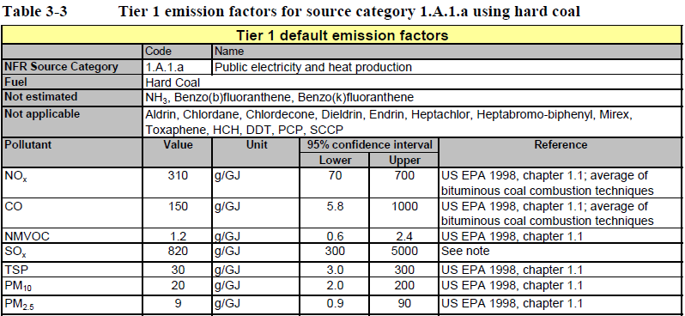
EMEP/EEA EI Guidebook (1)
Example for tier 1 emission factors (source: GB).

Slide 18
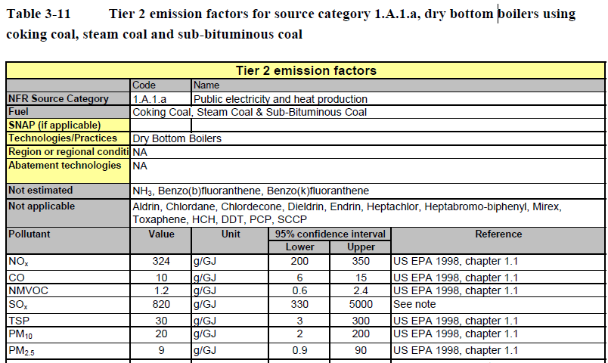
EMEP/EEA EI Guidebook (2)
Example for tier 2 emission factors (source: GB).

Slide 19
Tier 1 - Example
Calculate NO_{X} emissions (Gg) from hard coal combustion in residential heatings (NFR 1.A.4.b.i) for the year y.
From energy statistics we need
AR ...Activity rate =>Hard coal consumption (1000 t) for a specific year
NCV ...Heating value (MJ/kg) for a specific year
From the guidebook we need
EF_{NOX}...Tier 1 emission factor (g/GJ)
E_{NOX} = AR * NCV * EF_{NOX}
E_{NOX} = 10 000 kt * 28.5 MJ/kg * 110 g/GJ
E_{NOX} = 10*10⁶ t * 28.5 GJ/t * 110 g/GJ = 3.135*10¹⁰ g = 31.35 Gg NO_{X}

Slide 20
Austrian Experience
Tier 1 methods are (in general) not applied because „We know it better“.
Tier 2 methods are accepted but because the are applied for key sources (e.g. residential heatings ) there is a discussion about uncertainty.
Higher tier methods indicate higher work load in documentation and justification.
Models (Transport) are accepted but still suspicious because hard do follow (low transparency).
Industry: The integration or comparison of LCP, ETS and E-PRTR data with the inventory „works“.

Slide 21
Use of energy statistics - Units
In general energy statistics provides data in the unit of
Tons: solid and liquid fuels (coal, oil products, biomass)
1000 Nm3 or TJ: Gaseous fuels (natural gas)
International publications somestimes use ktoe (kilo tonne of oil equivalent).
1ktoe = 41,868 TJ
Unit conversion
All units should be converted to GJ or TJ NCV (Net calorific values).
To make energy carriers comparable.
For reporting of activity data.
Heating values: TJ/kt, TJ/Mio Nm3

Slide 22
Energy statistics (1)
All members of the International Energy Agency (IEA) have to report energy statistics at a yearly basis.
Energy statistics does not provide fuel combustion by technologies which is needed for Tier 2 methods.
For fuel combustion the following aggregates have to be considered:
Final energy consumption
Transformation input (avoid double counting !)
Own use of energy industries
The following aggregates are not considered to be combusted:
Non energy use (used for processes or used for products)
Statistical differences
Losses

Slide 23
Energy statistics (2)
When taking data from energy statistics double counting has to be avoided, especially for:
Coke ovens (coke production)
Transformation input = coking coal
Transformation output = coke + coke oven gas
Blast furnaces (iron production)
Transformation input = coke
Transformation output = blast furnace gas (used for energy recovery)
Oil Refineries
Transformation input = crude oil
Transformation output = oil products + refinery gas and other residuals

Slide 24
Energy statistics (3)
Energy statistics may be in conflict with other bottom up data which are collected by environment agencies such as:
Large combustion plants (LCP directive)
Emissions trading
E-PRTR
To avoid such conflicts it is good practice to exchange data with energy statistic institute.

Slide 25
Energy statistics (4)
For final consumption the IEA energy statistics shows enough details for all NFR fuel combustion sub categories to be reported, e.g, subcategories of 1.A.1, 1.A.2, 1.A.4
For transport 1.A.3 usually a model and other (vehicle, transport) statistics are used to estimate emissions for the different vehicle types.

Slide 26
EUROSTAT/IEA Joint Questionnaires (1)
Join Questionnaires (JQ) include time series from 1990 on.
One JQ for each of
Natural gas (in TJ on gross calorific basis) -> must be converted into net calorific value (NCV)
Oil (1000 t)
Coal (1000 t)
Electricity (GWh) and heat (TJ)
Renewables and waste (in TJ)
The structure is slightly different between the JQs.
Gas, oil and coal: JQs include net calorific heating values.
Consumption of industrial autoproducers is not reported by sector

Slide 27
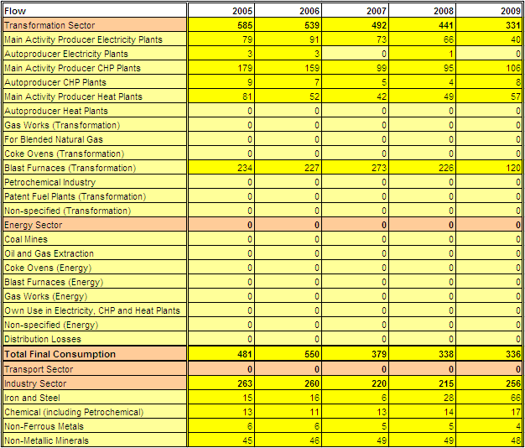
EUROSTAT/IEA Joint Questionnaires (2)
Example for residual fuel oil (1000 tons)

Slide 28
Contact & Information
Stephan Poupa
Stephan.poupa@umweltbundesamt.at
Umweltbundesamt www.umweltbundesamt.at
Training Workshop Chisinau, Sept. 2012

