Slide 1
Air Emissions from Diffuse sources (households)
Training Workshop Moldova, Chisinau, Sept 2012

Slide 2
Content
Overview of diffuse sources
Key source pollutants
Emission drivers
Measurements
Census data

Slide 3
Diffuse sources
Area/diffuse sources are mostly non industrial sources which include a lot of installations without knowledge of location, e.g.:
Residential combustion (heatings)
Commercial and Institutional combustion (heatings)
Transport and other mobile machinery
Small power plants/industrial boilers < 50 MW_{th}
Even a large number of smaller boilers will contribute less emissions to a source (power plants) than a few large boilers (> 300 MW_{th})
Solvent and Product use
Agriculture
Other Fugitive (VOC and Particulates)

Slide 4
Residential heatings are key source
Residential heatings have a major contribution to national total emissions in almost all countries.
Key source for a number of pollutants
CO₂
CO
VOC
NO_{X}
SO_{X}
Fine particulate matter (including black carbon/soot)
Heavy metals (coal)
POPs (Dioxins & Furans, polycyclic aromatic hydrocarbons)

Slide 5
Residential heatings – emission drivers (1)
Emissions drivers (just a list)
High fuel use due to heating demands (cold winters)
High heating demand of buildings (inappropriate insulation)
Low efficiency of heatings (incomplete combustion)
Inappropriate maintenance
Inappropriate (manual) operation
Incomplete combustion (poor technology)
Use of low cost technologies (stoves without certification, fires)

Slide 6
Residential heatings – emission drivers (2)
Emissions drivers
High age of boilers (simple boilers have a high life time)
Usage of biomass and brown coal (instead of natural gas or coal briquettes or low sulphur oil)
Illegal use of free available fuel (biomass/garden and municipal waste)
Backyard burning (‚tyre fires‘)
Not controlled by local authorities (especially biomass stoves)
High investment costs for new generation „low emission heatings“
Oversized capacity (kW) of heatings -> start/stop mode

Slide 7
Residential heatings – emission model (1)
Simpler Tier 2 models are needed to estimate emissions because detailed data will not become available due to high costs of data collection and measurements
Care has to be taken when using emission factors
Guidebook (Based on studies of other countries)
Real condition (field) measurements
Test bench measurements
High number of different technologies makes it difficult to find appropriate emission factors and yearly fuel input per technology.
Number of installations per technology continously changes
Use of boiler sales (hard to get)

Slide 8
Residential heatings – emission model (2)
Simpler Tier 2 models are needed to estimate emissions because detailed data will not become available due to high costs of data collection and measurements
Care has to be taken when using emission factors
Guidebook (Based on studies of other countries)
Real condition (field) measurements
Test bench measurements
High number of different technologies makes it difficult to find appropriate emission factors and yearly fuel input per technology.
Number of installations per technology continously changes
Use of boiler sales (hard to get)

Slide 9
Test Bench vs. Field Measurements
Test bench measurements are mostly performed under standard/optimal conditions to show that combustion is complete and emission limits are met:
Good fuel quality (e.g. low water content of log wood)
Good maintainance of heating (new equipment)
Ideal operation cycle (avoiding cold start emissions)
Ideal capacity utilisation
Sensor placement
Real condition measurements are expensive and the number of measurements are in general low. Different measure campaigns are not comparable
Different measurement standards (‚dilution tunnel‘)
Biased measurements (lets see what happens if…)

Slide 10
Emission factors
Different approaches used by countries (examples)
Guidebook
Austria: Measurement campaigns under real conditions for old heatings and test bench measurements for new gas and oil condensing boilers.
Germany: Combining field measurements with test bench measurements.
Validation of selected emission factors with other studies is highly recommended (QA/QC).

Slide 11
Census data
National census may be used to elaborate the different technologies applied in household heatings together with fuel consumption.
Collecting of census data is expensive and quality of reporting is questionable.
Face to face interviews are better than telephone interviews but much more expensive.
Adjustment of high outliers (high consumption is reported)
Biomass consumption has a rather high uncertainty because mostly not traded but self

Slide 12
Other sources for activity data
Additional data may be used for validation or adjustement of census data
Housing statistics
Heating degree days
Fuel sales (natural gas suppliers, total gas oil sales)
Boiler sales
Boiler statistics
Bottom up models
„ERNSTL“ from TU Vienna (used for scenario models and evaluation of measures)

Slide 13
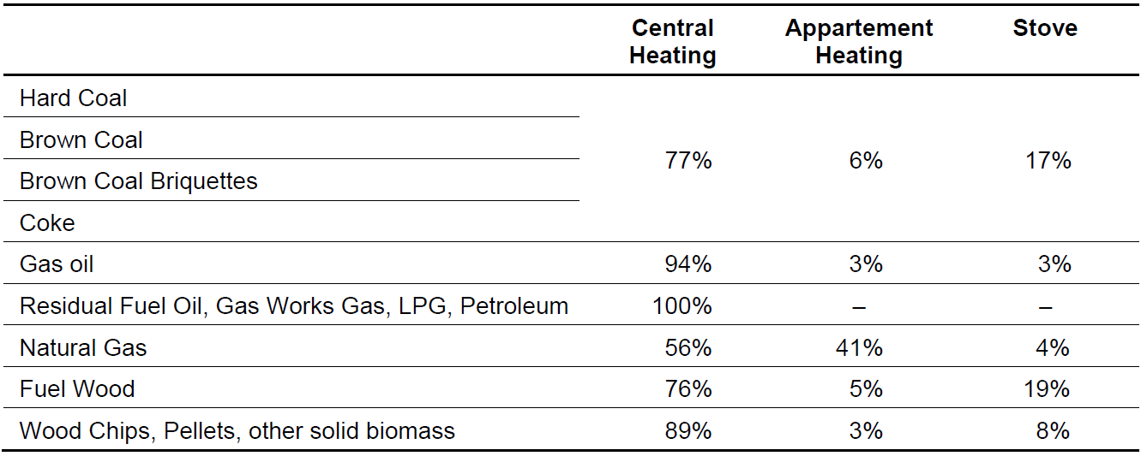
Census Data - Example Austria
Share of fuel consumption by type of heating in Austria 2010, derived from census data.

Slide 14
Contact & Information
Stephan Poupa
Stephan.poupa@umweltbundesamt.at
Umweltbundesamt www.umweltbundesamt.at
Training Workshop Chisinau, Sept. 2012

