Slide 1

COPERT 4 Training
3. Activity Data – Beginner’s Guide

Slide 2
Guide to a national inventory compilation - 1
A feasible approach…
Obtain fuel consumption from national statistics (fuel sold)
If derogation is in place: Estimate effects of tank tourism, black market, otherwise these are kept zero
From 1 and 2 estimate true consumption of road transport
Collect data on total fleet in operation per category
  National registers (cars, light trucks, heavy trucks, busses, motorcycles)
  Police (mopeds)
Collect data on vehicle distribution per fuel and sub-category
  National registers
  Data from countries with similar structure (data from the Fleets project)

Slide 3
Guide to a national inventory compilation - 2
If no statistical data exist, use age distributions to allocate vehicles to emission standards
    pre ECE vehicles up to 1971
    ECE 15 00 & 01 1972 to 1977
    ECE 15 02 1978 to 1980
    ECE 15 03 1981 to 1985
    ECE 15 04 1985 to 1992
    Euro 1 1992 to 1996
    Euro 2 1996 to 2000
    Euro 3 2000 to 2004
    Euro 4 2005 to 2010
  Use information on sales/new registrations
  Watch out for second-hand registrations
Obtain average min and max monthly temperatures for major cities and produce average. Data can be found on websites (e.g www.weatherbase.com) as well.
Estimate travelling speeds for urban areas (e.g. 25 km/h), rural areas (e.g. 60 km/h) and highways (e.g. 90 km/h). Estimation needs to be reasonable but not exact.

Slide 4
Guide to a national inventory compilation - 3
Estimate mileage shares in the three modes. The sum should make up 100%. Reasonable but not exact estimation is required.
Assume mileage values in the order of
  PCs: 11 – 15 Mm/year
  LDVs: 15 – 25 Mm/year
  HDVs: 50 – 80 Mm/year (national km only!)
  Busses: 50 – 70 Mm/year
  Mopeds: 2 – 5 Mm/year
  Motorycles: 4 – 8 Mm/year
  One could adjust mileage per age based on the ‘Fleets’ data
Perform COPERT run
Compare statistical with calculated fuel consumption per year
  Total fuel consumption
  Fuel consumption per fuel
Adjust mileage to equalize calculated with statistical values

Slide 5
Mileage as a function of age

Slide 6
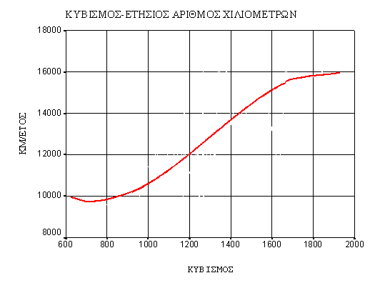
Mileage as a function of vehicle size (engine capacity)

Slide 7
How accurate should speed estimate be? - 1

Slide 8
How accurate should speed estimate be? - 2

Slide 9
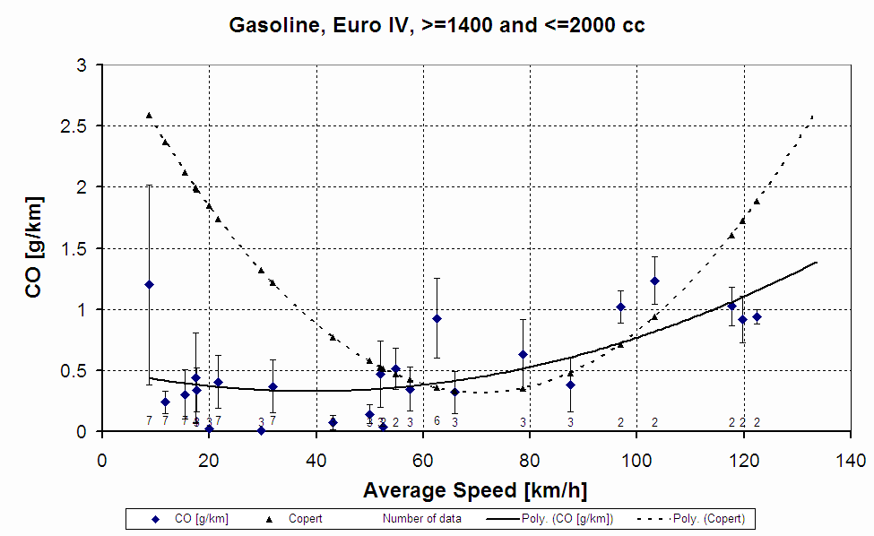
Typical Variability of Measured Data - CO

Slide 10
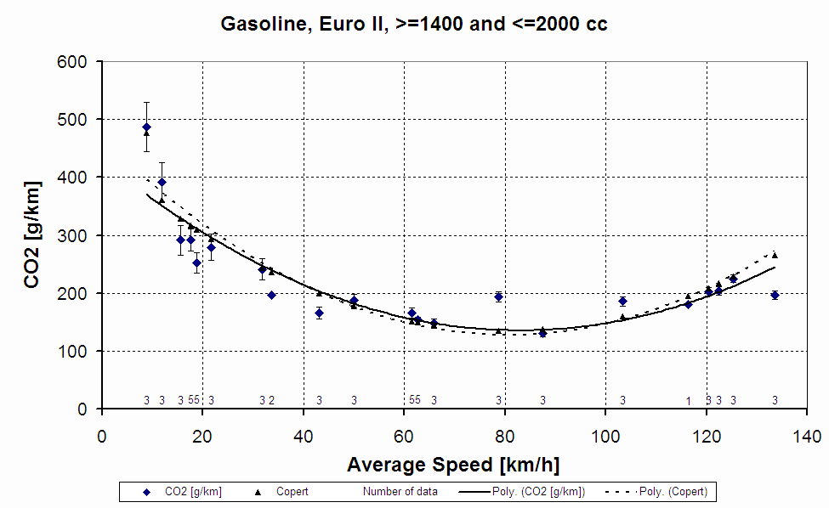
Typical Variability of Measured Data – CO₂

Slide 11
Trip distance
Required to calculate cold-start
  Short frequent trips increase over-emission due to cold start
What is a journey
  A driving sequence
What is a trip
  A driving sequence between a switch-on and switch-off event
    Work – grocery store – home: Two trips (one journey)
    Home – children drop-off – work: One trip

Slide 12
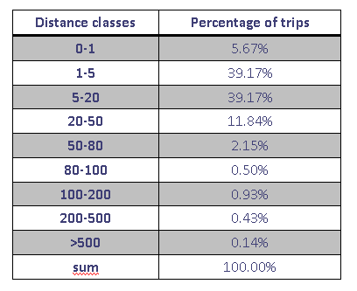
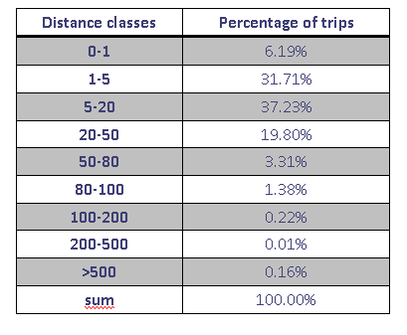
Typical trip distributions
France
Sweden

Slide 13
Importance of Input Variables
Parameter | Importance | Availability of statistics | Notes /Particular Issues
Total number of vehicles per class |  | ☺ | Question is the scooter and mopeds registration availability
Distinction of vehicles to fuel used |  | ☺ | Question is the availability of records for vehicles retrofitted for alternative fuel use
Distribution of cars/motorcycles to engine classes | ⇧ | 😐 | Not important for conventional pollutants, more important for CO2 emission estimates
Distribution of heavy duty vehicles to weight classes | ⇧ | 😐☹ | Vehicle size important both for conventional pollutant and CO2 emissions
Distinction of vehicles to technology level |  | 😐☹ | Imported, second-hand cars and scrappage rates are an issue
Annual mileage driven |  | 😐☹ | Can be estimated from total fuel consumption. The effect of mileage with age requires attention.
Urban driving speed | ⇧ | 😐 | Affects the emission factors
Rural, highway driving speeds |  | 😐 | Little affect the emission factors, within their expected range of variation
Mileage share in different driving modes |  | 😐☹ | Little affect emissions, within their expected range of variation

Slide 14
Detailed activity data – EU27
May be found at EMISIA website
Have been collected in the framework of the DG ENV ‘Fleets’ project
Up to 2005 in five year intervals
… a good starting point!

