Slide 1

COPERT 4 Training
4. NOx Emissions

Slide 2
Projected emission factors
Emission reductions for future vehicle technologies generally follow the rule:
Limitation:
  Real-world behaviour does not (always) follow emission standards

Slide 3
Learning from our past…

Slide 4
Runs executed (Germany)
Run 1: Original RAINS calculation
Run 2: COPERT 2 + RAINS Input
Run 3: COPERT 2 + EC4MACS Input
Run 4: COPERT 4 + RAINS Input
Run 5: COPERT 4 + EC4MACS Input

Slide 5
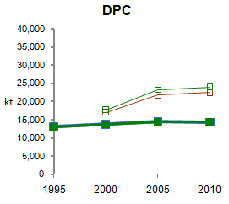
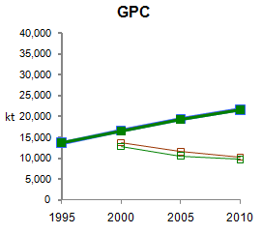
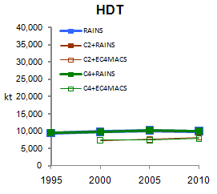
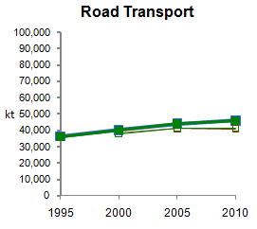
Fuel consumption - France

Slide 6
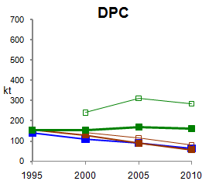
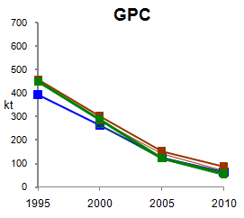
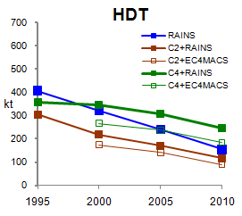
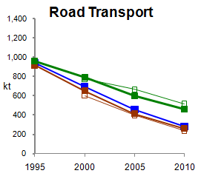
NO_{x} Emissions - France

Slide 7
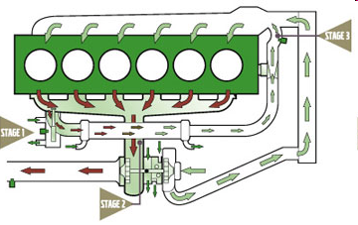
EGR Technology
Image taken from Volvo Trucks
Part of the exhaust is drawn through a bleed-off valve
This is cooled down in a heat exchanger
It is fed back to the intake air as an inert gas to absorb combustion heat, decrease T and decrease NOx concentration

Slide 8
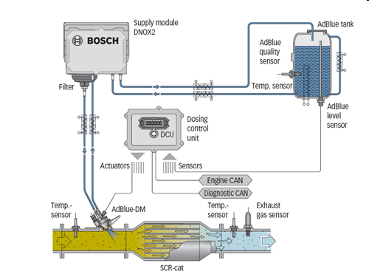
SCR Technology
Image taken from Bosch
Injection of urea (NH₂)₂CO upstream of a hydrolysis catalyst
Urea hydrolysis (NH₂)₂CO +H2O→2NH3 +CO₂
NOx reduction through ammonia to form N₂+H₂O

Slide 9
Heavy duty vehicles
Emission Level
EF over ES ratios
(Euro V over Euro IV)

Slide 10
How this is modelled with COPERT
Both EGR and SCR considered in COPERT for Euro V
The user needs to provide the %EGR for Euro V trucks
Calculation:
EF_{EUROV} = %EGR × EF_{EGR} + (100-EGR%) × EF_{SCR}
Remarks
  SCR is the dominant technology in the market (75% of sales)
  EGR in principle only selected by Scania, although Scania Euro V trucks with SCR have appeared
  Euro VI trucks will be all equipped with SCR. Large ones will be equipped with SCR+EGR
  No reliable Euro VI emission factors still in COPERT 4

Slide 11
EGR vs SCR penetration
Some values have been already filled in.
These values originate from market surveys and sales of Euro V trucks in 2008, 2009 and first quarter of 2010. These values therefore reflect our best knowledge for the year 2010.
The user may change these values if better information is available.
On the basis of the this analysis, the EGR ratio for 2008 was 26.6% and 24.6% for 2009.

Slide 12
Impact over previous version
Example: Austria
Max Effect 2015
HDTs: 15%
Road Transport: 7%
National Total: 3,8%

Slide 13
Light Duty Vehicles
Graph obtained by TUG (S. Hausberger) study
Euro 5 based on limited sample (7 cars)
Not yet included in COPERT 4

Slide 14
Impact on emission factors
Much larger impact expected than correction for HDVs!!!!

Slide 15
Summary
HDVs
  COPERT emission factors reliable up to Euro V
  Euro V trucks need EGR/SCR ratio for accurate prediction
  No indications yet on Euro VI trucks
LDVs
  COPERT emission factors reliable up to Euro 4
  Indications on Euro 5 diesel cars emitting much more NOx than expected
  Euro 5 car emission factors expected summer 2012
  First indications on demo Euro 6 show much better performance overall compared to Euro 5

