Slide 1
COPERT 4 Training
5. Exhaust and non-exhaust PM

Slide 2
COPERT 4 Training
5a. Exhaust PM

Slide 3
Exhaust particles
Total Particle Number (7 nm – 1 μm)
(negligible particle number above this range)
Integrated active surface concentration of total particle population
(7 nm – 1 μm)
Number of solid particles of three different size ranges
(value equivalent to PMP protocol)
  7 – 50 nm
  50 – 100 nm
  10 nm – 1 μm
Distinguished according to:
  Vehicle category
  Technology
  Aftertreatment
  Fuel
  Sulphur content (for non solid particles)

Slide 4
Examples of emission factors

Slide 5
Emission factors for solid particle number in the size ranges 7-50 nm, 50-100 nm and 100 nm-1 μm (aerodynamic diameter)

Slide 6
Definition of PM Speciation (OC/EC)
Elemental Carbon (EC): It appears in PM samples mainly as graphitic particles formed in combustion. It is determined by thermal optical methods where carbon is converted to CO2.
Black Carbon (BC): It corresponds to the light attenuation elements of carbon and it is determined by aethalometers. Black carbon is mainly EC. However, it also includes highly refractory elements of organic carbon (such as OCX2). Also, EC from different sources may exhibit different light absorption efficiencies, hence there is no global equivalence between BC and EC.
Organic Carbon (OC): It is the carbon desorbed when PM is heated at high temperature (i.e. 600-900°C) in inert atmosphere. Some of the organic species present in PM pyrolyse, instead of desorbing, and this falsely allocates them to EC instead of OC.
Organic Material (OM): It is the total mass of organic material (including the mass of hydrogen) that corresponds to the organic carbon. The organic mass corresponding to the organic carbon depends on the species profile. Usually, an empirical correction of ~1,2-1,4 is applied to OC to derive OM.

Slide 7
What is reported in COPERT
Elemental carbon (EC), where BC is considered identical to EC
Organic material (OM), i.e. 1.3 × OC.

Slide 8
Values used (excerpt)
In cases where advanced aftertreatment is used (such as catalysed DPFs) then the EC and OM does not sum up to 100%. The remaining fraction is assumed to be ash, nitrates, sulphates, water and ammonium, that can be a significant fraction of total PM.

Slide 9
COPERT 4 Training
5b. Non-Exhaust PM

Slide 10
General Methodology
Sources
  Tyre wear
  Brake wear
  Road surface wear
TEi,j = Nj ∙ Mj ∙ (EF)j ∙ fi ∙ S(V)
TE... Total Emissions [g]
N… Number of vehicles [veh.]
M… Mileage driven by “average” vehicle [km/veh.]
EF… TSP mass emission factor [g/km]
fi… Mass fraction attributed to particle size class i
S(V)… Correction factor for speed V (for road wear S(V)=1)
and indices,
i… TSP, PM₁₀, PM_{2.5}, PM₁ and PM_{0.1} size classes,
j… Vehicle category

Slide 11
Tyre wear rates

Slide 12
Tyre wear vs tyre PM emissions
Not all wear becomes airborne!
Particle size class (i) | Mass fraction (f_{T},_{i}) of TSP
TSP | 1.000
PM₁₀ | 0.600
PM_{2.5} | 0.420
PM₁ | 0.060
PM_{0.1} | 0.048

Slide 13
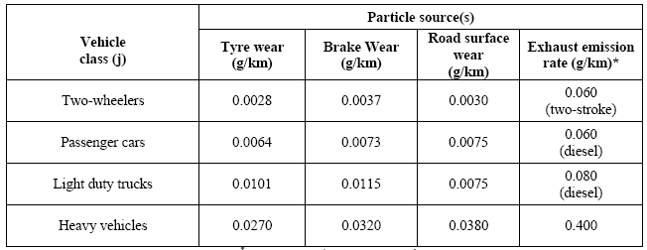
Example non-exhaust PM₁₀

Slide 14
A changing world…
2000 diesel car
  Exhaust PM_{2.5}: 50 mg/km
  Non-exhaust PM_{2.5}: 8 mg/km
  Non-exhaust/Exhaust: ~15%
2010 diesel car
  Exhaust PM_{2.5}: 1 mg/km
  Non-exhaust PM_{2.5}: 8 mg/km
  Non-exhaust/Exhaust: ~800%

