Slide 1

COPERT 4 Training
6. GHG Emissions

Slide 2
Methodology: Algorithm (Diesel)
Fuel Sold (t)
Fossil Diesel
VKT Travelled
Diesel Vehicles
Adjust
VKT
Biodiesel
B30 Busses
Equal fuel
mass?
Fuel Cons.
Factors (g/vkm)
R_{H:C,fossil}
R_{O:C,fossil}
CH₄, N₂O EFs
(Tier 3)
internal
equilibration
CO_{2, fossil}
CH₄, N₂O

Slide 3
Methodology: Tier Coverage
Legend:
NA
Not Available
IPCC Method Coverage by COPERT 4

Slide 4
Methodology: CO₂ Calculation
Calculation of ultimate CO₂ , i.e. all carbon in fuel oxidized to CO₂
Operates on the basis of g/km emission factors for consistency with other pollutants
R_{H:C}, R_{O:C} are the ratios of H to C and O to C atoms, respectively in the average fuel molecule

Slide 5
Internal CO₂ correction
Total CO_{2, fossil}
…
…
ΣCO_{2,calc}
CO2 - Diesel cars E1
CO2 - Diesel cars E2
CO2 - B30 Busses
Total CO_{2,fossil}
CF=
ΣCO_{2,calc}
ΣCO_{2,calc} ≡ Total CO_{2,fossil}

Slide 6
Emission Factors: CO₂

Slide 7
More Info: Petrol CO₂
COPERT higher than IPCC Default by ~5%
IPCC absolute value (69 kg/TJ) is low → designates use of oxygenates
European regulations (2009/30/EC) specify 3.7% wt. max oxygen in fuel, i.e. typical Petrol molecule: [CH_{1.8}O_{0.033}]_{x}
Assuming O reduces LHV by 3.3%, then EF_{CO2} cannot drop below 72 kg/TJ in Europe
Maybe IPCC value dominated by US standards?

Slide 8
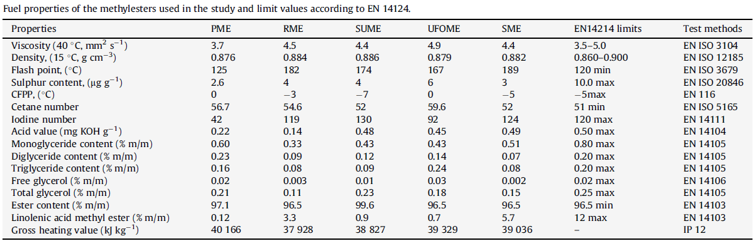
More Info: A closer look to biodiesel
IPCC NCVs
- 27 MJ/kg neat biodiesel (B100)
- 43 MJ/kg fossil diesel
Extract from Fontaras et al. Environ Pollut 158 (2010) 1451–1460:
Assuming methyl oleate (C₁₉H₃₆O₂) as the main ester and IPCC 2006 GL Box 1.1 (gross→net) conversion, the NCVs (MJ/kg) are:
Palm: 37.5, Rape: 37.3, Sunflower 36.2, Fr. Oil: 36.7, Soy: 36.4

Slide 9
Emission Factors: CH₄
Four values (mg/km) are provided: Cold Urban, Hot Urban, Rural, Highway
Data mostly based on ARTEMIS project (2000-2006), values differentiated per vehicle category, Euro standard
Cold/Hot urban part estimated on the basis of cold-start distance
Emission factors for new technologies based on extrapolation. Low CO₂ equivalent too weak to justify new measurements.

Slide 10
Emission Factors: N₂O
EF_{N2O} = (a×Cum.Mileage+b) × EF_{BASE}
  a, b, EF_{BASE} depend on technology level for gasoline PCs & LCVs
  a, b depend on fuel sulfur content
  Different factors for cold urban, hot urban, rural, highway
Much simpler approach for Diesel cars, HDVs and gasoline motorcycles
Note on failed SCR systems

Slide 11
Recent additions in AEIG/COPERT

Slide 12
New Fuels
Fuel (m) | Chemical formula | Ratio of hydrogen to carbon | Ratio of oxygen to carbon
Gasoline | [CH_{1.8}]_{x} | r_{H:C}=1.80 | r_{O:C}=0.0
Diesel | [CH₂]_{x} | r_{H:C}=2.00 | r_{O:C}=0.0
Ethanol | C₂H₅OH | r_{H:C}=3.00 | r_{O:C}=0.5
E5 | [CH_{1.8}]_{x} (95%) - C₂H₅OH (5%) | r_{H:C}=1.86 | r_{O:C}=0.025
E10 | [CH_{1.8}]_{x} (90%) - C₂H₅OH (10%) | r_{H:C}=1.92 | r_{O:C}=0.05
E85 | [CH_{1.8}]_{x} (15%) - C₂H₅OH (85%) | r_{H:C}=2.82 | r_{O:C}=0.43
ETBE | C₆H₁₄O | r_{H:C}=2.33 | r_{O:C}=0.17
Methanol | CH₃OH | r_{H:C}=4 | r_{O:C}=1
MTBE | C₅H₁₂O | r_{H:C}=2.4 | r_{O:C}=0.2
Natural Gas | CH₄ (95 %)- C₂H₆ (5 %) | r_{H:C}=3.90 | r_{O:C}=0.0
 | CH₄ (85 %)- C₂H₆ (15 %) | r_{H:C}=3.74 | r_{O:C}=0.0
LPG Fuel A | C₃H₈ (50 %)-C₄H₁₀ (50 %) | r_{H:C}=2.57 | r_{O:C}=0.0
LPG Fuel B | C₃H₈ (85 %)-C₄H₁₀ (15 %) | r_{H:C}=2.63 | r_{O:C}=0.0

Slide 13
Lube Oil Consumption
Category | Fuel/engine category | Age | kg/10.000 km
 |  |  | Mean | Min | Max
PC | Gasoline | Old | 1.45 | 0.85 | 2.13
 | Gasoline | New | 1.28 | 0.85 | 1.70
 | Diesel | Old | 1.49 | 0.85 | 2.13
 | Diesel | New | 1.28 | 0.43 | 2.13
LDV | Gasoline | Old | 1.45 | 0.85 | 2.13
 | Gasoline | New | 1.28 | 0.85 | 1.70
 | Diesel | Old | 1.49 | 0.85 | 2.13
 | Diesel | New | 1.28 | 0.43 | 2.13
Urban Buses | Diesel | Old | 8.50
 | Diesel | New | 0.85
Coaches | Diesel | Old | 1.91 | 1.70 | 2.13
 | Diesel | New | 1.70 | 1.28 | 2.13
HDV | Diesel | Any | 1.56
Mopeds | 2-stroke | Old | 10.20 | 6.80 | 13.60
 | 2-stroke | New | 6.80 | 5.10 | 8.50
Motorcycles | 4-stroke | Any | 0.43 |  | 0.85

Slide 14
Lube Oil Impact
Total contribution 0.2-0.3% for developed countries
Contribution potentially more important for developing countries

Slide 15
CO₂ from Urea Consumption
DIN 70070:
  specifies that urea should be in aqueous solution at a content of 32.5% wt (±0.7%) and a density of 1.09 g/cm3.
  If total commercial urea solution sales are known (UC in litres), then total ultimate CO2 emissions (in kg) are:
  If total urea is not known, this can be assumed 5-6% @ Euro V and 3-4% @ Euro VI of fuel consumption

Slide 16
SCR Urea impact on CO2
Notes:
All diesel vehicles assumed Euro 6/VI in 2020, require SCR agent ~ 6% of FC
CO₂ and consumption taken from PRIMES 2009 baseline

Slide 17
Export to CRF

Slide 18
Automatic XML-file creation
Automated procedure to export all years to CRF
CO₂ exported only on the basis of fossil fuel consumption
Biodiesel/Bioethanol CO₂ is set to 0
CH₄ and N₂O exports are proportional to fuel consumption, example:
CH_{4,XML,BIO,DIESEL} = CH_{4,COPERT} × FC_{BIO,DIESEL} / FC_{TOT,DIESEL}

