Slide 1
COPERT 4 Training
7. Advanced methodology elements

Slide 2
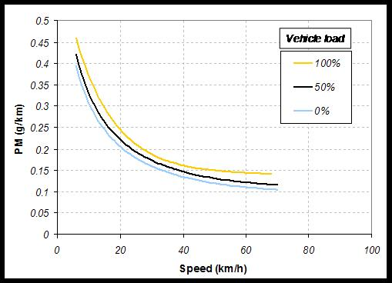
HDV Vehicle loading effects
Example: Urban bus midi <15t Euro 3
COPERT Default is 50% Loading

Slide 3
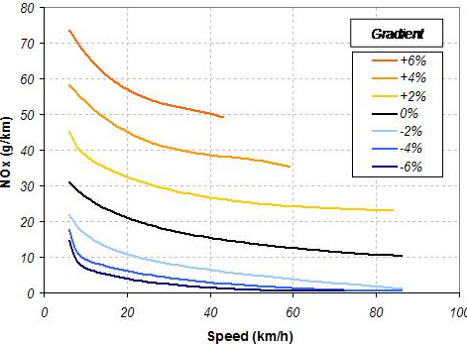
Slope (gradient) effect for HDVs
Example: Articulated truck 50-60t Euro 2

Slide 4
Number of axles in HDVs
Tyre wear for HDVs:
The user may determine the number of axles per HDV category

Slide 5
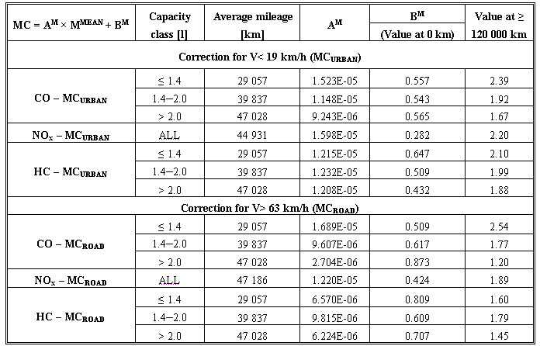
Emission degradation for PCs & LDVs
Input is ‘Cumulative’ mileage

Slide 6
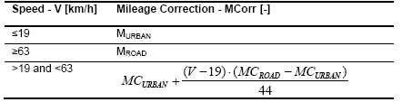
Application of mileage correction
Corrected HEF = Base HEF × MC

Slide 7
Cold start distance
E_{COLD} = bc · β · N · M · e_{HOT, BASE} · (e^{COLD}/e^{HOT}-1)
The user may change the bc value, depending on the technology level

