Slide 1
Air Quality Governance in the ENPI East Countries
Training on emission inventories
The EMEP/EEA Guidebook
Agriculture
11-12 December, 2013, Tbilisi, Georgia

Slide 2
Outline
Introduction to the Agriculture chapters
Emission shares
Methodological tiers
Basic data requirements
Guidance for new sources of emissions
Update of existing methodologies and default emission factors

Slide 3
Introduction to the Agriculture chapters
The agriculture sector consists of the following sources:
  3.B Manure management
  3.D Crop production and agricultural soils
  3.D.f, 3.I Agriculture other including use of pesticides
  3.F Field burning of agricultural wastes
There is not a complete link to the reporting categories in the NFR reporting tables

Slide 4
Emission shares – agriculture sector
The agriculture sector contributes little to the national emissions of many pollutants
However, for some pollutants the agriculture sector is very important or even the most important
Agriculture
< 1 % | SO_{x}, Cd, Hg, Pb, As, Cr, Cu, Ni, Se, Zn, PCDD/F, PCB
1- 5 % | NO_{x}, NMVOC, PM_{2.5}, CO
5-10 % | HCB
10-50 % | TSP, PM₁₀, PAH
> 50 % | NH₃

Slide 5
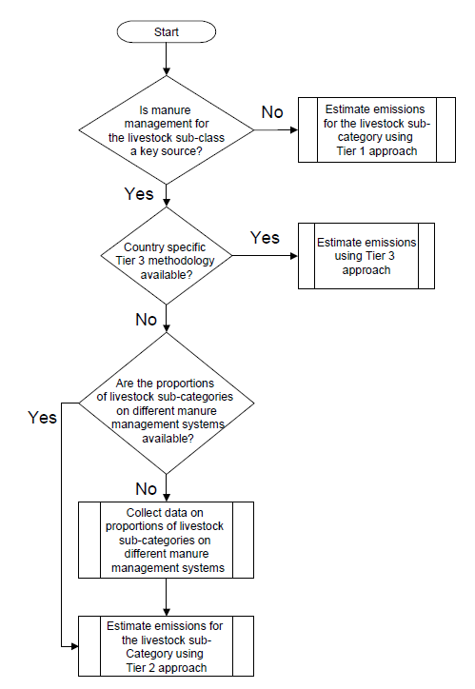
Methodological tiers
The GB provides guidance on the methodological Tier
For important animal types the Tier 2 methodology is good practice

Slide 6
Basic data requirements
Animal number
  Dairy cows (slurry and solid)
  Other cattle (slurry and solid)
  Fattening pigs (slurry and solid)
  Sows (slurry, solid and outdoors)
  Sheep & goats
  Horses, mules & asses
  Laying hens (slurry and solid)
  Broilers, ducks, geese & turkeys
  Fur animals
  Buffaloes
  Camels

Slide 7
Basic data requirements
Area of cultivated soils
Amount of synthetic fertiliser nitrogen applied to soils (mass)
Amount of biomass burned on the fields (mass of dry matter)

Slide 8
Updates to the 2013 GB (1)
Animal husbandry
  Included methodology (Tier 1 and Tier 2) and default emission factors (EFs) for NMVOC
  Including TSP EFs for all animal types
  Corrections to EFs for PM₁₀ and PM_{2.5} for both Tier 1 and Tier 2
  Including EFs for additional animal types not previously covered
Agricultural soils
  The methodology and EFs have been updated for synthetic fertilizer use

Slide 9
Updates to the 2013 GB (2)
Agricultural soils
  Updated EF for NMVOC emissions from crops
Field burning of agricultural waste
  EFs for heavy metals changed to make the references consistent
  Black carbon EFs added
  PAH EFs added

Slide 10
Thank you for your attention

