Slide 1
Air Quality Governance in the ENPI East Countries
Training on emission inventories
The EMEP/EEA Guidebook
Energy
11-12 December, 2013, Tbilisi, Georgia

Slide 2
Outline
General introduction to the EMEP/EEA Guidebook
Introduction to the Energy chapters
Emission shares
Basic data requirements
Guidance for new sources of emissions
Update of existing methodologies and default emission factors

Slide 3
General introduction to the EMEP/EEA Guidebook (1)
GB 2013 - the latest version of the guidebook
  will be formally endorsed by the EMEP Executive Body in December 2013
  http://www.eea.europa.eu/publications/emep-eea-guidebook-2013
GB 2013 will be translated to Russian hopefully before May 2014
GB 2009 – the previous version - is available in Russian
  http://www.eea.europa.eu/ru/publications/emep-eea

Slide 4
General introduction to the EMEP/EEA Guidebook (2)
General guidance chapters
  Key category analysis and methodological choice
  Data Collection
  Time Series Consistency
  Uncertainties
  Inventory Management, Improvement and QA/QC
  Spatial mapping of emissions
  Projections

Slide 5
Data Collection – general guidance
Focus on the largest sources
Collect data at a level of detail appropriate to the method used (increasing level of detail from Tier 1 to Tier 3)
Introduce agreements with data suppliers to support consistent and continuing information flows
Aim to do data collection activities that lead to a continuous improvement of the data sets used in the inventory
  resource prioritisation, planning, implementation, documentation, etc.
Review data collection activities and methodological needs on a regular basis, to guide inventory improvement
Prefer data that are available for all years in the time-series and that cover all or the majority of the sources in a category

Slide 6
Data Collection – data sources
National Statistics Agencies
Sectoral experts, stakeholder organisations
Other country national experts / inventory reports from other parties
Emission Factor collections
  EMEP/EEA GB, http://www.eea.europa.eu//publications/emep-eea-guidebook-2013
  TNO’s CEPMEIP Database, http://www.air.sk/tno/cepmeip/
  USA EPA’s AP42, www.epa.gov/ttn/chief/ap42/
International organisations publishing statistics
  e.g. UN, Eurostat, the International Energy Agency, OECD, and IMF
Scientific and technical articles in environmental books, journals and reports
Web search for organisations and specialists

Slide 7
Time Series Consistency
All emissions estimates in a time series should be estimated consistently
  the time series should be calculated using the same method and data sources in all years, as far as possible
Adding new categories (sources and/or pollutants) requires calculation for the entire time-series
Emission factors might change for the time-series due to e.g. technological improvements and abatement equipment
Data gaps:
  If data are updated less frequently than annually
  If data doesn’t cover all sources in a category
  If changes in data availability
Solutions to data gaps
  surrogate data
  gap-filling
  interpolation
  extrapolation
  expert judgement – only if no other way out !

Slide 8
Time Series Consistency
Approach | Applicability | Comments
Interpolation | Data needed for recalculation using the new method are available for intermittent years during the time series. | Estimates can be linearly interpolated for the periods when the new method cannot be applied. The method is not applicable in the case of large annual fluctuations.
Trend extrapolation | Data for the new method are not collected annually and are not available at the beginning or the end of the time series. | Most reliable if the trend over time is constant. Should not be used if the trend is changing (in this case, the surrogate method may be more appropriate). Should not be done for long periods.
Overlap | Data necessary to apply both the previously used and the new method must be available for at least one year, preferably more. | Most reliable when the overlap between two or more sets of annual estimates can be assessed. If the trends observed using the previously used and new methods are inconsistent, this approach is not good practice.
Surrogate data | Emission factors, activity data or other estimation parameters used in the new method are strongly correlated with other well-known and more readily available indicative data. | Multiple indicative data sets (singly or in combination) should be tested in order to determine the most strongly correlated. Should not be done for long periods.

Slide 9
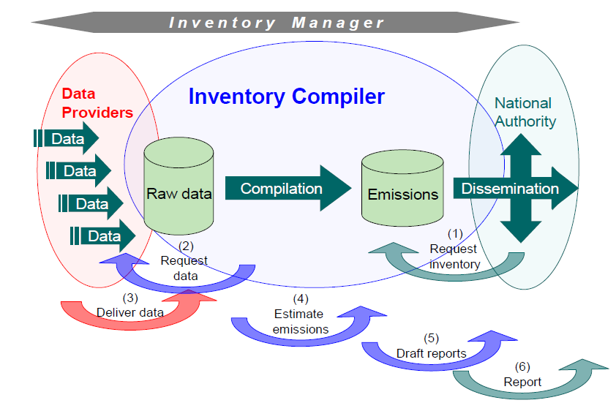
Inventory Management
Clear inventory process
  Dataflow; strong and continuous
  Timeliness; data agreements
Institutional arrangements
  Formal agreements
    deadlines
    data formats
    contact persons

Slide 10
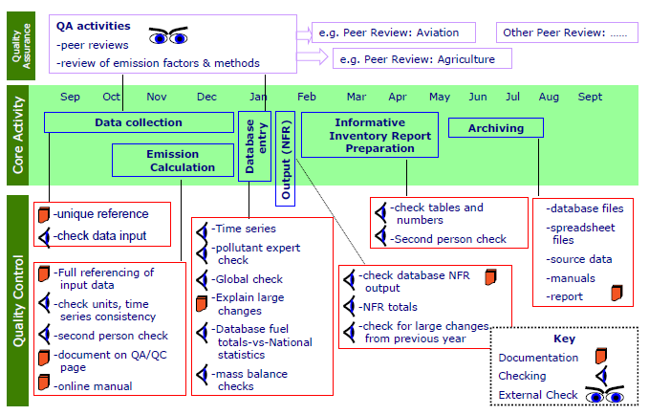
QA/QC (1)

Slide 11
QA/QC (2)
Element | Data quality objectives (general)
Transparency | Sufficient documentation and referencing to be able to trace any inventory estimates back through the calculations to the source data, data providers and assumptions.
Consistency | Ensuring that methods are consistent with good practice as defined in the EMEP/EEA guidebook
Comparability | Using agreed good practice methodologies and formats for estimating and reporting emissions. Allocating emissions to source categories in accordance with the split given by the in Reporting Guidelines.
Completeness | Providing all NFR tables including notation keys where appropriate and complete sectoral background data. Providing information in the inventory documentation on the completeness of the emissions inventory.
Accuracy | Using of appropriate or better tiered methodology that is consistent with the guidebook and other guidelines.

Slide 12
Improvements
Key category analysis and methodological choice
  A good tool to prioritise the effort for different sources
Uncertainties, Spatial mapping of emissions, and Projections
  Tools to make the inventory more useful to policy makers, air quality modellers, health scientists etc.
Uncertainty estimates
  Combination of key category analysis and uncertainty to identify sources that need improvements

Slide 13
Introduction to the Energy chapter
1.A Combustion
  1.A.1 Energy industries
  1.A.2 Manufacturing industries and construction
  1.A.3.a Aviation
  1.A.3.b.i-iv Exhaust emissions from road transport
  1.A.3.b.v Gasoline evaporation
  1.A.3.b.vi-vii Road vehicle tyre and brake wear, road surface wear
  1.A.3.c Railways
  1.A.3.d Navigation (shipping)
  1.A.3.e.i Pipeline transport (no guidance)
  1.A.4 Small combustion
  1.A.4 Non-road mobile sources and machinery

Slide 14
Introduction to the Energy chapter
1.B Fugitive emissions from fuels
  1.B.1.a Fugitive emissions from solid fuels: Coal mining and handling
  1.B.1.b Fugitive emissions from solid fuels: Solid fuel transformation
  1.B.1.c Other fugitive emissions from solid fuels (no guidance, catch all)
  1.B.2.a.i, 1.B.2.b Fugitive emissions: Exploration, production and transport of oil and natural gas
  1.B.2.a.iv Fugitive emissions oil: Refining and storage
  1.B.2.a.v Distribution of oil products
  1.B.2.c Venting and flaring
  1.B.2.d Other fugitive emissions from energy production

Slide 15
Emission shares – energy sector
The energy sector generally makes large contributions to the national emissions
Generally the major sources are:
  large heat and power plants (large energy consumptions)
  residential combustion (no flue gas treatment)
  transport (large fuel consumption)
  Extraction of fuels (oil and natural gas → NMVOC, coal → PM)
EU-27 | Energy
< 1 %
1- 5 % | NH₃
5-10 %
10-50 % | NMVOC, TSP, HCB, PCB
50-75 % | PM₁₀, Hg, Pb, Cr, PAH, PCDD/F
> 75 % | SOx, NOx, PM_{2.5}, CO, Cd, As, Cu, Ni, Se, Zn

Slide 16
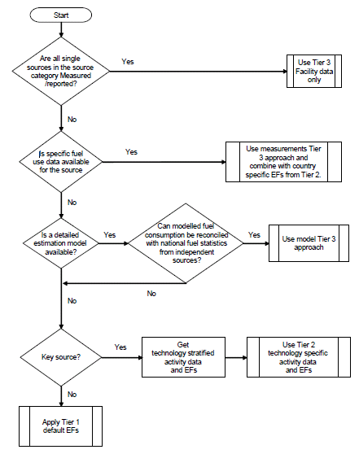
Methodological Tiers
Example of decision tree from GB2013
Tier 3 use of facility-specific data
  Where facility-level emission data of sufficient quality are available, it is good practice to use these data.
Tier 2 technology-specific approach
  To apply the Tier 2 approach, both the activity data and the emission factors need to be applied according to a country’s fuel usage and installed combustion technologies.
Tier 1 default approach
  The Tier 1 emission factors assume an average or typical technology and abatement implementation. The Tier 1 default emission factors derived from available data and information have been developed for key fuel groups.

Slide 17
Methodological tiers
For all combustion sources there is both Tier 1 and Tier 2 methodology
For all fugitive sources there is a Tier 1 methodology
For most fugitive sources there is a Tier 2 methodology

Slide 18
Basic data requirements (1)
Source | Tier 1 - Data requirement | Tier 2 - Additional data requirement
1.A.1 Energy industries | Fuel consumption [GJ] | Fuel consumption per technology [GJ] - e.g. boiler type (wet bottom, dry bottom, fluid bed)
1.A.2 Manufacturing industries | Fuel consumption [GJ] | Produced amount [tonnes] per activity and process - e.g. iron and steel manufacturing - sinter plants
1.A.3 Aviation | Fuel consumption [kg] (cruise) Number of LTOs | Fuel consumption per aircraft type [tonnes]
1.A.3 Road, exhaust | Fuel consumption [kg] per vehicle type (PC, LCV, HDV, two-wheel) | Fuel consumption per technology [tonnes] - e.g. Euro and ECE legislation classes
1.A.3 Gasoline evaporation | Number of vehicles per vehicle type and temperature intervals | E.g. number of vehicles per engine and canister

Slide 19
Basic data requirements (2)
Source | Tier 1 - Data requirement | Tier 2 - Additional data requirement
1.A.3 Road, non-exhaust | Mileage [km] per vehicle type (PC, LCV, HDV, two-wheel) | Mileage and speed correction factor
1.A.3 Railways | Fuel consumption [tonnes] | Fuel consumption per locomotive type [tonnes]
1.A.3 Navigation | Fuel consumption [tonnes] per sector (nat/int navigation, fishing) | Fuel consumption per engine type [tonnes] - slow, medium or high speed engines
1.A.4 Small combustion | Fuel consumption [GJ] per sector (residential, non-residential) | Fuel consumption per technology [GJ] - e.g. residential installation type (open fireplace, stove, boiler)
1.A.4 Other mobile | Fuel consumption [GJ] per sector (e.g. agriculture, and industry) | Fuel consumption per technology [tonnes] - e.g. age interval (<1981, 198-1990, 1990-Stage I) or Stage (I, II, IIIA)

Slide 20
Basic data requirements (3)
Source | Tier 1 - Data requirement | Tier 2 - Additional data requirement
1.B.1.a Coal mining | Coal production [Mg] | Coal production per technology [Mg] e.g. underground mining, storage, and handling
1.B.1.b Solid fuel transformation | Coke production [Mg] | Coke production per process [Mg] e.g. coal charging, door and lid leaks, coke pushing and soaking
1.B.2.a.i 1.B.2.b Exploration, production and transport of oil and natural gas | Oil production [Mg] Gas production [m³] | Production per facility type [Mg oil] or [m³ gas] Facilities producing oil or gas, onshore or offshore
1.B.2.a.iv Refining and storage | Crude oil input [Mg] | EFs for different processes Fresh feed [m³] - e.g. fluid catalytic cracking, catalytic reforming unit, fluid coking unit, S produced [Mg] S recovery Crude oil throughput [Mg] - diffuse emissions

Slide 21
Basic data requirements (3)
Source | Tier 1 - Data requirement | Tier 2 - Additional data requirement
1.B.2.a.v Distribution of oil products | Oil distribution [Mg] | Oil product throughput [m3] and True Vapour Pressure [kPa], both per technology Refinery dispatch station; road/rail/marine tanker Service stations; storage tanks filling/breathing, refuelling Terminals/depots; storage tanks
1.B.2.c Venting and flaring | Extraction: Gas burned [Mg] and throughput [Mg] Refineries: Refinery feed [m3] | Tier 2 methodology only available for two processes - Well testing; Oil burned [Mg] - Venting and flaring in oil refineries; [GJ]
1.B.2.d Other fugitive emissions from energy production | Geothermal energy extraction is only source. Electricity production [MWh] | No Tier 2 methodology

Slide 22
Updates to the 2013 GB
Implementation of BC default emission factors (EFs) for relevant categories
Improvements to the consistency between the Tier 1 and Tier 2 EFs for a number of categories
Improvements to the consistency of EFs between different chapters for a number of categories

Slide 23
Updates to the 2013 GB
Substantial update of chapter on Small combustion
  Reevaluation of the descriptions of techniques and the EFs provided
  Comprehensive literature study on small combustion
  Update of EFs including adding of references
Update of the chapters on fugitive emissions
  Update of a number of EFs
  Adding of some missing EFs for existing sources
  Tier 2 methodology for solid fuel transformation split into relevant processes
Update of EF for fugitive PM emissions
  Update of a number of EFs
  Adding of some missing EFs for existing sources

Slide 24
Thank you for your attention

