Slide 1
Air Quality Governance in the ENPI East Countries
Training on emission inventories
The EMEP/EEA Guidebook
Industrial processes and product use
11-12 December, 2013, Tbilisi, Georgia

Slide 2
Outline
Introduction to the Industrial Processes and Product Use (IPPU) chapters
Emission shares
Methodological tiers
Basic data requirements
Guidance for new sources of emissions
Update of existing methodologies and default emission factors

Slide 3
Introduction to the IPPU chapters
Mineral industry
  2.A.1 Cement production
  2.A.2 Lime production
  2.A.3 Glass production
  2.A.5.a Quarrying and mining of minerals other than coal
  2.A.5.b Construction and demolition
  2.A.5.c Storage, handling and transport of mineral products
  2.A.6 Other mineral products (No guidance – catch all)

Slide 4
Introduction to the IPPU chapters
Chemical industry
  2.B Chemical Industry
  2.B.7 Soda ash production
Chapter 2B covers a lot of different processes within the chemical industry, e.g.:
  NH3 production
  Nitric acid production
  Calcium carbide production
  Other chemical industry

Slide 5
Introduction to the IPPU chapters
Metal industry
  2.C.1 Iron and steel production
  2.C.2 Ferroalloys production
  2.C.3 Aluminium production
  2.C.4 Magnesium production (no guidance)
  2.C.5 Lead production
  2.C.6 Zinc production
  2.C.7.a Copper production
  2.C.7.b Nickel production
  2.C.7.c Other metal production
  2.C.7.d Storage, handling and transport of metal products

Slide 6
Introduction to the IPPU chapters
Solvent and other product use
  2.D.3.a Domestic solvent use including fungicides
  2.D.3.b Road paving with asphalt
  2.D.3.c Asphalt roofing
  2.D.3.d Coating applications
  2.D.3.e Degreasing
  2.D.3.f Dry cleaning
  2.D.3.g Chemical products
  2.D.3.h Printing
  2.D.3.i, 2.G Other solvent and product use

Slide 7
Introduction to the IPPU chapters
Other
  2.H.1 Pulp and paper industry
  2.H.2 Food and beverages industry
  2.H.3, 2.L Other industrial processes including production, consumption, storage etc. of bulk products (no guidance)
  2.I Wood processing
  2.J Production of POPs
  2.K Consumption of POPs and heavy metals

Slide 8
Emission shares – IPPU sector
The IPPU sector contributes significantly to the national emissions of many pollutants
Emission shares are largest for countries with large mineral, chemical or metal industry
EU-27 | Industrial processes and product use
< 1 %
1- 5 % | NO_{x}, NH₃, As, Cu
5-10 % | SO_{x}, Ni, PAH
10-25 % | TSP, PM₁₀, PM_{2.5}, CO, Cd, Hg, Pb, Cr, Se, Zn, PCDD/F
25-50 % | HCB, PCB
> 50 % | NMVOC

Slide 9
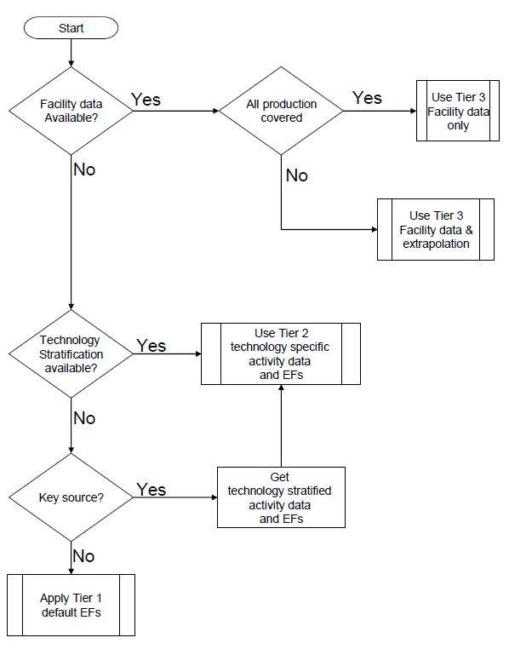
Methodological tiers
The GB provides guidance on the methodological Tier
Due to the large number of processes to be considered the guidance differs in detail and complexity
However, Tier 1 is available for all sources

Slide 10
Basic data requirements
Mineral industry
To estimate emissions using a Tier 1 the following data are required:
  Clinker production
  Lime production
  Glass production
  Amount of mineral quarried and mined (mass)
  Constructed and demolished floor area of buildings
For storage and handling of mineral products the emissions at the Tier 1 level is assumed to be included in the other emission factors

Slide 11
Basic data requirements
Chemical industry
For the Tier 1 methodology the following data are required:
  Ammonia production
  Nitric acid production
  Adipic acid production
  Calcium carbide production
  Other chemical production
  Soda ash production
As “Other chemical production” is a very broad term, it cannot be recommended to use these emission factors (EFs), instead the Tier 2 EFs should be used

Slide 12
Basic data requirements
Chemical industry
For the Tier 2 methodology for other chemical production the following data are required:
  Titanium dioxide production
  Sulphuric acid production
  Ammonium sulphate, nitrate and phosphate production
  Urea production
  Carbon black production
  Large range of organic chemicals, e.g. ethylene, vinylchloride, polyethylene, PVC, polypropylene, styrene, formaldehyde

Slide 13
Basic data requirements
Metal industry
For the Tier 1 methodology the following data are required:
  Steel production
  Total ferroalloys production
  Aluminium production
  Primary and secondary lead production
  Primary and secondary zinc production
  Primary and secondary copper production
  Nickel production
  Other metal production
Emissions from storage/handling only for Tier 2

Slide 14
Basic data requirements
Solvent and other product use
For the Tier 1 methodology the following data are required:
  Population
  Amount of paint applied
  Amount of cleaning products (most common: methylene chloride, tetrachloroethylene, trichloroethylene, xylenes)
  Textile treated (dry cleaning)
  Chemical products use (products incorporating solvents, polystyrene processing, polyvinylchloride processing, synthetic rubber processing)
  Ink consumption
  Amount of other product use

Slide 15
Basic data requirements
Solvent and other product use
For the Tier 1 methodology the following data are required:
  Amount of asphalt applied to roads
  Shingle production
The other product use category consists of a number of different products, e.g.:
  Glass and mineral wool enduction
  Preservation of wood
  Fat, edible and non-edible oil extraction
  Underseal treatment and conservation of vehicles and vehicle dewaxing
  Use of fireworks, tobacco and shoes

Slide 16
Basic data requirements
Other
For the Tier 1 methodology the following data are required:
  Mass of air dried pulp production
  Mass of food and beverages produced
  Mass of wood products processed
  Population

Slide 17
Updates to the 2013 GB (1)
Implementation of BC default emission factors (EFs) for relevant categories
Improvements to the consistency between the Tier 1 and Tier 2 EFs for a number of categories
Updated EFs for PM when new references were available
Update of POP EFs for several sources in metal production
Correcting of small errors related to the EFs and the uncertainty ranges provided

Slide 18
Updates to the 2013 GB (2)
Substantial redrafting of the chapter on domestic solvent use including changes to the methodological description and to the default EFs
Improvements to the chapter on other solvent and other product use including improved methodological descriptions and inclusion of more guidance for other product use

Slide 19
Thank you for your attention

